Slide 1
DRUG DISTRIBUTION SYSTEM

Slide 2
Outline:
OUT PATIENTS:
Definition and types of Outpatient
1. Emergency, 2.Tertiary care, 3. Primary care
Location and layout of out –patient dispensing
Scope of the activities of pharmaceutical services
Minimum standards for ambulatory care pharmaceutical services
Out patients dispensing routines
IN PATIENTS:
Definition and types of in-patients services
1. Individual prescription order system, 2. Complete floor stock system, 3. Combination of individual and floor stock system, 4. Unit dose dispensing
Step by step outline of unit dose procedure

Slide 4
Out-patient:
Out patient refers to patients not occupying beds in a hospital or in clinics, health centers and other places .
out patient load into three categories.
Emergency
Tertiary
Primary care

Slide 5
1. Emergency:
A person given emergency or accidental care for conditions which require immediate medical attention
Suffering from serious health conditions or illness
Such as RTA, MI or any kind of emergency

Slide 6
2. Tertiary care:
He is directly to outpatient department by his attending medical practitioner for specific treatment other than an emergency treatment
Such as patient suffering from chronic diseases like carcinogenesis, cardiovascular problems, arthritis, asthmatic etc.

Slide 7
3. PRIMARY CARE:
Primary care is majority care
It describe for meeting the great majority of daily personal health needs
Most primary care is used by patients who are ambulatory i.e. are able to move about freely
This majority includes the needs for preventive health maintenance and evaluation and management on continuing basis of general discomfort, early complaints, symptoms, problems, and chronic aspect of diseases

Slide 8
Location of out-patient dispensing:
It should be located on the ground floor of the building.
The out patient dispensing area should be provided with proper seating arrangement.
The pharmacy receives its supplies from medical stores weekly but emergency supplies can be obtained at any time.

Slide 9
Layout of out-patient department(OPD)
Racks of storing drugs
Refrigeration
Dispensary
Office
Windows for dispensing
Seating arrangement for patients

Slide 10
SCOPE OF THE ACTIVITIES OF PHARMACEUTICAL Services:
The scope of the activities of pharmaceutical services in ambulatory care settings may vary with practice, but commonly includes-
Obtaining and documenting patient medication histories.
Monitoring the safety and efficacy of drug therapy through the maintenance of medication profiles
Providing drug information to prescribers and other health care practitioners
Assisting prescribers in the proper selection and adjustment of the drug therapy through application of pharmacokinetic and other principles
Utilizing assessment skills in the management of acute and chronic diseases and providing appropriate referrals to the other health care providers

Slide 11
Scopes….
Detecting and reporting adverse drug reactions,
interactions, and non-compliant patient behaviour
Educating and counselling patients and general public in the proper use of medication
Participating in the drug-use review, patient care audits, and clinical drug investigation
Participating in the education program of the health care provider
Supervising the storage, preparation, dispensing and administration of medications in the patient care area
Developing systems for the delivery of pharmacy services in the institutional settings and the community
Developing and utilizing systems for fiscal managements and reimbursement

Slide 12
Minimum standards for ambulatory care pharmaceutical services:
Services to ambulatory patients are an important part of many institutional pharmacy programs. The essential elements of any ambulatory care pharmaceutical service program are as follows:
The ambulatory care pharmacy program must be directed by a qualified pharmacist.
All medications dispensed to patients will be completely and correctly labelled and packaged in accordance with all applicable regulations and accepted standards of practice.
Upon dispensing a new medication, the pharmacist will ensure that the patients or his representative receives and understand all information required for proper use of drug.
All drugs in ambulatory care services areas will be properly controlled.

Slide 13
Out patients dispensing routines:
The dispensing pattern involved in providing clinic patients as well as those patients being discharged with “take home drugs” is identical with that carried on by a community pharmacy.
In both instances, a prescription is written by the physician and he patients takes it to the pharmacy where it is compounded by a pharmacist.
If there is to be waiting period, the will make use of a prescription call check which numerically identified the patients, and the finished prescription.

Slide 15
In-patient:
In-patients are those patients ,who require hospitalization i.e get themselves admitted in the hospital, stay there for treatment till they are discharged.
They are four systems in general use for dispensing drugs for inpatients. They may be classified as follows;
Individual prescription order
Complete floor stock system
Combination of individual & floor stock system
Unit dose system

Slide 16
1. Individual prescription order system:
It is a type of prescription system where the physician writes the prescription for individual patient who obtains the drug prescribed from any medical store or hospital dispensary by paying own charges.
Advantages:
All medication orders are directly reviewed by pharmacists
It provides the interaction of pharmacist-doctor, nurse and the patient
It provides clear control of inventory

Slide 17
2. Complete floor stock system:
Under this system, the drugs are given to the patient through the nursing station and the pharmacy supplies from the drugstore of a hospital.
Drugs on the nursing station or ward may be divided in to-
A . Charge floor stock drugs
B . Non charge floor stock drugs.
Notes:
‹#›

Slide 18
A. Charge floor stock drugs.
These are medicines that are kept stocked at all times in the nursing station.
The patient gets charged for each dose of medicine they receive.
The hospital's Pharmacy and Therapeutics Committee (PTC) decides which medicines will be included in this stock for different wards.
Once the list is made, it's the hospital pharmacist's job to ensure these medicines are always available.
Notes:
‹#›

Slide 19
B. Non charge floor stock drugs.
Non charge floor stock drugs are the medications that are placed at the nursing station for the use of all patients on the floor.
It is divided into two methods.
Drug basket method.
Mobile dispensary unit.
In simple terms, charge floor stock drugs are those for which patients are billed individually for each dose they receive, while no charge floor stock drugs are available for all patients on the floor to use without direct billing.
Notes:
‹#›

Slide 20
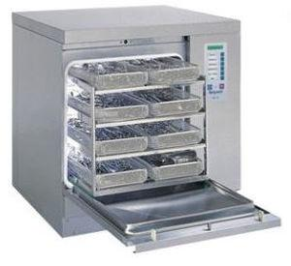
Drug basket method:
Nurse fill a requisition form for delivery of drugs at their floor;
When there is an empty container, the nurse place it in the drug basket.
Once the basket is completed, it then delivered to the floor via messenger service.

Slide 21
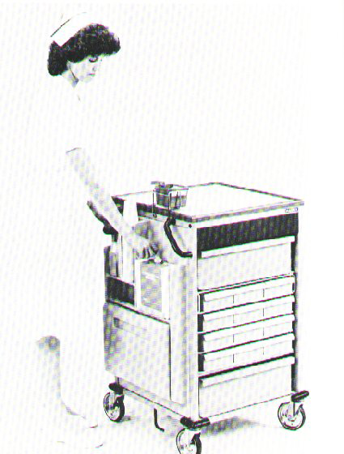
Mobile dispensary:
Alternately drug mobile dispensary can be use.
It is specially constructed stainless steel
60 inches high
48 inches wide and 25 inches deep
It is mounted on bottom tires
Notes:
‹#›

Slide 22
Advantages / Disadvantages of complete floor stock system
Advantages:
Ready availability of the required drugs
Elimination of drug returns
Reduction in the number of drug order transcriptions for the pharmacy
Reduction the number of pharmacy personnel required

Slide 23
Disadvantages:
Medication errors may increases because the review of medication orders is eliminated
Increased drug inventory on the pavilions
Greater opportunity for pilferage
Increased hazards associated with drug deterioration
Lack of proper storage facilities on the ward may require capital layout to provide them and
Greater inroads are made upon the nurses time.

Slide 24
Difference between Charge floor stock system Non-charge floor stock
Charge floor stock system
The charges are made in the system patients account after the have been administered from the stock drugs.
Every dose of the drug administered to the patients are charged .
Only those dose are charged which are expansive can rarely used.
Floor stock list is prepared which is sent to make the drugs available to all the nursing station drug have been administered
Non-charge floor stock system
The charges are not made in the account directly even after the drug have been administered.
This system charges are made indirectly to the patients.
The cost of the drugs are not high as they are mostly used in tablets, capsules.
A pre-determined list is prepared by nursing station.

Slide 25
3. Combination of individual and floor stock system:
This system is fallowed in the government and also in private hospital who run on the basis of no profit and no loss.
Individual prescription or medication system is prepared as a major means.
Requirement of drugs or surgical items are given to the patient who purchase and deposit these items in hospital wards or rooms under supervision of registered nurse .

Slide 26
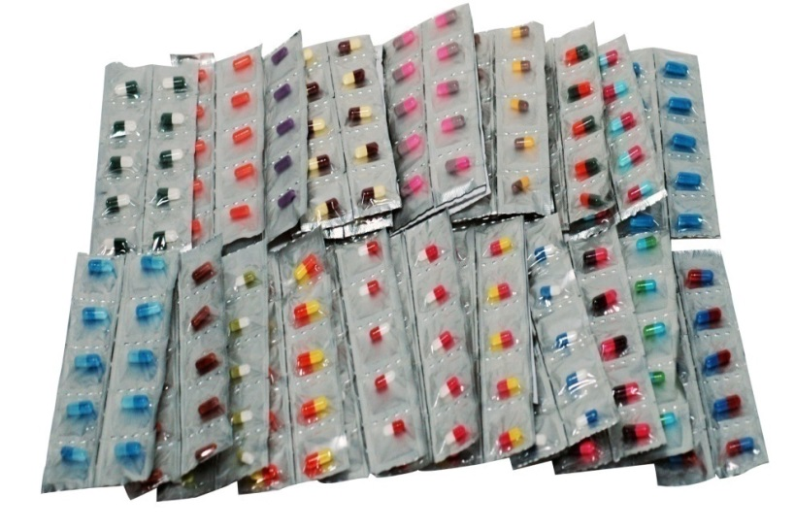
4. Unit dose dispensing:
Those medications which are ordered ,packed ,handled administered and charged in multiples of single dose units containing a predetermined amount of drug or supply sufficient for one regular dose
A single unit package is one which contains one complete pharmaceutical dosage forms
e.g.- tablet, capsule.
Notes:
‹#›

Slide 27
Advantages of unit dose system:
Patients received improved services round the clock and are charged for only those dosages which are administered to them
All doses of medications required at the nursing station are prepared by the pharmacy, thus allowing nurses more time for direct patient care
Medication errors are decreased because of direct check by the pharmacist
Excessive duplication of orders and paper work at the nursing station and pharmacy are eliminated
A decrease in the total cost of medication related activities

Slide 28
Advantages….
Improved overall drug control and drug use monitoring
More accurate patient billing for drugs
The elimination and minimization of drug credits
Greater control by the pharmacist over pharmacy workload patterns and staff scheduling
Greater adaptability to computerized and automated procedure regarding medication orders and delivery system.
The pharmacist can get out of the pharmacy and onto the wards where they can perform their intended function as drug consultants and help providing the team effort that is needed for better patient care

Slide 29
Disadvantages:
It requires more space since packaging material increases the bulk of dosage forms
It requires increased number of skilled and lay personnel in the pharmacy
The cost of medication is increased to the patient due to increased handling charges.

Slide 30
Two methods of dispensing unit doses are:
Centralized unit-dose drug distribution system (CUDD)
Decentralized unit dose drug distribution system (DUDD)

Slide 31
1.Centralised unit-dose drug distribution system(CUDD):
All in-patient drugs are dispensed in unit doses and all the drugs are stored in central area of the pharmacy and dispensed at the time the dose is due to be given to the patient
Drugs re transferred from the pharmacy to the indoor patient by medication cards

Slide 32
2. Decentralized unit dose dispensing:
This operates through small satellite pharmacies located on each floor of the hospital.
Procedure:
Patient profile card containing full date, disease , diagnosis is prepared
Prescription are sent directly to the pharmacist witch are then entered in the patient profile card
Pharmacist checks medication order
Patient profile card and prescription order is filled by pharmacy technicians
The nurses administer the drugs and make the entry in their records
Notes:
‹#›

Slide 33
Step–by step outline of unit dose procedure
Upon admission to the hospital, the patient is entered into the system. Diagnosis, allergies and other pertinent data are entered on to the patient profile card
Direct copies of medication orders are sent to the pharmacist
The medication order are entered on to the patient profile card
The pharmacist checks medication order for allergies, drug interactions etc.
Dosage schedule is coordinated with the nursing station.
Pharmacy technician picks medication orders, placing drugs in bins of transfer cart per dosage schedule
Medication cart is filled for particular dosage schedule delivery

Slide 34
Step by step outline….
Pharmacist checks cart prior to release
The nurse administers the medication and makes appropriate entry on the medication record.
Upon return to pharmacy, the cart is rechecked.
Throughout the entire sequence, the pharmacist is available for consultation by the doctors and nurses. In addition he/she is maintaining surveillance for discontinued orders.

Slide 35
Reference-Hospital and Clinical Pharmacy by Pratibha Nand , Dr. R. K. Khar

