Slide 1
Manufacturing of Pharmaceuticals in hospital Sterile & Non-sterile
By
Tahmina Afroz
Lecturer,
Daffodil International University

Slide 2
STERILE MANUFACTURE
Large and small volume parenteral :
The volume of injectable fluids vary greatly from fractions of milliliter (ml) to several hundred milliliter (ml). Intravenous fluids vary from one ml to 500 ml, or more than 500 ml.
Intravenous fluids of 500 ml and above are called as large volume parenterals ( LVP), Small volume parenteral (SVP) solutions are usually 100 ml or less

Slide 3
Facilities and Requirements for sterile manufacturing
For sterile manufacturing following equipment's are necessary to meet the requirements of Drugs and Cosmetics Act.
Storage equipment for ampoules and vials
Storage cabinets
Water still
Ampoule washing machine
Ampoule drying machine
Filling and sealing unit
Sintered glass funnel
Filter press
Hot Air Oven
Equipment's for evaluation and quality control
Autoclave
Labeling and packing units

Slide 4
Layout of sterile products Area:
The sterile area can be divided into following categories:
Clean up area
Preparation area or compounding area
Aseptic area
Quarantine area
Finishing and packaging area

Slide 5
1.Clean area:
This area has walls and ceilings with film coating material. There should be no holes, corners or projections. The air should be free dirt and microbe. The room should undergo a minimum of 10-15 air changes per hour. All incoming air should be passed through filters with an efficiency of at least 95%.

Slide 7
2. Preparation or Compounding Area:
In this area formula is compounded and for this it is not essential that the area should be aseptic but controlling measures are provided to control the dust generated from weighing and compounding procedures. Cabinets and counters are generally made up of stainless steel. The ceiling, walls should be made of such materials which are impervious to water.

Slide 9
3. Aseptic Area:
a)The ceiling, walls and floor must be sealed properly so that they can be washed and disinfected when required.
b) All the counters are made up of stainless steel and they are constructed in such a way that dirt particles shall not accumulate.
c) as much as possible storage tanks, mixing tanks containing the compounded products should remain outside the aseptic area and then the product is fed into aseptic area through pipelines.

Slide 10
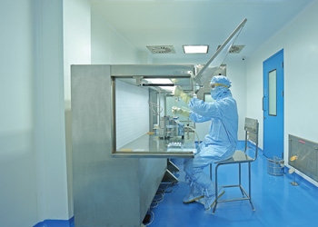

Slide 11
4. Quarantine Area:
The purpose of quarantine area is that batches can be stored physically segregated from either “in process” batches or approved batches in a locked store to which access is restricted to a responsible person. Facility should be available for segregation between batches and the storage system is designed in such a way that easy access to each batch of product can be made by an approved person in case of need for resembling.

Slide 12
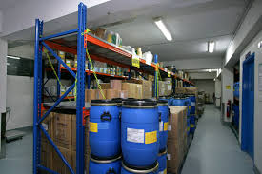

Slide 13
5. Labeling and Packing Area:
In this batch numbering and over-printing of labels should take place. Adequate space is required for installation of over-printing devices and packaging machines. Only one type of product label should be processed at any one time.

Slide 14
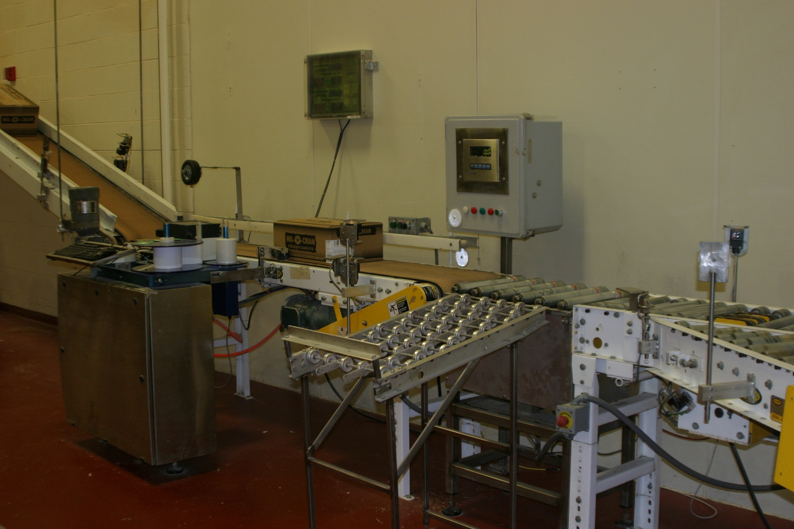
5. Labeling and Packing Area:
In this batch numbering and over-printing of labels should take place. Adequate space is required for installation of over-printing devices and packaging machines. Only one type of product label should be processed at any one time.

Slide 15
PRODUCTION PLANNING AND PROCESSING
Steps of production planning:
Cleaning of Equipment's
Cleaning of Containers and Closures
Preparation of solution or suspension
Filtration
Filling of the product in Ampoules/ Vial
Sealing
Sterilization
Tests for Quality Control

Slide 16
1. Cleaning of Equipments:
All the equipments should be disassembled so that the internal parts can be cleaned thoroughly with a stiff brush using an effective detergent.
Then thorough rinsing is done with distilled water.
Sometimes dichromate solution is used for glassware, rubber tubing followed by rinsing with distilled water.

Slide 17
2. Cleaning of Containers and Closures:
Various types of devices are available for cleaning of containers of parenteral products. The selection is dependent upon the type of container to be used. Closures are agitated vigorously in hot solution of 0.5% sodium phosphate, rinsed several times with water and finally with distilled water.
3. Preparation of solution or suspension:
The product to be prepared may be in the form of an aqueous solution or oily solution or suspension. Various ingredients of formulation are collected at one place where compounding is to be done. It should be kept in mind that solution must be prepared under aseptic condition.

Slide 18
4. Filtration:
If the solution contains any foreign particle, it must be filtered through bacteria proof filters such as Seitz filters, membrane filters and sintered glass filters. Membrane filters are made up of variety of polymers like cellulose esters, polyvinylidiene fluoride, etc. Membrane filters can be easily sterilized by autoclaving or steaming. They are very effective, non-reactive and disposable. Positive pressure is commonly used during filtration by sterilization.

Slide 19
5. Filling of the product in Ampoules/ Vial:
The filtered product is filled into ampoules or vials with the help of semi-automatic or automatic machines under aseptic conditions. In such cases all the materials used to be sterile and then the sterility is further maintained by using laminar air flow benches which provide very clean air. This air flows along parallel lines and sweeps all the dust. On small scale, filling can be done with hypodermic syringes attached with long needles, burettes, etc. While filling ampoules, precautions should be taken that the needle does not touch the neck of the ampoule to prevent cracking and staining at the time of sealing.

Slide 20
6. Sealing:
Sealing should be done immediately after filling under aseptic conditions only. Sealing of ampoules is done by two methods.
Tip sealing (fusion) method
Pull sealing method
In tip sealing method, the tip of the ampoules is melted and heat is provided from all sides. Melting of glass will form a bead and thus close the opening while in pull sealing method, ampoule below the tip is melted and rotated uniformly. As the glass has melted the tip of the ampoules is pulled.
Vials and bottles are sealed by fitting the rubber closure with the help of vacuum and then aluminum caps are further placed on it either by hand or by mechanical method.

Slide 21
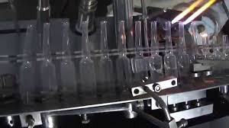
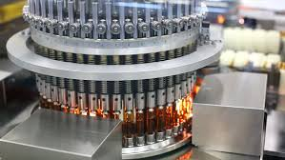

Slide 22
7. Sterilization:
Sterilization is done by various methods depending upon nature of preparation. In case of drugs, sterilization is carried out either in autoclave at a temperature of 115-116 °C for 30 minutes or in an oven at 150-160 °C for one hour. For thermo labile drugs, sterilization is done by filtration through bacteria proof filters. In case of oily vehicles, the sterilization is done by dry heat method.
8. Tests for Quality Control:
Following tests are performed to maintain quality of parenteral.
Sterility test
Clarity test
Leakage test
Pyrogen test

Slide 23
Non-sterile Manufacturing
Type of the products manufactured vary from hospitals to hospital. Large number of hospitals go for manufacturing because of the following reasons;
Commercially available products are not often suited for the treatment of certain unusual illness which a physician with a hospital practice is expected to copy with.
Because of pharmacist physician relation ship in the hospital , doctors can easily request the pharmacist to prepare a special pharmaceutical preparation either for clinical experimental use.

Slide 24
MATERIALS REQUIREMENT
Once the hospital pharmacist has determined what products be intends to manufacture and what volume and quantity he must next arrange for the procurement of necessary supplies.
The first step in this direction is to take each formulae and determine the quantity of chemical or other material which will be required to produce the annual supply.
The second step is to enter these quantity on a summary sheet because the same drug, chemical or container may be required by many different formulas.

Slide 25
MANUFACTURING CAPACITY
Two important considerations in any bulk compounding program are-
Whether or not the pharmacist has the kind of equipment necessary to produce the drug as per formulae .
Whether or not the manufacturing capacity is enough to produce the desired quantity.
.

Slide 26
MANUFACTURING EQUIPMENTS AND ITS SOURCES
The kind and size of manufacturing equipment required in hospital pharmacy will vary from institution to institution
Modern technology has developed equipment to meet every production need. The available manufacturing capacity can handle amounts that are considered to be of practical volume or quantity for a small or medium sized hospital.
In addition the larger hospitals have automatic and semi automatic heavy production equipment which may be useful in handling large volume in minimum duration of time.

Slide 27
MANUFACTURING STAFF
The manufacturing section of pharmacy must be supervised by a technically competent, legally qualified pharmacist
In addition he must be supported with ancillary person who can be trained to carry on such non technical pursuits as bottling , filtering labelling etc.

Slide 28
MANUFACTURING OF ONIMENTS, LIQUID AND CREAMS
The products are required to be free from viable organisms and can be subjected to a terminal heat sterilization process in its final container. Hence the facilities required will be less expensive and sophisticated.
Some products require bulk manufacture in clean environment followed by sterilization by membrane filtration and aseptic filling in to previously sterilized containers.
Hospitals may not indulge in complication and expensive process of manufacturing but will be mainly concerned with the dispensing of such products in small quantities to meet individual prescriptions .

Slide 29
Before a new batch is started the bulk manufacture or filling area should be inspected by an expert to confirm that the area should be thoroughly cleaned in the access zone prior to admission to the area has been cleared of all items remaining from previous batch .
Final product containers such as collapsible tubes, glass bottles and jars will require pre treatment prior to use in filtering zone. This pre treatment area is the best if adjacent to the filling zone, and the facilities provided should be similar in principle to those provided for the washing of sterile fluid bottles.

Slide 30
After washing it is necessary to dry the containers .If products are to be sterilized by dry heat in their final containers , a second oven should be provided for the purpose of steam , cooling etc.
The receiving vessel in aseptic area should be equipped with the necessary blending and homogenizing devices so that the product does not become exposed to the aseptic environment .

Slide 31
MANUFACTURING OF TABLETS CAPSULES , GRANULES AND POWDERS
. The tableting process can be split into five stages
Dispensing
Granulation
Dry blending
Compression
Coating
Dispensing: Dispensing involves use of a central dispensary for all use in the pharmacy. Dust extraction points will be required at each weighing station so that fine powders can be removed at source.

Slide 32
Granulation: Granulation involves blending of dispensed materials after any preliminary treatment according to the batch document. The dry mass moistened with the granulation fluid and a suitable mass is then passed through sieve. Resultant moist granules are dried up. During this process suitable blenders and operators skill affect not only physical characteristics but also physiological effects. After moist granulation they using small fluid bed dryer of tray dryer
Dry blending : After granules have cooled and hardened , final dry blending of potent drugs , lubricants are made to correctly stored and label the granules.

Slide 33
Compression :Tableting machine should be stripped down for cleaning after each batch and tools examined, polished must be necessary . During compression various physical test including hardness , thickness , weight variation must be provided adjacent to machine . The containers should be covered in such a way that the product is protected from the atmosphere , including light. Facilities should be available for each container to be sealed and labelled properly to the products status.

Slide 34
Coating :The best can be expected in hospital pharmacy is chloroform soluble coating polymer with the required physical properties and dusting the product at the end of each application with talcum powder. Final product may not have an appearance comparable to industrial scale but reliable product having their required properties and fit for intended use. Some products which are already dispensed in the form of powders or granules can be prepared in same facilities where tablets are being made.

