Slide 1
Public Policy Cycle & Garbage Can Model

Slide 2
Public Policy: Functional Dimensions
Policymaking occurs within an environment and there are some of the official and unofficial participants who plays an important role in policy formulation & implementation.
The Policy Environment:
Demands are generated in the environment and transmitted into the political system.
Environment places limits and constraints
James E. Anderson identifies two environmental factors, namely, political culture and socio-economic variables and their influence on policy makers.

Slide 3
Public Policy: Functional Dimensions (Continued)
The Official Policy Makers:
People with legal authority. (e.g. legislators, executives, administrators and judges)
Each performs policy making tasks, at least somewhat different from others.
Unofficial Participants:
Besides the official policy makers, many other unofficial players may participate in the policy making process, like interest groups, political parties and individual citizens.
They may considerably influence policy formulation without possessing the legal authority.

Slide 4
Public Policy and Politics
Politics intervenes at every stage of the policymaking process. Many energetic lobbies and political action committees in the United States, e.g., work to influence elected officials every day. Politicians’ work is difficult because the values espoused by competing interest groups often differ widely. When it comes to social welfare policy, Americans represent the political spectrum from conservatives to middle-of-the-road centrists to liberals. This diversity of opinion causes the country to pursue a pluralist approach to social welfare policymaking.
Policymakers follow several lines of thinking and arrive at policies and programs that are often contradictory and overlapping because they try to see that there is something there for everyone.

Slide 5
Public Policy and Politics (Cont.)
Social welfare policy development and implementation are much more a political “art and craft” than a rational science. It is not enough for human service professionals to know the needs of people and to want to pass policies and provide services to help them. Policy advocates for the disenfranchised must both understand the political process and be adept at working within it if they are to have a voice in shaping social policy.

Slide 6
Policy Cycle
The Policy Cycle provides a simplified way of visualizing the policy management process, and assist in targeting the most effective way of influencing this process in your organization or sector.
In reality, the policy cycle is far from a linear and circular, it is important to understand the links between the various phases to improve the process.
The framework can comprehensively and coherently organize facts and concepts that support an understanding of public policy. A recent text in public policy supports the cycle model:

Slide 8
Stagist Policy-Making as Problem Solving
(Howlett & Ramesh)
Stages in Policy Cycle
Phases of Problem Solving
Agenda-setting
Policy formulation
Decision-making
Policy implementation
Policy evaluation
Problem recognition
Proposal of solution
Choice of solution
Putting solution into effect
Monitoring results

Slide 9
Policy Cycle (Continued)
The policy cycle has thus been cast as steps that display the sequential flow depicted by Jones's approach to public policy:
Agenda setting: Problems are defined and issues are raised. Gatekeepers filter out those which well be given attention by either the executive or the legislative branches.
Formulation: Analysis and politics determine how the agenda item is translated into an authoritative decision: a law, rule or regulation, administrative order, or resolution. There are two steps in policy formulation:
Alternative policy proposals are put forth, claiming rationality and technical analysis within the process. Policy analysts bring these alternatives to the attention of political decision makers with their recommendations.
The policy prescription is chosen among the alternatives, including the no-action option. This is usually accomplished by building the support of a majority. What is produced here is a binding decision or series of decisions by elected or appointed officials who are not necessarily experts but who are presumably accountable to the public.

Slide 10
Policy Cycle (Continued)
Implementation: The authorized policy must be administered and enforced by an agency of government. The agency must take instructions as stated in the policy, but will probably be called upon to provide missing pieces and to make judgments as to intent, goals, timetables, program design, and reporting methods. The agency's mission may be well defined or poorly understood, but the action has shifted.
Budgeting: Financial resources must be brought to bear within an ongoing annual stream of budget cycles. Budget decisions are generally made with partial information and by changes from year to year which are only slightly different from the year before, a process called instrumentalism. In recent years, budget constraints have significantly elevated budget considerations in importance within the policy cycle. Budget items are highly competitive and vital for policy delivery.
Evaluation: The impacts of the policy may be assessed. If goals exist, the effectiveness of the policy and its components can be determined. Side-effects must also be discovered and reckoned. The output of evaluation may be no change, minor modification. overhaul, or even (but rarely) termination. The feedback provided by evaluation is injected back into the agenda setting stage, thus closing the loop of the cycle.

Slide 11
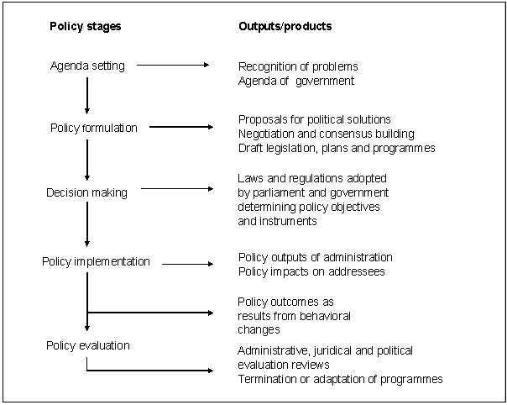
Overview of Public Policy Change

Slide 12
Advantages of Policy Cycle
• It helps see policy making as a process rather than just a set of institutions – a process which transcends particular institutions or policy designs
• It disaggregates complex phenomena into manageable steps
It allows some synthesis of existing knowledge
• It serves as a description of policy-making to assist in making sense of policy development
• It is normative in suggesting and defending the view that a particular sequence is an appropriate way to approach the policy task

Slide 13
Limitations of Policy Cycle
There is a risk that it may impose too great a neatness on policy making which is renowned for complexity and discontinuity rather than the logical unfolding implied in most stagist and cycle thinking.
The sheer scale and complexity of public policy-making means that there is a limit to the number of problems or issues that can receive attention at any one time.
Proponents of what is sometimes called the ‘Garbage Can’ model reject conventional policy cycle models that see policy development processes as rational and underpinned by the logic of problem solving.

Slide 14
Garbage Can Model
The ‘garbage can’ is where, over time, policy ideas, problems and possible solutions are (metaphorically) dumped. This draws attention to the fact that the history of policy development and change is crucial to an understanding of what policies might emerge in the future.
The overall result for defenders of the ‘garbage can’ view is to see policy development and implementation as a complex and often random combination of problems and solutions, including preferred solutions in search of a problem to which they might become attached.
Garbage Can Theory sees policy-making processes as: (i) Uncertain, complex and fluid; (ii) Chaotic, random and frequently irrational; (iii) Involving numerous actors and competing interests; and (iv) Entailing a loose relationship between policy problems, policy analysis and policy solutions – ranging from unstable, fragmented policy environments to more stable and coherent ones

Slide 15
Thank You

