Slide 1
Policy Instruments

Slide 2
Public Policy Instruments
  Policy instruments are the methods used to achieve policy objectives.
  There is a huge range of policy instruments from the very broad to the very specific.
  All instruments have strengths and weaknesses.
  Governments influence what happens in society through a variety of policy instruments.
  Contemporary policy-making is primarily focused upon less-intrusive means of intervention and the use of less coercive policy instruments.

Slide 3

Hood on Policy Instruments
Nodality – information and its control
Authority – legal and coercive powers
Treasure – financial resources
Organisation – formal organisational responses
Christopher Hood

Slide 4
Types of Policy Instruments
1. ‘Voluntary’ - advocacy and persuasion
2. ‘Mixed’ - information and exhortation, subsidies, taxes and user charges
3. ‘Compulsory’- regulation, public enterprises and direct provision of services.
1. Policy through advocacy - arguing a case, educating or persuading;
2. Policy through money - using spending and taxing powers to shape activity;
3. Policy through direct government action - delivering services; and
4. Policy through law - legislation, regulation and authority.

Slide 5
Policy Implementation Instruments
Non-coercive Forms of Action | Coercive Forms of Action
Communication | Legislation & regulation
Expenditure | Licensing
Inspection | Administrative directions
Loans, Subsidies & benefits | Reporting
Taxation incentives | Taxation

Slide 6
Selection Criteria for Policy Instruments
Appropriateness: is this a reasonable way to process?
Efficiency: will the instrument choice be cost effective?
Effectiveness: can the instrument get the job done?
Workability: is the instrument simple and robust?
Equity: are the likely consequences fair?

Slide 7
Instrument Choices in Program Delivery
Departments: public servants
Statutory authorities: courts
Govt. owned enterprises: service-based
Contracting out: Business/NGOs
Govt. owned Companies: Private sector employees; run by a BOD

Slide 8
Delivery Mixes in Policy Delivery
Governmental Mix
Sectorial Mix
Enforcement Mix
Value Mix
Central & Local Govt.
Decentralized, Flatter, Fragmented structures
Localization, Flexibility, Devolution
Public, Private & NGOs
PPP, GO-NGO collaboration
Community: service, action, development
Threat- destruction, Exchange- production, Love- Integration
Compliance capability
Bargaining, Tyrannical, Manipulative, Authoritarian
Choice & Priorities
Efficiency vs Equality vs Equity
Citizens satisfaction: Exit, Voice & Loyalty

Slide 9
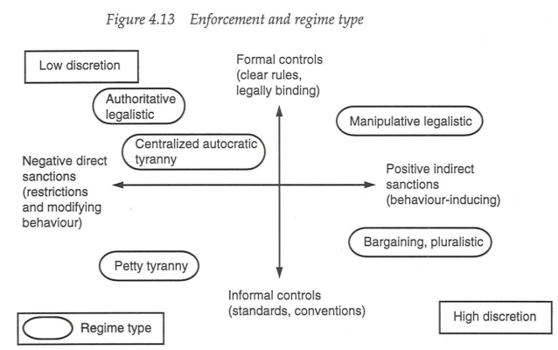

Slide 10
Thank You

