Slide 1
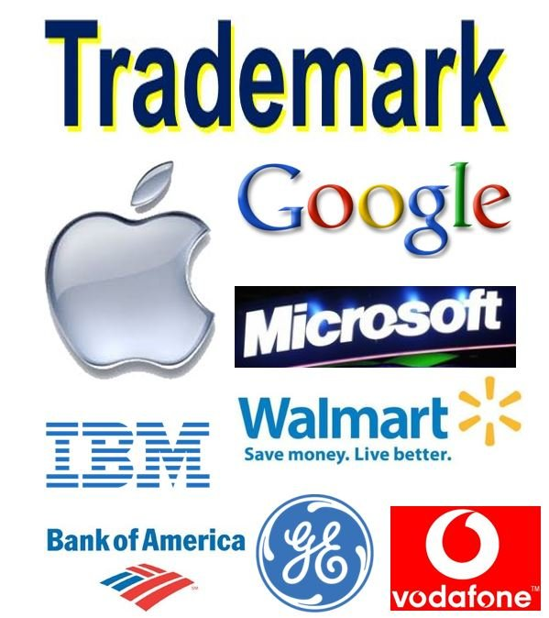
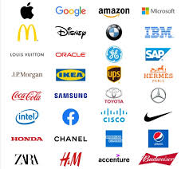
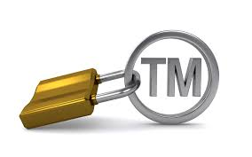
Trademark

Slide 2
Introduction,
A trademark (also written trade mark or trade-mark is a type of intellectual property consisting of a recognizable sign, design, or expression that identifies products or services from a particular source and distinguishes them from others.
The trademark owner can be an individual, business organization, or any legal entity.
A trademark may be located on a package, a label, a voucher, or on the product itself.
Trademarks used to identify services are sometimes called service marks.

Slide 3
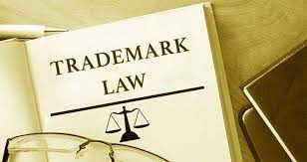
Commencement of Trade Mark law
The first legislative act concerning trademarks was passed in 1266 under the reign of Henry III, requiring all bakers to use a distinctive mark for the bread they sold.
The first modern trademark laws emerged in the late 19th century. In France, the first comprehensive trademark system in the world was passed into law in 1857.

Slide 4
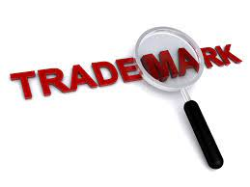
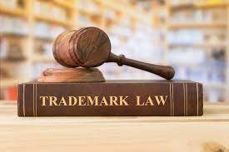
Continue,
The Trade Marks Act 1938 of the United Kingdom changed the system, permitting registration based on "intent-to-use", creating an examination based process, and creating an application publication system.
The 1938 Act, which served as a model for similar legislation elsewhere, contained other novel concepts such as "associated trademarks", a consent to use the system, a defensive mark system, and a non-claiming right system.

Slide 5
Symbols
The symbols ™ (the trademark symbol)
The symbol ® (the registered trademark symbol)
The latter is only for use by the owner of a trademark that has been registered.

Slide 6
Usage
Identify
A trademark identifies the brand owner of a particular product or service.
Can be used
Trademarks can be used by others under licensing agreements.
Unauthorized
Usage
For example, Bullyland obtained a license to produce Smurf figurines; the Lego Group purchased a license from Lucasfilm to be allowed to launch Lego Star Wars; TT Toys Toys is a manufacturer of licensed ride-on replica cars for children.
The unauthorized usage of trademarks by producing and trading counterfeit consumer goods is known as brand piracy.

Slide 7
Legal Protection
The owner of a trademark may pursue legal action against trademark infringement.
Most countries require formal trademark registration as a precondition for pursuing this type of action.
The United States, Canada, and other countries also recognize common law trademark rights, which means action can be taken to protect any unregistered trademark if it is in use.
Still, common law trademarks offer to the holder, in general, less legal protection than registered trademarks.

Slide 8
Designation and symbols
A trademark may be designated by the following symbols:
™ (the "trademark symbol", which is the letters "TM" in superscript, for an unregistered trademark, a mark used to promote or brand goods)
℠ (which is the letters "SM" in superscript, for an unregistered service mark, a mark used to promote or brand services)
® (the letter "R" surrounded by a circle, for a registered trademark)
The three symbols associated with trademarks represent the status of a mark and accordingly its level of protection.

Slide 9
Continue,
While ™ can be used with any common law usage of a mark,
® may only be used by the owner of a mark following registration with the relevant national authority, such as the U.S. Patent and Trademark Office (USPTO or PTO) or Indian Patent Office (IPO).
The proper manner to display either symbol is immediately following the mark in superscript style.

Slide 10
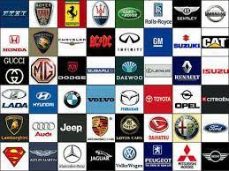
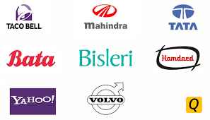
Styles
A trademark is typically a name, word, phrase, logo, symbol, design, image, or a combination of these elements.
There is also a range of non-conventional trademarks comprising marks which do not fall into these standard categories, such as those based on color, smell, or sound (like jingles).
Trademarks that are considered offensive are often rejected according to a nation's trademark law.
The term trademark is also used informally to refer to any distinguishing attribute by which an individual is readily identified, such as the well-known characteristics of celebrities. When a trademark is used about services rather than products, it may sometimes be called a service mark, particularly in the United States.

Slide 11
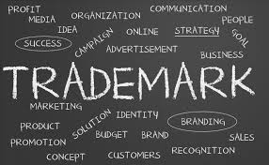
Fundamental concepts
The essential function of a trademark is to exclusively identify the source or origin of products or services, so a trademark, properly called, indicates the source or serves as a badge of origin.
In other words, trademarks serve to identify a particular entity as the source of goods or services.
The use of a trademark in this way is known as trademark use.
Certain exclusive rights attach to a registered mark.

Slide 12
Continue,
Trademarks are used not only by businesses but also by noncommercial organizations and religions to protect their identity and goodwill associated with their name.
Trademark rights generally arise out of the use of, or to maintain exclusive rights over, that sign about certain products or services, assuming there are no other trademark objections.
Different goods and services have been classified by the International (Nice) Classification of Goods and Services into 45 Trademark Classes (1 to 34 cover goods, and 35 to 45 cover services).
The idea behind this system is to specify and limit the extension of the intellectual property right by determining which goods or services are covered by the mark, and to unify classification systems around the world.

Slide 13
Thank you

