Slide 1


Slide 2

Food Chemistry
0711-2101
DEPARTMENT OF NUTRITION & FOOD ENGINEERING
DAFFODIL INTERNATIONAL UNIVERSITY

Slide 3
Today’s topic
Introduction to Chemistry of Food

Slide 4

Lecture objectives
To learn about:
Food Chemistry and its importance & role
Composition of food
Factors affecting quality of food
Chemistry of functional groups

Slide 5
Food Chemistry
Chemistry is the science of the composition of matter and the changes in composition that occur under changing conditions. The developments in various branches of chemistry such as organic chemistry, analytical chemistry, and physical chemistry were considered as essential to the advances of food chemistry.
Food chemistry is one of the major disciplines of food science which is mainly focusing on changes in the composition and chemical, physical, and functional properties of foods and food products during various stages from farm to fork. Such changes would ultimately affect the quality attributes and sensory characteristics of foods as well as the safety aspect. Therefore, the application of food chemistry mainly focuses on improving food quality and safety for the consumers.

Slide 6
Importance of Food Chemistry
Why should we learn food chemistry?
Food chemistry does not only concern with the composition of food raw materials and end products but also with the desirable and undesirable reactions which are controlled by a variety of physical and chemical parameters. There are extensive studies on the chemical composition of foods, micronutrients, contaminants, and additives as well as mechanisms of various reactions which affect the quality and safety of foods.
Food chemistry can provide an in-depth understanding of the principles and mechanisms involved in the various reactions that happened during food preparation, processing, and storage. A thorough understanding of all these chemical reactions that occur in foods would allow us to maximize the production or preservation of health-promoting compounds while minimizing the formation of harmful substances during food handling and preparation.

Slide 7
Importance of Food Chemistry (cont..)
Some typical examples of these chemical reactions include enzymatic and nonenzymatic browning (Maillard reaction), lipid oxidation, starch hydrolysis, formation of trans-fatty acids, cross-linking and denaturation of proteins, gel formation, starch retrogradation, toughening and softening of meat texture, degradation of vitamins, development of food flavor and off-flavors, formation of carcinogenic compounds during cooking, migration of various chemicals from packaging materials to food and their interactions, as well as those measures taken to reduce deterioration of foods during handling, processing, and storage.

Slide 8
Societal role of Food Chemists
Food chemists in Bangladesh should actively engage in societal issues involving technology for the following reasons:
Education and Responsibility: With advanced education and specialized skills, food chemists hold a significant responsibility to use their expertise for the benefit of society.
Impact on Public Welfare: The work of food chemists directly affects the adequacy of the food supply, population health, food costs, waste management, water and energy use, and food regulations. Given these broad implications for public welfare, it is essential for food chemists to contribute positively.

Slide 9
Societal role of Food Chemists (cont..)
Preventing Misinformed Influence: If food chemists don't participate in societal issues, less qualified individuals such as scientists from other fields, lobbyists, media personalities, activists, and those against technology may shape opinions on food-related matters.
Resolving Controversies: Food chemists have a crucial role in resolving controversies that affect public health and how the public perceives scientific and technological advancements. Current issues include the safety of cloned organisms and GMOs, the use of animal growth hormones in agriculture, and the nutritional value of crops from organic and conventional methods.

Slide 10
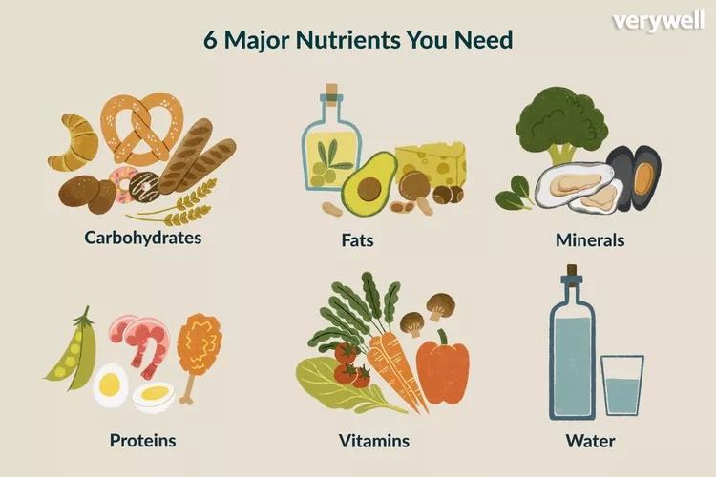
Composition of Foods
Food may be defined as substances, which when eaten and absorbed by the body, maintain life and growth, i.e. supply, build and repair tissues. The chemical components that perform these functions are called nutrients. Food must contain at least one nutrient. Nutritious foods such as milk contain a variety of nutrients and can fulfil all the requirements of the body, while glucose contains only one nutrient.
Six types of nutrients have been identified in foods. They are carbohydrates, fats, proteins, minerals, vitamins and water. Lack of the necessary minimum amounts of these nutrients leads to general deficiency and undernourishment while lack of any one particular nutrient in sufficient quantity leads to malnutrition. The chemical composition of each group of nutrients and its function in the body are interrelated.

Slide 11
Composition of Foods (cont..)
The nutrients may be classified into three main types based on their biological functions :
The nutrients required for energy include carbohydrates, fats and proteins
The nutrients for control of body processes include proteins. minerals, vitamins and water.
The nutrients required for the growth of tissues and their maintenance include proteins, minerals and water.
In addition to the major nutrients, foods contain natural or added minor constituents such as colorants, flavors, preservatives, toxins, etc. The additives in processed foods may be intentional to achieve certain aims during processing such as preservation, emulsification or flavor enhancement, or unintentional/accidental additives such as metallic contaminants, and fertilizer and pesticide residues.

Slide 12
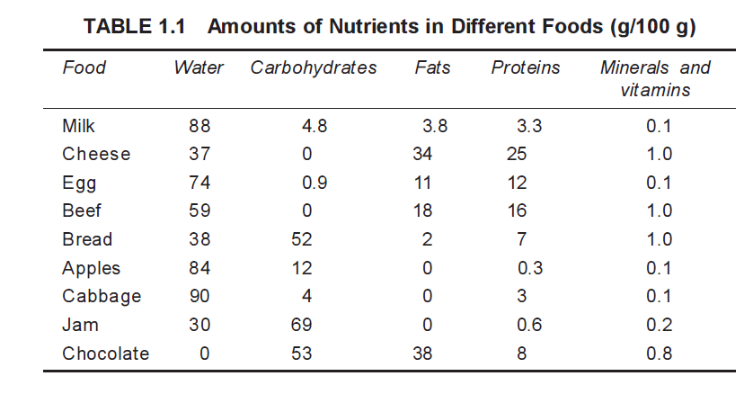
Composition of Foods (cont..)
The nutrient contents of a few typical foods are shown in the Table 1.1

Slide 13
Factors affecting quality of food
The quality of a food is defined from two perspectives:
Scientific status: it includes composition, spoilage, colorants, additives, nutrients, flavorants, functional ingredients (affecting health), contamination, general safety, etc.
Consumer preferences: these are linked directly to the human senses such as sight, touch, smell, taste, and mouthfeel. Visual factors include color, moisture, overall appearance, etc. Tactile factors include sliminess, elasticity, softness, hardness, etc. Factors responsible for taste and smell cover many specific chemicals. Mouthfeel refers to texture, softness, tenderness, chewy sensation, and so on

Slide 14

Factors affecting quality of food (cont..)
Nutrition: The nutrition of food has reached an all-time high as far as its impact on our health is concerned. There is no doubt the majority of people consider a quality food as one with high nutritional value. Some salient points follow:
Meat and poultry are nutritious because of their high source of protein, vitamins, and minerals.
The high content of fat and cholesterol in land muscle foods is undesirable. Thus, “lean” is in.
Fish and shellfish are an important part of a healthy diet. Fish and shellfish contain high quality protein and other essential nutrients, are low in saturated fat, and contain omega-3 fatty acids. A well-balanced diet that includes a variety of fish and shellfish can contribute to heart health and children’s proper growth and development.

Slide 15
Factors affecting quality of food (cont..)
Flavors and Aroma: One major reason, among many, that we like to eat is because food tastes good, which equates to flavor and aroma. Extensive research over the past 25 to 30 years has identified more than 1,000 flavor compounds in meats. However, a single compound or group of compounds responsible for “meaty flavor” has not and perhaps never will be identified due to the overall complexity of meat flavor.
Flavor is dependent on the pool of flavor precursors in the food tissue and the chemical reactions that occur during processing. Processing and subsequent storage contribute to the development of the characteristic flavors in foods. Because the precise flavor precursors vary between and within species/types of food, each food have distinctive flavor characteristics. The quality of food is to a large extent defined by its flavor and aroma.
(Flavor is the sensory impression of a food or other substance; it is a combination of taste and aroma. Aroma are volatiles released in mouth and then sensed in the nasal cavity)

Slide 16

Factors affecting quality of food (cont..)
Colors: The first impression that a consumer receives concerning a food product is established visually, and among the properties observed are color, form, and surface characteristics. Color is the main aspect that defines a food’s quality, and a product may be rejected simply because of its color, even before other properties, such as aroma, texture, and taste, can be evaluated.
Food technologists have a special interest in the color of food for several reasons. First, because of the need to maintain a uniform color throughout processing; second, to prevent any external or internal agent from acting on the product during processing, storage, and display; third, to improve or optimize a product’s color and appearance; and, last, to attempt to bring the product’s color into line with what the consumer expects.

Slide 17

Factors affecting quality of food (cont..)
Processing: The quality of food is obviously affected by the way it is processed. Selected examples will illustrate how food processing can affect the quality of a food product:
Heat application: All of us know that overheating tender meat and chicken usually means toughness. The same is especially true for seafood.
Heat removal or cold preservation: Freezing is a good example. Most of us are familiar with freezer-burn of meat, chicken, fish, shellfish, or other products left in the freezer over extended periods of time.
Evaporation and dehydration: Food drying has been popular since the beginning of time. Destruction of nutrients, especially vitamins, is one drawback to this method of preservation.
Freeze burnt meat

Slide 18
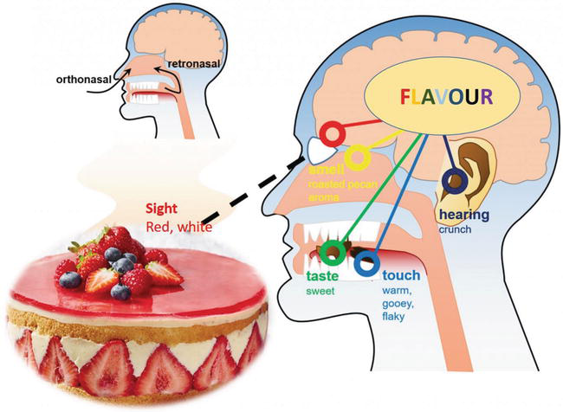
Factors affecting quality of food (cont..)
Fermentation: In general, of meat, poultry, and fish products, fermented meat such as sausages is most popular. The quality of a sausage is to a large extent determined by the consumer, e.g., dry, sweet, salty, and pickled. Each method affects the quality in terms of nutrients, hardness, tenderness, and flavor.
New technology: There are numerous new technologies in food processing such as irradiation, microwaving, and ohmic heating. Each method affects the quality of a food in various ways.
Sensory attributes and the consumer: The sensory attributes of muscle foods are related to the senses of taste, smell, sight, feel, and sound.
Government standards and specifications: Many countries use the United States as an example in formulating their standards and specifications for foods.

Slide 19
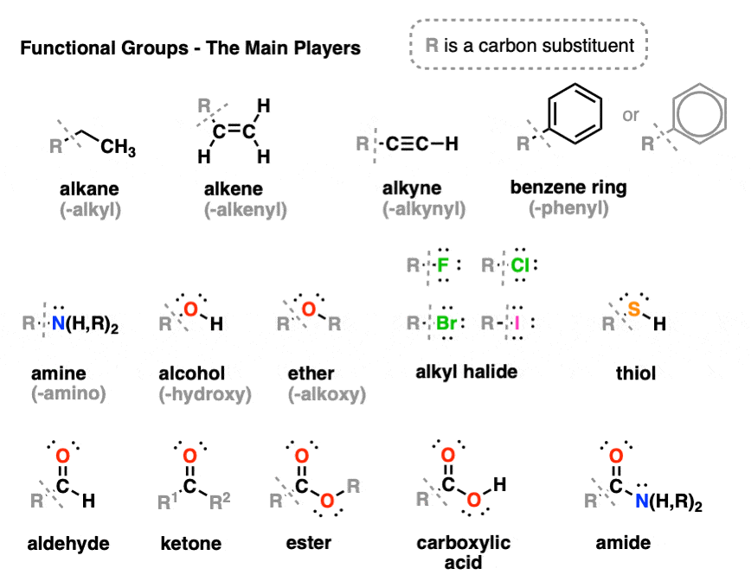
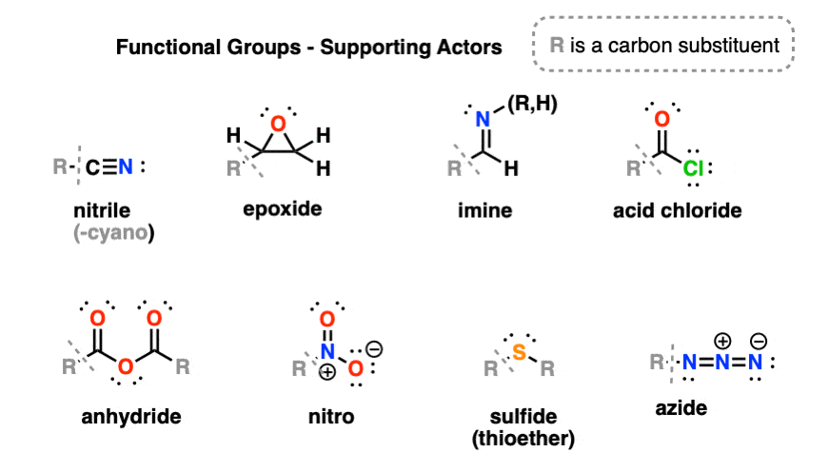
Chemistry of functional groups
A functional group is a specific group of atoms within a molecule that is responsible for characteristic chemical reactions of that molecule. No matter what size a molecule is, a functional group participates in chemical reactions in a predictable manner. Functional groups link to the rest of the molecule via covalent bonds. The group may be neutral or charged. Examples of common functional groups include alcohol (-OH), aldehyde (-COH), and nitrile (-CN).

Slide 20
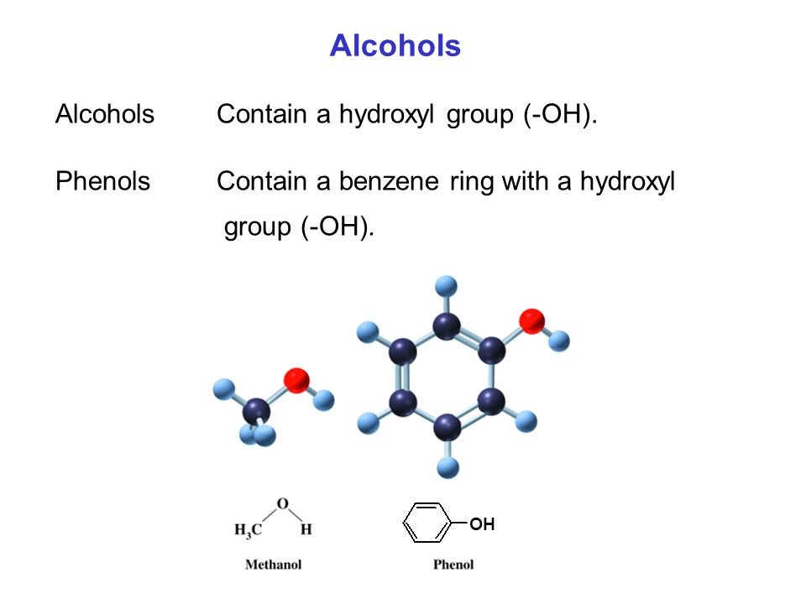
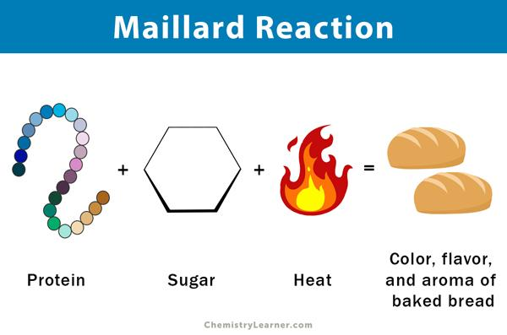
Chemistry of functional groups (cont..)
Common Functional Groups in Food Molecules:
1. Hydroxyl (-OH):
- Found in carbohydrates, alcohols, and phenolic compounds.
- Impacts sweetness and solubility in water.
- Example: In sugars, hydroxyl groups contribute to the sweetness of fruits and sweeteners.
2. Carbonyl (C=O):
- Present in sugars, proteins, and fats.
- Determines flavors and textures.
- Example: Maillard reaction between amino acids (protein) and reducing sugars (carbonyl group) contributes to the browning of baked goods.

Slide 21
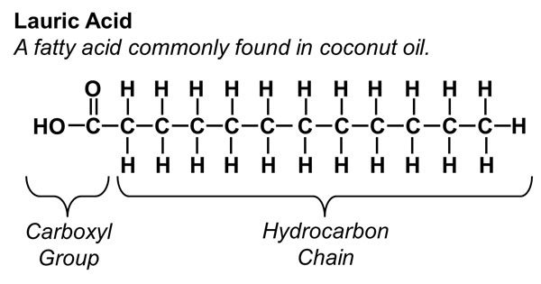
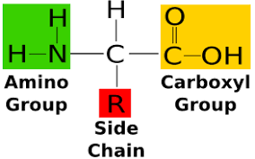
Chemistry of functional groups (cont..)
Common Functional Groups in Food Molecules:
3. Carboxyl (-COOH):
- Found in fatty acids and amino acids.
- Influences acidity and contributes to sour tastes.
- Example: Fatty acids with carboxyl groups affect the taste and texture of oils and fats.
4. Amino (-NH₂):
- Integral to amino acids and proteins.
- Contributes to umami taste.
- Example: Amino acids in protein-rich foods enhance the savory and meaty flavors.
Amino Acid

Slide 22
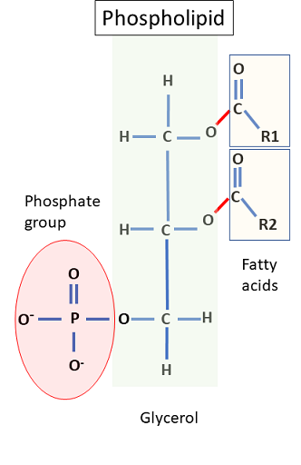
Chemistry of functional groups (cont..)
Common Functional Groups in Food Molecules:
5. Phenyl (-C₆H₅):
- Found in phenolic compounds, providing antioxidants and influencing color in fruits, vegetables, and beverages.
6. Phosphate Group (-PO₄):
- Key component in nucleic acids and energy
-rich compounds.
- Plays a role in pH regulation.
- Example: Phospholipids, containing phosphate groups, are essential in forming cell membranes.

Slide 23

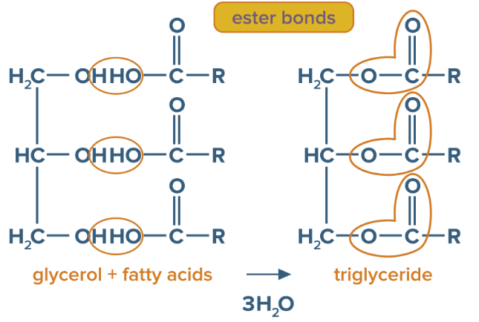
Chemistry of functional groups (cont..)
Common Functional Groups in Food Molecules:
7. Sulfhydryl Group (-SH):
- Present in amino acids and certain proteins.
- Forms disulfide bonds, contributing to protein structure and stability.
- Example: Disulfide bonds in gluten proteins contribute to the elasticity of dough.
8. Ester Group (-COO-):
- Found in lipids, providing flavor and aroma.
- Contributes to the pleasant odors in fruits and some fatty foods.
- Example: Esters are responsible for the fruity aromas in various fruits like apples and strawberries.

Slide 24

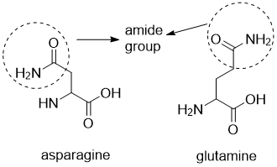
Chemistry of functional groups (cont..)
Common Functional Groups in Food Molecules:
9. Ether Group (-O-):
- Occurs in various natural compounds.
- May impact the volatility and aroma of certain foods.
- Example: Ethers in essential oils contribute to the characteristic scents of herbs and spices.
10. Amide Group (-CONH₂):
- Abundant in proteins and peptides.
- Influences the structure and function of proteins.
- Example: The peptide bonds formed by amide groups link amino acids in
protein molecules.

Slide 25
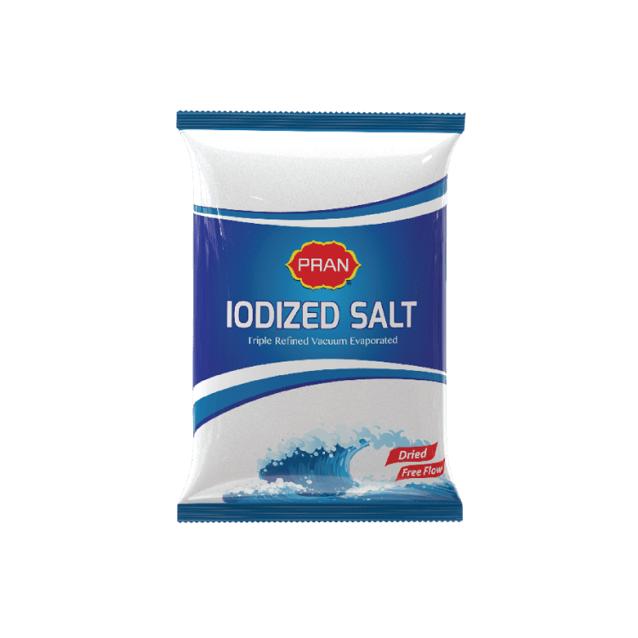
Chemistry of functional groups (cont..)
Common Functional Groups in Food Molecules:
11. Halide Group (-X, where X is a halogen):
- Rare in food, but iodine-containing compounds are essential for thyroid function.
- Iodine is incorporated into certain salts and seafood.
- Example: Iodized salt is a common source of dietary iodine.
12. Alkene Group (-C=C-):
- Occurs in lipids and contributes to the fluidity of fats.
- Involved in lipid oxidation reactions affecting food shelf life.
- Example: Unsaturated fatty acids with alkene groups are prone to oxidative rancidity.

Slide 26
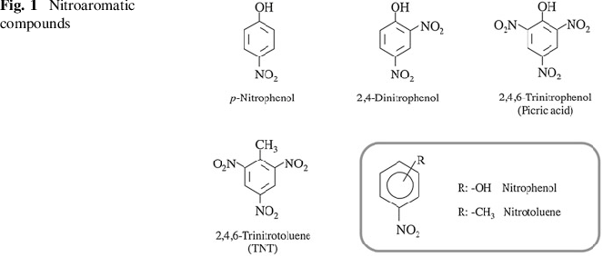
Chemistry of functional groups (cont..)
Common Functional Groups in Food Molecules:
13. Alkyne Group (-C≡C-):
- Rare in food, but certain phytochemicals contain triple bonds.
- May contribute to antioxidant properties.
- Example: Some plant-derived compounds with alkyne groups exhibit potential health benefits.
14. Nitro Group (-NO₂):
- Infrequently found in food, but certain additives or contaminants may contain nitro groups.
- Nitro compounds can have toxic effects in high concentrations.
- Example: Nitroaromatic compounds may be found in some food contaminants.

Slide 27

Chemistry of functional groups (cont..)
Common Functional Groups in Food Molecules:
15. Nitrile Group (-C≡N):
- Present in some plant compounds and occasionally in food additives.
- May contribute to the bitterness of certain foods.
- Example: Nitriles in certain cruciferous vegetables contribute to their characteristic bitter taste.
16. Haloamine Group (-NHX, where X is a halogen):
- Found in some amino acids and proteins.
- Involved in the Maillard reaction, contributing to flavor development in cooked foods.
- Example: The Maillard reaction between amino acids and reducing sugars can produce haloamines, influencing the taste and color of foods.

Slide 28


Slide 29


