Slide 1
Introduction to Integrating Marketing Communications
Dr. Amir Ahmed

Slide 2
Advertising and sales promotion play an important role in the exchange process by informing consumers about an organisations product/services and persuading them to purchase to satisfy their needs and wants.
Many companies recognize the need to integrate their various marketing communication efforts, such as media advertising, direct marketing, sales promotion, and public relations, to achieve more effective marketing communications

Slide 3
Integrated Marketing Communications
company develops its integrated marketing communication programme using all the elements of the marketing mix (product, price, place, and promotion).
An integration of all these promotional tools along with other components of marketing mix to gain edge over competitor is called Integrated Marketing Communication.
marketing and promotional tools must be coordinated to communicate effectively and present a consistent image to target markets.

Slide 4
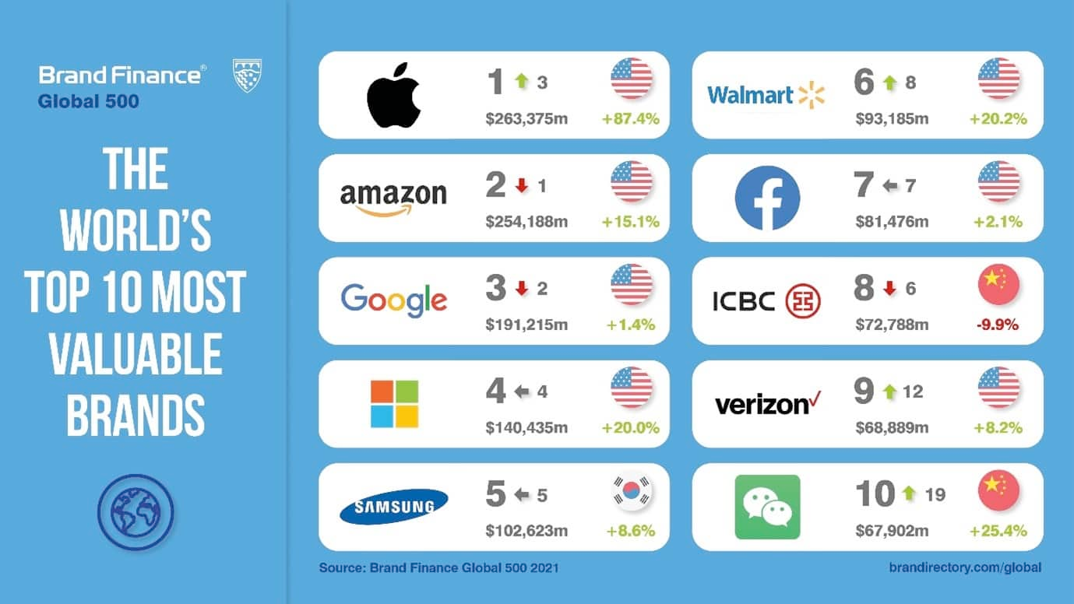
Brand Identity is a combination of factors: Name, logo, symbols, design, packaging, product or service performance, and image or associations in the consumer’s mind.
IMC plays a major role in the process of developing and sustaining brand identity and equity.
© 2003 McGraw-Hill Companies, Inc., McGraw-Hill/Irwin
Notes:
Relation to text This slide relates to material found on pp14-15 and IMC Perspective 1-2 of the text.
Summary Overview With more and more products and services available to consumers, developing and maintaining brand identity is becoming increasingly more important. Well known brands have a major competitive advantage in today’s marketplace. A well-defined and coordinated IMC plan contributes to overall brand identity and equity.
Use of this slide This slide can be used to define brand identity and discuss the importance of building and sustaining strong brand identity. The list of the 10 most valuable brands, as measured by the brand consultancy company Interbrand, should be familiar to your students. You might discuss how these popular brands may have a competitive edge with consumers during the purchase decision process.

Slide 5
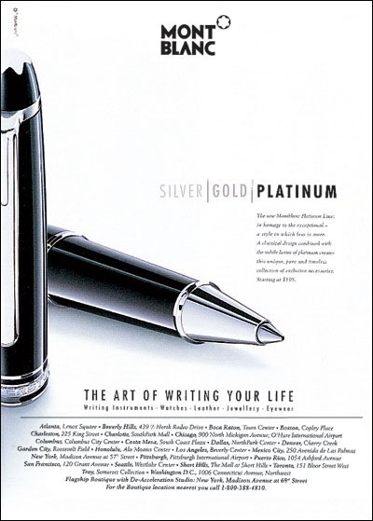
+
© 2003 McGraw-Hill Companies, Inc., McGraw-Hill/Irwin
Notes:
Relation to text This slide relates to material on pp. 14-16 of the text.
Summary Overview This slide shows a print ad for a Mont Blanc pen. Mont Blanc uses a classical design and a distinctive brand name as well as a high price to position its pens as high-quality, high-status writing instruments. The upscale image is enhanced by the company’s strategy of distributing its products only though boutiques, jewelry stores, and other exclusive retail shops. Mont Blanc’s distinctive image is a result of coordination of all of the marketing mix elements.
Use of this slide This slide can be used to show how Mont Blanc uses a variety of marketing mix elements including price, product design, brand name, and distribution strategy to create a high-quality, upscale image for its writing instruments.

Slide 6
Advertising
Advertising
Direct Marketing
Direct Marketing
Interactive/
Internet Marketing
Interactive/
Internet Marketing
Sales Promotion
Sales Promotion
Publicity/Public
Relations
Publicity/Public
Relations
Personal Selling
© 2003 McGraw-Hill Companies, Inc., McGraw-Hill/Irwin
Notes:
Relation to text This slide relates to material on page 16-24 and Figure 1-1.
Summary Overview The promotional mix is the basic tools used to accomplish an organization’s communication objectives. These tools include:
Advertising – any paid form of non personal communication about an organization, product, service, or idea by an identified sponsor
Direct marketing – communication directly with target customers to generate a response and/or transaction
Interactive/Internet marketing – communication through interactive media such as the Internet, CD-ROMS and kiosks.
Sales promotion – marketing activities that provide extra value or incentives to sales force, distributors, or consumers to stimulate immediate sales
Publicity/Public Relations – Publicity is a form of non-personal communication not directly paid for or run under identified sponsorship. Public relations is a management function which executes programs of action to earn public understanding and acceptance an enhance the image of the company.
Personal Selling – person-to-person communication between a seller and buyer
Use of this slide This slide can be used to introduce and define the various elements of the promotional mix.

Slide 7
Any paid form of nonpersonal communication about an organization, product, service, or idea by an identified sponsor.
Advantages
Disadvantages
Reach large number of people
Low cost per contact
Powerful tool for building brand equity
Total cost is high
National reach is expensive for small companies

Slide 8
National Advertising
National Advertising
Retail/Local Advertising
Retail/Local Advertising
Primary vs. Selective Demand Advertising
Primary vs. Selective Demand Advertising
Consumers
Business-to-Business Advertising
Business-to-Business Advertising
Professional Advertising
Professional Advertising
Trade Advertising
Organizations
© 2003 McGraw-Hill Companies, Inc., McGraw-Hill/Irwin
Notes:
Relation to text This slide relates to pp. 16-19 and Figure 1-3 in text.
Summary Overview The nature and purpose of advertising differs from one industry to another and/or across situations. Advertising can be targeted toward consumer and/or business markets.
Consumer advertising is classified as:
National advertising – done by large companies on a nationwide basis. Ads for well-known brands and companies shown on television are an example.
Retail/Local advertising – done by retail and local merchants encouraging consumers to shop at a specific store, use a local service, or patronize a particular establishment.
Primary versus selective demand advertising – primary demand advertising is designed to stimulate demand for the general product class or industry. Selective-demand focuses on creating demand for a specific company and/or its brands.
Advertising to business and professional markets includes:
Business to business advertising – advertising that targets individuals who buy or influence the purchase of industrial goods or services for their companies.
Professional advertising – advertising targeted to professionals such doctors, lawyers, engineers, and the like.
Trade advertising – targeted to marketing channel members such as wholesalers, distributors, and retailers.
Use of this slide This slide can be used to explain the various types of advertising and how the role of advertising can vary given the target customer, goals and objectives, or situation.

Slide 9
Traditionally this has not been considered as an element of promotional mix
Organizations communicate directly with target customers
Channels of Direct Marketing:
Direct Marketing is much more than direct mail and mail order catalog. It involves a verity of activities including:
Database management
Direct mail
Telemarketing
Email Marketing
Door-to-Door Leaflet Marketing
+
© 2003 McGraw-Hill Companies, Inc., McGraw-Hill/Irwin
Notes:
Relation to text This slide relates to material found on p. 24 and Exhibit 1-15 of the text.
Summary Overview Business-to-business marketers, who generally sell expensive, risky, and often complex products and services, generally use personal selling more often than media advertising. However, companies like Honeywell do use advertising to perform important functions such as building awareness of the company and its products, generating leads for the sales force, and reassuring customers about purchases they have made.
Use of slide This slide can be used to show how business-to-business marketers use advertising to build awareness of their company and its products or services.

Slide 10
Direct
Mail
Direct
Mail
Direct
Response
Advertising
Direct
Response
Advertising
Internet
Sales
Direct Marketing
Shopping
Channels
Shopping
Channels
Telemarketing
Telemarketing
Cataloging
Catalogs
© 2003 McGraw-Hill Companies, Inc., McGraw-Hill/Irwin
Notes:
Relation to text This slide relates to material on pp. 18-20 of the text.
Summary Overview Direct marketing is a form of integrated marketing communications whereby an organization communicates directly with target customers to generate a response and/or transaction. It involves a variety of activities including:
Direct mail
Direct response advertising (on TV, radio or in magazines or newspapers)
Telemarketing
Internet Sales
Catalogs
Shopping channel
Use of this slide This slide can be used to provide an overview of direct marketing and the various forms it can take.

Slide 11
The Internet
Educates or Informs Customers
A Persuasive Advertising Medium
A Sales Tool or an Actual Sales Vehicle
Educates or Informs Customers
A Persuasive Advertising Medium
A Sales Tool or an Actual Sales Vehicle
Obtains Customer Database Information
Provides Customer Service and Support
Obtains Customer Database Information
Provides Customer Service and Support
Builds and Maintains Customer Relationships
Communicates and Interacts With Buyers
Communicates and Interacts With Buyers
© 2003 McGraw-Hill Companies, Inc., McGraw-Hill/Irwin
Notes:
Relation to text This slide relates t material on pp. 20-21 which discusses interactive marketing and the Internet as IMC tools.
Summary Overview The rapid changes in technology have led to dramatic growth of communications through interactive media, particularly the Internet. This communication medium is unique in that it allows for the back-and-forth flow of information in real time. Customers can perform a variety of functions on the Internet such as receive and alter information and images, make inquires, respond to questions, and, of course, make purchases. The Internet has changed the ways companies communicate to their customers as companies and organizations of all sizes have developed websites to promote their products and services.
Use of this slide This slide can be used to show that the Internet has changed the way companies communicate with their customers. Because of its interactive nature, it is a very effective way to communicate with customers. Actually, it is a medium that can be used to execute all elements of the promotional mix. In addition to advertising, companies can offer sales promotion incentives such as coupons or contests, do direct marketing, and execute public relations, and personal selling functions via the Internet.

Slide 12
Coupons
Coupons
Samples
Trade
Allowances
Samples
Premiums
Premiums
POP Displays
POP Displays
Contests/Sweepstakes
Contests/Sweepstakes
Training Programs
Refunds/Rebates
Training Programs
Refunds/Rebates
Bonus Packs
Bonus Packs
Trade Shows
Trade Shows
Loyalty Programs
Loyalty Programs
Coop Advertising
Coop Advertising
Events
Events
Consumer-oriented
[For end-users]
Trade-oriented
[For resellers]
© 2003 McGraw-Hill Companies, Inc., McGraw-Hill/Irwin
Notes:
Relation to text This slide relates to material on pp. 21-22 of the text which discusses the role of sales promotion as an IMC tool.
Summary Overview Sales promotion is defined as those activities that provide extra value or incentives to the sales force, the distributors, or the ultimate consumer and can stimulate immediate sales. Sales promotion is generally broken down into two categories:
Customer-oriented – targeted to the ultimate user of the product or service and includes coupons, sampling, premiums, contests, sweepstakes, refunds/rebates, bonus packs, events, and loyalty programs.
Trade-oriented – targeted to marketing intermediaries such as wholesalers, distributors, and retailers and includes trade allowances, price deals, sales contests, trade shows, and cooperative advertising.
Use of slide This slide can be used to introduce sales promotion as an IMC tool and the various types consumer and trade promotions.

Slide 13
Get Existing Customers to Buy More
Introduce New Products
Get Existing Customers to Buy More
Introduce New Products
Combat Competition
Attract New Customers
Attract New Customers
Sales
Promotion
Enhance Personal Selling
Enhance Personal Selling
Maintain Sales In Off Season
Maintain Sales In Off Season
Increase Retail Inventories
Tie In Advertising & Personal Selling
Increase Retail Inventories
Tie In Advertising & Personal Selling
© 2003 McGraw-Hill Companies, Inc., McGraw-Hill/Irwin
Notes:
Relation to text This slide relates to the material on pp. 21-22 which discusses the role of sale promotion as part of the IMC program.
Summary Overview There are various reasons why companies choose to use sales promotion in their IMC programs. The various uses of consumer and trade promotion include:
Introduce new products
Get existing customers to buy more
Attract new customers
Maintain sales in off seasons
Increase retailer inventories
Enhance or tie in advertising with personal selling
Combat competition
Use of Slide This slide can further supplement the discussion of sales promotion and why companies use this tool as part of their IMC programs

Slide 14
Factor
Advertising
Publicity
Control
Great
Little
Credibility
Lower
Higher
Reach
Measurable
Undetermined
Frequency
Schedulable
Uncontrollable
Cost
High/Specific
Low/Unspecified
Flexibility
High
Low
Timing
Specifiable
Tentative
© 2003 McGraw-Hill Companies, Inc., McGraw-Hill/Irwin
Notes:
Relation to text This slide relates to material on pp. 22-23 which discusses the role of publicity.
Summary Overview Another important component of an organization’s promotional mix is publicity/public relations. Publicity refers to the non personal communications regarding an organization, product, service, or idea not directly paid for or run under identified sponsorship. Companies attempt to get the media to cover or run favorable stories on their products, services, or causes. It usually comes in the form of a news story, editorial, or announcement. There are a number of advantages and disadvantages that publicity has relative to advertising. This slide compares advertising and publicity on a number of factors.
Use of this slide This slide can be used to introduce publicity/public relations and to discuss how publicity compares to advertising with respect to various factors.

Slide 15
Publicity
Non-paid, non-personal communication to promote the organisation, products, services, idea or image of the company not directly done under an identified sponsorship.
It usually comes in the form of a news story, editorial, or announcement about an organisation and/or its product and services.

Slide 16
An advantage of publicity over other forms of promotion is its credibility.
Consumers generally tend to be less skeptical towards favorable information about a product or service when it comes from a source they believe is unbiased.
Publicity is not always under control of an orgnisation and is sometimes unfavorable.

Slide 17
Feature
Articles
Feature
Articles
News
Releases
News
Releases
Interviews
Interviews
Publicity Vehicles
Press
Conferences
Special
Events
Special
Events
© 2003 McGraw-Hill Companies, Inc., McGraw-Hill/Irwin
Notes:
Relation to text This slide relates to the material on pp. 22-24.
Summary Overview Companies attempt to get the media to cover or run favorable stories on their products, services, or causes. There are a number of publicity vehicles available to marketers. Publicity can be generated through the use of:
feature articles
news releases
press conferences
special events
interviews
Use of Slide This slide can be used to show the various methods that can be used to generate publicity for companies, brands, organizations, or causes.

Slide 18
Public Relations
Public Relations (or PR) is a field concerned with maintaining public image for high-profile people, commercial businesses and organizations, non-profit associations or programs.
It defined the practice of public relations as "the art and social science of analyzing trends, predicting their consequences, counseling organizational leaders, and implementing planned programs of action, which will serve both the organization and the public interest."

Slide 19
Publicity
Vehicles
Special
Publications
Publicity
Vehicles
Special
Publications
Community
Activities
Community
Activities
Corporate Advertising
Cause-related Marketing
Corporate Advertising
Cause-related Marketing
Public Affairs
Activities
Public Affairs
Activities
Special Event
Sponsorship
© 2003 McGraw-Hill Companies, Inc., McGraw-Hill/Irwin
Notes:
Relation to text This slide relates to material on pp. 22-23 which discusses public relations.
Summary Overview It is important to distinguish between publicity and public relations. When an organization systematically plans and distributes information in an attempt to control and manage its image and the nature of the publicity it receives, it is really engaging in public relations. There are a variety of public relations tools available to marketers such as publicity vehicles, special publications, community activities, fund raising programs, public affairs activities, and special event sponsorships. Organizations can also use advertising as a public relations tool.
Use of Slide This slide can be used to explain the various public relations tools. It also provides an opportunity to discuss the differences between public relations and publicity.

Slide 20
Personal selling
A form of person-t0-person communication in which a seller attempts to assist and/or persuade prospective buyers with the intention of making a sale.

