Slide 1
Entering Foreign Markets
Non-equity modes of market entry
  Exporting
    Selling some regular production overseas
    Requires little investment
    Relatively free of risk
    Indirect exporting
    Direct exporting
Equity modes of market entry
  Wholly owned subsidiary
  Joint venture
  Strategic alliance

Slide 2
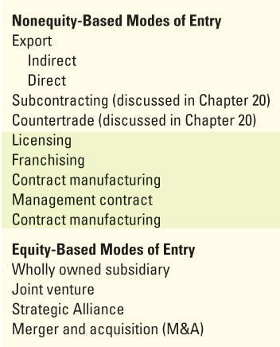
Summary: Modes of Entry

Slide 3
Indirect Exporting…
Exporting of goods and services through various home-based exporters
  Manufacturers’ export agents
    sell for manufacturer
  Export commission agents
    buy for overseas customers
  Export merchants
    purchase and sell for own accounts
  International firms
    use the goods overseas

Slide 4
Direct Exporting
Exporting of goods and services by the producing firm
Sales company option
    Business established to market goods and services
Internet has made direct exporting much easier
    Cost of trial low

Slide 5
Exporting…
Turnkey Project used for export of
  Technology
  Management expertise
  Capital equipment (some cases)
After trial run, facility is turned over to purchaser
Exporter of a turnkey project may be
  Contractor that specializes in designing and erecting plants in a particular industry
  Company that wishes to earn money from its expertise
  Producer of a factory

Slide 6
Exporting
Licensing
  A contractual arrangement: one firm sells access to its patents, trade secrets, or technology to another
  Licensee pays fixed sum and sales royalties (2%-5%)
Popular because
  Courts have begun upholding patent infringement claims
  Patent holders have become vigilant in suing violators
  Foreign governments have been pressed to enforce their patent laws
  Examples: Rangs for Sony, Abdul Momen Group for Cocacola.

Slide 7
Franchising
Franchising
  Form of licensing in which one firm contracts with another to operate a certain type of business under an established name according to specific rules.
  This involves an initial franchising fees known as Know How Fees followed by successive royalty (usually 12-25% of the revenue per monthly or annually
  Example: Pizzahut, Burger King

Slide 8
Contracts
Management Contract
  Arrangement by which one firm provides management in all or specific areas to another firm.
  Examples: Gas companies
Contract Manufacturing
  Arrangement in which one firm contracts with another to produce products to its specifications but assumes responsibility for marketing.
  Examples: Most of the garments industries in Bangladesh

Slide 9
Equity-Based Modes of Entry
Wholly Owned Subsidiary
Joint Venture
Strategic Alliance

Slide 10
Wholly Owned Subsidiary
Wholly Owned Subsidiary
    build a new plant (greenfield investment)
    acquire a going concern
    purchase distributor, to obtain a distribution network familiar with products

Slide 11
Joint Venture…
Joint Venture
  Cooperative effort among two or more organizations that share common interest in business enterprise
    corporate entity formed by international company and local owners
    corporate entity formed by two international companies for the purpose of doing business in a third market
    a corporate entity formed by a government

Slide 12
Indirect Exporting
Exporters that sell for the manufacturer
  Manufacturers’ export agent
    Acts as the international representative for various noncompeting domestic manufacturers
  Export management companies (EMC)
    Acts as the export department for noncompeting manufacturers
  International trading companies
    Acts as agent for some companies and as wholesaler for others

Slide 13
Indirect Exporting: International Trading Companies
International Trading Companies
  Japan: Sogo Shosha
    Originally established by the zaibatsu, centralized, family-dominated economic groups
  Korean: chaebol
  Owned by Korean conglomerates
Export trading companies (ETC)
  U.S. firm established principally to export domestic goods and services

Slide 14
Indirect Exporting…
Exporters that buy for their overseas customers
  Export commission agents
    Represent overseas purchasers, such as import firms and large industrial users
    Paid commission by the purchaser for acting as resident buyer

Slide 15
Indirect Exporting…
Exporters that buy and sell for their own account
  Export merchants
    Purchase products directly from the manufacturer and then sell, invoice, and ship them in their own names
  Cooperative exporters/piggyback exporters
    Established international manufacturers that export other manufacturers’ goods as well as their own
  Webb-Pomerene Associations
    Organizations of competing firms that have joined together for the sole purpose of export trade

Slide 16
Indirect Exporting
Exporters that purchase for foreign users and middlemen
  Large foreign users
    Buy for their own use overseas
  Export resident buyers
    Perform essentially the same functions as export commission agents but more closely associated with a foreign firm

