Slide 1
10
Media Planning and Strategy
McGraw-Hill/Irwin
© 2004 The McGraw-Hill Companies, Inc., All Rights Reserved.

Slide 2
Media Terminology
Media Planning - A series of decisions involving the delivery of messages to audiences.
Media Objectives - Goals to be attained by the media strategy and program.
Media Strategy - Decisions on how the media objectives can be attained.
Media - The various categories of delivery systems, including broadcast and print media.
Broadcast Media - Either radio or television network or local station broadcasts.

Slide 3
Media Terminology
Print Media - Publications such as newspapers and magazines.
Media Vehicle - The specific message carrier, such as the Washington Post or 60 Minutes.
Coverage - The potential audience that might receive the message through the the vehicle.
Reach - The actual number of individual audience members reached at least once by the vehicle in a given period of time.
Frequency - The number of times the receiver is exposed to vehicle in a specific time period.

Slide 4
Problems in Media Planning
Lack of information
Inconsistent terms
Serious time pressure
Measurement problems

Slide 6
Three Scheduling Methods
 | Continuity
 | Flighting
Pulsing
Jan Feb Mar Apr May Jun Jul Aug Sep Oct Nov Dec

Slide 8
Flighting:

Slide 10
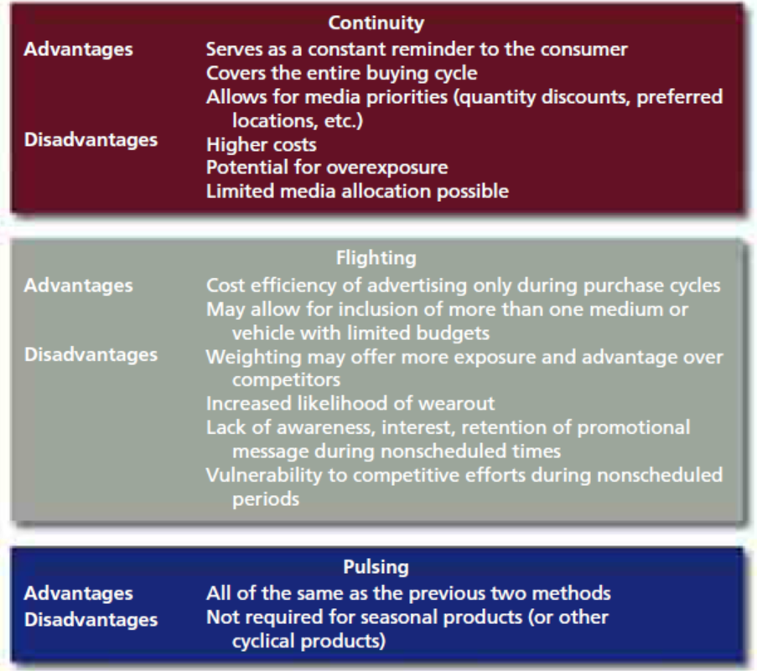

Slide 11
Television Characteristics
Advantages
Disadvantages
Mass coverage
High reach
Impact of sight, sound, and motion
High prestige
Low cost per exposure
Attention getting
Favorable image
Low selectivity
Short message life
High absolute cost
High production costs
Clutter

Slide 12
Radio Characteristics
Advantages
Disadvantages
Local coverage
Low cost
High frequency
Flexible
Low production costs
Well-segmented audiences
Audio only
Clutter
Low attention getting
Fleeting message

Slide 13
Magazines Characteristics
Advantages
Disadvantages
Segmentation potential
Quality reproduction
High information content
Longevity
Multiple readers
Long lead time for ad placement
Visual only
Lack of flexibility

Slide 14
Newspapers Characteristics
Advantages Disadvantages
Short life
Clutter
Low attention- getting capabilities
Poor reproduction quality
Selective reader exposure
High coverage
Low cost
Short lead time for placing ads
Ads can placed in interest sections
Timely (current ads)
Reader controls exposure
Can be used for coupons

Slide 15
Outdoor Characteristics
Advantages
Disadvantages
Location specific
High resolution
Easily noticed
Short exposure time requires short ad
Poor image
Local restrictions

Slide 16
Direct Mail Characteristics
Advantages
Disadvantages
High selectivity
Reader controls exposure
High information content
Opportunities for repeat exposures
High cost/contact
Poor image (junk mail)
Clutter

Slide 17
Internet / Interactive Media Characteristics
Advantages
Disadvantages
User selects product information
User attention and involvement
Interactive relationship
Direct selling potential
Flexible message platform
Limited creative capabilities
Web snarl (crowded access)
Technology limitations
Few valid measurement techniques
Limited reach

