Slide 1
Describing Pictures
Jannatul Ferdous Himika
Lecturer (English)
Business Administration
Daffodil International University

Slide 2
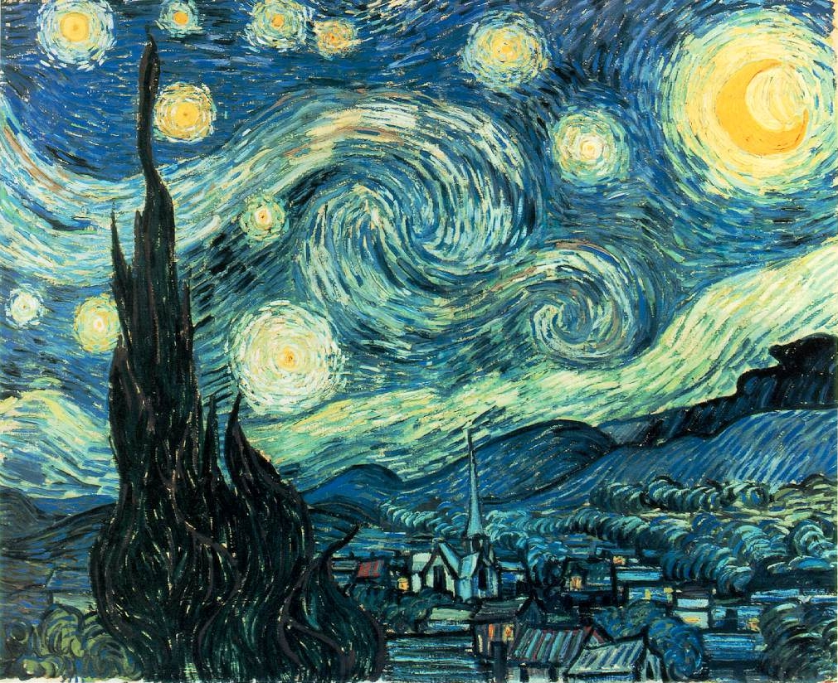

Slide 3
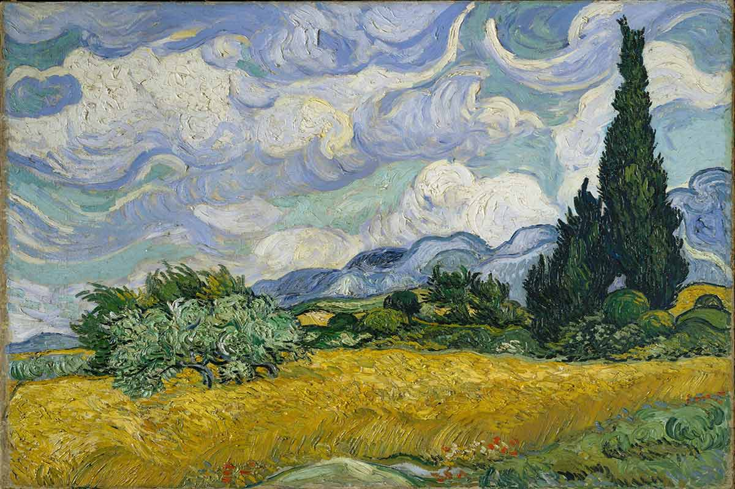

Slide 4
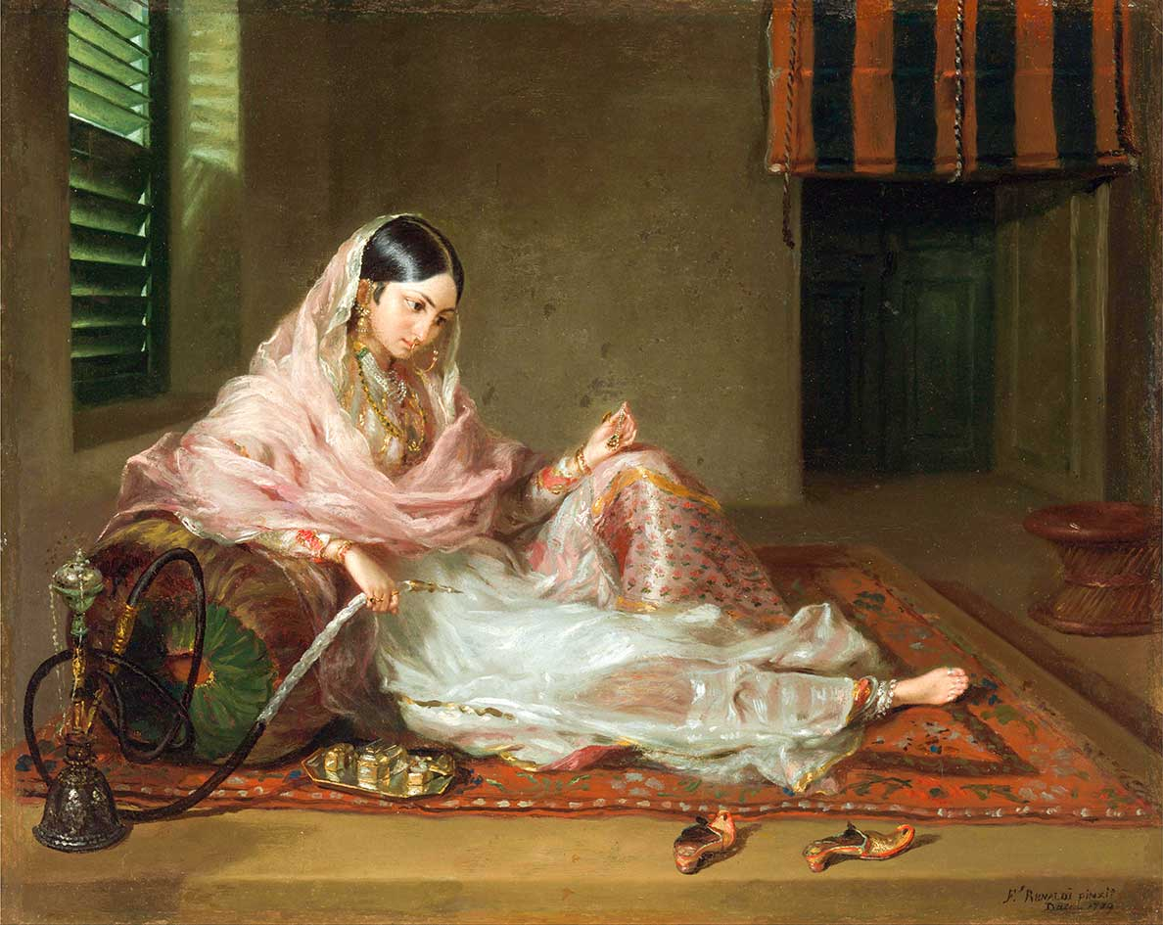

Slide 6
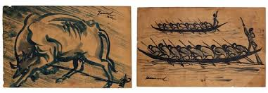

Slide 7
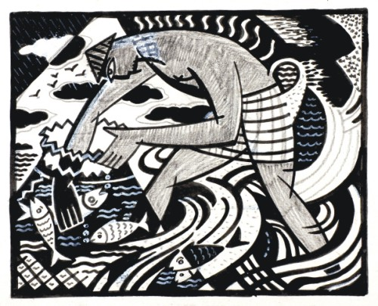

Slide 8
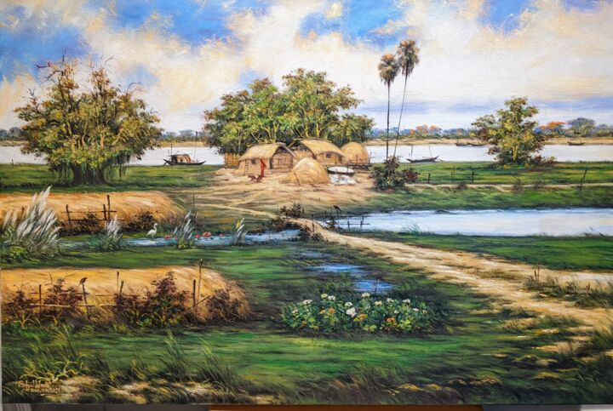

Slide 9
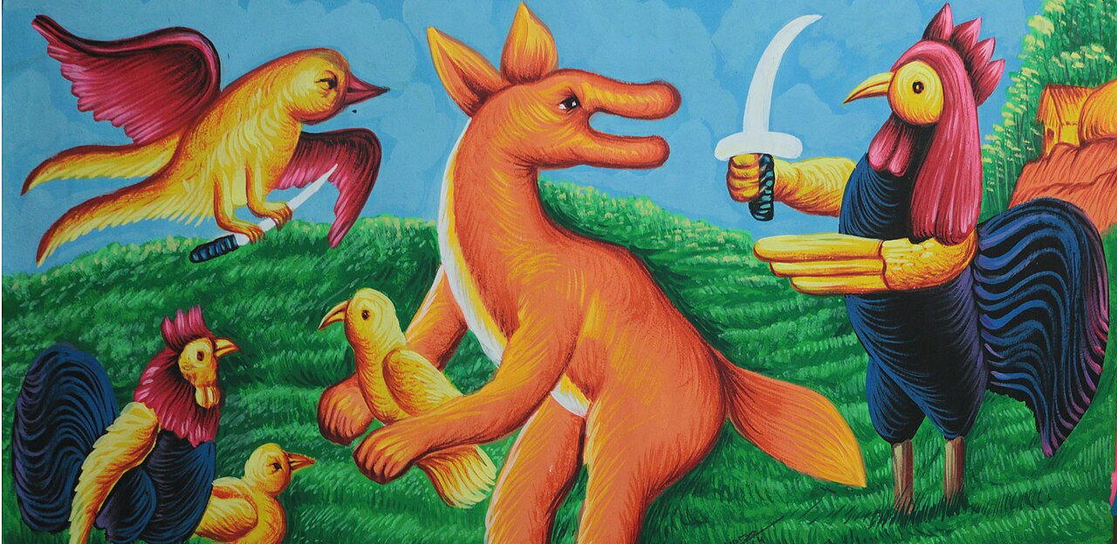

Slide 10
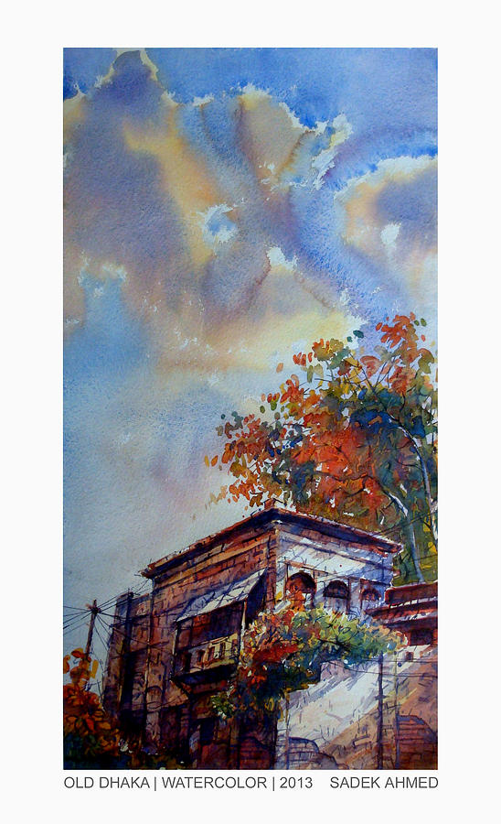
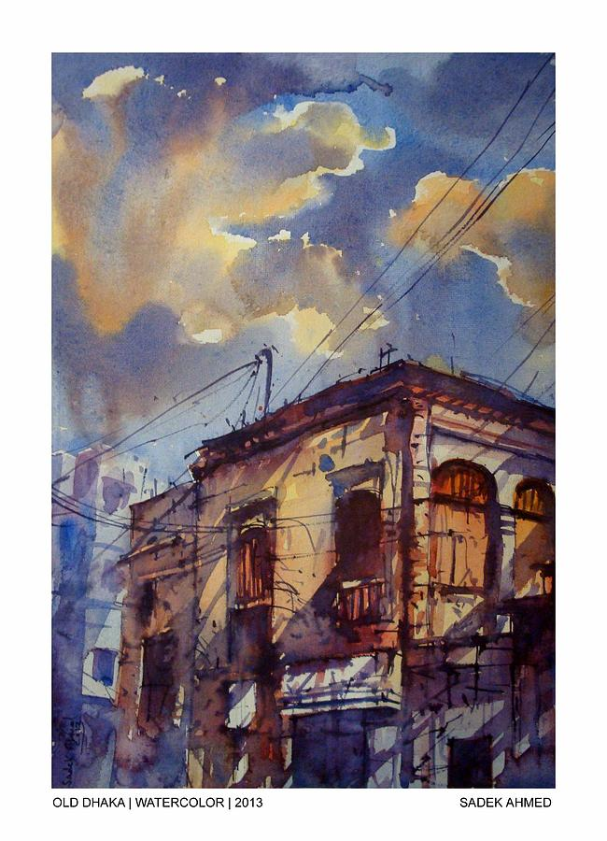
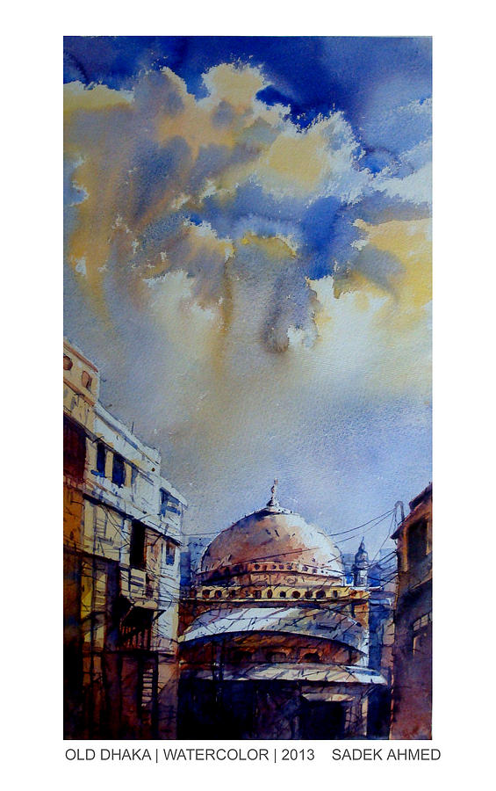

Slide 11
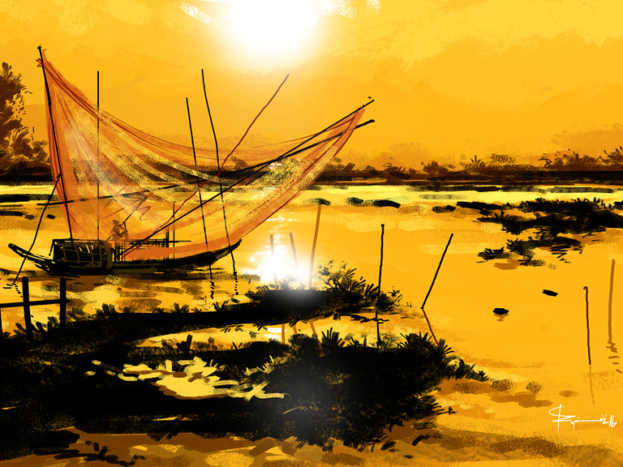

Slide 12
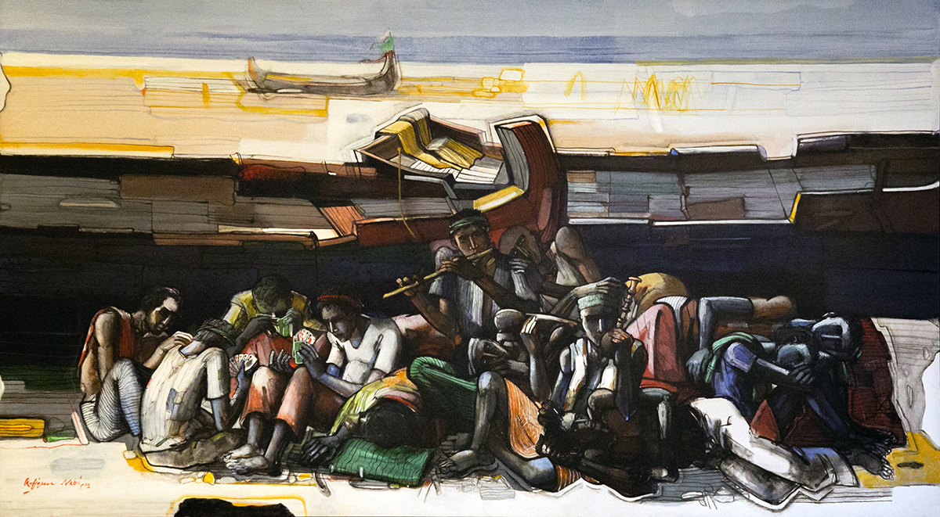

Slide 13
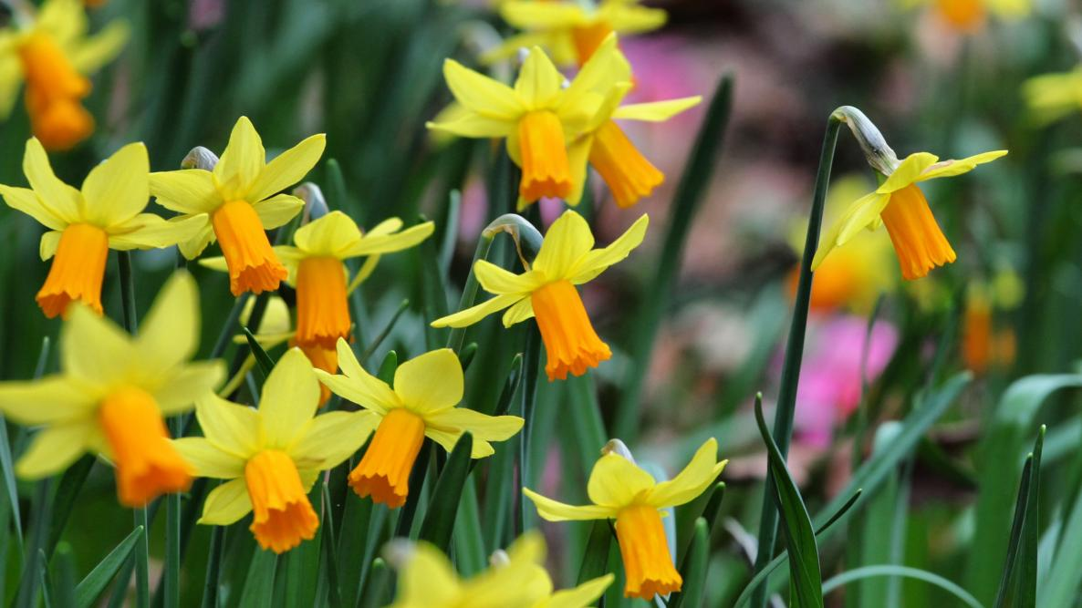

Slide 14
To Daffodils BY ROBERT HERRICK
Fair Daffodils, we weep to see
You haste away so soon;
As yet the early-rising sun
Has not attain'd his noon.
Stay, stay,
Until the hasting day
Has run
But to the even-song;
And, having pray'd together, we
Will go with you along.
We have short time to stay, as you,
We have as short a spring;
As quick a growth to meet decay,
As you, or anything.
We die
As your hours do, and dry
Away,
Like to the summer's rain;
Or as the pearls of morning's dew,
Ne'er to be found again.

Slide 15
Any Other Questions?

