Slide 1
Business Law and the Legal Environment
Chapter 1: Introduction to Law and Legal Systems

Slide 2
Introduction
Law has different meanings as well as different functions. Philosophers have considered issues of justice and law for centuries, and several different approaches, or schools of legal thought, have emerged.
In this chapter, we will look at those different meanings and approaches and will consider how social and political dynamics interact with the ideas that animate the various schools of legal thought. We will also look at typical sources of “positive law” in the United States and how some of those sources have priority over others, and we will set out some basic differences between the US legal system and other legal systems.

Slide 3
What Is Law?
Law is a word that means different things at different times. Black’s Law Dictionary says that law is “a body of rules of action or conduct prescribed by controlling authority, and having binding legal force. That which must be obeyed and followed by citizens subject to sanctions or legal consequence is a law.”Black’s Law Dictionary, 6th ed., s.v. “law.”

Slide 4
Functions of the Law
In a nation, the law can serve to
(1) keep the peace,
(2) maintain the status quo,
(3) preserve individual rights,
(4) protect minorities against majorities,
(5) promote social justice, and
(6) provide for orderly social change. Some legal systems serve these purposes better than others.
Although a nation ruled by an authoritarian government may keep the peace and maintain the status quo, it may also oppress minorities or political opponents (e.g., Burma, Zimbabwe, or Iraq under Saddam Hussein).
Under colonialism, European nations often imposed peace in countries whose borders were somewhat arbitrarily created by those same European nations. Over several centuries prior to the twentieth century, empires were built by Spain, Portugal, Britain, Holland, France, Germany, Belgium, and Italy. With regard to the functions of the law, the empire may have kept the peace—largely with force—but it changed the status quo and seldom promoted the native peoples’ rights or social justice within the colonized nation.

Slide 5
Sources of Law
In the Bangladesh today, there are numerous sources of law. The main ones are
(1) constitutions—
(2) statutes and regulations, and
(3) judicial decisions.
In addition, chief executives (the president and the various governors) can issue executive orders that have the effect of law.
Commercial law in Bangladesh governs the various aspects of business transactions and regulates the conduct of individuals and corporations engaged in commercial activities. The law is based on several statutes, including
1. the Companies Act, 1994
2. Partnership Act, 1932
3. Contract Act, 1872
4. Sales of Goods Act, 1930
and others.

Slide 6
In international legal systems, sources of law include
1. treaties (agreements between states or countries) and what is known as customary international law (usually consisting of judicial decisions from national court systems where parties from two or more nations are in a dispute).
As you might expect, these laws sometimes conflict: a state law may conflict with a Constitutional law, or a any other laws might be contrary to an international obligation. One nation’s law may provide one substantive rule, while another nation’s law may provide a different, somewhat contrary rule to apply.
Not all laws, in other words, are created equal. To understand which laws have priority, it is essential to understand the relationships between the various kinds of law.

Slide 7
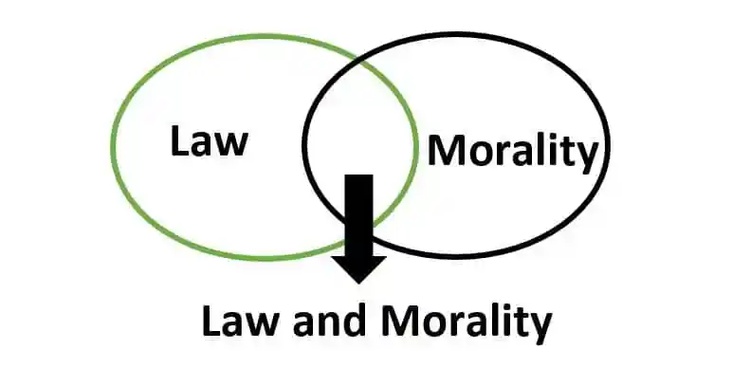
Relationship Between Law And Morality

Slide 8
Law and morality-
We have definitely heard these two terms in our daily life. However law and morality have two different meanings, but if we talk about jurisprudence, it shows the relationship between law and morality. In this article on the relationship between law and morality, we will understand this relationship with the help of definitions and some case laws.
What Is The Law?
As per the definition of law: the law is a set of rules and principles that is created by the state to regulate human conduct.
In simple words, the law is a bunch of rules and regulations which are made by our legislature and in force by the executive so that the people should act according to the law.
What Is Molarity?
As per the definition of morality: morality is the set of principles, beliefs and behaviour standards created and enforced by society.
In simple words, morality is a set of principles and moral values which were created by our ancestors.
For example, if somebody helps a person who is drawing in the water, it shows his morality.

Slide 9
Distinction between Law and Morality
Law and morality are related concepts, but they are distinct from each other. Law refers to a set of rules and regulations that are enforced by the state or other governing authority, while morality refers to a set of principles or values that guide individuals' behavior and judgments about what is right or wrong.
1. One of the main differences between law and morality is that law is enforceable by the state, whereas morality is not. This means that breaking the law can result in legal consequences, such as fines or imprisonment, while breaking moral principles may result in social disapproval or moral condemnation.
2. Another difference is that laws are created and enforced by a governing authority, while morality is shaped by various factors, including cultural norms, religion, philosophy, and personal beliefs. The law is typically a product of a formal legal process, such as legislation or court rulings, while morality is often influenced by informal sources, such as family and community values.

Slide 10
4. Furthermore, the consequences of violating the law and violating moral principles can be different. For example, violating the law against theft may result in a criminal record and imprisonment, while violating the moral principle against lying may result in a loss of trust and respect

