Slide 1
Virtual Memory
Virtual memory – separation of user logical memory from physical memory.
Only part of the program needs to be in memory for execution
Logical address space can therefore be much larger than physical address space
Allows for more efficient process creation
Virtual memory can be implemented via:
Demand paging
Demand segmentation

Slide 2
Virtual Memory Diagram
Fig. 9.1, p.291
virtual memory
page 0
page 1
page 2
page 3
secondary storage
memory map
physical memory
page n

Slide 3
What is VM?
Program:
....
Mov AX, 0xA0F4
....
Table
(one per
Process)
0xA0F4
Mapping
Unit
(MMU)
0xC0F4
Virtual
Address
„Piece“ of Virtual Memory
Physical Memory
„Piece“ of Physical Memory
Physical
Address
Virtual Memory
‹#›

Slide 4
1.1 Why Virtual Memory (VM)?
Shortage of memory
Efficient memory management needed
Process may be too big for physical memory
More active processes than physical memory can hold
Requirements of multiprogramming
Efficient protection scheme
Simple way of sharing
Process 3
Process 2
Process 4
Process 1
OS
Memory
‹#›

Slide 5
1.3 The Mapping Process
Usually every process has its own mapping table
Not every „piece“ of VM has to be present in PM
„Pieces“ may be loaded from HDD as they are referenced
Rarely used „pieces“ may be discarded or written out to disk (→ swapping)
check using mapping table
piece
in physical
memory?
OS brings
„piece“ in
from HDD
virtual
address
memory
access fault
yes
OS adjusts
mapping
table
physical
address
translate
address
MMU
‹#›

Slide 6
Demand Paging
Bring a page into memory only when it is needed
Less I/O needed
Less memory needed
Faster response
More users
Page is needed ⇒ reference to it
invalid reference ⇒ abort
not-in-memory ⇒ bring to memory

Slide 7
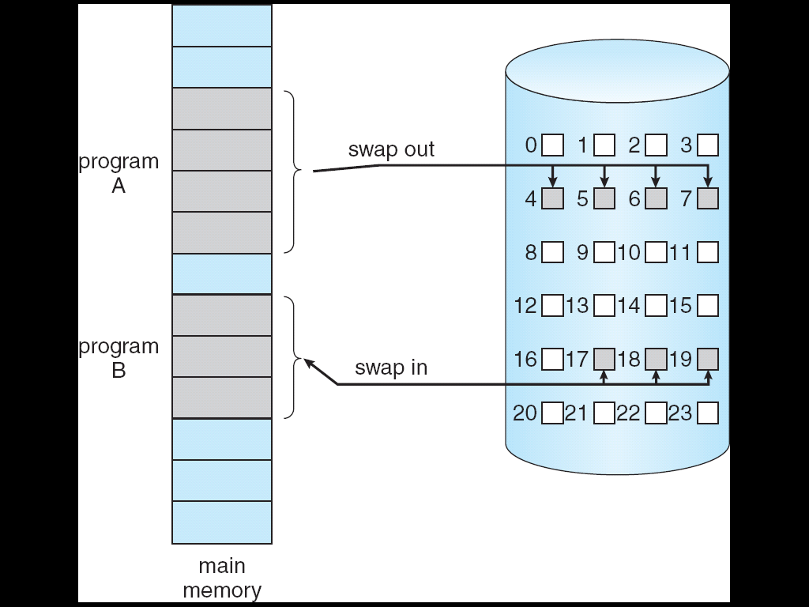
Transfer of a Paged Memory to Contiguous Disk Space

Slide 8
To replace pages or segments of data in memory. Swapping is a useful technique that enables a computer to execute programs and manipulate data files larger than main memory. When the operating system needs data from the disk, it exchanges a portion of data (called a page or segment ) in main memory with a portion of data on the disk.
DOS does not perform swapping, but most other operating systems, including OS/2, Windows, and UNIX, do.
Swapping is often called paging.
When set of paged data sets moved from auxiliary storage to
real storage during execution of any job is called swap-in.
Reverse is swap out.

Slide 9
What is a process
We typically mean that a process is a running program
A better definition is that a process is the state of a running program
Now we have a really good definition of the state of a running program
A program counter
A page table
Register values

Slide 10
Address Translation
Physical Memory
CPU
A.1
@8190
B.1
C.1
A.2
virtual
addresses
0-4095
4096-8191
8192-12287
12288-16384
C.4
address
translation
C.6
Process A
B.2
A.1
B.3
A.2
A.3
A.4
A.3
A.4
C.2
Disk
C.3
C.5
. . .
. . .

Slide 11
Example
Process A
Physical Memory
A.1
A.2
A.3
A.4
Process B
B.1
B.2
B.3
Process C
C.1
C.2
C.3
Disk
C.4
C.5
C.6

Slide 12
Example: Memory Snapshot
Process A
Physical Memory
A.1
A.2
A.1
A.3
B.1
A.4
C.1
A.3
Process B
C.4
C.6
B.1
B.2
B.2
B.3
B.3
Process C
C.1
A.2
C.2
A.4
C.3
C.2
Disk
C.4
C.3
C.5
C.5
C.6
. . .
. . .

Slide 13
Memory Protection
Process A
Physical Memory
A.1
A.2
A.1
A.3
B.1
A.4
C.1
A.3
Process B
C.4
B.1
C.6
B.2
B.2
B.3
B.3
Process C
C.1
A.2
C.2
A.4
C.3
C.2
Disk
C.4
C.3
C.5
C.5
C.6
. . .
. . .
Virtual memory ensures protection
Process A cannot cannot read/write into the memory of process B
As we’re going to see, this is easily enforced by the virtual memory address translation scheme

Slide 14
Paging
Each process has its own page table
Each page table entry contains the frame number of the corresponding page in main memory
A bit is needed to indicate whether the page is in main memory or not
‹#›

Slide 15
Page Tables
The entire page table may take up too much main memory
Page tables are also stored in virtual memory
When a process is running, part of its page table is in main memory
‹#›

Slide 16
Page Size
Smaller page size, less amount of internal fragmentation
Smaller page size, more pages required per process
More pages per process means larger page tables
Larger page tables means large portion of page tables in virtual memory
‹#›

Slide 17
Page Faults
A miss in the page table is called a page fault
When the “valid” bit is not set to 1, then the page must be brought in from disk, possibly replacing another page in memory

Slide 18
VM:Sharing
„Pieces“ of different processes mapped to one single „piece“ of physical memory
Piece 0
Piece 0
Piece 0
Piece 1
Piece 1
Piece 1
Piece 2
Piece 2
Piece 2
Physical
memory
shared
memory
Virtual memory
Process 1
Virtual memory
Process 2
‹#›

Slide 19
VM: Advantages
VM supports
Swapping
Rarely used „pieces“ can be discarded or swapped out
„Piece“ can be swapped back in to any free piece of physical memory large enough, mapping unit translates addresses
Protection
Sharing
Common data or code may be shared to save memory
Code can be placed anywhere in physical memory without relocation (adresses are mapped!)
‹#›

Slide 20
VM: Disadvantages
Memory requirements (mapping tables)
Longer memory access times (mapping table lookup)
‹#›

