Slide 1

Hierarchy in garment industry
Hierarchy: A system with grades of authority status from highest to the lowest
1. Grade I-C : Chairman
2. Grade II-MD: Managing Director
3. Grade III-ED: Executive Director
4. Grade IV-D’S: Directors ( Administration, Finance,
Merchandising, Etc.)
5. Grade V-GM : General Manager ( Administration,
Finance, . Merchandising, Etc.)

Slide 2
Hierarchy in garment industry
6. Grade VI-M’S : Managers ( Administration, Finance,
Merchandising, Etc.)
7. Grade VII-Asst. M’S: Assistant Managers
( Administration, Finance, Merchandising, Etc.)
8. Grade VIII-LC : Line Chief (A, B, C Categories)
9. Grade IX-S & I : Supervisors & Inspectors
10. Grade X-O & W: Operators & Workers

Slide 3
Different sections in a garment industry and their functions
Sample Section:
i) Sample making
ii) Pattern making and grading
Cutting Section:
i) Marker making
ii) Fabric spreading
iii) Fabric cutting
Sewing Section:
i) Apparel assembling and checking
ii) In-line Inspection
iii) Repair the defective goods
Finishing Section:
i) Ironing, measuring, folding, packing
ii) Final Inspection

Slide 4
Different sections in a garment industry
Store Section:
i) Store the materials for order
ii) Issue and supply the materials to production unit
iii) Prepare Inventory report
Maintenance Section:
i) Store the spare and repair parts
ii) Supply and repair to the production unit as per requirements
iii) Routine maintenance to avoid break down.

Slide 6
Sample
Sample is the reference garments corresponds to
    The artwork (styling) done by designer and/or developer
    Particular purchase order
    Any revision to the style work
    Conform with any specific requirement, etc.

Slide 7
Flowchart of Sampling Process
Receive artwork/ Reference garment
Select size
Pattern making
Fabric cutting
Print/Embroidery (If any)
Sewing
Finishing
Packing
Send to buyer for approval/review

Slide 8
Responsibilities of Sample Section
Sample department of apparel manufacturing industry has to maintain the below responsibilities:
  Getting clarifications about style details from the merchandiser,
  Checking Pattern’s work-ability,
  Preparation of different samples and getting the buyer’s approval,
  Informing quality related problems, encountered during preparing samples to QC,
  Minimizing operations and consumption.

Slide 9
Different types of samples
Sampling process varies from buyer to buyer, and type of style as well, but in industry there is particular order of sampling is followed, the stages and purpose of sample may be same but terminology used may be different and it totally depend upon buyer.
The typical samples name and Chronology are described as:

Slide 10
Sequence of sampling
Proto Sample/Development Sample/First Pattern
Second (Proto/development/First pattern)
Fit Sample
Counter sample
Salesman Sample (SMS)
Ad / Photo sample
Test Sample

Slide 11
Sequence of sampling
    Size set sample
    Approval Sample / mock-up
    Pre-production sample
    Top of production (TOP) sample
    Production Sample
    Shipping sample

Slide 12
Sequence of sampling (Proto Sample)
Proto Sample /development sample/First Pattern:
    The first physical version of any garment as per the artwork done by designer and/or developer
    Normally, buyer send proto sample request to 2-3 factories.
    Proto sample is developed at very initial stage and normally order is confirmed to the factory based on proto sample only.

Slide 13
Proto Sample (development sample/First Pattern):
    Human mind Sketch paper pattern sample
    Purpose : To see the design work and test the fitting
    Status : Nothing specific
    Material : Available (If actual fabric is not available)
    Price : Not confirmed
    Quantity : 1 (for buyer)+ 1 (for self keeping)
    Delivery : As per urgency

Slide 14
Sequence of sampling(Second Proto Sample)
Second (Proto/development/First pattern):
    If buyer does not approve the proto sample, factory needs to submit the 2nd proto sample to get approval.
    Usually designer/developer always asks for some changes to the development/first pattern sample. Second pattern sample is made as per the comments on first pattern sample.
    Purpose : To be sure that that factory has understood well the changes designer wanted
    Material : Available
    Price : Not confirmed
    Quantity : 1 (for buyer)+ 1 (for self keeping)

Slide 15
Sequence of sampling(Fit Sample)
    Fit Sample
Once proto get approved buyer asks to start working on fit sample.
Fit sample is made and send to conform the fit of the garment on live models or on dummy and for approval of construction details.
    Purpose : Buyer want tot be sure that factory understands thoroughly the construction and quality details and standards
    Material : Available
    Price : Not confirmed
    Quantity : 1 (for buyer)+ 1 (for self keeping)

Slide 16
Sequence of sampling (Counter)
Counter Sample:
  Suppliers has to develop a sample given by the buyer
    Purpose : To see the WORKMANSHIP and test the FACTORY SKILL
    Status : Nothing specific
    Material : Available
    Price : Not confirmed
    Quantity : 1 (for buyer)+ 1 ( for self keeping)
    Delivery : As per urgency

Slide 17
Sequence of sampling(Salesman)
Salesman Sample (SMS):
    Buyers held a meeting with its customer and record their response on order quantity per color and size. Order quantity may changed after sales meeting.
    The cost of sample production is given by buyer.
    Purpose : Sales meeting with retailers, market appraisal, order forecast, to collect the order from the retailers.
    Status : final stage of the order confirmation
    Material : Actual
    Price : Confirmed
    Quantity : Minimum 1 piece from each color
    Delivery : Very important to meet the delivery date

Slide 18
Sequence of sampling (Ad/photo)
    Ad/Photo Sample:
  In order to promote the new style in the market normally buyer asks for AD sample for photo shoot.
  Buyer uses this photo for marketing purpose either on catalogue or various media like, print, TV or websites to see the response of the consumer.
  This sample mainly sends in medium to large or sizes specified by buyer.

Slide 19
Sequence of sampling (Test Sample)
Test Sample
    Some buyer called this sample GPT (Garment Performance Test)
    The main purpose of Test sample is to perform the physical and chemical testing on garment to ensure the performance of the garment.
    Test Samples are made of actual material
    The tests are done on garments are: Shrinkage, Color Fastness, Seam performance etc.
    Normally, Test Sample is sent to 3rd party laboratory and results are sent to both factory as well as buyer.
    If same style is having 3-4 different colours then only one color sample is tested completely and other colours samples are tested i.e. only colour fastness tests are conducted. only with colour way test

Slide 20
Sequence of sampling (Size Set)
Size Set:
    The main purpose of size set sample is to check the factory's capability to make the sample in all sizes
    Consists one piece from each color and each size. If sizes are more in number then buyer may ask to skip some sizes, called jump size set sample.
    The samples can be made in the sample room or actual production floor, as required by the buyer.
    Purpose : To test fit of the garment in different sizes and different colours.
    Material : Actual
    Price : Confirmed
    Quantity : 1 set (for buyer)+ 1 set ( for self keeping)

Slide 21
Sequence of sampling(Approval / Mock up)
Approval Sample:
    In any discrete period of time, whenever buyer revise any specification, a new sample is made (some time mock up is workable too) as per new specification. It is sent to the buyer for his approval to ensure that the revision is done correctly

Slide 22
Sequence of Sampling (Approval / Mock up)
Mock up sample:
    Mock up means not a total garment, it’s a fixed part of a garment.
    If any part contains fault, then buyers requires a fault free that parts to be confirmed that the supplier is capable and understood the requirement.

Slide 23
Sequence of sampling (PP sample)
Pre-production sample
    When all the items/material for bulk production arrived, factory makes a sample with the actual material and send it to buyer for approving the production.
    PP Sample is the standard for production and bulk production garments should be identical to PP sample.
    The factory can start the production of bulk garment only after the approval of preproduction sample.
    PP sample sends in only one size 1-2 samples or specified by buyer.

Slide 24
Sequence of sampling (TOP sample)
Top of Production (TOP) Sample
  The top of production is sent to the buyer as soon initial pieces are come out of sewing line
  The purpose of TOP sample is to see that the factory producing right designed and right quality garment
  The top of production is sent to the buyer as soon initial pieces are come out of sewing line

Slide 25
Sequence of sampling (Production)
Production Sample:
    It is reference to the buyer that the bulk is being produced as per specification. Buyer want to be sure that the correct material is sourced and line workmanship conformed with the quality level
    All the above samples are made in sampling department. Buyer wants pre-production sample (PP sample) to be made in actual production line, so that operators know what they are going to make. This sample is made with actual fabric, trims and accessories and made by sewing line tailors.

Slide 26
Sequence of sampling (Shipping )
Shipping Sample:
    A sample is send to the buyer just after completion of final inspection so that buyer may know what types of garments he is going to receive.
    It also helps the buyer to settle the customs procedure earlier.
    Supplier kept one pieces as well so that he may refer in case of any dispute/claim

Slide 27
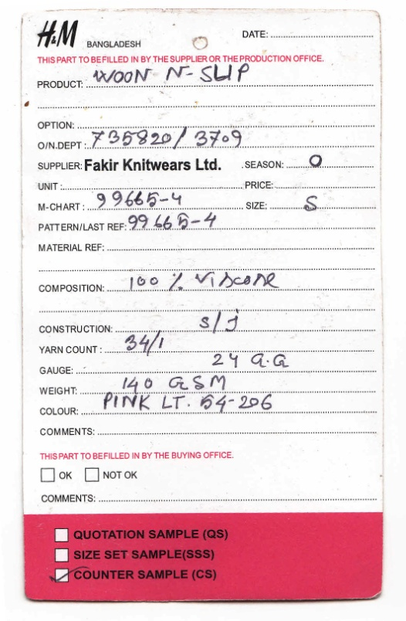
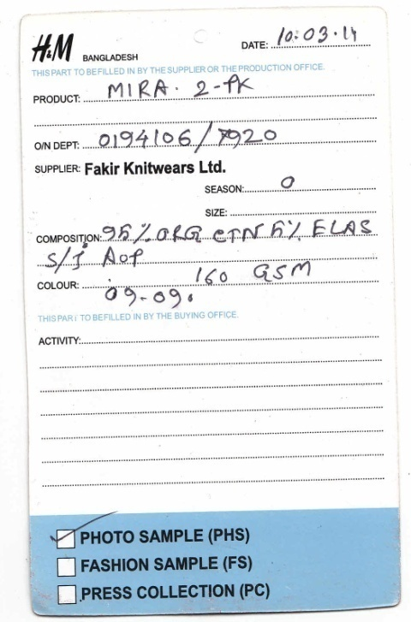
Sample Tag

Slide 28
Assessment of sample (Conti…)
Buyer assesses the sample and gives the feed back within 5 - 7 days to factory with respect to sample.
Feedback from the buyer is 3 types i.e.
i. Accepted,
ii. Accepted with comments and
iii. Rejected.
The rejection of sample may be due to following reasons:
  .

Slide 29
Assessment of sample:
  There could be one or more reasons for the sample rejection from buyer, these are:
  Sample made out of tolerance of measurement,
  Fitting problem,
  Fabric quality may not up to mark,
  Incorrect packaging,
  Incorrect size submission,
  Wrong style,
  Accessories,
  Workmanship, etc.

