Slide 1
Chapter Eleven
Pricing Strategies

Slide 2
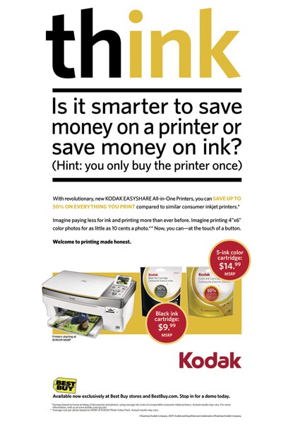
Pricing Products
Topic Outline
New-Product Pricing Strategies
Product Mix Pricing Strategies
Price Adjustment Strategies
Price Changes
Notes:
Check this

Slide 3
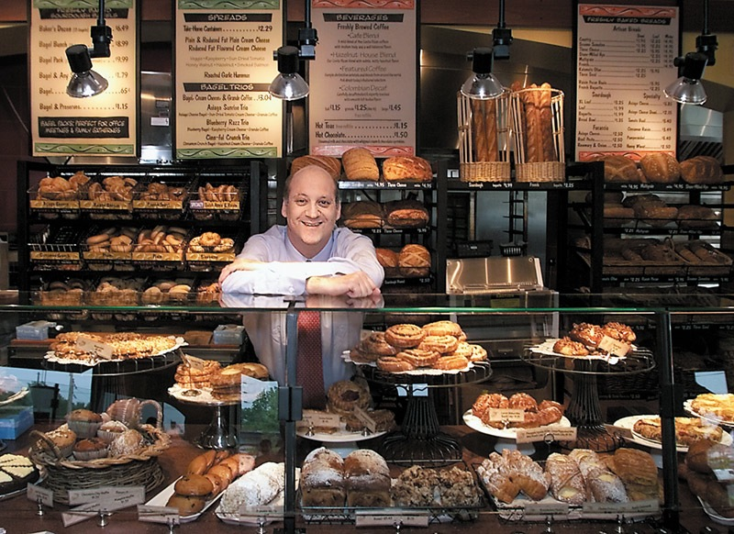
What Is a Price?
Price is the only element in the marketing mix that produces revenue; all other elements represent costs

Slide 4
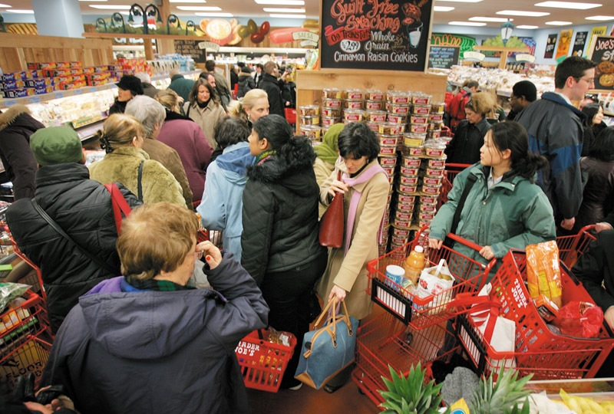
Customer Perceptions of Value
A price
Understanding how much value consumers place on the benefits they receive from the product and setting a price that captures that value

Slide 5
Price has many names:
Fee
Dues
Interest
Donation
Salary
Rent
Tuition
Fare
Rate
Commission
Wage
14-5

Slide 6
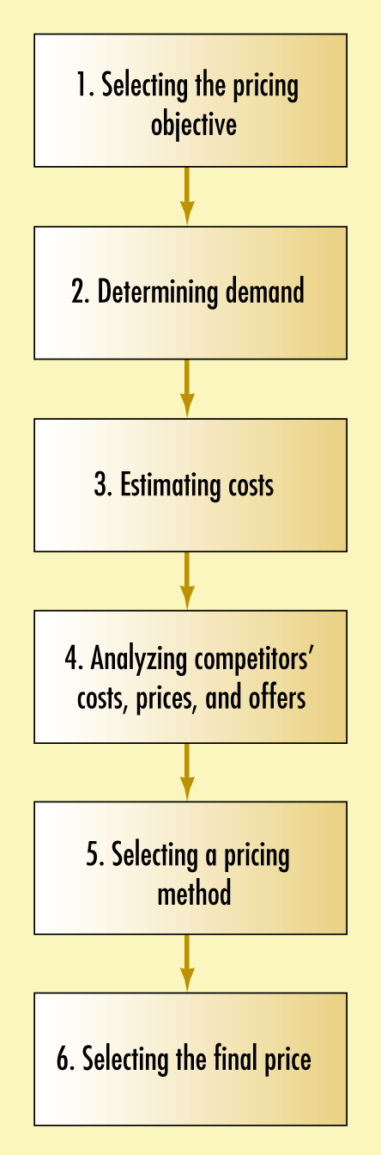
Steps in Setting Pricing
14-6

Slide 7
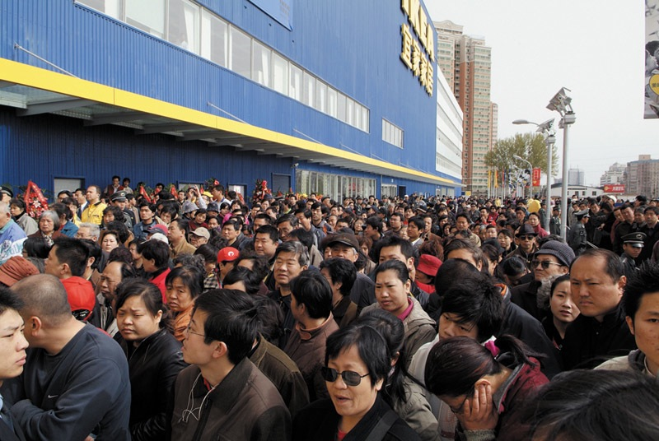
New-Product Pricing Strategies
Pricing Strategies
Market-skimming pricing
Market- penetration pricing

Slide 8
New-Product Pricing Strategies
Two Broad Strategies
Market skimming pricing – set a high initial price
Market penetration pricing – set a low initial price

Slide 9
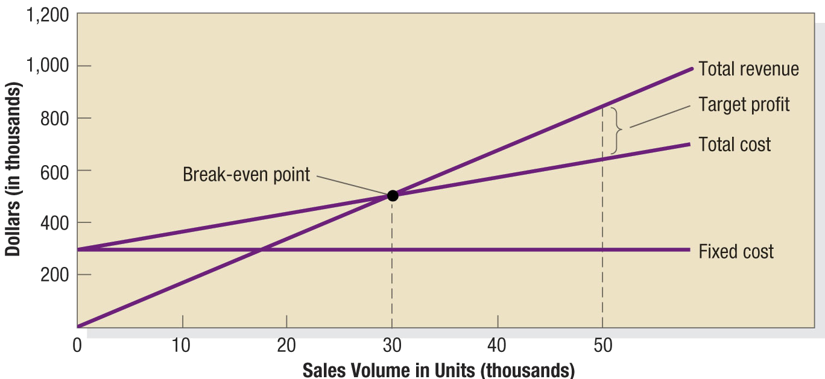
Figure 14.6 Break-Even Chart

Slide 10
New-Product Pricing Strategies
Market-skimming pricing is a strategy for setting a high price for a new product to skim maximum revenues layer by layer from the segments willing to pay the high price, the company make fewer but more profitable sales.
Product quality and image must support the price
Buyers must want the product at the price
Costs of producing the product in small volume should not cancel the advantage of higher prices
Competitors should not be able to enter the market easily

Slide 11
Market-skimming pricing
For example when Sony introduced the world first high definition television (HDTV) to the Japanese market , the high tech sets cost 43,000$ . These televisions were purchased only by customers who really wanted the new technology and afford to pay high prices.

Slide 12
New-Product Pricing Strategies
Pricing Strategies
Market-penetration pricing sets a low initial price in order to penetrate the market quickly and deeply to attract a large number of buyers quickly to gain market share
Price sensitive market
Production and distribution costs must fail as sales volume increases.
Low prices must keep competition out of the market
Notes:
Note to Instructor
The text gives an excellent example of IKEA in China:
When IKEA first opened stores in China in 2002, people crowded to take advantage of the freebies—air conditioning, clean toilets, and even decorating ideas.
Chinese consumers are famously frugal. When it came time to actually buy, they shopped instead at local stores just down the street that offered knockoffs of IKEA’s designs at a fraction of the price.
So IKEA slashed its prices in China to the lowest in the world.
The penetration pricing strategy worked. IKEA now captures a 43 percent market share of China’s fast-growing home wares market.

Slide 13
Market-penetration pricing
For example , Dell used penetration pricing to enter the personal computer market, selling high quality computer products through lower cost direct channels.

Slide 14
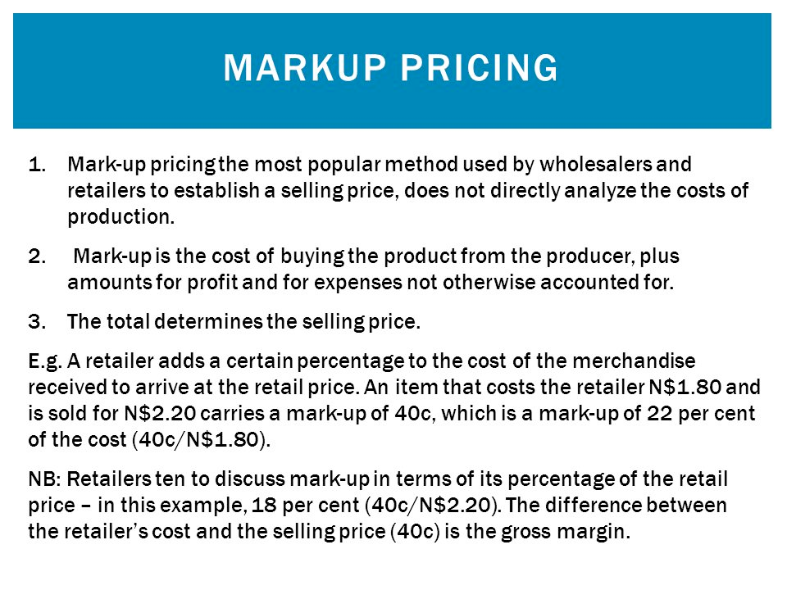

Slide 15
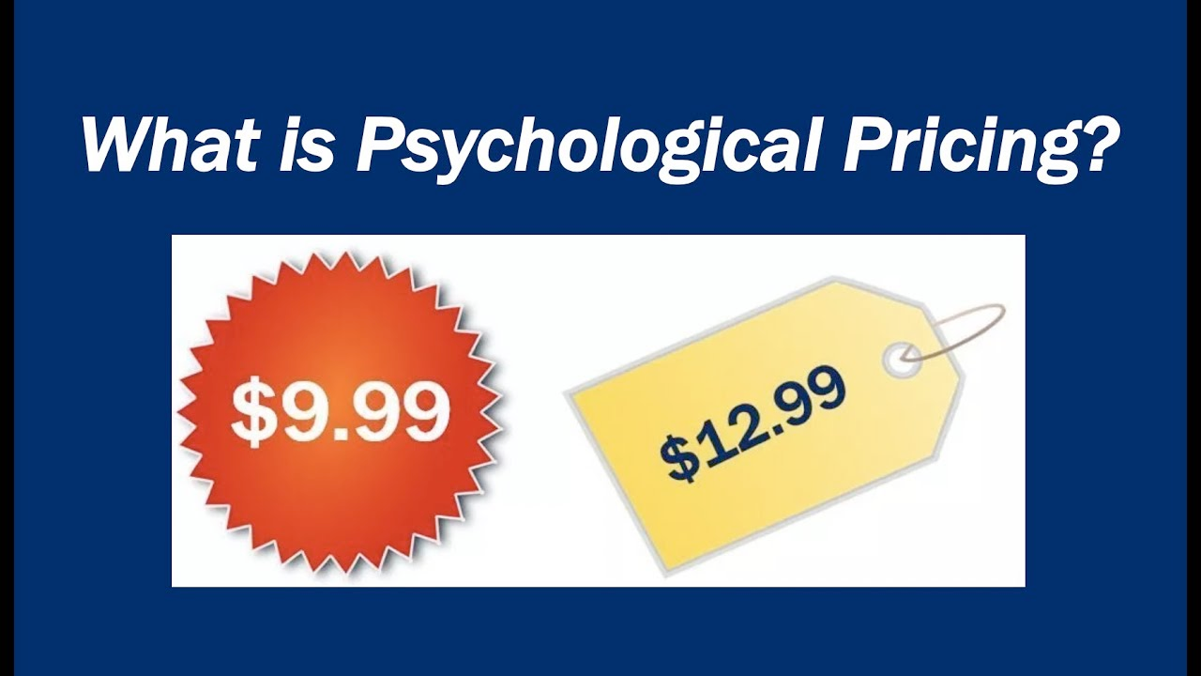

Slide 16
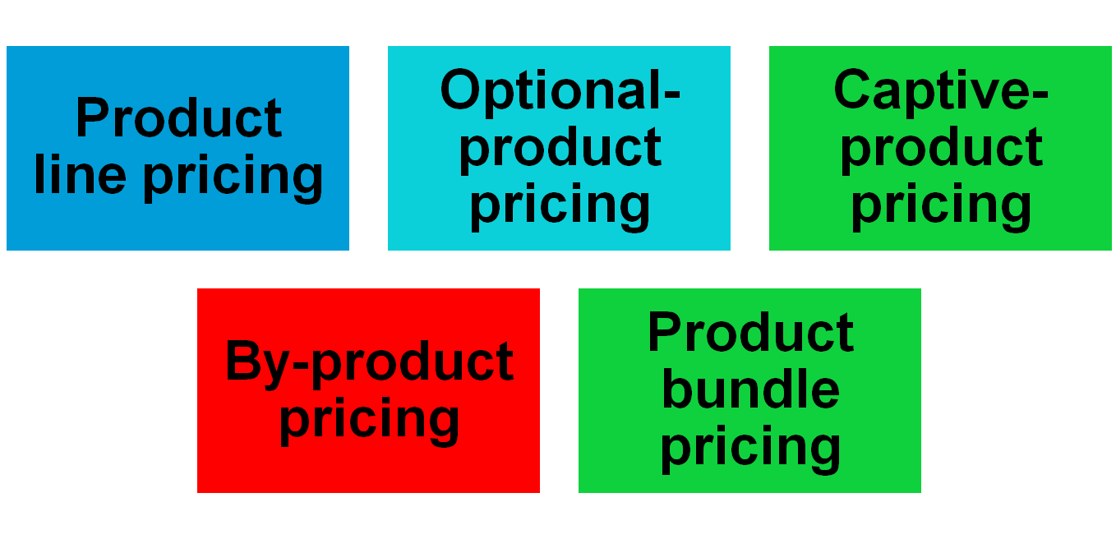
Product Mix Pricing Strategies
Pricing Strategies

Slide 17

Product Mix Pricing Strategies
Pricing Strategies
Product line pricing takes into account the cost differences between products in the line, customer evaluation of their features, and competitors’ prices
* For example channel offers 20 different collections of bags of all shapes and sizes at price that range from under $50 to more than $1,250.
Notes:
Note to Instructor
This Web link brings you to Bluemountain.com. Many students may know this site for its free greeting cards. Notice how they have product line pricing—you can get some basic cards for free but need to join to be able to use more advanced features.

Slide 18
Product Mix Pricing Strategies
Pricing Strategies
Optional-product pricing takes into account optional or accessory products along with the main product
For example : a car buyer may choose to order a GPS navigation system & Bluetooth wireless communication.
Refrigerators come with optional ice maker

Slide 19
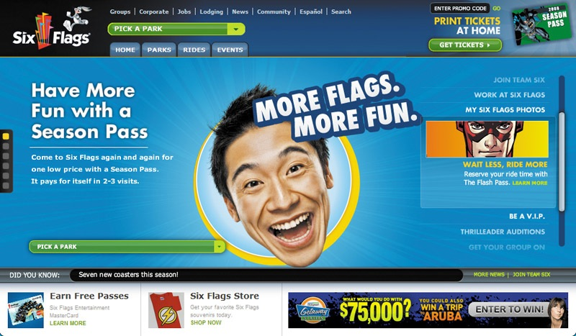
Product Mix Pricing Strategies
Pricing Strategies
Captive-product pricing involves products that must be used along with the main product
Examples of Captive products are razor blade cartridges , Gillette once you bought the razor, you are committed to buying replacement cartridges at $25 an eight pack
Notes:
Note to Instructor
Students will quickly realize this is what their cell phone bill might be. Ask them how they feel about this pricing. This Web link goes to an ad for AT&T’s campaign for rollover minutes.

Slide 20
Product Mix Pricing Strategies
Pricing Strategies
Two-part pricing involves breaking the price into:
  Fixed fee
  Variable usage fee
  For example : Jawwal company charge a flat rate for a basic calling plan, then charge for minutes over what the plan allows.
  The service firm must decide how much to charge for the basic service and how much for the variable usage.
  Another example is when you visit a park , you pay a ticket charge + fee for food and additional features

Slide 21
Price Mix Pricing Strategies
Pricing Strategies
By-product pricing refers to products with little or no value produced as a result of the main product. Producers will seek little or no profit other than the cost to cover storage and delivery.
petroleum products often results in by-products. *bread Cramps

Slide 22
Price Mix Pricing Strategies
Pricing Strategies
Product bundle pricing combines several products at a reduced price
For example : fast food restaurants bundle a burger, fries and a soft drink at a combo price

Slide 23

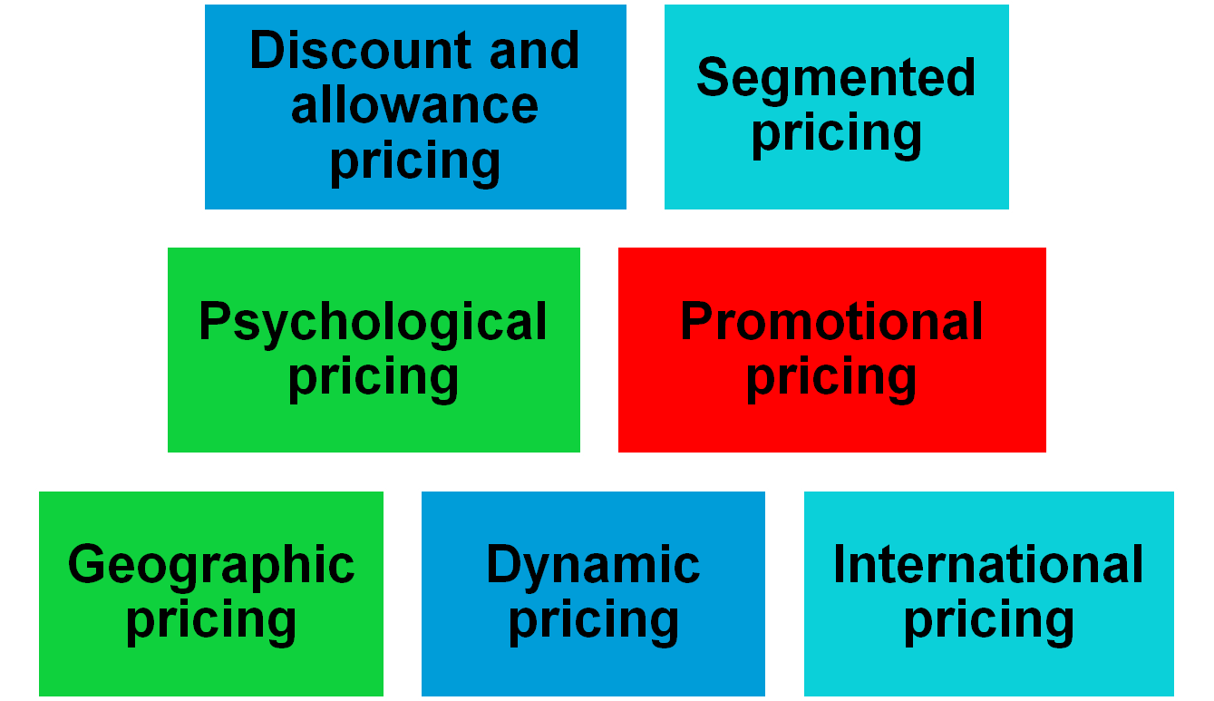
Price-Adjustment Strategies
Notes:
Note to Instructor
In slideshow view, click on movie icon to launch General Electric video snippet. See accompanying DVD for full video segment

Slide 24
Price-Adjustment Strategies
Pricing Strategies
Discount and allowance pricing reduces prices to reward customer responses such as paying early or promoting the product
Discounts
Allowances
Notes:
Note to Instructor
Discounts are either cash discount for paying promptly, quantity discount for buying in large volume, or functional (trade) discount for selling, storing, distribution, and record keeping.
Allowances include trade-in allowance for turning in an old item when buying a new one and promotional allowance to reward dealers for participating in advertising or sales support programs.

Slide 25
Price-Adjustment Strategies
Price Discounts and Allowances
Quantity discount: The more you buy, the cheaper it becomes-- cumulative and non-cumulative.
Trade discounts” functional”: Reductions from list for functions performed-- storage, promotion.
Cash discount: A deduction granted to buyers for paying their bills within a specified period of time, (after first deducting trade and quantity discounts from the base price)

Slide 26
Price-Adjustment Strategies
Functional discount: discount offered by a manufacturer to trade-channel members if they will perform certain functions.
Seasonal discount: a price reduction to those who buy out of season.
Allowance: an extra payment designed to gain reseller participation in special programs.
Trade in allowances: are price reductions given for turning in an old item when buying a new one ( Automobiles industry)
Promotional allowances: are payments or price reductions to reward dealer for participating in advertising and sales support program

Slide 27

Price-Adjustment Strategies
Pricing Strategies
Segmented pricing is used when a company sells a product at two or more prices even though the difference is not based on cost
Notes:
Note to Instructor
The three types of segmented pricing are:
Customer segment pricing is when different customers pay different prices for the same product or service.
Product form segment pricing is when different versions of the product are priced differently but not according to differences in cost.
Location pricing is when the product sold in different geographic areas is priced differently even though the cost is the same.

Slide 28
Segmented pricing
Customer segment pricing: different customers pay different prices for the same product or service . For ex. Museums charge a lower admission for students .
Product from pricing: different versions of the product are priced differently but not according to differences in their costs
Location pricing: company charges different prices for different locations
Time pricing : a firm varies it prices by the season , the month , the day and even the hour

Slide 29
Price-Adjustment Strategies
Pricing Strategies
Segmented Pricing
To be effective:
Market must be segmentable
Segments must show different degrees of demand
Watching the market cannot exceed the extra revenue obtained from the price difference
Must be legal
Notes:
Note to Instructor
Discussion Question
How have you benefited from price segmentation?
Most likely they have had student discounts. Ask them why that is effective given the criteria above.

Slide 30
Price-Adjustment Strategies
Pricing Strategies
Psychological pricing occurs when sellers consider the psychology of prices and not simply the economics” the price is used to say something about the product”
Reference prices are prices that buyers carry in their minds and refer to when looking at a given product
  Noting current prices
  Remembering past prices
  Assessing the buying situations
  For example : a company could display its product next to more expensive ones in order to imply that it belongs in the same class
Notes:
Note to Instructor
Discussion Question
How well do you carry prices of coffee, pizza, and milk in your head?
It might be interesting to collect the prices of items sold near or on campus including coffee, pizza, and sandwiches. Ask them how well they know these prices, have them write down the price of these items and then check themselves. You will often find that people do NOT know prices as well as they think they do.

Slide 31
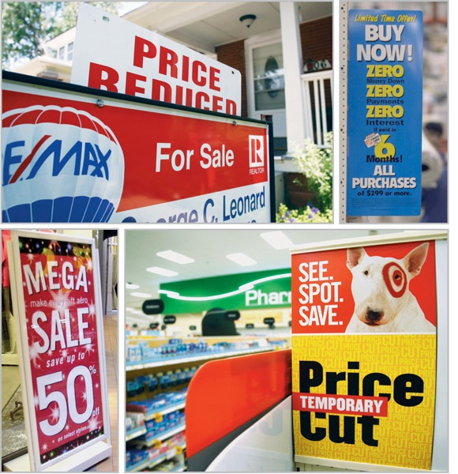
Price-Adjustment Strategies
Pricing Strategies
Promotional pricing is when prices are temporarily priced below list price or cost to increase demand
Loss leaders
Special event pricing
Cash rebates
Low-interest financing
Longer warrantees
Free maintenance
Notes:
Note to Instructor
Loss leaders are products sold below cost to attract customers in the hope they will buy other items at normal markups.
Special event pricing is used to attract customers during certain seasons or periods.
Cash rebates are given to consumers who buy products within a specified time.
Low-interest financing, longer warrantees, and free maintenance lower the consumer’s “total price.”

Slide 32
Price-Adjustment strategies
Promotional Pricing
Loss-leader pricing: supermarkets and department stores often drop the price on well known brands to stimulate additional store traffic
Special-event pricing: sellers well establish special pricing in certain seasons to draw in more customers
Cash rebates: companies offer cash rebates to encourage purchase of the manufacturers products within a specified time period
Low-interest financing: the company can offer customers low-interest financing

Slide 33
Price-Adjustment strategies
Longer payment terms: sellers especially mortgage banks and auto companies stretch loans over longer periods and thus lower the monthly payment
Warranties and service contracts: companies can promote sales by adding a free or low cost warranty or service contract

Slide 34
Price-Adjustment Strategies
Pricing Strategies
Risks of promotional pricing
Used too frequently, and copies by competitors can create “deal-prone” customers who will wait for promotions and avoid buying at regular price
Creates price wars

