Slide 1
Global Marketing
John L Graham
Farhana Noor
Assistant Professor
Daffodil International University

Slide 2
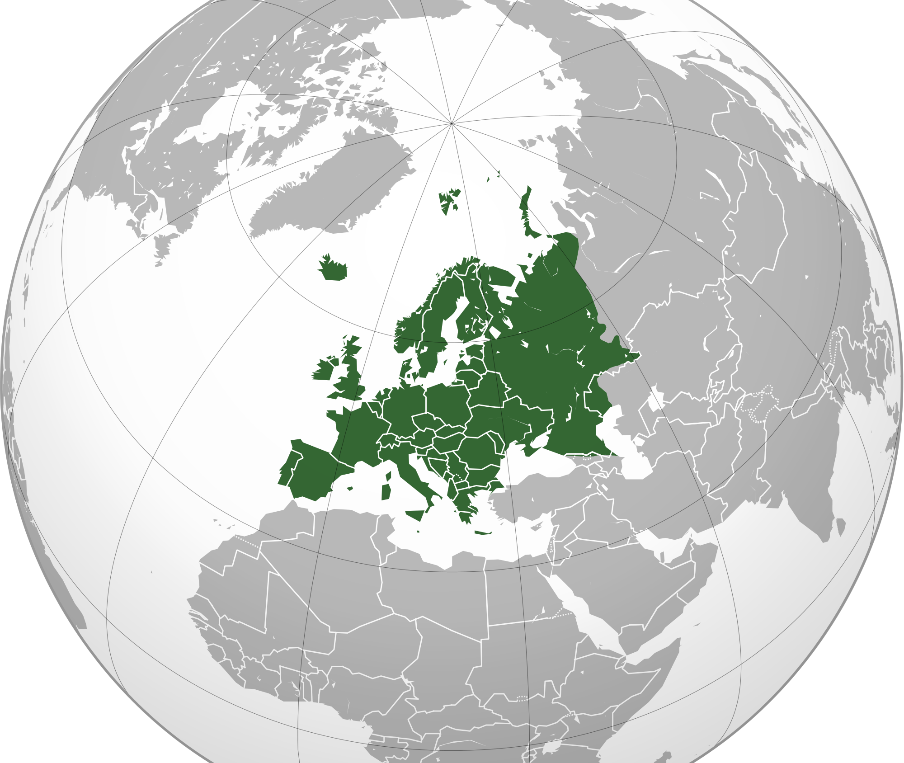
Chapter-1
The Scope & challenge of international marketing.

Slide 3
Definition:
Global Marketing:Is the performance of the business activities designed to plan, promote, price and direct the flow of a company's goods and services to consumers users in more than one nation for profit.
International marketing:It is the performance of business activities designed to plan, price, promote and direct the flow of a company’s goods and services to users in more than one nation for a profit.

Slide 5
International environmental forces
Marketing controllables: The successful manager
constructs a marketing program designed for optimal adjustment to the uncertainty of the business climate.
Domestic uncontrollables: This includes home country elements that can have a direct effect on the success of a foreign venture: political forces, legal structure, and economic climate.
Foreign uncontrollable: The problem of uncertainty is further complicated by a frequently imposed "alien status" that increases the difficulty of properly assessing and forecasting the dynamic international business climate.

Slide 6
Global awareness

Slide 7
Developing global awareness
.Tolerance of cultural differences:
- Understanding cultural differences and accepting and working with others whose behavior may be different.
· Knowledge of cultures, history, world market potential,global economic, social, and political trends
• Approaches to global awareness:
- Select individual managers specifically for their demonstrated global awareness
- Develop personal relationships in other countries
- Have a culturally diverse senior executive staff.

Slide 8
Stages Of International Marketing Involvement

Slide 11
Environmental Adaptation Needed
Be able to interpret effectively the influence and impact of the culture.
- Cultural adjustments.
Establish a frame of reference:
Avoid measuring and assessing markets against the fixed values and assumptions of your own culture

Slide 12
Environmental Adaptation Needed
Cross cultural misunderstanding: It can also occur when a simple hand gesture has a number of different meanings in different parts of the world.
Marketing relativism: Marketing strategy sensitive to the cultural complexities of foreign consumers focuses on the linguistic,moral, cultural,local differences that arise in various international contexts.

Slide 13
International marketing task
Marketing decision factors

Slide 14
Self-Reference Criterion (SRC)
Most international marketing research is hindered by the unconscious tendency to fall back on one's own cultural norms and values to interpret a given business situation'.
Worse than ethnocentrism; 4-step SRC correction mechanism:
1. Define the problem in home Country.
2. Define the problem in foreign Country.
3. Isolate the SRC effect and see how it interferes with the business problem.
4. Re-define the business problem without the SRC interference and identify the solution.

Slide 15
Self-Reference Criterion (SRC)
https://www.youtube.com/watch?v=ablixeCNYew
https://www.youtube.com/watch?v=Zq7mN8oi8ds
Surf Excel Adds Bangladesh Surf Excel Adds India

Slide 16
Thank You

