Slide 1

The Cultural, Political & Legal, Economic and geographical Environments

Slide 2

Environment of International Marketing

Slide 3
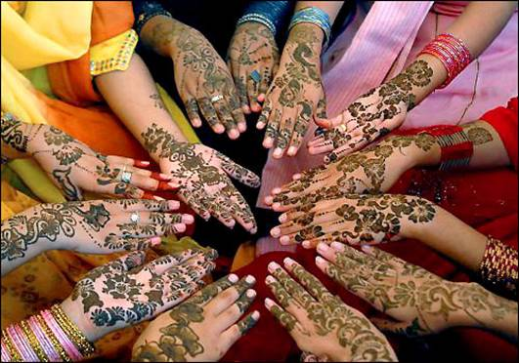
Bangladeshi Culture

Slide 4
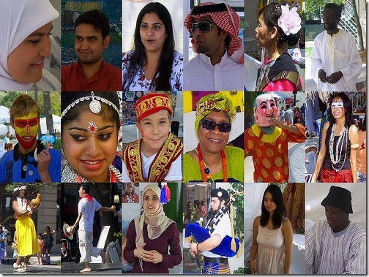
Cultural Environment
Culture defined: the specific learned norms of a society that reflect attitudes, values, and beliefs.

Slide 5

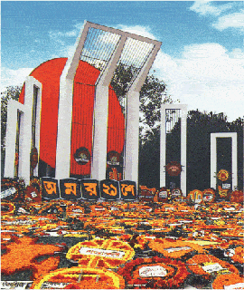
language

Slide 6
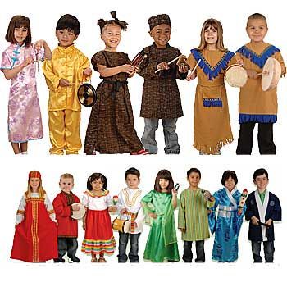
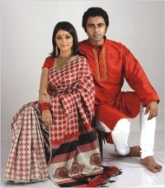
Clothing

Slide 7
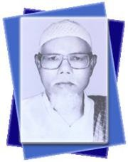

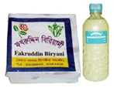
Food

Slide 8
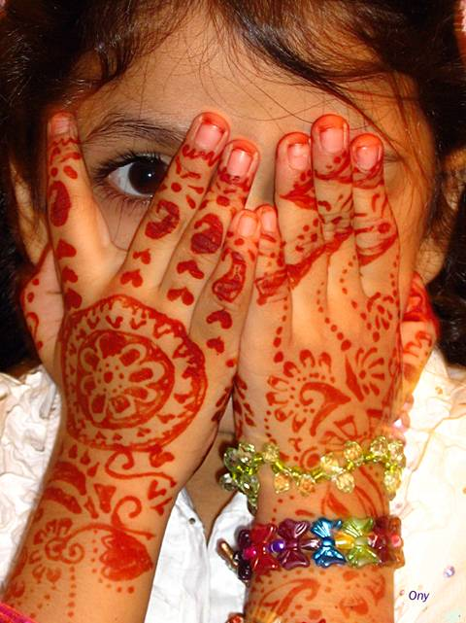
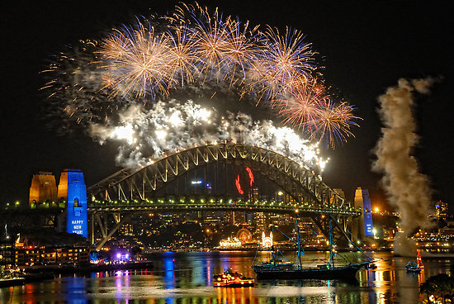
Festival

Slide 9
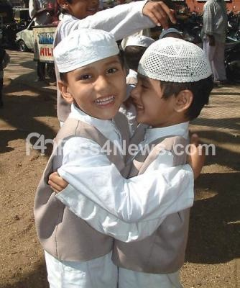
Religion

Slide 10
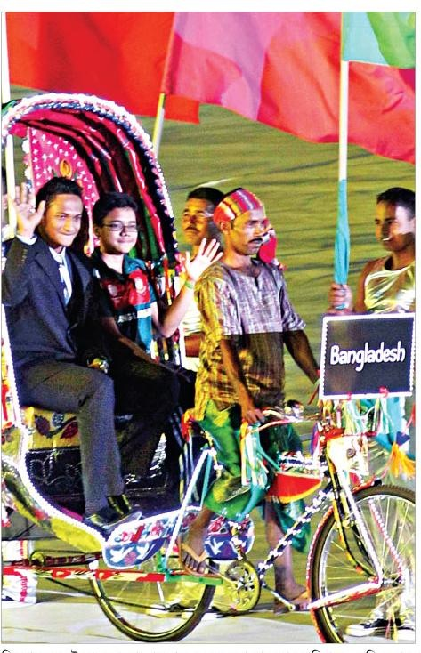
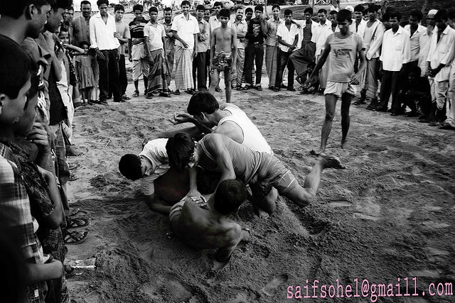
Game

Slide 11
Elements of Culture
Language
Food
Festival
Clothing
Game
Religion

Slide 12
Cultural Environment
Class Discussion
Culture problem in IM
Major problems of cultural collision are likely to occur if:
- a firm implements practices that do not reflect
local customs and values and/or. (2 days holiday)
-employees are unable to accept or adjust
to foreign customs. (HSBC-Bangladesh)
12/8/16

Slide 13
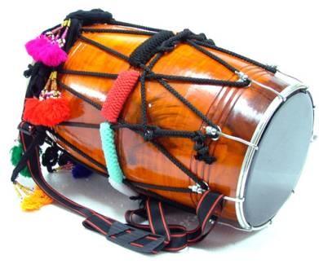
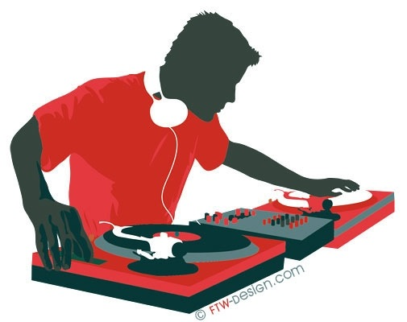
Cultural Dynamism

Slide 14
Cultural Dynamics
Cultures consist of societies, relatively homogeneous groups of people, who share attitudes, values, beliefs, and customs.
􀂄 Cultures are dynamic; they evolve over time.
􀂄 Cultural value systems are set early in life, but may change because of:
choice or imposition
contact with other cultures.
(cultural fusion, digital culture, mixed culture)
Ind.Mrg

Slide 15
Language as a Cultural Stabilizer
Isolation from other groups, especially because of language tends to stabilize cultures language & cultures.
Some countries see language as being so important that they regulate the inclusion of foreign words and/or mandate the use of the country’s official language for business purposes. (Eng./USA)

Slide 16
Religion as a Cultural Stabilizer
Religion is a major source of both cultural imperatives and cultural taboos.
Major religions include:
-Buddhism
-Christianity
-Hinduism
-Islam
-Judaism
Note: Korean Marriage,
Halal products

Slide 17
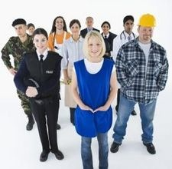
Social Stratification Systems
Ascribed group memberships are defined at birth; they may include gender, family, age, caste and gender, ethnic or national origin.
Acquired group memberships are based on one’s choice of affiliation, such as political party, religion, and social and professional organizations.

Slide 18
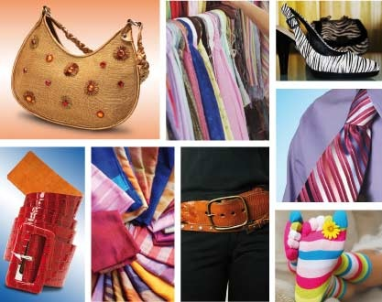
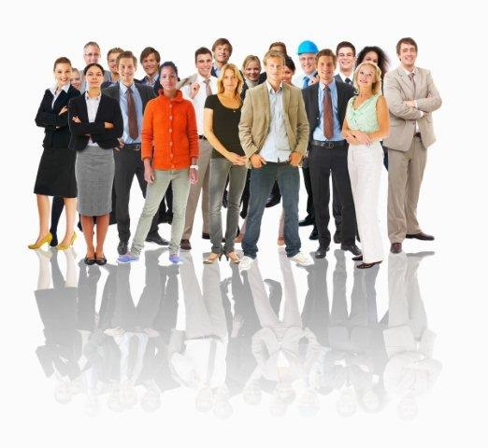
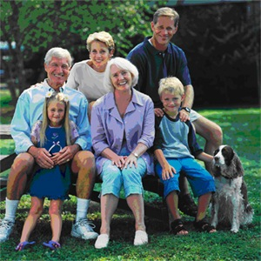

Household Patterns / Demographic Analysus

Slide 19
Factors Affecting the Communication Process
Spoken language
Written language
Silent language
-color associations
-conversational distance
-perception of time
-kinesics [body language and gestures]
Discussion: Problems in communication may arise, even
when nations share the same basic language
(e.g., British, Canadian, and American English).

Slide 20
Managerial Issue with Cultural Differences
Accommodation of foreigners
Cultural distance [degree of similarity]
Culture shock and reverse culture shock
Managerial orientations
􀂉 polycentric (Unilever, Nestle )
􀂉 ethnocentric (Macintosh, iPhone, Sony, Toyota, Pizzahut)
􀂉 geocentric (KFC)
Regiocentric

Slide 21
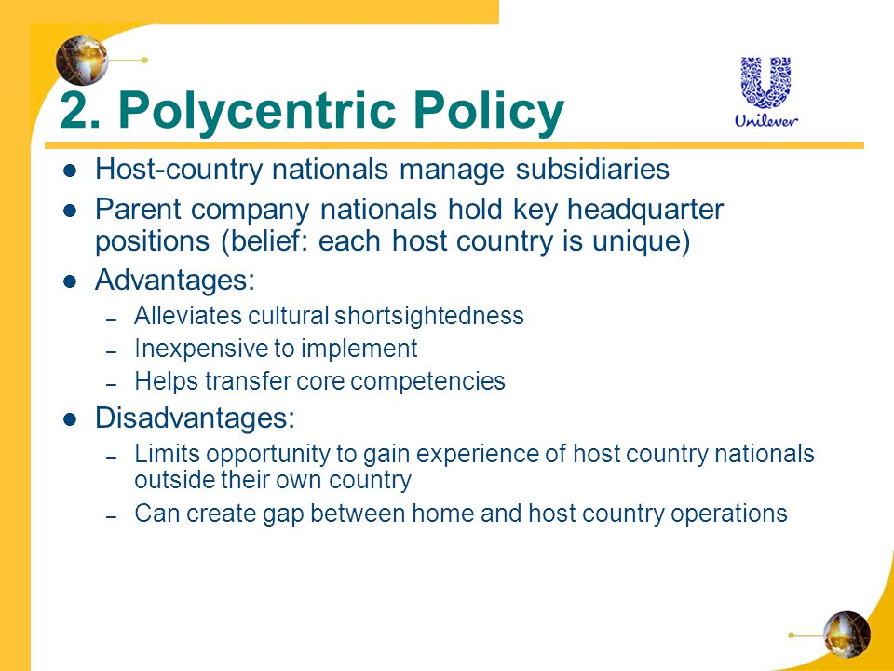

Slide 22
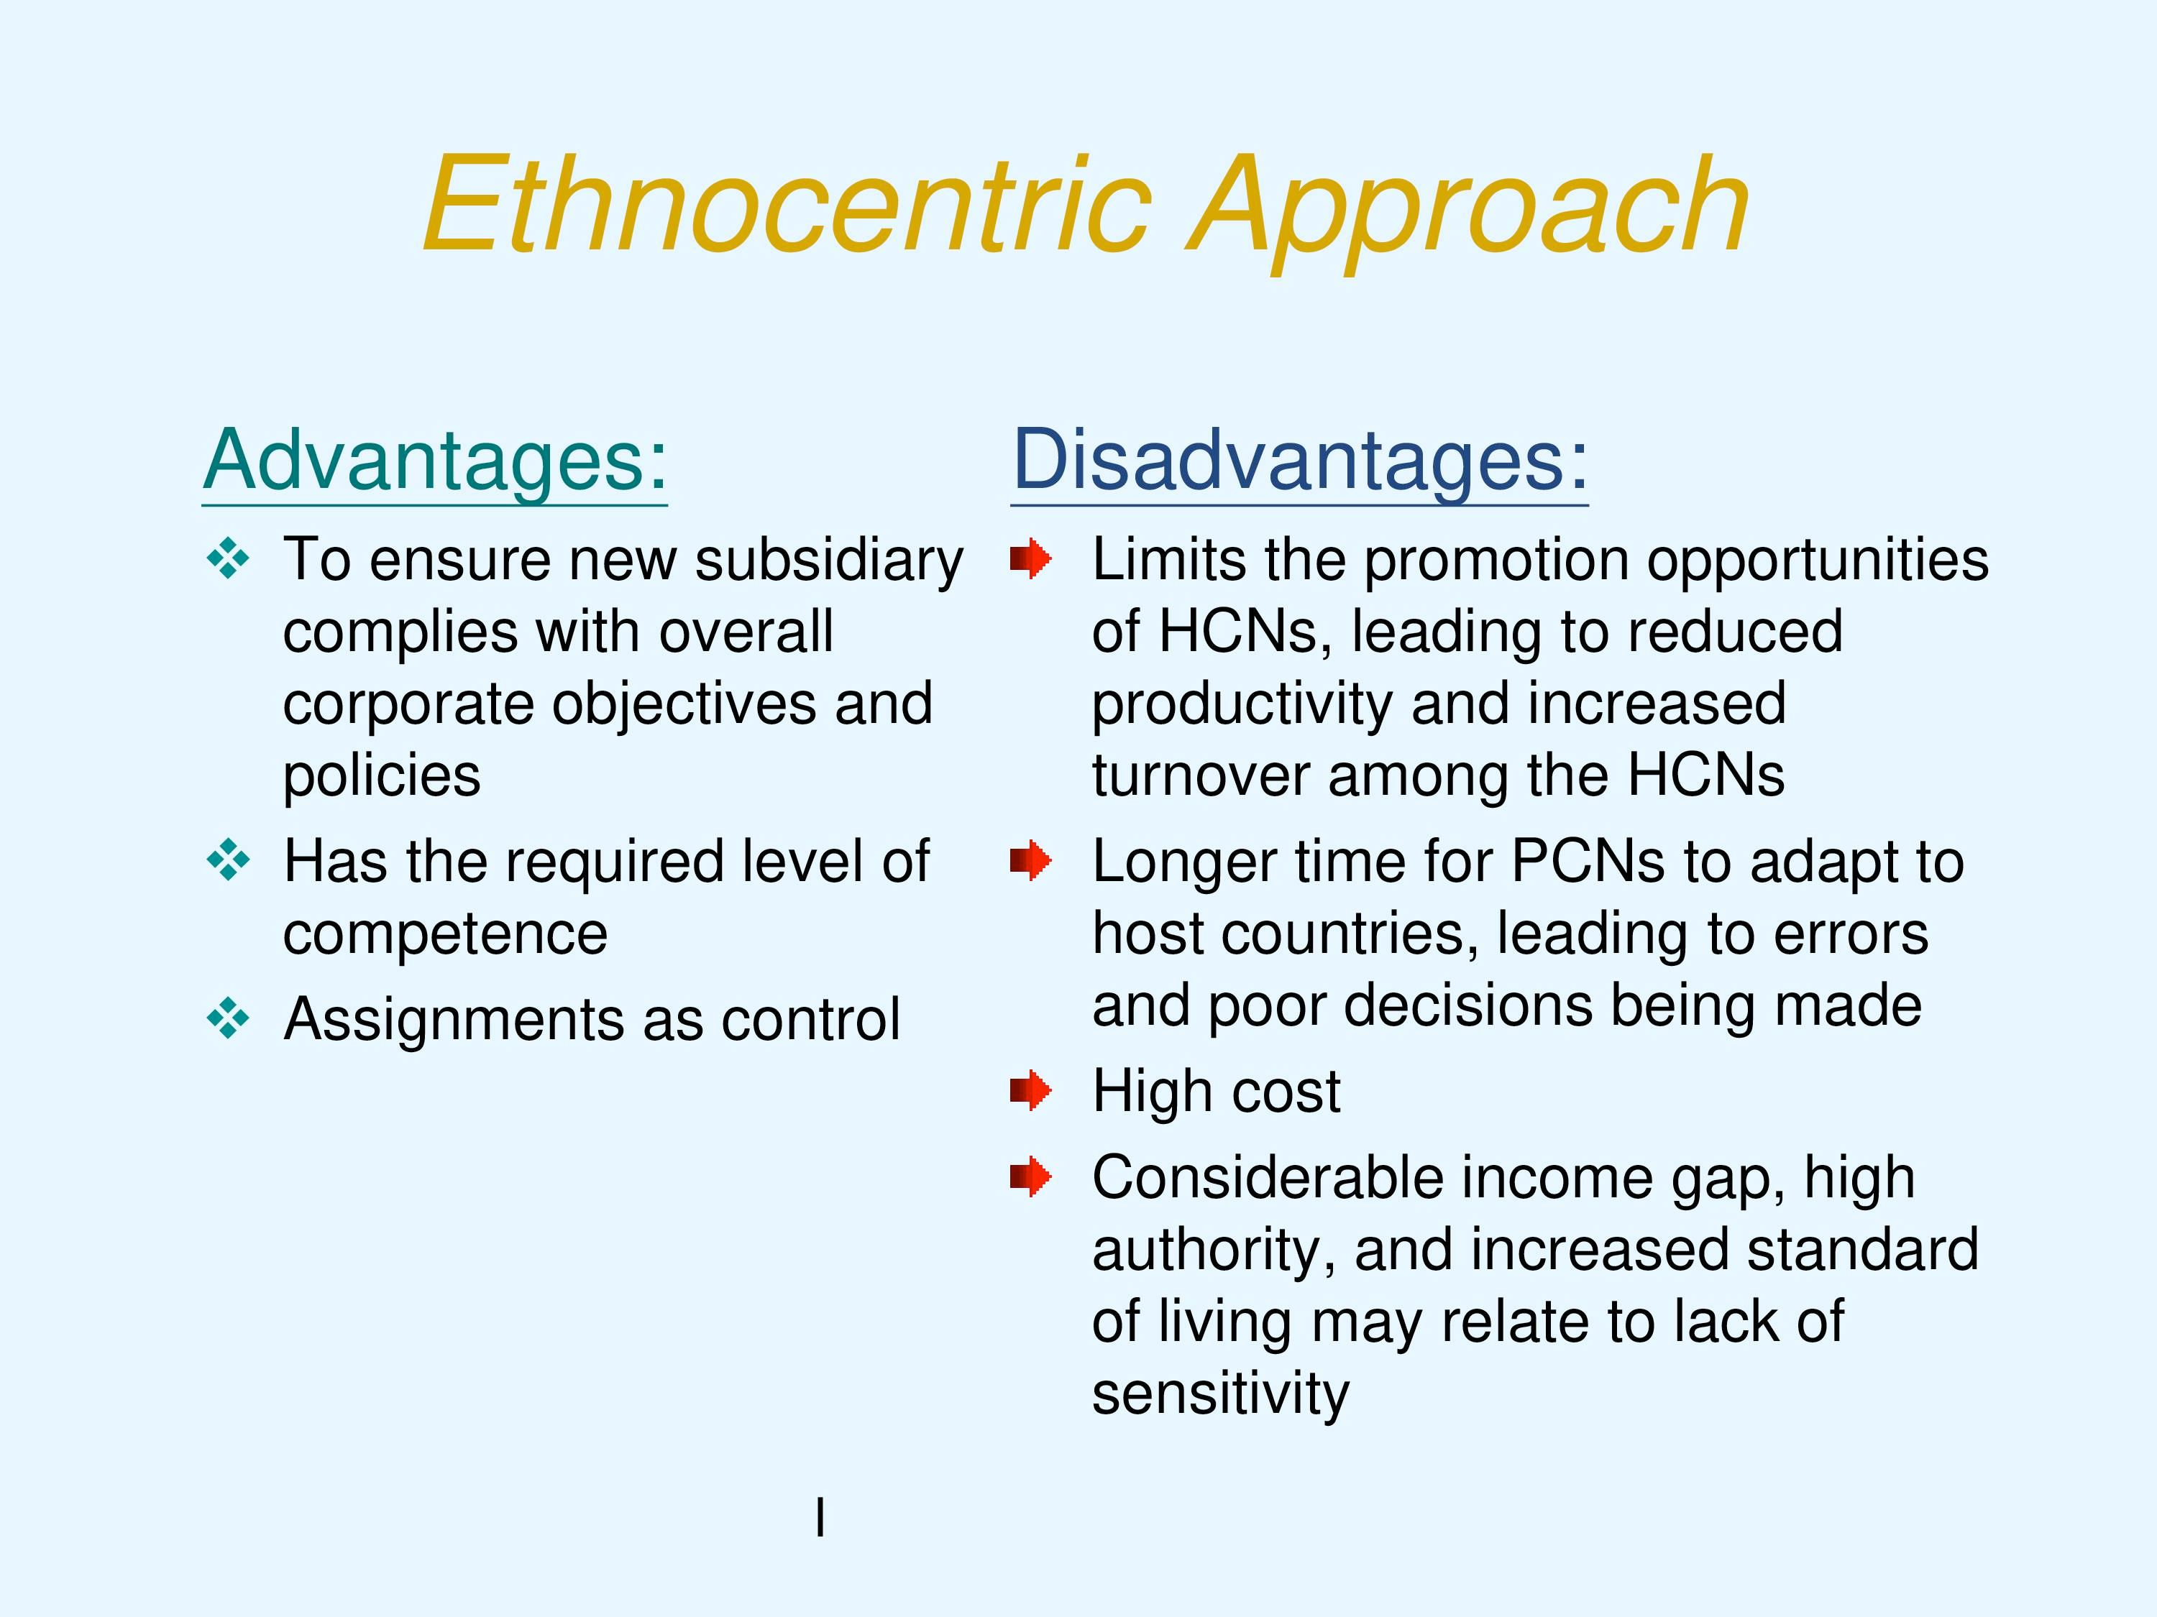

Slide 23
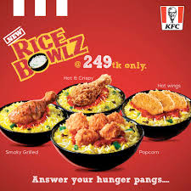
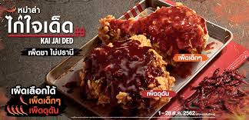
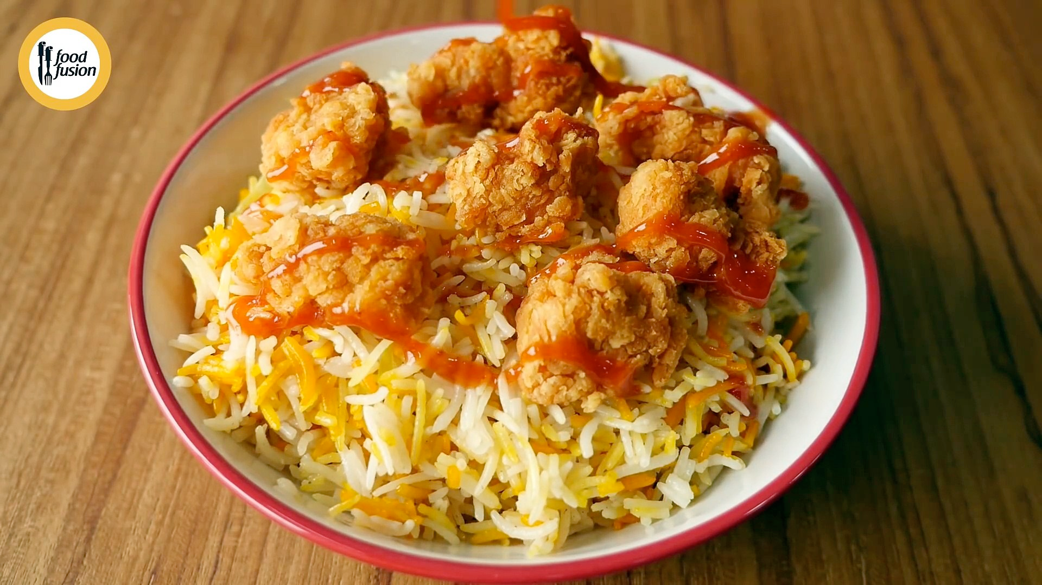

Slide 24
