Slide 1
Chapter 6
The Political Environment:
A Critical Concern
Farhana Noor
Assistant Professor
Daffodil International University

Slide 2
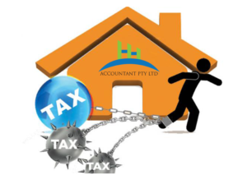
Political Risks of Global Business
Confiscation– the seizing of a company’s assets without payment
Expropriation– where the government seizes an investment but makes some reimbursement for the assets.
Domestication– when host countries gradually cause the transfer of foreign investments to national control and ownership through a series of government decrees
Mandating local ownership
Greater national involvement in a company’s management

Slide 3
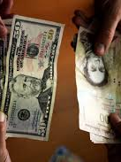
Economic Risks
Exchange controls:–When a nation faces shortages of foreign exchange and/or a substantial amount of capital is leaving the country, controls may be levied over all movements of capital or selectively against the most politically vulnerable companies to conserve the supply of foreign exchange for the most essential uses.

Slide 4
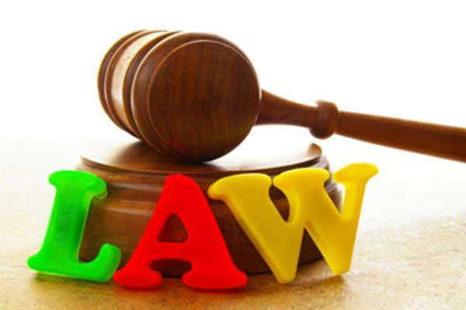
Economic Risks
Local-Content Laws:- In addition to restricting imports of essential supplies to force local purchase, countries often require a portion of any product sold within the country to have local content, that is, to contain locally made parts.

Slide 5
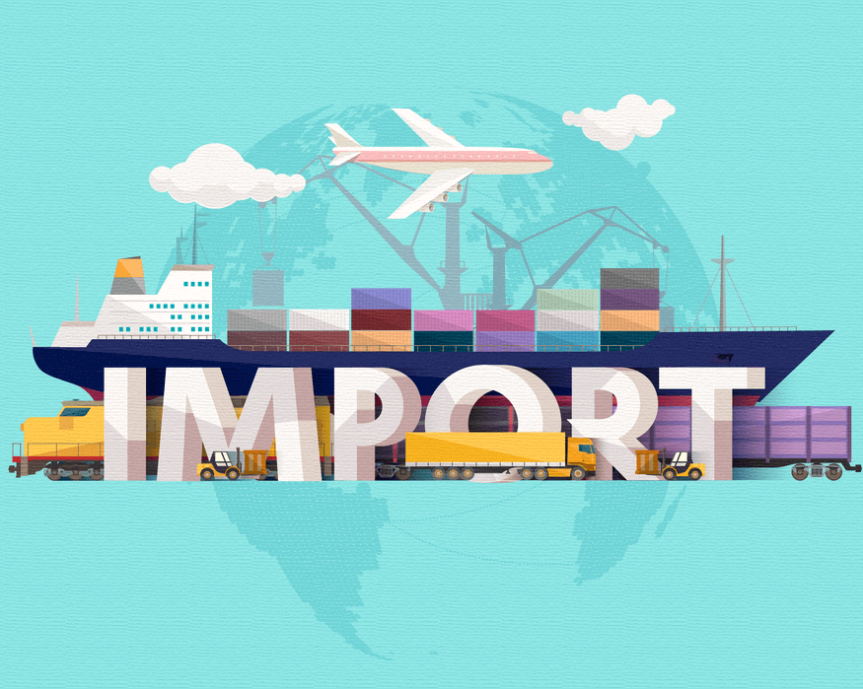
Economic Risks
Import Restrictions:- Selective restrictions on the import of consumer products, raw materials, machines, and spare parts are fairly common strategies to force foreign industry to purchase more supplies within the host country and thereby create markets for local industry.

Slide 6
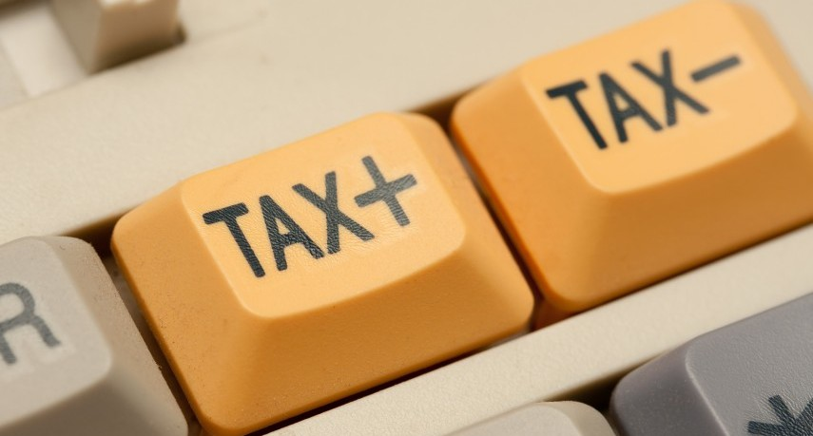
Economic Risks
Tax Controls :- Taxes must be classified as a political risk when used as a means of controlling foreign investments.

Slide 7
Economic Risks
Price Controls:- Essential products that command considerable public interest, such as pharmacy food, gasoline, and cars, are often subjected to price controls. Such controls applied during inflationary periods can be used to control the cost of living. They may also be used to force foreign companies to sell equity to local interests.

Slide 8
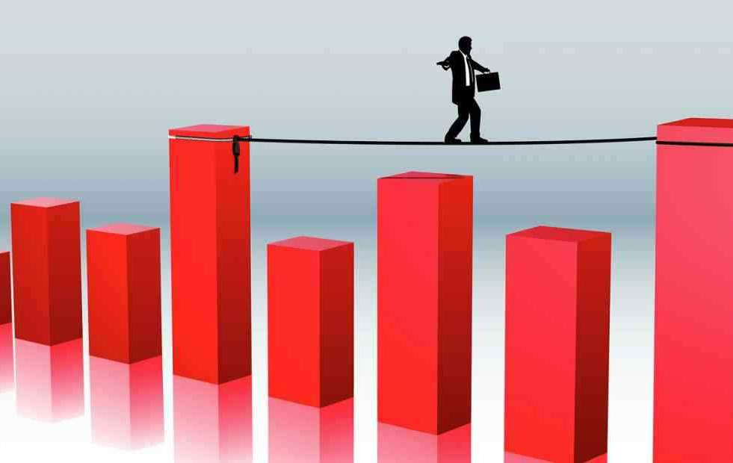
Economic Risks
Labor Problems:- Labor unions with strong government support may use it effectively to obtain special concessions from businesses. Layoffs may be forbidden, profits may have to be shared, and an extraordinary number of services may have to be provided.

Slide 9
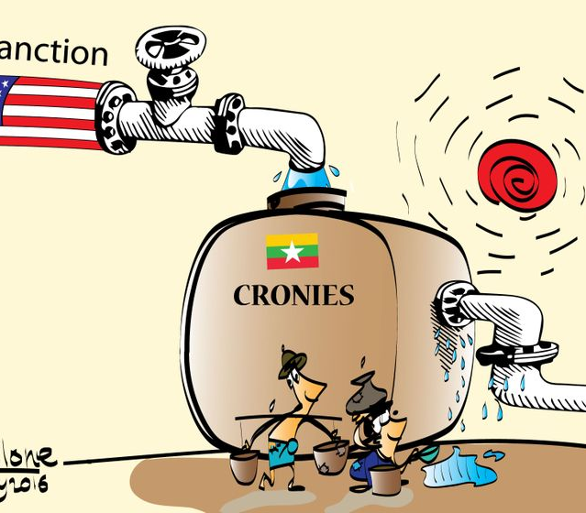
Political Sanctions
One or a group of nations may boycott another nation, thereby stopping all trade between the countries, or may issue sanctions against the trade of specific products.
United States’ long-term boycott of trade with Cuba and Iran.
Chinese recently signed and agreement with Iran.

Slide 10
Political and Social Activists (PSAs) and Nongovernmental Organizations
Those who seek to bring about peaceful change
Those who resort to violence and terrorism to effect change
Some of the most effective and best-known PSAs
Worldwide boycott of Nestlé
Free Burma Campaign (FBC)
College campuses boycott of Pepsi drinks and PepsiCo-owned Pizza Hut and Taco Bell stores

Slide 11
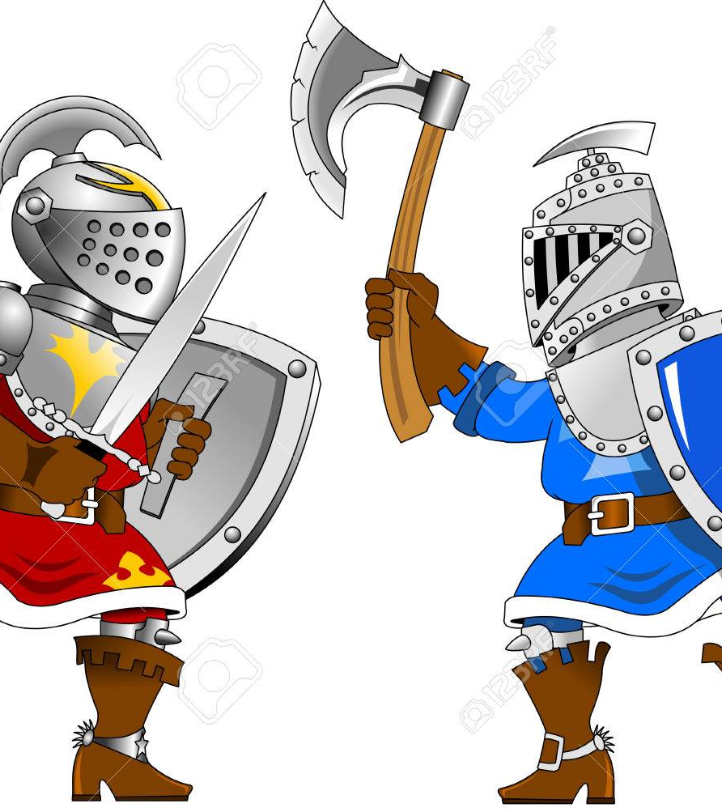
Violence Terrorism and War
Terrorist attacks victimized thousands of people around the world.
These attacks affect business Multinationals are targeted to embarrass government and its relationship with firms generate funds by kidnapping executives inflict terror \ within a country

Slide 12
Cyberterrorism and Cybercrime
As the Internet grows, “It’s only a matter of time before every terrorist, anarchist, thief, and prankster with a PC and a phone line will be waging a virtual war and inflicting real harm.
One of the problems of tracking cyberterrorism and criminals is that it is hard to determine if the cyber attack has been launched by-
a rogue state
a terrorist
a hacker as a prank

Slide 13
Assessing Political Vulnerability
-A marketer has • no absolute guidelines to determine whether a company and its products will be subject to political attention.
-Countries seeking investments in high-priority industries may well excuse companies from- • taxes • customs duties • quotas • exchange controls • other impediments to investment

Slide 14
Politically Sensitive Products and Issues
Products that have or are perceived to have an effect on the
environment
exchange rates
national and economic security
welfare of people
particularly children health

Slide 15
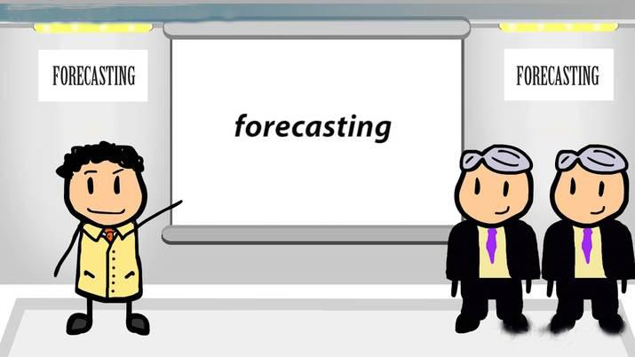
Forecasting Political Risk
Political risk assessment
an attempt to forecast political instability to help management identify and evaluate political events and their potential influence on current and future international business decisions
used to estimate the level of risk a company is assuming when making an investment and to help determine the amount of risk it is prepared to accept
Foreign Policy magazine uses 12 criteria to rank countries on its “Failed States Index.”
Demographic pressures
Human flight
Uneven development

Slide 16
Lessening Political Vulnerability
Joint ventures
Expanding the investment base
Licensing
Planned domestication
Political bargaining
Political playoffs

Slide 17
Joint ventures
Typically less susceptible to political harassment, joint ventures can be with locals or other third-country multinational companies; in both cases, a company’s financial exposure is limited.
A joint venture with locals helps minimize anti-MNC feelings, and a joint venture with another MNC adds the additional bargaining power of a third country.

Slide 18
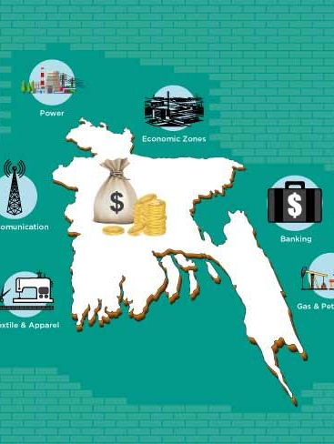
Expanding the investment base
Including several investors and banks in financing an investment in the host country is another strategy. This approach has the advantage of engaging the power of the banks whenever any kind of government takeover or harassment is threatened.

Slide 19
Licensing
Including several investors and banks in financing an investment in the host country is another strategy. This approach has the advantage of engaging the power of the banks whenever any kind of government takeover or harassment is threatened.

Slide 20
Planned domestication
The strategies just discussed can be effective in forestalling or minimizing the effect of a total takeover. However, in those cases where a host country in demanding Local participation, the most effective long-range solution is planned phasing out, that is planned domestication. Planned domestication essence, a gradual process of participating with nationals in all phases of company operation.

Slide 21
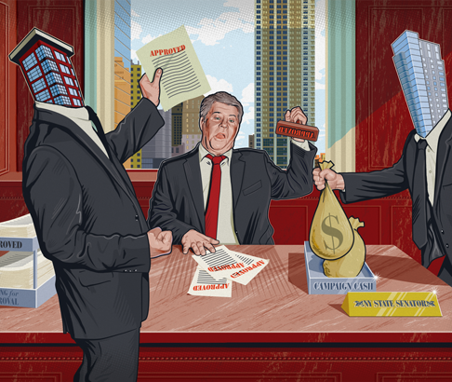
Political Payoffs
An attempt to lessen political risks by paying those in power to intervene on behalf of the multinational company.
Not allowing an international student (non-citizen) to work in a government or military position.

