Slide 1
Chapter 18
Pricing for International Markets
Farhana Noor
Assistant Professor
Daffodil International University

Slide 2
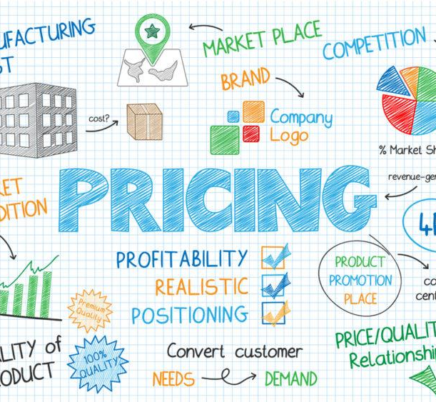
Pricing
Pricing is the process whereby a business sets the price at which it will sell its products and services, and may be part of the business's marketing plan.

Slide 3

Pricing Policy
Active marketing in several countries compounds the variables relating to price policy.
The country in which business is being conducted, the type of product, variations in competitive conditions, and other strategic factors affect pricing activity.

Slide 4

Pricing Objectives
In general, price decisions are viewed in two ways:
Pricing as an active instrument of accomplishing marketing objectives, or
Pricing as a static element in a business decision

Slide 5
Pricing Objectives
Overall financial marketing and strategic objective of the company.
To meet the objective of product or services.
Consumer price elasticity.
Maintain price leadership.

Slide 6
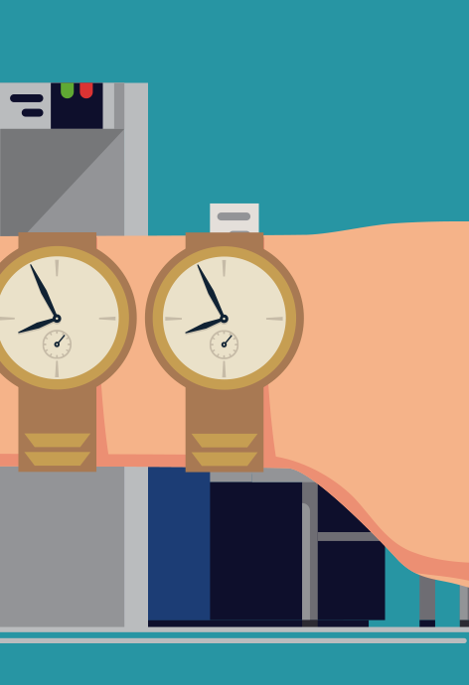
Parallel Importation
•The possibility of a parallel market occurs whenever price differences are greater than the cost of transportation between two markets
• On account of competition, firms may have to charge different prices from country to country
• Parallel imports develop when importers buy products from distributors in one country and sell them in another to distributors who are not part of the manufacturer’s regular distribution system

Slide 7

Parallel Importation
• The possibility of a parallel market occurs whenever price differences are greater than the cost of transportation between two markets.
• For example, the ulcer drug Losec sells for only $18 in Spain but goes for $39 in Germany; and the heart drug Plavix costs $55 in France and sells for $79 in London

Slide 8
Parallel Importation
Thus, it is possible for an intermediary to buy products in countries where it is less expensive and divert it to countries where the price is higher and make a profit
Exclusive distribution, a practice often used by companies to maintain high retail ­margins encourage retailers to stock large assortments, or to maintain the exclusive-quality image of a product, can create a favorable condition for parallel importing

Slide 9
Approaches to International Pricing
Full-Cost Pricing:no unit of a similar product is different from any other unit in terms of cost, which must bear its full share of the total fixed and variable cost.
Variable-Cost Pricing: firms regard foreign sales as bonus sales and assume that any return over their variable cost makes a contribution to net profit

Slide 10
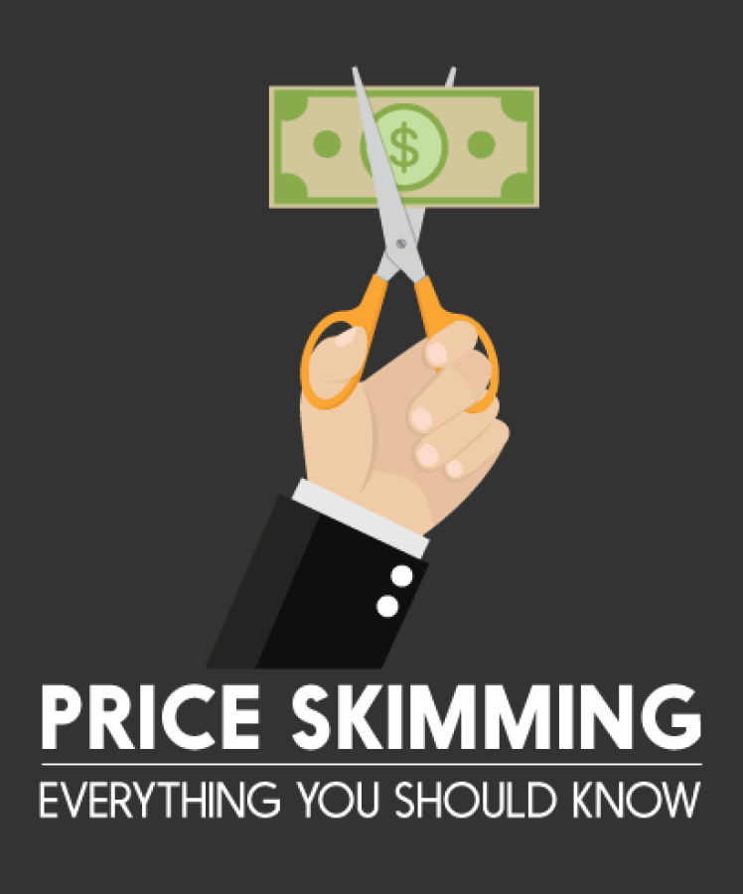
Approaches to International Pricing
Skimming Pricing: This is used to reach a segment of the market that is relatively price insensitive and thus willing to pay a premium price for a product • Penetration Pricing: This is used to stimulate market growth and capture market share by deliberately offering products at low prices.

Slide 11
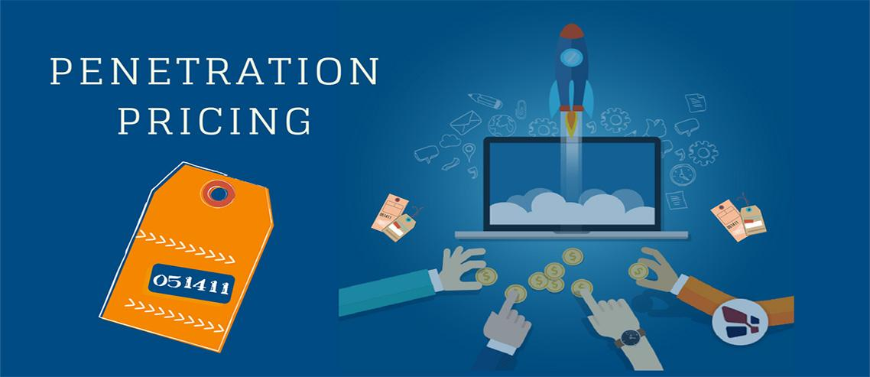
Penetration pricing
To offer products at low prices
To stimulate a market growth, increase seals and market shares.
Suitable for the market that is relatively price sensitive (brand switching).
Based on the assumption that this initial low price will help secure a market acceptance.

Slide 12
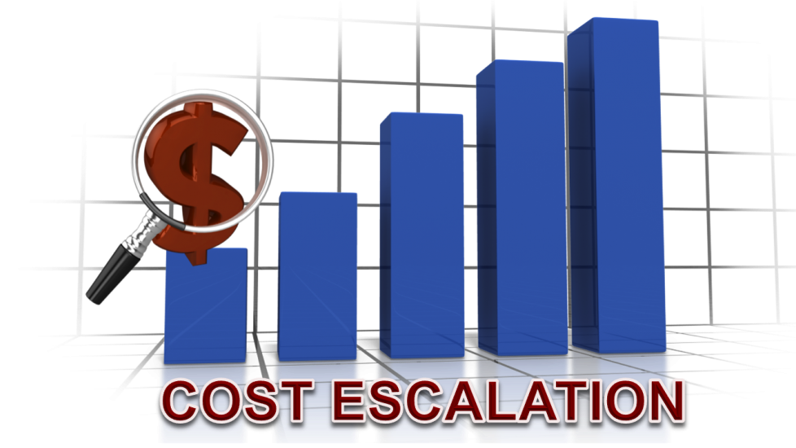
Price Escalation
Price escalation refers to the added costs incurred as a result of exporting products from one country to another.

Slide 13
Factors in Price Escalation
Costs of Exporting: the term relates to situations in which ultimate prices are raised by shipping costs, insurance, packing, tariffs, longer channels of distribution, larger middlemen margins, special taxes, administrative costs, and exchange rate fluctuations.
Taxes, Tariffs, and Administrative Costs: These costs results in higher prices, which are generally passed on to the buyer of the product
Inflation: Inflation causes consumer prices to escalate and the consumer is faced with rising prices that eventually exclude many consumers from the market.

Slide 14
Factors in Price Escalation
Middleman and Transportation Costs: Longer channel length, performance of marketing functions and higher margins may make it necessary to increase prices
Exchange Rate Fluctuations and Varying Currency Values: Currency values swing vis-à-vis other currencies on a daily basis, which may make it necessary to increase prices

Slide 15
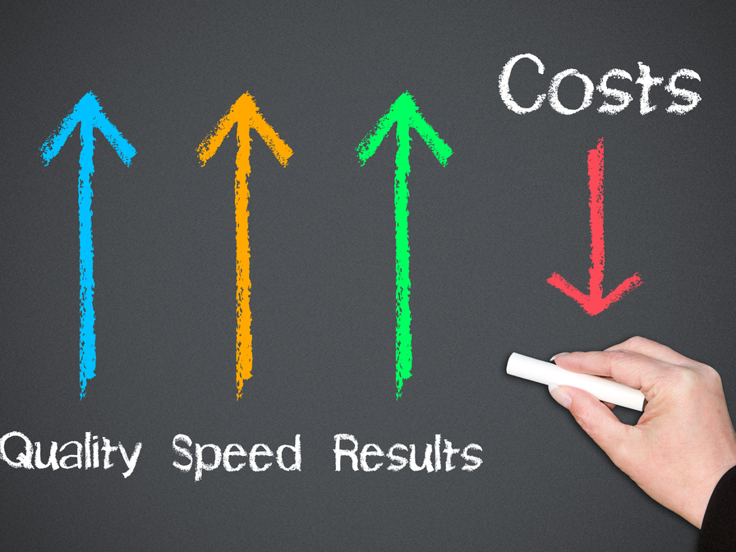
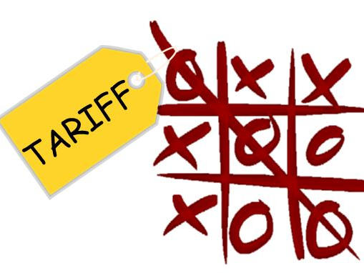
Approaches to Reducing Price Escalation
Lowering Cost of Goods: Firms can lower costs by eliminating costly features in products or by manufacturing products in countries where labor costs are cheaper.
Lowering Tariffs: Firms can lower prices by categorizing products in classifications where the tariffs are lower

Slide 16


Approaches to Reducing Price Escalation
Using Foreign Trade Zones: Firms can manufacture products in free trade zones where the incentive offered is the elimination of local taxes, which keep prices down.
Dumping:A countervailing duty or minimum access volume (MAV), which restricts the amount a country will import, may be imposed on foreign goods benefiting from subsidies whether in production, export, or transportation .One approach classifies international shipments as dumped if the products are sold below their cost of production • The other approach characterizes dumping as selling goods in a foreign market below the price of the same goods in the home market.

Slide 17


