Slide 1
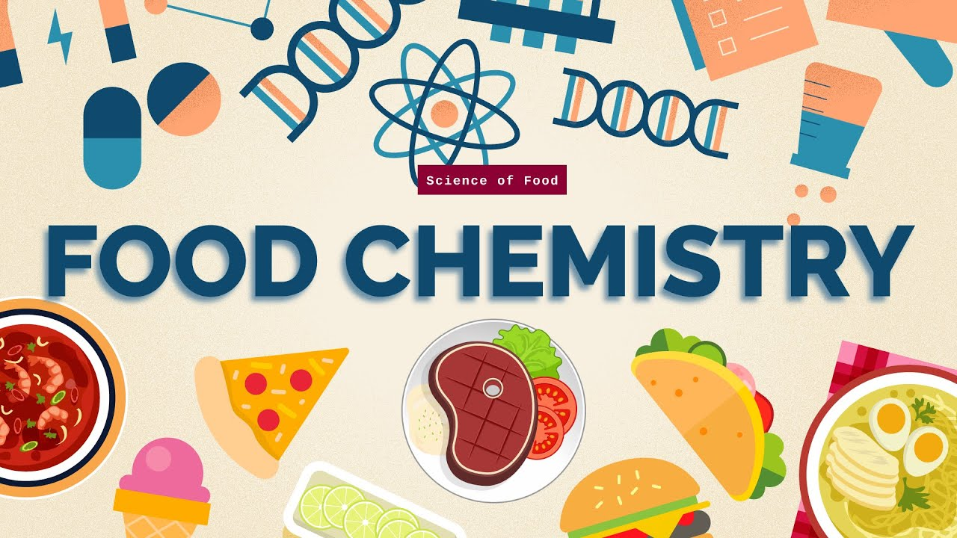
Food Chemistry 0711-2101 Carbohydrates
Department of Nutrition & Food Engineering
Daffodil International University

Slide 2
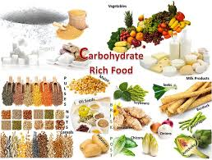
Contents
Introduction to carbohydrates and its functions
Classification of carbohydrates
Monosaccharides and changes
Introduction to common Oligosaccharides
Polysaccharides and its classifications
Starch- structure, gelatinization, retrogradation
Modified starches
Glycogen
Chitin
Cellulose
Carbohydrate digesting enzymes

Slide 3
Carbohydrates Introduction
Carbohydrates are the most abundant and diverse class of organic compounds occurring in nature. They are also one of the most versatile materials available.
Carbohydrate-related technologies have played a critical role in the development of new products ranging from foods, nutraceuticals, pharmaceuticals, textiles, paper, and biodegradable packaging materials.
Carbohydrates are produced during the process of photosynthesis:
The first carbohydrates studied contained only carbon (C), hydrogen (H), and oxygen (O), with the ratio of H:O the same as in water, 2:1, hence the name carbohydrates or hydrates of carbon, C_{x}(H₂O)_{y}, was given. The composition of some carbohydrates is indeed captured by the empirical formula, but most are more complex.

Slide 4
Carbohydrates Introduction
Carbohydrates are widely distributed both in animal and plant tissues, where they function as:
Energy reserves (e.g., starch, fructans, glycogen).
Structural materials (e.g., cellulose, chitin, xylans, mannans).
Protective substances. Some plant cell wall polysaccharides are elicitors of plant antibiotics (phytoalexins). In soybean, fragments of pectic polysaccharides (α-4-linked dodecagalacturonide) induce synthesis of a protein (protein inhibitor inducer factor) that inhibits insect and microbial proteinases. Arabinoxylans have been postulated to inhibit intercellular ice formation, thus ensuring winter survival of cereals.
Cell recognition moieties. Oligosaccharides conjugated to protein (glycoproteins) or to lipids (glycolipids) are important components of cell membranes and can be active in cell to cell recognition and signaling. It is recognized that oligosaccharide moieties serve as probes through which the cell interacts with its environment. In addition, the environment delivers signals to the interior of the cell through the cell surface oligosaccharides.
Information transfer agents (nucleic acids)

Slide 5
Carbohydrates
According to a more comprehensive definition of Robyt (1998), carbohydrates are polyhydroxy aldehydes or ketones, or compounds that can be derived from them by-
Reduction of the carbonyl group to produce sugar alcohols
Oxidation of the carbonyl group and/or hydroxyl groups to sugar acids
Replacement of one or more of the hydroxyl moieties by various chemical groups, e.g., hydrogen (H) to give deoxysugars, aminogroups (NH₂ or acetyl-NH₂) to give amino sugars
Derivatization of the hydroxyl groups by various moieties, e.g., phosphoric acid to give phosphor sugars, sulphuric acid to give sulpho sugars
Their polymers having polymeric linkages of the acetal type

Slide 6
Food Carbohydrates Classifications
Food carbohydrates encompass a wide range of molecules and can be
classified according to their chemical structure into three main groups:
• Low molecular weight mono- and disaccharides
• Intermediate molecular weight oligosaccharides
• High molecular weight polysaccharides
Nutritionists divide food carbohydrates into two classes:
Available, or those which are readily utilized and metabolized. They may be either mono-, di-, oligo- or polysaccharides, e.g., glucose, fructose, sucrose, lactose, dextrins, starch.
• Unavailable, or those which are not utilized directly but instead broken down by symbiotic bacteria, yielding fatty acids, and thus not supplying the host with carbohydrate. This includes structural polysaccharides of plant cell walls and many complex polysaccharides, e.g., cellulose, pectins, beta-glucans.

Slide 7
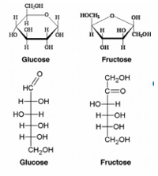
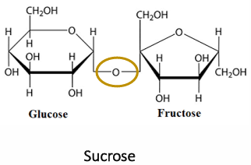
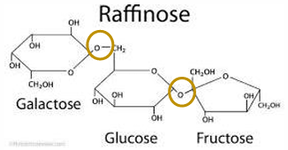
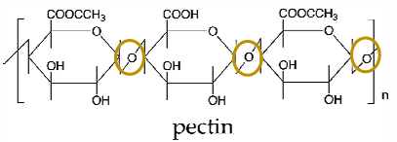
Food Carbohydrates Classifications
Monosaccharides (1 unit), e.g.
Glucose (Glu), Fructose (Fru), Galactose (Gal)
Disaccharides (2 units), e.g. Sucrose (Glu-Fru),
Maltose (Glu-Glu), Lactose (Gal-Glu)
Oligosaccharides (3 – 10 units), e.g. Maltotriose
(Glu-Glu-Glu), Raffinose (Gal-Glu-Fru), Lacto-oligos
(Gal-Gal-Glu
Polysaccharides (10+ units), e.g. Starch, Cellulose, Pectin, Carrageenan, Alginates, Locust bean gum

Slide 8
Food Carbohydrates Sources & Basic Functions in Food
Plants
Sugar: Sugar cane, sugar beet etc.
Starch: Potatoes, grains etc.
Cellulose: Cell walls
Pectin: Fruit pomace and peels
Gum: Arabic – acacia tree
Animals
Glycogen: Chitin and chitosan
Algae and microbes: Gums - agar, carrageenan, alginate, xanthan
Functions in Food
sweetening
gel or paste-forming
thickening agents
stabilizers precursors for aroma and coloring substances

Slide 9
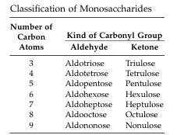
Food Carbohydrates Monosaccharides
Monosaccharides are chiral polyhydroxy aldehydes and polyhydroxy ketones that often exist in cyclic hemiacetal forms. They are monomeric in nature and cannot be depolymerized by hydrolysis to simpler sugars.
Monosaccharides are divided into two major groups according to whether their acyclic forms possess an aldehyde or a keto group, that is, into aldoses and ketoses, respectively. These, in turn, are each classified according to the number of carbons in the monosaccharide chain (usually 3 to 9), into trioses (C3), tetroses (C4), pentoses (C5), hexoses (C6), heptoses (C7), octoses (C8), nonoses (C9). By adding the prefix aldo- to these names, one can define more closely a group of aldoses, e.g., aldohexose, aldopentose. For ketoses it is customary to add the ending -ulose

Slide 10
Food Carbohydrates Monosaccharides-Aldoses
The simplest monosaccharide is the three-carbon glyceraldehyde (aldotriose). It has one asymmetric carbon atom (chiral center) and consequently, it has two enantiomeric forms. The two forms are D- and L-glyceraldehydes These two compounds have the same empirical formula, C₃H₆O₃, but are distinct, having different chemical and physical properties. For instance, D-glyceraldehyde rotates the plane polarized light to the right (+) and has a specific optical rotation ([α]D) at 25°C of +8.7°; whereas L-glyceraldehyde rotates the plane polarized light to the left (-) and has a different specific optical rotation, [α]D, at 25°C of –8.7°. Carbon C-2 in glyceraldehyde corresponds to the chiral center. If the OH group attached to the highest numbered chiral carbon is written to the right in the vertical structure as shown above, a sugar belongs to the D-chiral family; if the OH is written to the left, a sugar belongs to the L-chiral family. R (Latin, rectus, right) should be used instead of D. S (Latin, sinister, left) instead of L
The higher aldoses belonging to the D- and L-series are derived from the respective D- and L-aldotrioses by inserting one or more hydroxymethylene (–CHOH) groups between the first chiral center and the carbonyl group of the corresponding isomer. The insertion of the hydroxymethylene group leads to creation of a new chiral center. The number of chiral carbon atoms (n) in the chain determines the number of possible isomers. Since each chiral carbon atom has a mirror image, there are 2^{n} arrangements for these atoms.
In a six-carbon aldose with 4 chiral carbons, there are 24 or 16 different arrangements, allowing formation of 16 different six-carbon sugars with aldehyde end. Eight of these belong to the D-series the other eight are their mirror images and belong to the L-series.

Slide 11
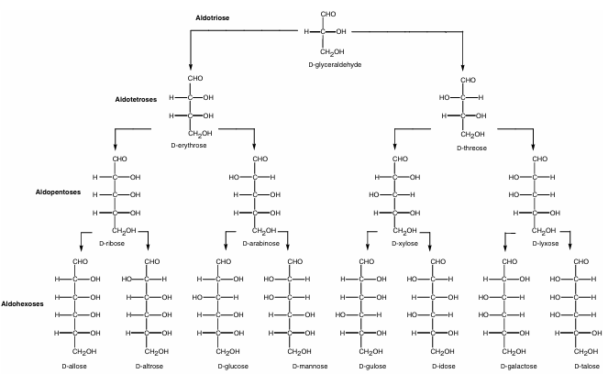
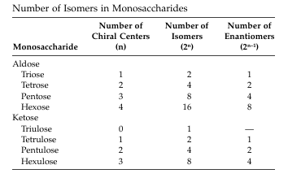
Food Carbohydrates Monosaccharides-Aldoses (D/R)
.

Slide 12
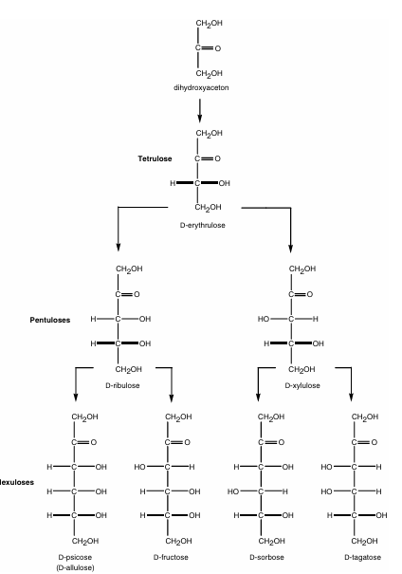
Food Carbohydrates Monosaccharides-Ketoses (D/R)
The ketotriose (dihydroxyacetone) has no
chiral center, the first monosaccharide in the
ketose series is erythrulose.

Slide 13
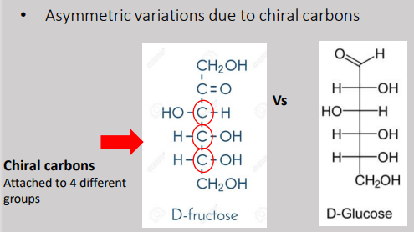
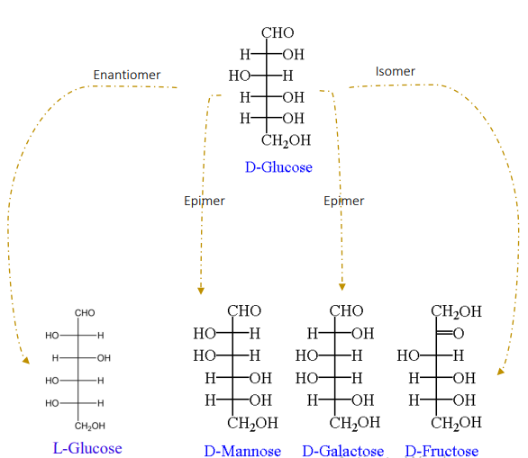
Food Carbohydrates Monosaccharides-Structures & Stereochemistry
Isomer: One of two or more molecules that
have the same chemical formula but have a
different stereochemical (special) arrangement
of their atoms.
Epimer: Diastereomeric monosaccharides that
differs at only one carbon position
Enantiomer: A pair of chiral isomers
(stereoisomers) that are direct, nonsuperimposable
mirror images of each other.

Slide 14
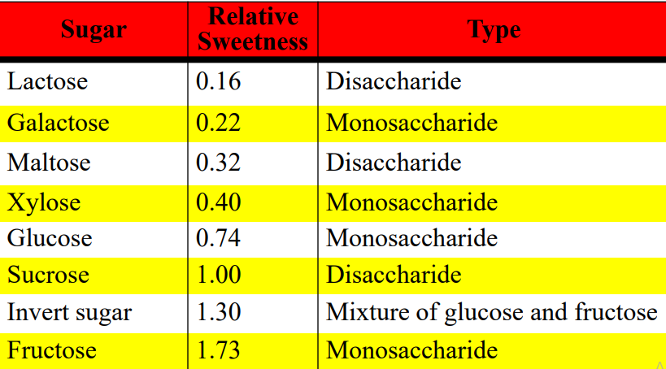
Food Carbohydrates Monosaccharides-Physical Properties
Most monosaccharides have a sweet taste (fructose is sweetest; 73% sweeter than sucrose).
• They are solids at room temperature.
• They are extremely soluble in water.
The presence of large numbers of OH groups make the monosaccharides much more water soluble than most molecules of similar MW. Glucose can dissolve in minute amounts of water to make a syrup (1 g / 1 ml H₂O).

Slide 15
Food Carbohydrates Monosaccharides- Occurrence
The majority of the naturally occurring carbohydrates have the D-configuration. L-monosaccharides are less abundant in nature, although L-arabinose and L-galactose are present as carbohydrate units in many carbohydrate polymers (polysaccharides).
The pyranose forms dominate in aqueous solution of most monosaccharides, it is quite common to find furanose form when the sugar is incorporated into a biomolecule.
The popular names of sugars often indicate their principal sources and their optical rotary properties.
Synonyms for D-glucose are dextrose, grape sugar, and starch sugar.
Synonyms for fructose are levulose, honey sugar, fruit sugar.

Slide 16
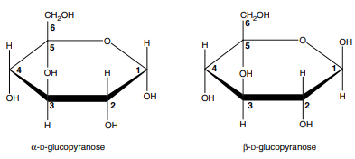
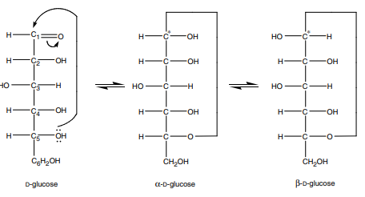
Food Carbohydrates Monosaccharides-Ring Forms of Sugar
The structure of D-glucose is not the only one in existence. It was found that a relatively high initial value of specific rotation of glucose in solution (+112°) changed to a much lower value
(+52°) after a period of time. Two forms of D-glucose, designated α and β, were isolated; they had almost the same melting point but vastly different values of specific rotation (+112° and +19°), which changed with time, to +52°.
These forms of D-glucose result from an intramolecular Nucleophilic attack by the hydroxyl oxygen atom attached to C-5 on the carbonyl group, and the consequent formation of a hemiacetal. Because cyclization converts an achiral aldehyde carbon atom (C-1) into a chiral hemiacetal carbon atom, two new discrete isomeric forms, called anomers are produced; they are designated α and β. The six membered ring is related to tetrahydropyran and is called pyranose.

Slide 17
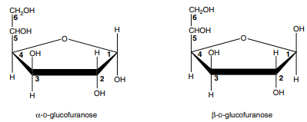
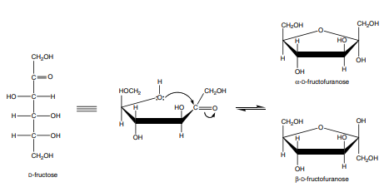
Food Carbohydrates Monosaccharides-Ring Forms of Sugar
A five-membered ring can also be formed from the intramolecular nucleophilic attack by the hydroxyl oxygen atom attached to C-4 on the carbonyl group and hemiacetal formation. The five-membered ring is related to tetrahydrofuran and is, therefore, designated as furanose.
The anomeric carbon of ketoses is C-2.

Slide 18
Food Carbohydrates Monosaccharides- Mutarotation
When sugar molecules are dissolved in aqueous solutions, a series of reactions, involving molecular rearrangements around rearrangements are associated with the change in optical rotation, and lead to formation of a mixture of products that are in equilibrium. This process, first observed for D-glucose, is called mutarotation. If one dissolves α-Dglucopyranose ([α]D +112°) or β-D-glucopyranose ([α]D +19°) in water, an equilibrium is formed with the [α]D of the resultant solution being +52.7°.Theoretically, the mixture contains five different structural forms of glucose: α-D-glucopyranose, β-D-glucopyranose, α-D-glucofuranose, β-D-glucofuranose, and open-chain free aldehyde. The four ring structures are transformed into each other via the open chain form. The process will take place if the starting material represents any of the five forms.
The mutarotation process is slow (it may take several hours to reach equilibrium) if conducted in water at 20°C. The rate of mutarotation increases, however, 1.5 to 3 times with each 10°C increase in the temperature. Both acids and bases increase the rate of mutarotation. Certain enzymes, such as mutarotase will also catalyze the mutarotation reactions. The rate and the relative amount of products are also affected by the polarity of the solvent, with less polar solvents decreasing the rate of mutarotation.

Slide 19
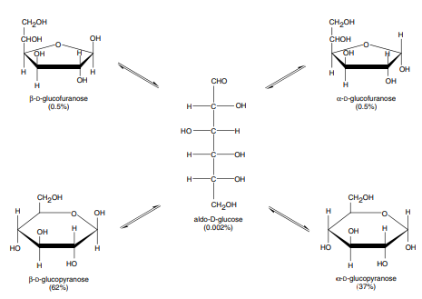
Food Carbohydrates Monosaccharides- Mutarotation
.

Slide 20
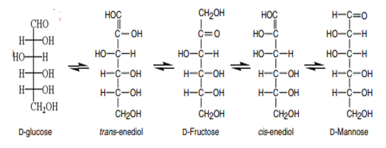
Food Carbohydrates Monosaccharides- Enolization and Isomerization
In the presence of alkali, sugars are relatively easily interconverted. The transformation involves epimerization of both aldoses and ketoses as well as aldose ketose isomerization.
The enolization reaction is a general reaction of a carbonyl compound having an α-hydrogen atom. Starting with aldehydo-D-glucose, the 1,2 enediol is first formed, which can be converted into another aldose (with opposite configuration at C-2) and the corresponding ketose. Therefore, by enolization and isomerization, D-glucose, D-mannose, and D-fructose can be easily interconverted. Either a base or an enzyme catalyzes isomerization, and it will also occur under acid or neutral conditions, although at a much slower rate.

Slide 21
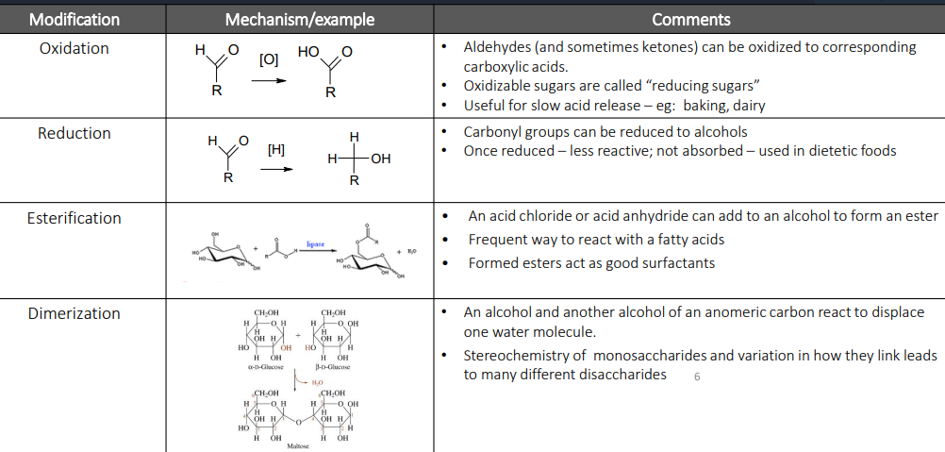
Food Carbohydrates Monosaccharides- Chemical Modifications
In

Slide 22
Food Carbohydrates Oligosaccharides- Formation of Glycosidic Linkage
The hemiacetal form of sugars can react with alcohol to produce a full acetal according to the following reaction.
The two products are more commonly referred to as glycosides — more specifically, as methyl α- and β-D-glucopyranosides. The carbohydrate (glycon) portion of the molecule is distinguished from the noncarbohydrate aglycon. The acetal linkage is formed from a glycosyl donor and a glycosyl acceptor.

Slide 23
Food Carbohydrates Oligosaccharides-Disaccharides
Disaccharides are glycosides in which the aglycon constitutes another monosaccharide unit.
Alcohol groups of one carbohydrate (monosaccharide) can react with a hemiacetal hydroxyl group of another carbohydrate (monosaccharide) and form a glycoside between two carbohydrate units.
Disaccharides can be divided into heterogeneous and homogeneous types according to their monosaccharide composition, and into reducing or non-reducing disaccharides, depending whether they possess a free anomeric carbon.
Homodisaccharides contain two identical monosaccharide units, whereas heterodisaccharides are composed of two different monomers.
Reducing disaccharides, in contrast to non-reducing ones, contain a reactive hemiacetal center that can be easily modified chemically (e.g., via oxidation or reduction).

Slide 24
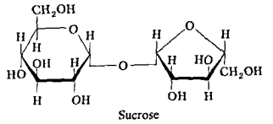
Food Carbohydrates Oligosaccharides-Disaccharides
The two most important naturally occurring heterodisaccharides are sucrose and lactose.
Sucrose (commonly known as sugar or table sugar) occurs in all plants, but it is commercially obtained from sugar cane and sugar beets. It is composed of an α-D-glucopyranosyl unit and a β-D-fructofuranosyl unit linked reducing end to reducing end, thus it is a non-reducing sugar. Its chemical name is α-D-glucopyranosyl-β-D-fructofuranoside.
Sucrose is the world’s main sweetening agent. Sucrose is common in many baked products, breakfast cereals, deserts, and beverages. Sucrose is hydrolyzed into D-glucose and D-fructose by the enzyme sucrase, which is present in the human intestinal tract, and therefore can be utilized by humans for energy. Monosaccharides (D-glucose and D-fructose) do not need to undergo digestion before they are absorbed. The plant enzyme invertase is able to hydrolyze sucrose into its two constituent sugars in equimolar mixture of D-glucose and D-fructose; the mixture has a different value of specific rotation, and is termed invert sugar.

Slide 25
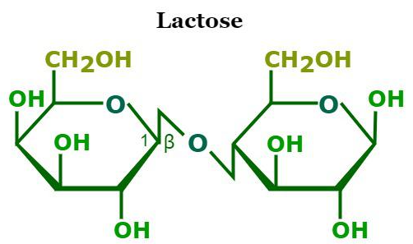
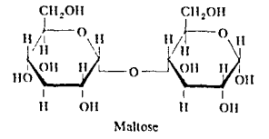
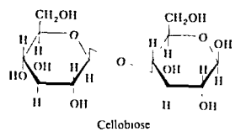
Food Carbohydrates Oligosaccharides-Disaccharides
Lactose occurs in the milk of mammals, where it serves as an energy source for developing mammals. The concentration of lactose in milk may vary from 2 to 8%, depending on the source. Lactose is also a by product in the manufacture of cheese. Lactose is composed of two different sugar residues: β-D-galactopyranose and D-glucopyranose linked via β-1→4 linkage. Its chemical name is β-D-galactopyranosyl-D-glucopyranoside.
Other common naturally occurring disaccharides are maltose and Cellobiose.

Slide 26
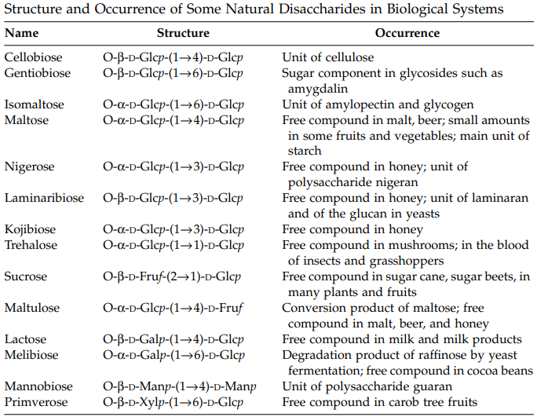
Food Carbohydrates Oligosaccharides-Disaccharides
.

Slide 27
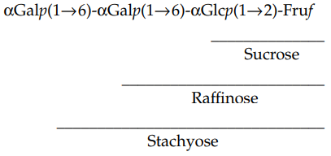
Food Carbohydrates Oligosaccharides
According to the International Union of Pure and Applied Chemistry (IUPAC), oligosaccharides are compounds containing 3 to 9 monomeric sugar residues. The number of sugar residues determines the degree of polymerization of oligosaccharides. A number of oligosaccharides occur naturally as free compounds in some plants. Raffinose is a non-reducing trisaccharide that is formed from sucrose by the addition of α-Dgalactopyranose to the C-6 of the glucose moiety of sucrose. It is widely distributed in many plants and commercially prepared from beet molasses and cotton seeds. Stachyose is another derivative of sucrose; it occurs as a free oligomer in many legumes and pulses.

Slide 28
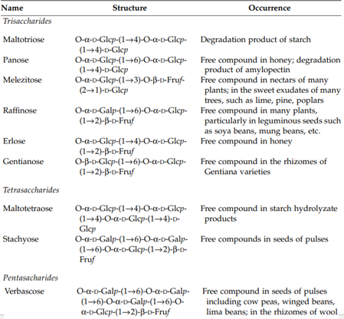
Food Carbohydrates Oligosaccharides
.

Slide 29
Food Carbohydrates Polysaccharides
Polysaccharides are the carbohydrates which contain more than 10 monosaccharide units. They can be hydrolyzed into hundred or even thousands of monosaccharide units. The suffix –ose in sugar is changed to –ans to describe the corresponding polysaccharide.
Examples:
(1) Pentosans - (a) Arabans, (b) Xylans
(2) Hexosans - (a) Glucans- starch, dextrin, glycogen, cellulose, inulin; (b) Mannans; (c) Galactans
(3) Complex polysaccharides- (a) Pectins or pectic substances, (b) Gums, (c) Mucilages, (d) Algal polysaccharides- Alginic acid and carrageenan, (e) Bacterial polysaccharides- Xanthan gum.
Polysaccharides commonly present in foods are starch, glycogen, cellulose, hemicellulose, pectic substances, gums.

Slide 30
Food Carbohydrates Classification of Polysaccharides
Polysaccharides occur in an infinite variety of different structural types which can be broadly classified into homopolysaccharides and heteropolysaccharides
Homopolysaccharides: They contain the same structural units throughout. For example, the glucans (starch and glycogen), fructans, mannans etc. These polymers can possess either simple linear structure or branched structures of varying complexity with more than one type of inter unit linkage.
Perfectly linear polysaccharides: They compounds with single neutral monosaccharides structural unit with only one type of linkage are denoted as perfectly linear polysaccharides. They are usually insoluble in water and can be solublized only under drastic conditions. They also have tendency to precipitate from solution retrogradation.
Branched polysaccharides: They are more soluble in water than linear polysaccharides as the chain-chain interaction are less pronounced. Compare to the linear polysaccharides of equal molecular weight and concentration, solution of branched polysaccharides have the lowest viscosity and lower tendency to precipitate. They have the ability to form the sticky paste at higher concentration, probably due to side chain – side chain interaction. So they are suitable as binder or adhesives.

Slide 31
Food Carbohydrates Classification of Polysaccharides
Linearly branched polysaccharides: They are polymers with long backbone chains and with mainly short chain viz. alkyl cellulose. They have properties, which are a combination of perfect linear and branched polymers. The long backbone chain is responsible for high viscosity of the solution. The presence of numerous short-side chains weakens the interaction between molecules and thereby gives it good solubility and rehydration rates and also provides stability to highly concentrated solutions.
Modified Polysaccharides: The properties of polysaccharides can be modified by physical and chemical methods that result in products suitable for specific purposes in the food industry. The solubility in water, viscosity and stability of solutions are all increased by binding neutral subsituents to linear polysaccharide chain e.g. hydroxypropyl cellulose. Binding acid groups (carboxymethyl, sulphate groups) also results in increased solubility and viscosity.

Slide 32
Food Carbohydrates Classification of Polysaccharides
Heteropolysaccharides
They contain two or more types of different monomer units. For example, the arabinoxylans, glucomannans etc.
These biopolymers can be linear or branched to varying degrees with different types of branch points. Typical sugars units found in heteropolysaccharides which occur in food are D- Fructose (Fru), D-mannose (Man), D-Glucose (Glc), D-Mannuronic acid (Man A), D-Glucuronic acid (Glu A), D-Xylose (Xyl), D-Galactose (Gal), L-Arabinose (Ara), D-Galacturonic acid (Gal A), L-Rhamnose (Rha)

Slide 33
Food Carbohydrates Homopolysaccharides Occurring/Used in Foodstuffs

Slide 34
Food Carbohydrates Heteropolysaccharides Occurring/Used in Foodstuffs

Slide 35
Food Carbohydrates Starch
Starch is a natural polymer of the sugar D-glucose. Starch occurs widely in the vegetables kingdom.
The important of starch in food processing is based on the fact that it provides a very high proportion of the world’s food energy intake; over 80 % of all food crops are composed of cereals and starchy – food crops.
Starch occurs in nature in the form of microscopically small, spherical particles or granules whose size and shape are characteristic for each species. The granules can be shown by ordinary and polarized light microscopy and by X-ray diffraction to have a highly order crystalline structure.
It is formed in plants by the condensation of a large number of glucose molecules (few hundred to several thousand units) into two types of polymers.
One of these is a linear polymer, amylose, that is made up of more than 2000 glucose units. The individual glucose units are connected to each other by α-1,4-glycosidic linkage.
A second starch component, called, amylopectin, has a highly branched structure, with each branch consisting of 20 to 30 glucose units, and each molecule containing several hundreds of these branches. The glucose units in each linear branch are connected by α-1,4 linkage. The branch points, are connected through α-1,6-glycosidic linkages.

Slide 36
Food Carbohydrates Starch
Both amylose and amylopectin molecules are deposited in starch granules in an orderly radial pattern.
The important sources of starch are (i) Cereals and millets (65 to 85 %) e.g. maize, wheat, rice; (ii) Roots and tubes (19 to 35 %) e.g. potato, tapioca
Cereal starches differ from root and tuber starches in their physical properties. A cereal starch paste (5%) sets to a thick jelly on cooling whereas a turber starch paste (5%) remains as a fluid and does not set to a thick jelly.
In cereals moisture content is low and the starch granules are embedded in a hard, proteinaceous matrix, which requires preliminary softening before starch extraction. Potato contains high moisture and no preliminary softening is required.

Slide 37
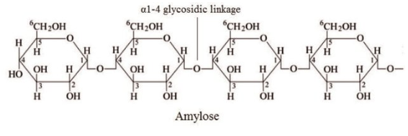
Food Carbohydrates Starch-Amylose
This is a long unbranched chain of D-glucose molecules linked together by α-1,4 linkage, similar to that present in maltose.
Molecular weight of amylose range from 10⁵ to 10⁶ daltons and one molecule of amylose may contain 500 to 5000 glucose molecules.
The solution on keeping turns turbid due to the precipitations of amylose by a process known as retrogradation. Amylose is mainly responsible for the stiffening of cooked rice on standing.
Amylose gives a blue color with iodine. Amylose content of a starch can vary considerably depending on the botanical species. Cereal starches such as wheat starch contains 25 – 30% amylose, corn starch (amylomaize) contains 40 – 80% amylose. Waxy maize contain 0% starch.

Slide 38
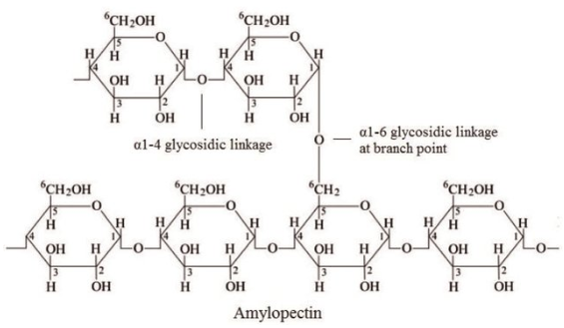
Food Carbohydrates Starch-Amylopectin
Amylopectin is branched chain polysaccharide component of starch. In this polysaccharide short chains (20 to 30 molecules) of D- glucose linked by α-1,4 linkages. These chains are linked to each other by α-1,6 linkages. Molecular weight of amylopectin range from 10⁷ to 10⁸ daltons, and one molecule of amylopectin may contain 50000 to 500000 molecules of D-glucose. Amylopectin gives a purple color with iodine.

Slide 39
Food Carbohydrates Starch-Gelatinization
Starch gelatinization is a process that breaks down the intermolecular bonds of starch molecules in the presence of water and heat, allowing the hydrogen bonding sites (the hydroxyl hydrogen and oxygen) to engage more water.
This irreversibly dissolves the starch granule. Penetration of water increases randomness in the general granule structure and decreases the number and size of crystalline regions.
Crystalline regions do not allow water entry. Heat causes such regions to become diffuse, so that the chains begin to separate into an amorphous form. Under the microscope in polarized light starch loses its birefringence.
Gelatinization is influenced by a number of factors. The gelatinization temperature and the length of heating, plant type (wheat and corn starch show different behavior patterns) and the amount of water present, pH, size of starch granule.
Some type of unmodified native starches start swelling at 55 °C, other types at 85 °C.

Slide 40
Food Carbohydrates Starch-Retrogradation of Starch
In dilute solutions, starch molecules will precipitate, with the insoluble material being difficult to redissolve by heating.
The process of dissolved starch becoming less soluble is called retrogradation.
Retrogradation of cooked starch involves amylose and amylopectin, with amylose undergoing retrogradation at a much more rapid rate than does amylopectin.
The rate of retrogradation depends on several variables, including molecular ratio of amylose to amylopectin; botanical source of starch; temperature; starch concentration; salts; surfactants.
Bread staling is due to starch retrogradation. Staling is due to the gradual transition of amorphous starch to a partially crystalline, retrograded state.

Slide 41
Food Carbohydrates Modified Starches
The behavior of pastes of the common native starches when subjected to the effects of heat and shear used in modern food technology is often unsatisfactory.
Consequently modified starches and starch derivatives with more sophisticated stability characteristics have been developed. Modified starches include-
Acid modified starches
Pre-gelatinized starches
Cross-linked starches
Esters & ethers of starch
Starch phosphates
Hydroxyalkyl substituted starch

Slide 42
Food Carbohydrates Acid Modified Starches
Acid modified or thin boiling starches are prepared by heating starch granules with diluted hydrochloric acid at temperature below that of gelatinization.
The resultant superficially uncharged granules fragment appear to swell less during gelatinization, with a consequent reduced volume and lower maximum hot paste viscosity.
The solubility in hot water is increased, the extent depending on the degree of acid treatment.
Acid-degraded starch, particularly the non-waxy cereal type, is widely used in the manufacture of fruit gums on account of the strength and clarity of the resultant gel which is much improved in comparison to an unmodified, thick-boiling starch.
The viscosity of the gel prepared from acid-modified starch is much lower than that prepared from the corresponding concentration of the unmodified starch.
As a result hot gel can be easily poured into moulds. The acid treatment causes an increase in the resultant gel strength, probably because of the preferential degradation of amylopectin. The gel clarity is also improved.

Slide 43
Food Carbohydrates Pre-gelatinized Starches
For many food uses, a water holding or thickening agent is required to function without the application of heat. For this purpose a pre-gelatinized starch is often used. Pre-gelatinized starch is prepared by destroying the granular structure on cooking, which simultaneously causes a considerable reduction in paste viscosity.
The cooked paste is then dried on rollers or with a spray-drier. The powdered product will easily rehydrate in cold water but, the resultant dispersions are not equivalent to freshly prepared paste. This is due to the starch degradation which has taken place.
The largest use of pre-gelatinized starch is in the instant puddings – a packaged powder which only needs to be mixed with cold milk and allowed to stand for a few minutes, producing a simple pudding. The powders are mixture of pre-gelatinized starch with sugar and flavorings, together with salts which produce sufficient viscosity increase in the milk to keep the starch suspended until hydration can take place.
Another widespread use is in frozen fruit-pie fillings where a pre-gelatinized starch keeps the fruit suspended and helps retain the flavor without the need for heating.

Slide 44
Food Carbohydrates Cross-linked and Other Derivatized Starches
A great number of esters and ethers of starch, with an infinite range of physicochemical properties (particularly with regard to the heat stability), can be prepared.
But use of such derivatives in food is restricted and only a few of these are important in the food industry. Starch phosphates, which have a analogues in the amylopectin fraction of root and tuber starches, are examples of starch derivatives which are suitable as food additives. The introduction of free-acid groups in starch phosphates both increases and stabilizes the paste viscosity by the
Negatively charged phosphate groups expand the molecule in solution
Coulombic repulsion
Prevent the formation of aggregates
Because of their high viscosity and paste clarity, starch phosphates are put to extensive use in foods as thickness and texturizing agents. Their resistance to molecular aggregation is of importance in the formulation of frozen foods.
The swelling and ultimate breakdown of starch granules during cooking can be controlled by introducing a suitable number of cross-linkages between the molecules.
Cross linked phosphate esters may be prepared commercially by esterification with trimetaphosphate. The extent of cross linking is measured by the change in the pasting properties of the derivatives. Starch with low level of phosphate cross linking is also used in textural modification of food e.g. Cross bonded phosphate starches are used as thickeners in salad cream and fruit-pie fillings.
The introduction of hydroxyalkyl substituent increases the solubility of starch and prevents molecular aggregation e.g. hydroxypropyl starch. Hydroxyalkyl starches gelatinize at lower temperature than the parent starch and paste show little tendency to form gels.

Slide 45
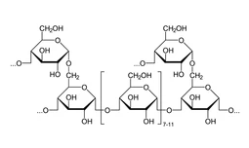
Food Carbohydrates Glycogen
Glycogen the reserve carbohydrate is a polysaccharide found in the animal body. It is found mainly in the
muscles (0.5 to 1 percent) and liver (3 to 7 percent). Glycogen resembles starch in its chemical properties. It is formed by the condensation of a large number (5000-10000) of glucose molecules. It is a branched chain polysaccharide, resembling amylopectin. The chain length varies from 8 to 12 glucose units. The molecular weight of glycogen from different sources range from 10⁵ to 10⁸ daltons.

Slide 46
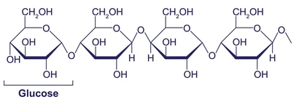
Food Carbohydrates Cellulose
Cellulose is the most abundant polysaccharide in nature, since one-third of all higher plants consists of this biopolymer which functions as the main structural material. It is a linear polymer of D-glucose units linked (1, 4) in the β – configuration. The cellulose chains are unbranched and may contain as many as 5000 glucose units. Because of the β- linkage, the glucose units in the chain alternate, and the molecule is effectively a rigid and straight chain.
Cellulose molecules can readily align themselves side-by-side in an arrangement which is stabilized by intermolecular hydrogen bonding and form crystalline regions. Intermolecular bonding is so strong that cellulose is insoluble in water, and even in strong sodium hydroxide solution.
The cellulose is responsible for the form and gross texture in all foodstuffs prepared from plants. Being insoluble, it is little affected by any cooking process and does not disperse. On ingestion, it is unaffected by enzymes in the digestive tract and does not hydrate.

Slide 47
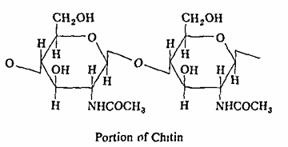
Food Carbohydrates Chitin
Chitin is a homopolysaccharide that occurs as a structural compound in lobster, shrimp, and crab shells as well as in some insects, and fungi.
The shells contain calcium carbonate, proteins, and other compounds, but this polysaccharide is mainly responsible for the rigidity of the tissue.
It is easily extracted. The repeating unit in chitin is 2-N-acetyl glucosamine, linked β-1,4.

Slide 48
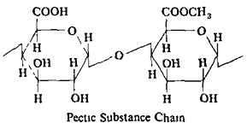
Food Carbohydrates Pectins
The pectins or pectic substances are found universally in the primary cell walls & intercellular layers in plants.
They are most abundant in young tissue. They are characteristic constituent of fruits e.g. citrus fruits contain 30% pectin. The pectic substances are a family of very closely associated polysaccharides which are very difficult to separate. The term ‘pectin’ is used in relation to water-insoluble polysaccharides.
D-galacturonic acid is the principal constituent which is esterified as methyl ester and possess considerable gelling power.
Other constituents include D-galactose, L-arabinose, D-xylose, L-rhamnose and L-fucose. Three types of homopolysaccharides are also present – D-galacturonan, D-galactan, and L-arabinan.
Typical heteropolysaccharides associated with pectic substance include the soyabean L-arabino-D-galactan.
Preparations in which more than half of the carboxyl groups are in the methyl ester form are classified as high-methoxyl pectins, the remainder of the carboxyl groups will be present as a mixture of free acid and salt forms.
Preparations in which less than half of the carboxyl groups are in the methyl ester form are called as low-methoxyl pectins.
Pectin is widely used in marmalade and jelly preparation. High-methoxyl pectin solutions gel sufficient acid and sugar are present. Low-methoxyl pectin solutions gel only in the presence of calcium ions, which provide cross bridges.

Slide 49
Food Carbohydrates Carbohydrate Digesting Enzymes
Degradation of polysaccharides is now largely replaced by enzymatic processes as acid hydrolysis requires the use of corrosion resistant materials which gives rise to high color, salt and ash content (after neutralization), needs more energy for heating and is relatively difficult to control.
Amylases
Enzymes involved in degradation of starch belong to hydrolases (Glycosidases). Amylases are the most important starch degrading enzymes. They hydrolyze the starch to oligosaccharides and simple sugars. Of the two components of starch, amylopectin presents the great challenge to hydrolytic enzyme systems. This is due to the residues involved in α-1,6-glycosidic branch points which constitute about 4 - 6% of the glucose present. Most hydrolytic enzymes are specific for α-1,4-glucosidic links yet the α-1,6-glucosidic links must also be cleaved for complete hydrolysis of amylopectin to glucose. The following are the most important enzymes.

Slide 50
Food Carbohydrates Carbohydrate Digesting Enzymes
α-amylase
α-amylase is an endoenzyme. It hydrolyzes the α-1,4 glycosidic bonds randomly along the chain. Amylopectin is hydrolyzed to oligosaccharides that contain two to six glucose units. The branch points are over jumped. A mixture of amylose and amylopectin is hydrolyzed into a mixture of dextrins, maltose and glucose. Amylose is completely hydrolyzed to maltose. Calcium ions are required for its activation. α-amylase cleaves both amylose and amylopectin molecules producing oligosaccharides. Oligosaccharides of 6-7 glucose units are released from amylose. α-amylase activity leads to a rapid decrease in viscosity of starch solution.
Enzymatic hydrolysis is increased by the gelatinization of starch. α-amylase hydrolyzes the α-1,4-bonds of amylose and amylopectin in a random manner, liberating small units with free non-reducing end groups. Low molecular weight dextrins are formed.
β-amylase
β-amylase also hydrolyzes the α-1,4-bonds of amylose and amylopectin, removing maltose units from the non-reducing end of starch in an orderly fashion. The α-amylase and β-amylase do not cleave the α-1,6-linkagees in amylopectin.
Glucoamylase
Glucoamylase is used in combination with an α-amylase to produce D-glucose syrups and crystalline D-glucose. The enzyme acts upon fully gelatinized starch sequentially releasing single D-glucosyl units from the nonreducing ends of amylose and amylopectin molecules.
Pullulanase
Pullulanase hydrolyzes α-1,6 glucosidic bonds in polysaccharides, e.g. in amylopectin, glycogen, and pullulan. Linear amylose fragments are formed from amylopectin.

