Slide 1
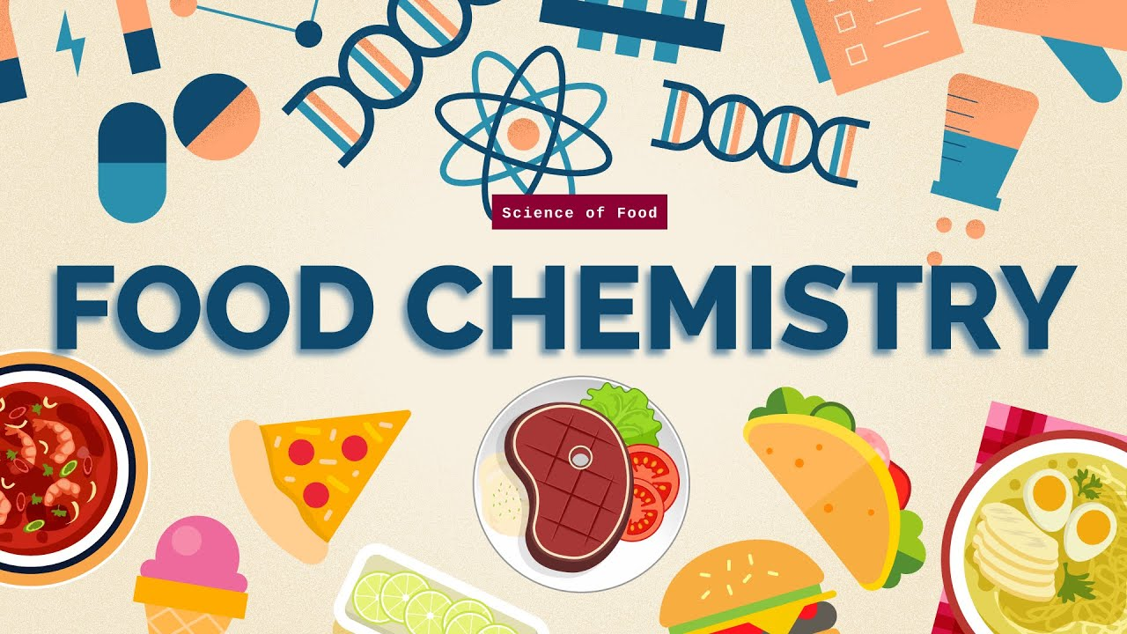
Food Chemistry
0711-2101
DEPARTMENT OF NUTRITION & FOOD ENGINEERING
DAFFODIL INTERNATIONAL UNIVERSITY

Slide 2
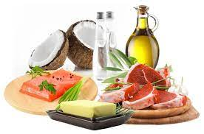
Today’s topic
Fats & Oils

Slide 3
Introduction
Lipids are one of the large group of organic compounds characterized by their hydrophobic nature which are of great importance in food we eat because they are readily digested and absorbed in the body. They are the triesters of long chain fatty acids with glycerols.
They include triglycerides, phospholipids, sterols, and waxes.
Triglycerides are the most common form and consist of glycerol linked to three fatty acid chains.
Lipids play vital roles in energy storage, insulation, cell membrane structure, and signaling pathways.
Fat is used as a medium of cooking in a variety of preparations. The advantages of using fat lies in the ease with which it heats up and its quality to transfer heat. It is better than water or air as it has a higher operating temperature and greater specific heat

Slide 4
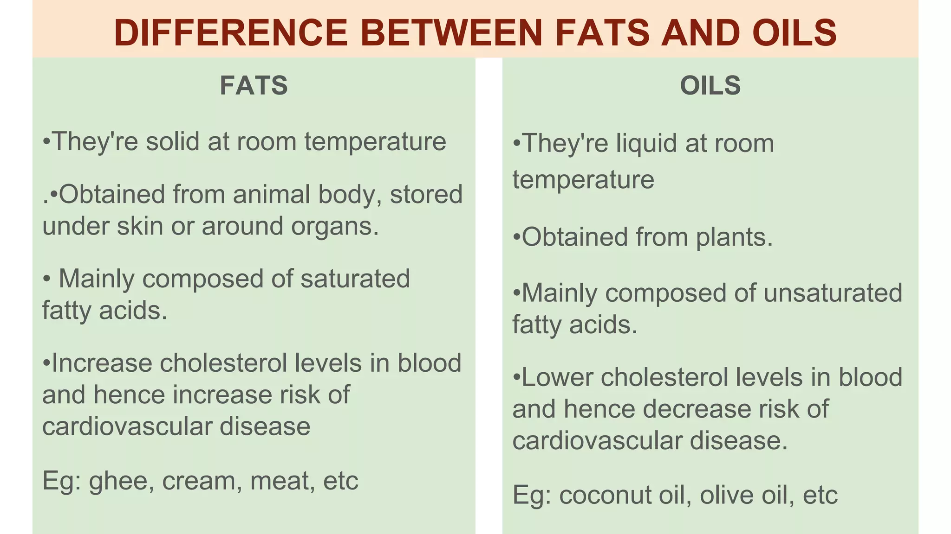

Slide 5
Major functions of fats & oils
1. They are the concentrated source of energy, yielding 9 Kcal per gm of fat against 4 Kcal from proteins and again 4 Kcal from carbohydrates.
2. They serve as a carries of fat soluble vitamins- A ,D ,E, and K.
3. They furnish the essential fatty acids- omega 3 and omega 6 without which the organisms cannot thrive. Essential fatty acids are components of membranes of living cells. They also play a vital role in immunity. Deficiency of essential fatty acids may lead to deficient mental and physical capacities.
4. They are present in each and every cell of the body with high concentration in the cells & tissues of reproductive organs.
5. They have a major role to play in the synthesis of fat-soluble vitamins, sterols and phospholipids.
6. They have a major role to play in the biosynthesis of long chain fatty acids.
7. They have an important role in the synthesis of prostaglandins, which are hormone-like compounds. The EPA (eicosapentaenoic acid) has a role in synthesis of prostaglandins and fats are an excellent source of EPA.

Slide 6
Major functions of fats & oils
8. They reduce the bulk of the diet and increase its calorific value. Since they are slow in leaving the stomach, longer feeling of satiety remains after the intake of fat rich foods.
9. They are themselves good source of fat soluble vitamins. Butter contains a lot of vitamin A while vegetable oils are rich in vitamin E.
10. They are indispensable in cooking as many foods just can’t be cooked without their addition. They transfer heat very fast to the food particles which are cooked in fat.
11. They have the quality of making foods more palatable to which they are added. In fact all the flavours dissolve in fats while cooking, making the food product delicious to the palate.

Slide 7
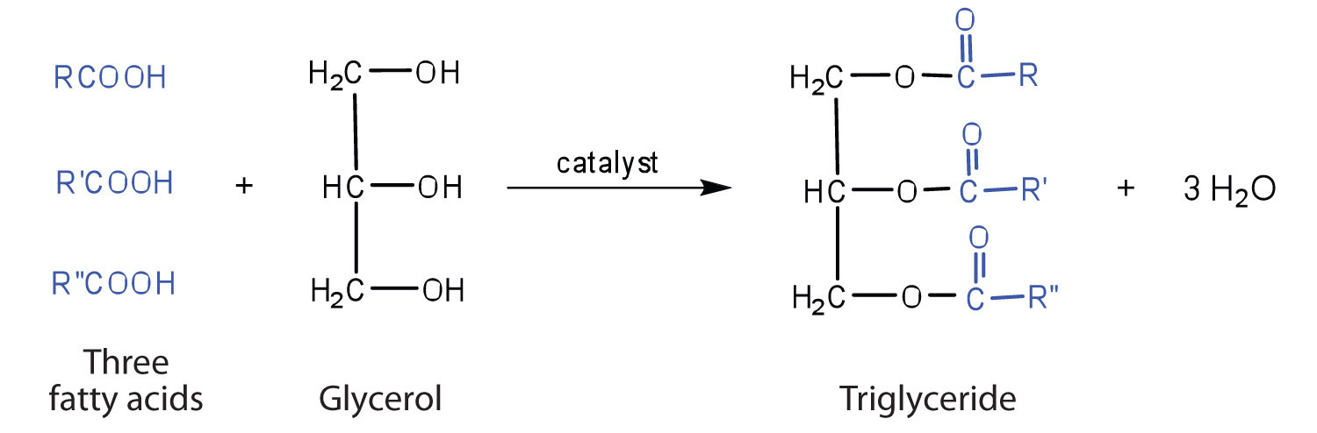
Classification of Lipids
Simple Lipids: Contain only carbon, hydrogen, and oxygen.
  Fats and oils are called triglycerides (or triacylcylgerols)
  Fats: Predominantly saturated fatty acids, solid at room temperature.
  Oils: Contain unsaturated fatty acids, liquid at room temperature.
Compound Lipids: Contain additional elements like phosphorus, nitrogen, or sulfur.
  Phospholipids: Form cell membranes and participate in cellular signaling.
  Glycolipids: Present in cell membranes, involved in cell recognition.
Derived Lipids: Result from hydrolysis or other chemical reactions.
  Steroids: Include cholesterol and hormones like estrogen and testosterone.
  Waxes: Provide waterproofing and protective coatings in plants and animals.

Slide 8
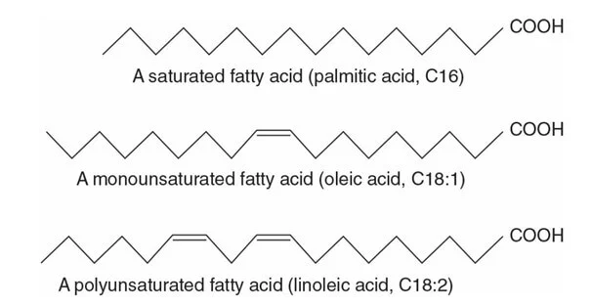
Fatty Acids
Saturated fatty acids: have carbon chains in which all carbon atoms are bonded to the maximum number of hydrogen atoms possible, resulting in no double bonds.
Examples of saturated fatty acids include stearic acid (C18H36O2​) found in animal fats and coconut oil, and palmitic acid (C16H32O2​) found in palm oil and butter.
Unsaturated Fatty Acids: have one or more double bonds in their carbon chain, which results in fewer hydrogen atoms bonded to the carbon atoms.It can be further classified as monounsaturated (containing one double bond) or polyunsaturated (containing multiple double bonds).
Monounsaturated fatty acids are typically liquid at room temperature and are found in olive oil, canola oil, and avocado.
Polyunsaturated fatty acids, such as omega-3 and omega-6 fatty acids, are essential nutrients and are found in sources like fish, nuts, and seeds.
**Trans fatty acids (TFAs) are another unsaturated fatty acids with at least one trans double bond in their molecular structure. They can occur naturally in small amounts in certain animal products like meat and dairy. However, the primary source of trans fats in the human diet is through the process of partial hydrogenation of vegetable oils.

Slide 9
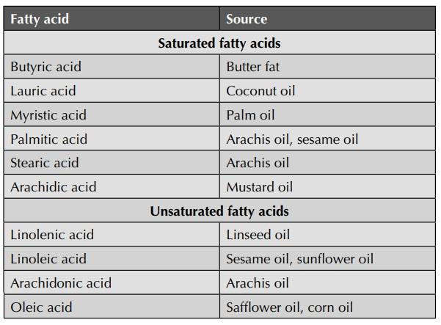
Sources of Some SFA and UFA

Slide 10
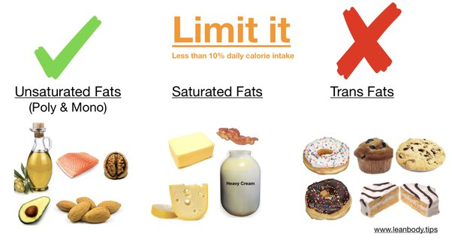

Slide 11
Role of Fats and Oils in Food
Fats and oils serve various functions in food products, including:
  Texture enhancement: Providing creaminess, crispiness, or flakiness.
  Flavor development: Carrying and enhancing the flavors of other ingredients.
  Nutrient absorption: Facilitating the absorption of fat-soluble vitamins (A, D, E, K).
  Satiation: Contributing to the feeling of fullness and satisfaction after eating.
Common dietary sources of fats and oils include:
  Animal fats: Butter, lard, tallow.
  Plant oils: Olive oil, soybean oil, sunflower oil.
  Fish oils: Rich in omega-3 fatty acids, beneficial for heart health.

Slide 12
Essential Fatty acids
Essential fatty acids, such as omega-3 (alpha-linolenic acid) and omega-6 (linoleic acid), cannot be synthesized by the body.
Essential fatty acids (EFAs) are polyunsaturated fatty acids that are essential for human health but cannot be synthesized by the body and must be obtained from the diet. The two primary types of EFAs are omega-3 (alpha-linolenic acid) and omega-6 (linoleic acid).
They must be obtained from dietary sources like fish, nuts, and seeds.
Essential fatty acids are crucial for brain function, cardiovascular health, and inflammatory response regulation.

Slide 13
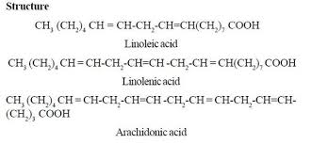
Omega-3 Fatty Acids:
  Examples include alpha-linolenic acid (ALA), eicosapentaenoic acid (EPA), and docosahexaenoic acid (DHA).
  Found in fatty fish (such as salmon, mackerel, and sardines), flaxseeds, chia seeds, walnuts, and certain algae.
  Omega-3 fatty acids play crucial roles in brain function, heart health, inflammation regulation, and the maintenance of healthy skin and hair.
Omega-6 Fatty Acids:
  Examples include linoleic acid (LA) and arachidonic acid (AA).
  Found in vegetable oils (such as corn oil, soybean oil, and sunflower oil), nuts, seeds, and certain grains.
  Omega-6 fatty acids are important for growth and development, immune function, and the regulation of inflammation.

Slide 14
Physical Properties of fats and oils
Melting Point: Temperature at which solid fat transits to liquids. The melting point of fats depends on the degree of saturation and the length of fatty acid chains.
saturated fatty acids tend to have higher melting points as they have straight molecular chains (stronger intermolecular forces), e.g- coconut oil.
Unsaturated fatty acids tend to have lower melting points.
Fats with longer fatty acid chains generally have higher melting points because longer chains allow for more surface area contact and stronger intermolecular forces.
Polymorphism is important to understanding the melting point behavior of fats and fatty acids. It plays role in any operation where fats are solidified. e.g- when chocolate are dipped the formation of high melting point forms is producing by controlling the temperature of solidification

Slide 15
Softening Points: Temperature at which solid fat transits to semisolids or plastic consistency. closely related to the melting point.
Specific Gravity: the specific gravity of fats provides information about their density compared to water. Unsaturation of fatty acids and increase in chain length tend to increase the specific gravity. It is measured at 25°C, but at 40°C or even 60°C for high melting fats.
Refractive Index: It is the measure of how much light is bent (or refracted) as it passes through a sample of fat. It decreases as the temperature rises but increases with the length of carbon chains and no of double bonds present. It is measured at 25°C, but at 40°C or even 60°C for high melting fats.
Smoke, Flash and Fire point: The smoke point is the temperature at which a fat or oil gives off a thin bluish or smoke. The Flash point is the temperature at which the mixtures of vapor with air will ignite; The fire point is the temperature at which the substance will sustain combustion, meaning it continues to burn after being ignited.
Turbidity point: also known as the crystallization point, refers to the temperature at which a clear fat or oil starts to become cloudy or turbid due to the formation of crystals. This phenomenon occurs when the fat undergoes a phase transition from a liquid to a semi-solid or solid state as it is cooled.

Slide 16
Chemical Properties of fats and oils
Hydrolysis: Fats and oils can undergo hydrolysis, a chemical reaction in which water molecules break the ester bonds that link fatty acids to the glycerol backbone. This reaction, catalyzed by enzymes called lipases or by acids, produces fatty acids and glycerol. Hydrolysis can occur during food digestion, food processing, or storage, leading to the degradation of fats and the formation of off-flavors and odors.
Triglyceride+3 Water→Glycerol+3 Fatty Acids
Oxidation: Oxidation is a chemical reaction in which fats and oils react with oxygen molecules, leading to the formation of oxidative by-products such as peroxides, aldehydes, and ketones. This process, known as lipid oxidation or rancidity, can occur through autoxidation, photooxidation (exposure to light), or enzymatic oxidation (catalyzed by enzymes). Lipid oxidation affects the flavor, aroma, and nutritional quality of fats and oils, leading to off-flavors, rancid odors, and loss of unsaturated fatty acids.
Fatty Acid+Oxygen→Peroxides+Aldehydes+Other Oxidation Products
Polymerization: Under certain conditions, such as prolonged heating or exposure to high temperatures, fats and oils can undergo polymerization, a chemical reaction in which the fatty acid molecules combine to form larger molecules or polymers. Polymerization can lead to the formation of polymers with altered physical properties, such as increased viscosity or decreased fluidity. In food processing, polymerization can affect the texture and stability of fats and oils, leading to changes in product quality

Slide 17
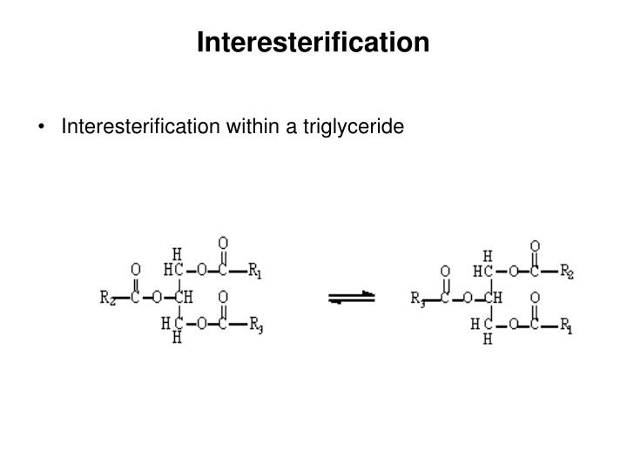
Interesterification: Interesterification is a chemical reaction involving the rearrangement of fatty acids within triglyceride molecules. It is typically used to modify the physical properties of fats and oils, such as their melting point, crystallization behavior, and stability, without the need for hydrogenation. Interesterification can be carried out enzymatically or chemically, and it involves the exchange of fatty acid chains between different triglyceride molecules.
Hydrogenation: Unsaturated fats are saturated with hydrogen, converting liquid oils into solid fats, but may also produce trans fats with health implications.
Unsaturated Fatty Acid+Hydrogen→Saturated Fatty Acid

Slide 18
Rancidity in Fats : refers to the development of off-flavors and off-odors in fats and oils due to the oxidation of unsaturated fatty acids present in the lipid molecules.
The three main types of rancidity in fats and oils are:
Hydrolytic Rancidity: Hydrolytic rancidity occurs when the ester bonds between fatty acids and glycerol in fats and oils are broken down by water or enzymes called lipases. One example is the rancidity of butter due to the action of lipases naturally present in the milk. When butter is stored improperly, moisture can promote the hydrolysis of its triglycerides, resulting in the release of free fatty acids and the development of a sour taste and smell.
Oxidative Rancidity: Oxidative rancidity occurs when fats and oils react with oxygen in the air, leading to the formation of oxidative by-products such as peroxides, aldehydes, and ketones. This process, known as lipid oxidation, alters the flavor, aroma, and nutritional quality of the fats and oils, resulting in off-flavors and off-odors. For instance, when cooking oil is repeatedly used for frying at high temperatures, it can undergo oxidative rancidity, leading to the development of off-flavors and off-odors. Certain metals e.g. copper speeds up the oxidative rancidity.
Ketonic Rancidity: This type is most frequently encountered as a result od action of molds and fungus such as Aspergillus niger , Penicillium glaucum on coconut or other oilseeds The tallowy odour developed maybe due to aldehydes and ketones formed by the action of the enzymes present in the fungi on oils. For example, when nuts or seeds containing fats are stored in warm and humid conditions, molds can grow and produce enzymes that cause microbial rancidity, resulting in a musty or unpleasant taste and smell. .

Slide 19
Test for Rancidity in Fats:
1. Peroxide value
2. Determination of Carbonyl compound
3. Active Oxygen Determination
4. Thio-barbutiric Acid (TBA) Test
5. Schaal Oven Test

Slide 20
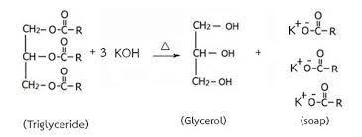
Chemical tests
To identify fats and to detect adulteration-
Reichert Meissl Number: the number of milliliters of 0.1 N alkali (KOH) required to neutralize the volatile fatty acids obtained from 5 grams of fat or oil. It is a parameter used to quantify the amount of volatile fatty acids (the range of molecular weights from butyric acid(C4) to myristic acid (C14) ),present in a fat or oil sample. It is commonly used as an indicator of the extent of hydrolysis or rancidity in fats and oils.
Saponification Value (SV) Test: the milligrams of potassium hydroxide (KOH) required to saponify 1 gram of fat or oil . It Calculates average molecular weight of fatty acids. Fats with higher saponification numbers generally contain shorter fatty acid chains or a higher proportion of unsaturated fatty acids, whereas fats with lower saponification numbers typically have longer fatty acid chains or a higher proportion of saturated fatty acids.

Slide 21
Acid Value (AV) Test: The acid value is expressed as the number of milligrams of potassium hydroxide (KOH) or sodium hydroxide (NaOH) required to neutralize the free fatty acids present in one gram of fat or oil. It measures free fatty acids, indicating hydrolysis or rancidity. Also provides valuable information about the freshness, quality, and stability of fats and oils, as higher acid values indicate higher levels of free fatty acids, which can result from hydrolytic or oxidative rancidity.
Iodine Value (IV) Test: The iodine number is expressed as the number of grams of iodine absorbed per 100 grams of fat or oil. It provides information about the level of unsaturation present in the sample, with higher iodine numbers indicating a higher degree of unsaturation and lower iodine numbers indicating greater saturation. It helps determine the oxidative stability, shelf life, and nutritional quality of fats and oils, as well as their suitability for various culinary and industrial applications.
Peroxide Value (PV) Test: Quantifies peroxide concentration, signaling early lipid oxidation. It is determined by titrating the sample with a reducing agent (e.g., potassium iodide) and then titrating the liberated iodine with a standardized thiosulfate solution

Slide 22
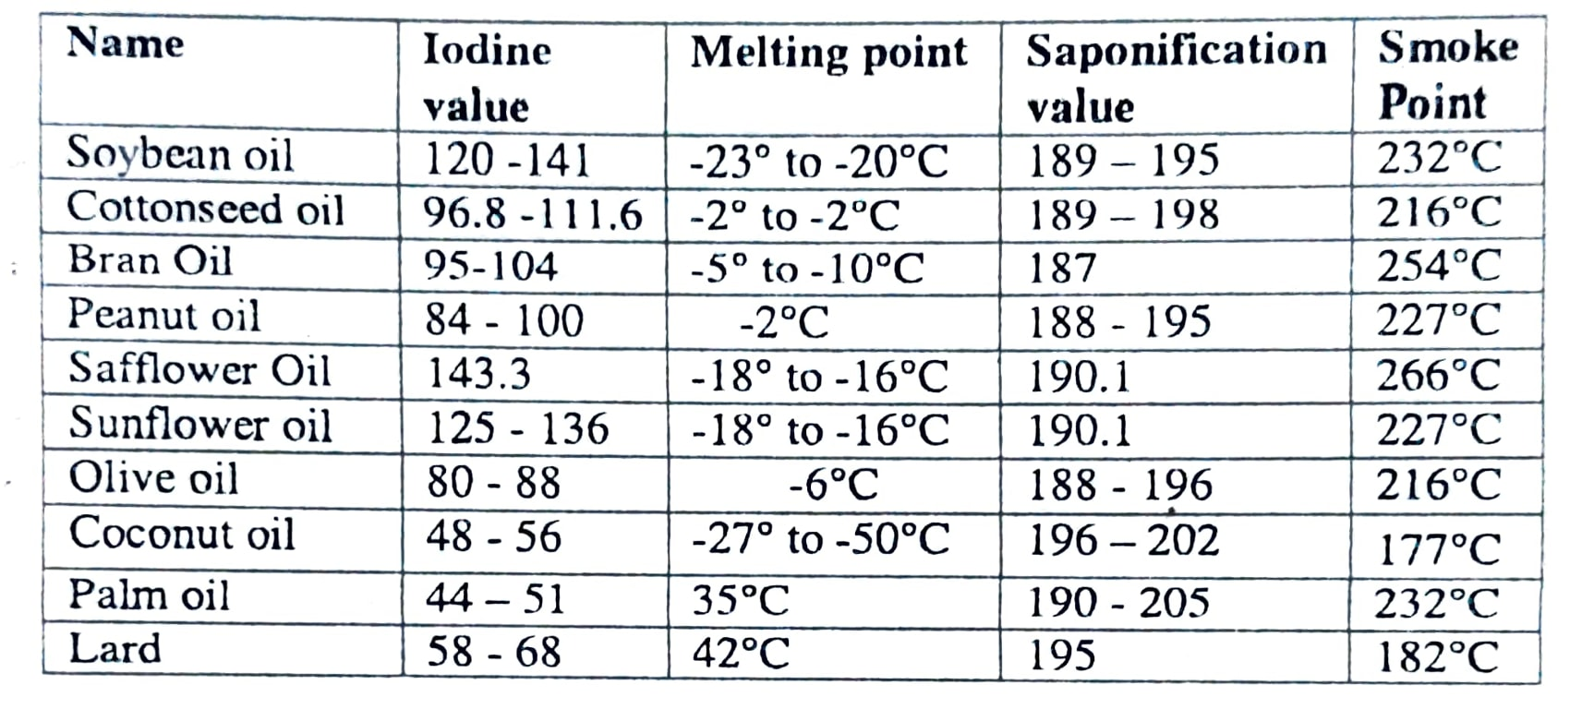
Chemical characteristics of some oils and fats

Slide 23
Fat processing
Refining of oils and fats: is a vital process that eliminates impurities, undesirable flavors, and colors from crude oils, ensuring high-quality edible oils. This process involves several key steps:
Neutralization: Crude oil undergoes treatment with an alkali, usually sodium hydroxide, to remove free fatty acids. This reaction forms soap, which separates from the oil, reducing off-flavors and enhancing quality.
Bleaching: The oil is treated with adsorbents like activated charcoal or bleaching earth to remove pigments, trace metals, and other impurities, resulting in clearer and visually appealing oil.
Deodorization: This final step removes volatile compounds causing off-odors from the oil. Steam or vacuum distillation is used to heat the oil under reduced pressure, removing unwanted odors and improving overall aroma and taste.

Slide 24
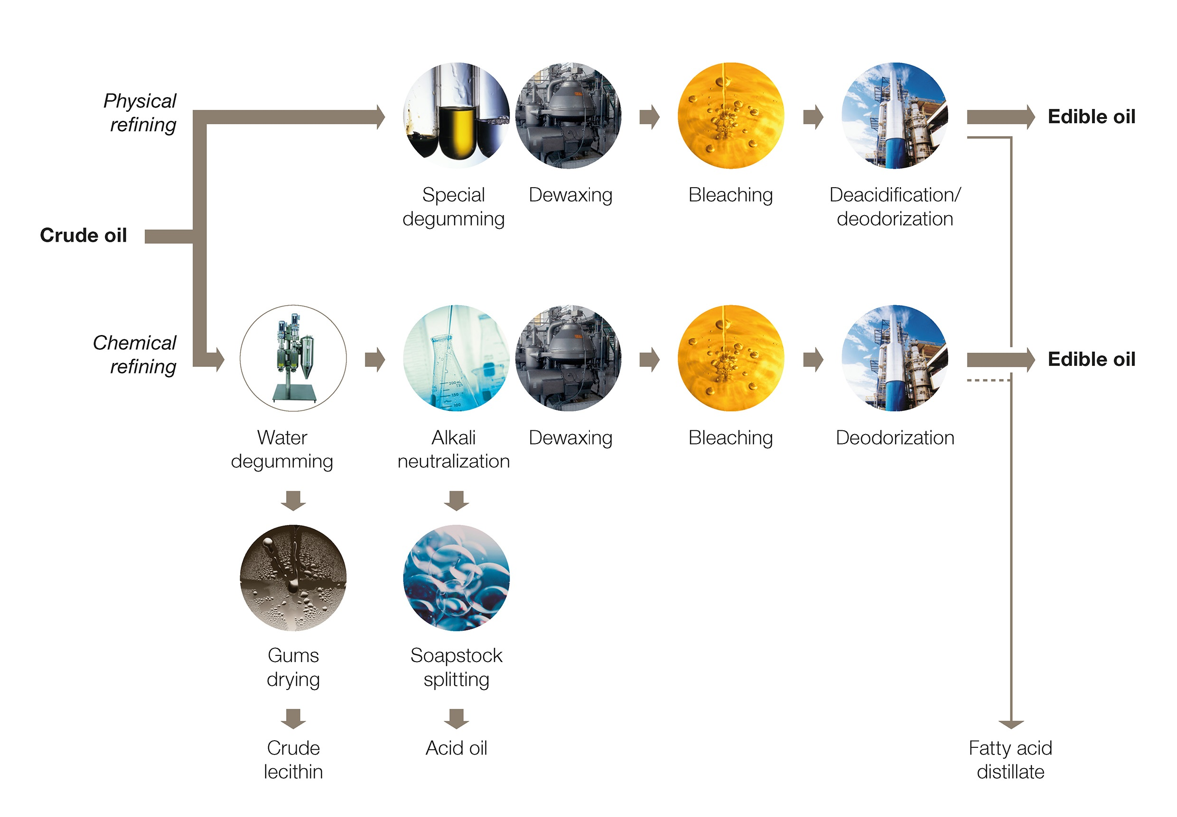
Edible oil Refining

Slide 25
Shortenings and Spreads: Shortenings are fats commonly employed in baking to impart tender textures to pastries, cakes, and cookies. They facilitate the creation of delicate and flaky baked goods by inhibiting gluten formation, resulting in a softer and more crumbly texture.
On the other hand, spreads refer to semi-solid fats applied to bread, crackers, and sandwiches for flavor enhancement and moisture retention. They are versatile additions to various dishes and are often used as substitutes for butter or as toppings for toast and other baked goods.
Examples of spreads include margarine, which is a vegetable oil-based spread, and vegetable shortening, a solid fat primarily utilized in baking to achieve desired textures and consistency in baked goods.

Slide 26
Fat Replacer: Substances used to mimic the functionality of fats in food products while reducing overall fat content. Serve to maintain taste, texture, and mouthfeel of foods while reducing fat content. Utilized in food manufacturing to create low-fat or reduced-fat versions of products without compromising sensory qualities. Carbohydrate-based replacers (e.g., cellulose derivatives) and protein-based replacers (e.g., whey protein) are common.
Essential Oils: Concentrated hydrophobic liquids extracted from plants, containing volatile aromatic compounds. Not fats or oils in the traditional sense but relevant to the discussion due to their lipid-like properties. Utilized in food flavoring, aroma, and preservation due to their potent aromatic properties. Examples include peppermint oil, lavender oil, and lemon oil.

Slide 27
Extraction of Essential Oils
  Distillation: The most common method where steam is passed through plant material, carrying volatile compounds which are then condensed to extract the essential oil.
  Expression (Cold Pressing): Used for citrus fruits where the peel is mechanically pressed to release essential oils.
  Solvent Extraction: Solvents like hexane are used to dissolve essential oils from plant material, and then the solvent is evaporated to leave behind the oil.
Refining of Essential Oils
  Filtration: Initial step to remove larger particles and impurities from the crude oil.
  Distillation: Further distillation may be employed to remove any remaining impurities or unwanted compounds.
  Fractional Crystallization: Utilized to separate different components of the essential oil based on their freezing points.
  Fractional Distillation: Used to separate components with different boiling points, ensuring the final oil is pure and of high quality.
(Extra information: Rendering is the process of heating and melting animal fat to separate it from connective tissue, proteins, and water. During rendering, fat is liquefied, allowing impurities to be filtered out. This produces a clear liquid fat, often called tallow or lard, which can be used for cooking, soap making, or other industrial applications.)

Slide 28
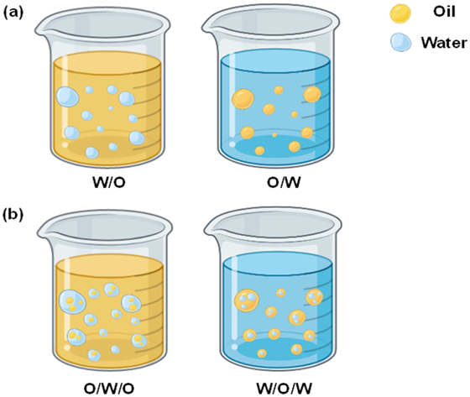
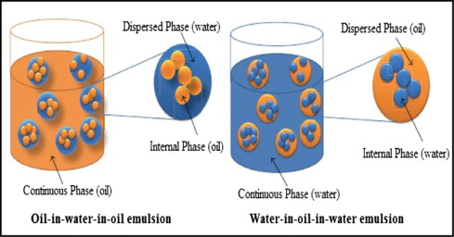
Emulsion
An emulsion is a mixture of two immiscible liquids, where one is dispersed in the other in the form of tiny droplets.
Fats and oils, being hydrophobic (water-repellent), do not mix readily with water, which is hydrophilic (water-attracting).However, by utilizing emulsifiers or stabilizers, it's possible to create stable emulsions of fats and oils in water-based solutions.
Common emulsifiers include lecithin, egg yolks, and certain proteins, which have both hydrophilic and hydrophobic regions that can interact with both water and oil molecules, facilitating their dispersion. Examples of emulsions of fats and oils include mayonnaise, salad dressings, and vinaigrettes, where oil droplets are dispersed in a water-based medium.
The stability of these emulsions is crucial and can be affected by factors such as the ratio of oil to water, the type and concentration of emulsifier used, and the processing conditions. Emulsions play a significant role in food texture, mouthfeel, and flavor, providing a creamy and smooth consistency to various culinary preparations.

Slide 29
Factors affecting fat absorption
Factor | Effect
Moisture | All foods contain moisture which causes hydrolysis of fats, resulting in greater absorption of fats.
Temperature | If cooking is done at Lower temperatures for longer periods, more absorption of fats take place
Length of cooking | More the length of cooking period, greater is the absorption of fat
Sugar | Increases the absorption of fat by fried foods
Types of Surfaces | Smooth surfaces absorb less fat than porous surface. If the surface has fissures and cracks fat absorption increases. Therefore bread, dhokla, idli absorb more fat
Surface exposed | Greater the surface area of the product, more will be the fat absorption and vice versa
Egg Yolk | Addition of egg yolk to food products increases the absorption of fat
Wheat flour | Products made from soft wheat flour absorb more fat than those made from hard wheat flour. This is because of difference in gluten content of both the flours. Hard wheat flours have strong gluten which interferes with fat absorption
Shortening | Addition of more shortening to the dough or batter of the fried product, retards the development of gluten, resulting into greater absorption of fats
Smoke point of fat | There is a negative correlation between smoke point of fat & quantity of fat absorbed. Greater fat absorption takes place if foods are fried in fats of low smoke point.

Slide 30
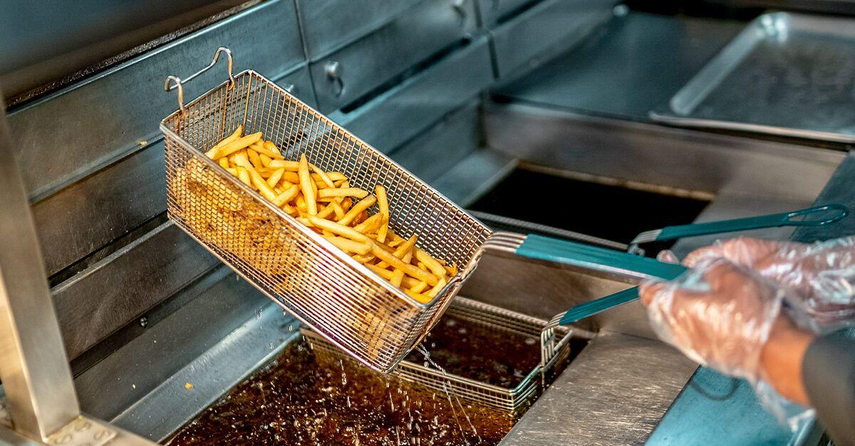
Changes in fat during Cooking/ Baking/ Frying
Most fats appear to withstand normal cooking and baking conditions and temperature without major objectionable changes. If fats are not properly used i.e. they are continuously heated at high temperatures, there may be undesirable changes in flavor, odor and nutritional value of fats, however. Some of the changes that may occur are:
an increase in free fatty acids,
a decrease in iodine number,
an increase in refractive index,
a decrease in smoke point,
an increase in peroxide value,
an increase in carbonyl value,
a decrease in melting point,
a darkening of color,
an increase in viscosity,
an increase in foaming,
polymerization of the fat

Slide 31
Thank you

