Slide 1
Fundamentals of
Research Methodology
Abdullah Al Mamun
Associate Professor
Department of TE
Daffodil International University

Slide 2
Meaning of Research
According to Clifford Woody research comprises defining and redefining problems, formulating hypothesis or suggested solutions; collecting, organising and evaluating data; making deductions and reaching conclusions; and at last carefully testing the conclusions to determine whether they fit the formulating hypothesis.
D. Slesinger and M. Stephenson in the Encyclopaedia of Social Sciences define research as “the manipulation of things, concepts or symbols for the purpose of generalising to extend, correct or verify knowledge, whether that knowledge aids in construction of theory or in the practice of an art.
The search for knowledge through objective and systematic method of finding solution to a problem is research.

Slide 3
Objective of Research
1. To gain familiarity with a phenomenon or to achieve new insights into it (studies with this object in view are termed as exploratory or formulative research studies);
2. To portray accurately the characteristics of a particular individual, situation or a group (studies with this object in view are known as descriptive research studies);
3. To determine the frequency with which something occurs or with which it is associated with something else (studies with this object in view are known as diagnostic research studies);
4. To test a hypothesis of a causal relationship between variables (such studies are known as hypothesis-testing research studies).

Slide 4
Motivation in Research
1. Desire to get a research degree along with its consequential benefits;
2. Desire to face the challenge in solving the unsolved problems, i.e., concern over practical problems initiates research;
3. Desire to get intellectual joy of doing some creative work;
4. Desire to be of service to society;
5. Desire to get respectability.

Slide 5
Research Approaches
Quantitative approach
Qualitative approach
Quantitative approach can be further classified into:
Inferential
Experimental
Simulation approaches

Slide 6
Significance of Research
Research has its special significance in solving various operational and planning problems of business and industry.
Research is equally important for social scientists in studying social relationships and in seeking answers to various social problems
In addition:
(a) To those students who are to write a master’s or Ph.D. thesis, research may mean a careerism or a way to attain a high position in the social structure;
(b) To professionals in research methodology, research may mean a source of livelihood;
(c) To philosophers and thinkers, research may mean the outlet for new ideas and insights;
(d) To literary men and women, research may mean the development of new styles and creative work;
(e) To analysts and intellectuals, research may mean the generalisations of new theories.

Slide 7
What is research, really??
What you are doing in thesis….Research
  Re – Again
  Search – To find something
    So, in research, you are searching for
      Inventing something new
      A solution of a specific problem
      Alternative solution of a problem
      Modification/Refine of a solution
      Criticism of a practiced solution or
      Study of a process/operation (Weakest one)

Slide 8
Choosing Project
Good idea about the arena where you want to research/thesis
Facility to conduct the thesis
Choose the area in where you want to do job/ build your career.

Slide 9
Criteria of Good Research
The qualities of a good research are as follows:
Good research is systematic
Good research is logical
Good research is empirical
Good research is replicable

Slide 10
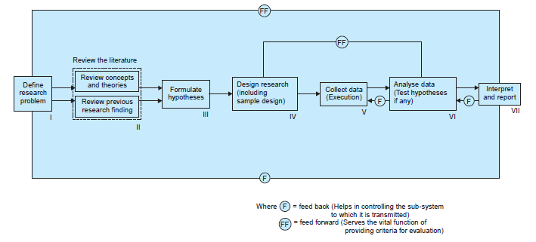
Research Process

Slide 11
Thanks For Your Patience Hearing!

