Slide 1
BIG DATA ANALYTICS
Big Data and IoT
Prepared By:
Mahmudul Hasan Khan (201-15-13791)
Shraboni Khan (202-15-14404)
Dipayan Das (201-15-14234)

Slide 2
What is big data?
Big Data refers to a huge volume of data, that cannot be stored and processed using the traditional computing approach within a given time frame.

Slide 3
Example of big data
For example, if we try to attach a document that is of 100 megabytes in size to an email, we would not be able to do so. As the email system would not support an attachment of this size.
Therefore this 100 megabytes of attachment with respect to email can be referred to as Big Data.

Slide 4
What is Big Data Analytics?
Big Data Analytics is a process to extract meaningful insight from big such as hidden patterns, unknown correlations, market trends and customer preferences.

Slide 5
Types of Big Data Analytics
Structured Data
Unstructured Data
Semi-Structured Data

Slide 6
Structured Data
Structured Data refers to the data that has a proper structure associated with it. For example, the data that is present within the databases, the CSV files, and the excel spreadsheets can be referred to as Structured Data.

Slide 7
Unstructured Data
Unstructured Data refers to the data that does not have any structure associated with it at all. For example, the image files, the audio files, and the video files can be referred to as Unstructured Data.

Slide 8
Semi-Structured Data
Semi-Structured Data refers to the data that does not have a proper structure associated with it. For example, the data that is present within the emails, the log files, and the word documents can be referred to as Semi-Structured Data.

Slide 9
Characteristics of Big Data
Big Data is categorized into 3 important characteristics:
Volume
Velocity
Variety

Slide 10
Volume | Velocity | Variety
Volume refers to the amount of data that is getting generated. | Velocity refers to the speed at which the data is getting generated. | Variety refers to the different types of data that is getting generated.

Slide 11
Process of Big Data Analytics

Slide 12
Tools used in Big Data Analytics

Slide 13
Big Data application domains

Slide 14
Education
Enhancing student results
A better grading system
Gaining attention
Customized programs
Reducing the number of dropouts

Slide 15
Healthcare
Health tracking
Improve the care delivery system / machinery
Fraud detection and prevention
Real-time alerts

Slide 16
Weather Forecast
Estimates of areas where flooding is likely to be most severe
The strength and direction of tropical storms
The most likely amount of snow or rain that will fall in a specific area
The most likely locations of downed power lines
Estimates of areas where wind speeds are likely to be greatest

Slide 17
Agriculture
Boosting productivity
Access to plant genome information
Predicting yields
Risk management
Food safety
Savings

Slide 18
Manufacturing
Product quality
Defects tracking
Supply planning
Manufacturing process defect tracking
Testing and simulation of new manufacturing processes

Slide 19
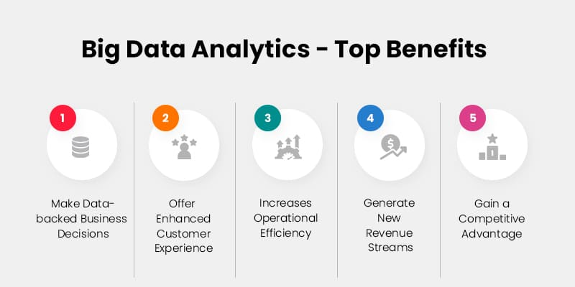

Slide 20
Some Real Time Applications of Big Data

Slide 21
Google Big Data
Google developed several open source tools and techniques that are extensively used in big data ecosystem. With the help of different big data tools and techniques, Google is now capable of exploring millions of websites and fetch you the right answer or information within milliseconds.

Slide 22
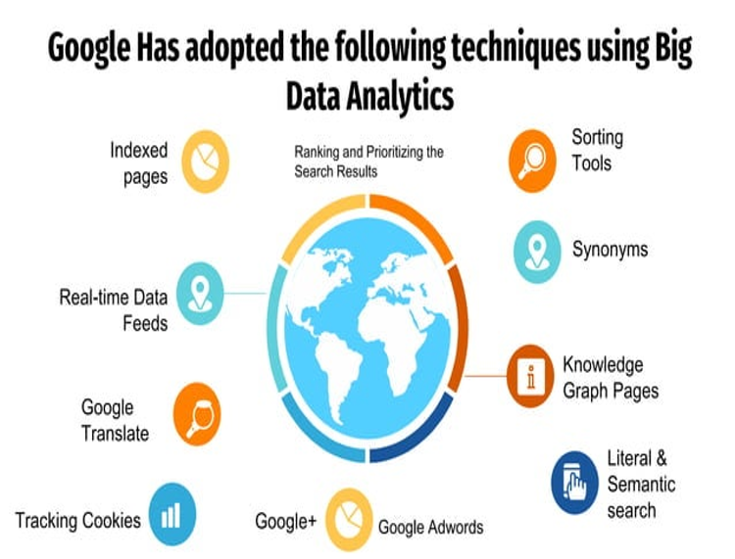

Slide 23
IBM’s Weather Forecasting
One example of an application of big data to weather forecasting is IBM’s Deep Thunder. Unlike many weather forecasting systems, which give general information about a broad geographical region, Deep Thunder provides forecasts for extremely specific locations, such as a single airport, so that local authorities can get critically important information in real time.

Slide 24
Thank You

