Slide 1
Chapter 1
Introduction to ICT and Computer

Slide 2
Learning Objectives
Basic Concept of ICT
Components of ICT
Applications of ICT
Drawbacks of ICT
Definition of Computer
Data v/s Information
Characteristics of a Computer
Various Parts of Computer System
Historical Evolution of Computing
Various types of Computer
Users Of Computer

Slide 3
Basic Concept of ICT
ICT includes any product that collect , process and store information electronically and help you access, use, and share information.
It is an umbrella term that includes any communication device, encompassing: radio, television, cellular phones, computer and network, hardware and software, satellite systems and so on, as well as the various services and applications associated with them, such as videoconferencing and distance learning.

Slide 4
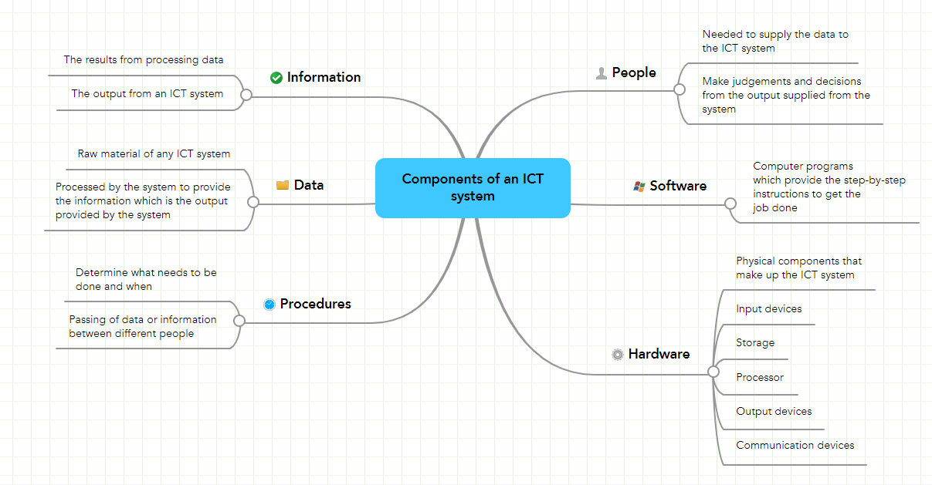
Components of ICT

Slide 5
Applications of ICT
ICT in Education
ICT in Agriculture
ICT in Medicine
ICT in Defense
ICT in Government
ICT in E-Commerce
ICT in Banking
ICT in Transport

Slide 6
Drawbacks of ICT
Lack of Job Security
Overriding Cultures
Lack of Security/Privacy
Reliance on Technology
Cyber Bulling
Costs of Implementation and Regulatory Compliance
Computer Viruses

Slide 7
The Computer Defined
The word computer comes from the word “compute “ which means, “to calculate". Thereby, a computer is an electronic device that can perform arithmetic operations at high speed.
A computer is also called a data processor because it can store, process, and retrieve data whenever desired.

Slide 8
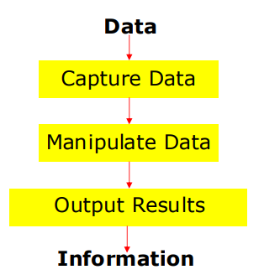
Data Processing
The activity of processing data using a computer is called data processing .
DATA is raw material used as input and INFORMATION is processed data obtained as output of data processing.

Slide 9
Characteristics of a Computer
1) Automatic: Given a job, computer can work on it automatically without human interventions.
2) Speed: Computer can perform data processing jobs very fast, usually measured in microseconds, nanoseconds , and picoseconds.
3) Accuracy: Accuracy of a computer is consistently high and the degree of its accuracy depends upon its design. Computer errors caused due to incorrect input data or unreliable programs are often referred to as Garbage- In-Garbage-Out (GIGO)

Slide 10
Characteristics of a Computer
4) Diligence: Computer is free from monotony, tiredness, and lack of concentration. It can continuously work for hours without creating any error.
5) Versatility: Computer is capable of performing almost any task, if the task can be reduced to a finite series of logical steps.
6) Power of Remembering: Computer can store and recall any amount of information because of its secondary storage capability. It forgets or looses certain information only when it is asked to do so.

Slide 11
Characteristics of a Computer
7) No I.Q.: A computer does only what it is programmed to do. It cannot take its own decision in this regard.
8) No Feelings: Computers are devoid of emotions. Their judgment is based on the instructions given to them in the form of programs that are written by human.

Slide 12
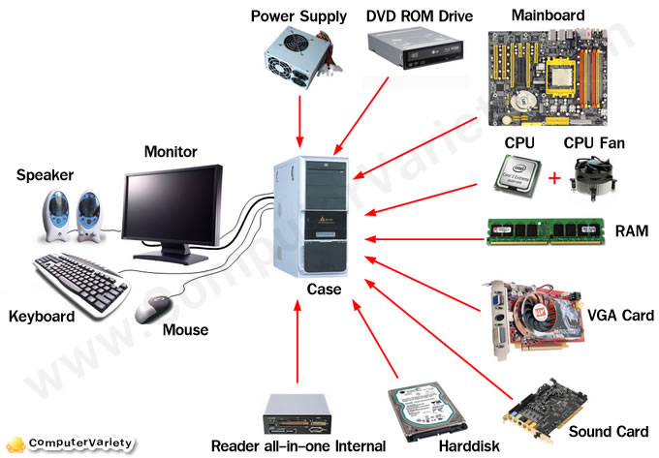
Parts of a Computer System

Slide 13
Evolution of Computers
Blaise Pascal invented the first mechanical adding machine in 1642 .
Baron Gottfried Wilhelm von Leibniz invented the first calculator for multiplication in 1671 .
Keyboard machines originated in the United States around 1880 .
Around 1880, Herman Hollerith came up with the concept of punched cards that were extensively used as input media until late 1970s .

Slide 14
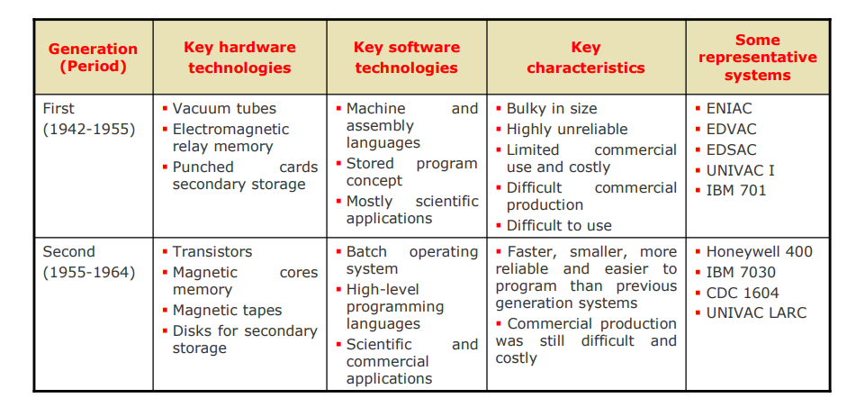
Historical Evolution of Computer

Slide 15
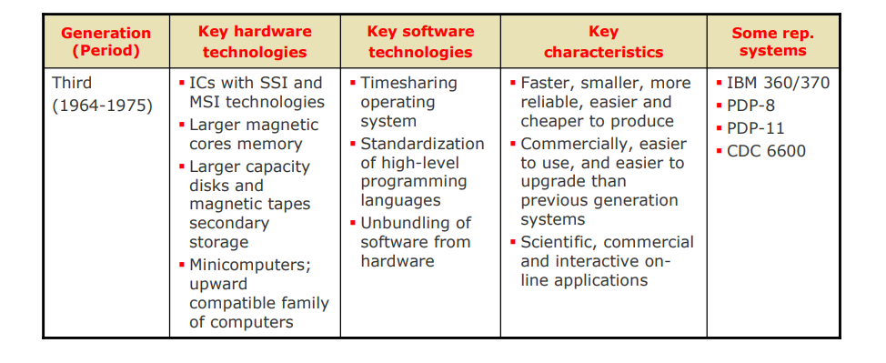
Historical Evolution of Computer

Slide 16
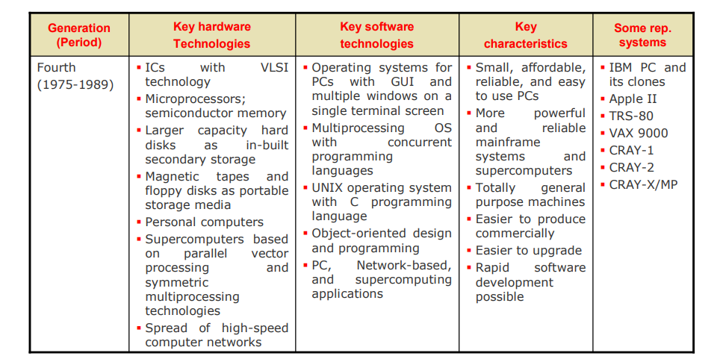
Historical Evolution of Computer

Slide 17
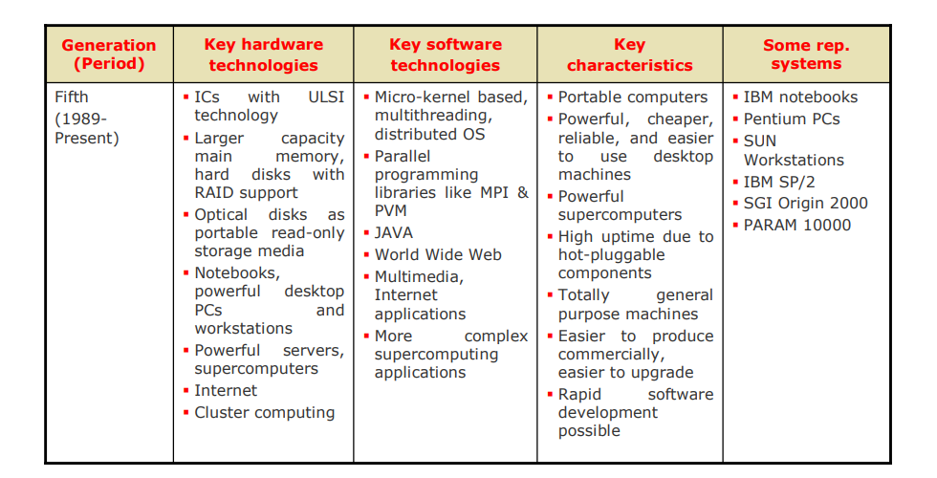
Historical Evolution of Computer

Slide 18
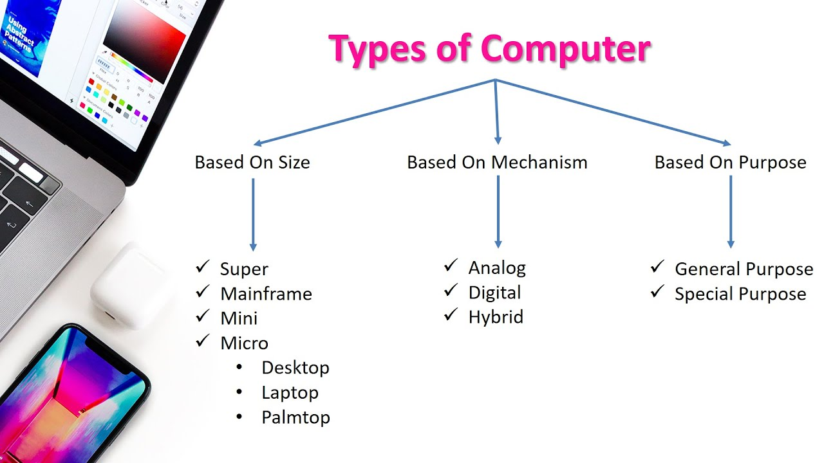

Slide 19
Analog Computer
A computer in which numerical data are represented by measurable physical variables, such as electrical voltage.
An analog computers is a form of computer that uses the continuously changeable aspects of physical phenomena such electrical, mechanical, or hydraulic quantities to model the problem being solved.
Analog computers are also used in science and industry.
Analog computers deal with measure data.
Examples:
1. Thermometer because it measures the length of a mercury column, which varies continuously.
2. Analog Clock
3. Car Speedometer

Slide 20
Digital Computer
A digital computer is an electronic computing machine that uses the binary digits(bits) 0 and 1 to represent all forms of information internally in digital form.
Every computer has a set of instructions that define the basic functions it can perform.
Sequences of these instructions constitute machine-language programs that can be stored in the computers.
Examples:
1. Calculator (a small computer)
2.Digital clock, Digital watches
3. Weighing machines
4. Consumer electronic equipment (such as microwave oven )
5. Automobiles

Slide 21
Hybrid Computer
Hybrid computes are computers that exhibit features of analog computers and digital computers.
The digital component normally serves as the controller and provides logical operations.
The analog component normally serves as a solver of differential equations.
Examples:
Gas Pump Station (where measurement of gas by analog system, and displaying such calculation by digital system(computer).

Slide 22
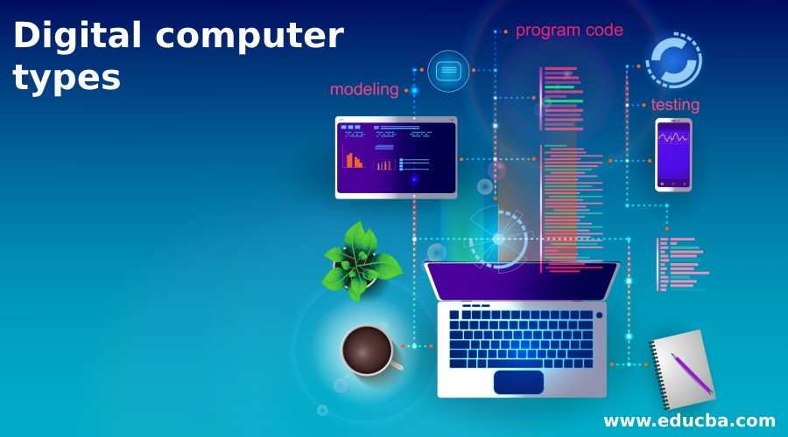
Types of Digital Computer
Based on the types and size of the device, these digital computers are divided into 4 types namely Micro computer, Mini computer, Mainframe computer, and Super computer

Slide 23
Super Computer
Supercomputers are the fastest, largest, most expensive & also the most powerful computers available. They are very fast in processing. They can perform many complex calculations in a fraction of a second.
Most Supercomputers use multiple processors. In this case, a single task is split among the processors for faster execution. However, all the processors are controlled by a single central processor. Supercomputers generate a lot of heat, & therefore require special cooling systems.
Supercomputers are very large & heavy, and are usually kept under special environmental conditions (i.e., in a special room). They are operated by computer specialists. A Supercomputer can be operated by over 500 users at the same time
Areas where supercomputers are used:
  Weather forecasting.
  Petroleum research.
  Defense and weapon analysis.
  simulation.

Slide 24
Mainframe Computer
Mainframes are less powerful & less expensive than supercomputers. They are big in size but smaller compared to Supercomputers. Are powerful computers with very high capacities of main storage. They also have a large backing storage capacity.
Have a very high processing speed, i.e., can process large amounts of data very quickly. They can support a large number of peripherals of different types. They can handle hundreds of users at the same time, e.g., they can be operated by 200 users at a time.
Mainframe computers are general-purpose, and can handle all kinds of problems whether scientific or commercial.
Areas where mainframe computers are used:
  In Banks & Hospitals for preparing bills, Payrolls, etc.
  In communication networks such as the Internet where they act as Servers.
  By Airline reservation systems where information of all the flights is stored.

Slide 25
Mini Computer
A Minicomputer is physically smaller than a mainframe. However, it can support the same peripheral devices supported by a mainframe.
A Minicomputer can support several users at a time, e.g., can be operated by 6 users at a time. Several workstations/ terminals are connected to one central minicomputer so that the users connected can share its resources (C.P.U time, storage, etc.).
Minicomputers are easier to manufacture & maintain compared to mainframes. Minicomputers are cheaper than the mainframes, but more costly than the microcomputers. They handle small amounts of data, are less powerful, & have less memory than the mainframes.
Areas where minicomputers are used:
  Scientific laboratories & research institutions.
  Engineering plants/factories to control of chemical or mechanical processes.
  Space industry.
  Insurance companies & Banks for accounting purposes

Slide 26
Micro Computer
Microcomputers are the PCs mostly found today in homes, schools & many small offices. They are called Personal Computers (PCs) because they are designed to be used by one person at a time.
The data processing in microcomputers is done by a Microprocessor
Their design is based on Very Large Scale Integration (VLSI) that confines several physical components into an IC.
Areas where microcomputers are used:
  Training and learning institutions such as schools.
  Small business enterprises, and
  Communication centres as terminals.

Slide 27
Computers For Individual Use
Desktop computers
  The most common type of computer
  Sits on the desk or floor
  Performs a variety of tasks
Notes:
Insider information
System units are commonly called cases. Many computer enthusiasts customize or ‘mod’ their cases with windows and lights. See www.casemodgod.com for examples of cases and products.
Sun Microsystems makes the most popular workstations on the planet. Sun’s systems are used in diverse applications such as medical imaging and CGI (computer generated image) animation.

Slide 28
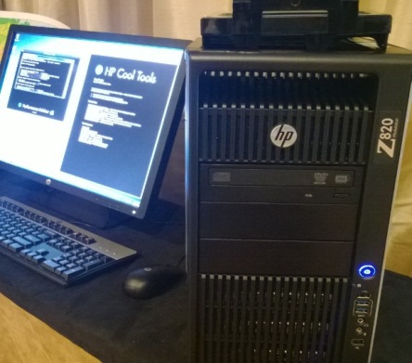
Computers For Individual Use
Workstations
  Specialized computer that is more powerful than a desktop
  Designed for technical or scientific applications
  Optimized for scientists, engineers, and animators.
  Connected to a local area network
  Run multi-user operating systems

Slide 29
Computers For Individual Use
Notebook computers
  Small portable computers
  Weighs between 3 and 8 pounds (1.36 kg to 3.63 kg; 1p=.45kg)
  About 8.5 by 11 inches
  Typically as powerful as a desktop
  people frequently set these devices on their lap, they are also called laptop computer
  Can plugged into docking station
  Monitor, keyboard, mouse and other devices.
Notes:
Discussion point
Have students contrast desktop and notebook computers. Focus on the pros and cons of each type of computer.

Slide 30
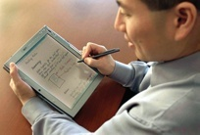
Computers For Individual Use
Tablet computers
  Newest development in portable computers.
  can accept input from a special pen—called a stylus or a digital pen—that is used to tap or write directly on the screen
  Run specialized versions of office products
Notes:
Teaching tip
The tablet PC was designed to simulate a piece of paper. Users interact with the tablet as if it was an unlimited paper notebook.
For more information
See www.microsoft.com/windowsxp/tabletpc/evaluation/tours/default.mspx for an example of the Tablet PC in action.

Slide 31
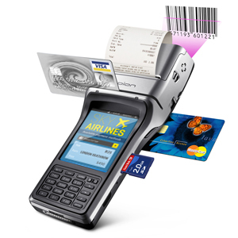
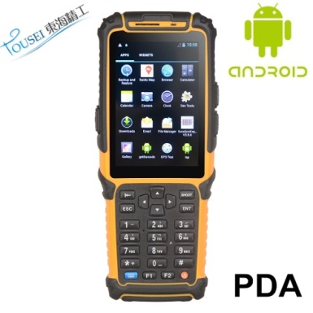
Computers For Individual Use
Handheld computers
  Very small computers
  Small enough to fit in your hand
  Personal Digital Assistants (PDA)
  Note taking or contact management
  It is pen-based, using a stylus for handwriting as input and with small keyboards
  PDA can be connected to larger computers to exchange data
  A typical PDA can function as a cellular phone, fax sender, Web browser and personal organizer. PDAs may also be referred to as a palmtop, hand-held computer or pocket computer.
Notes:
Teaching tip
At this point, refer the students to the productivity tip on page 13. This tip helps the student determine what type of PC is best for them.

Slide 32
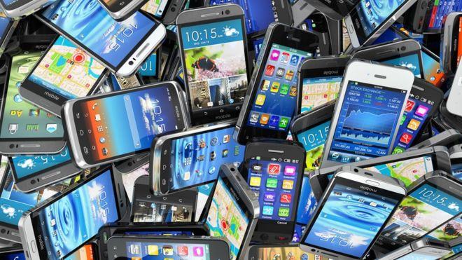
Computers For Individual Use
Smart phone
  Wireless phone with voice, text and internet capabilities.
  Hybrid of cell phone and PDA
  Web surfing, e-mail access, camera, music player, video calling, app store, gps, voice recognition, note taker

Slide 33
Computers For Organizations
Network servers
Most organizations’ networks are based on personal computers. Individual users have their own desktop computers, which are connected to one or more centralized computers, called network servers.
A network server is usually a powerful personal computer with special software and equipment that enable it to function as the primary computer in the network

Slide 34
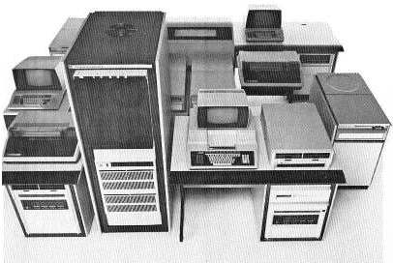
Computers For Organizations
Minicomputers
  Called midrange computers
  Power between mainframe and desktop
  Handle hundreds of users
  Used in smaller organizations
  Users access through a terminal

Slide 35
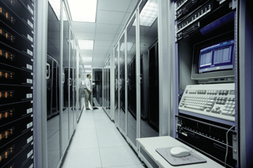
Computers For Organizations
Mainframe computer:
  Used in large organizations
  Handle the processing needs of thousands of users at any given moment
  Users access to mainframe resources through a terminal.
  Large, powerful systems

Slide 36
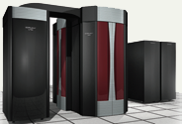
Computers For Organizations
Supercomputers
  The most powerful and largest computers made
  Handle large and complex calculations
  Process trillions of operations per second
  Found in research organizations.
  Used for forecasting weather.
Notes:
Teaching tip
Students have a hard time understanding trillions of calculations. A simple explanation is to add 1 trillion random numbers together in a second. Contrast the speed of a super computer to the fastest desktop computer advertised during the week of class.

Slide 37
Computers For Society
Computers at home
    Communications
    Business Work Done at Home
    Schoolwork
    Finance
    Entertainment
Notes:
Insider information
The 2000 Census determined that 51% of American households had computers. Over 42% of these households also had Internet access. This can be contrasted to 36% and 18% in 1997. See www.census.gov/prod/2001pubs/p23-207.pdf for more information.

Slide 38
Computers For Society
Computers in education
  Computer literacy required at all levels
  Education Information Systems
  Essential learning equipment
Computers in small business
  Rely on inexpensive computer and software
  Makes businesses more profitable
  Allows owners to manage
Notes:
Insider information
Specialized mountain bikes are designed on Sun workstations.

Slide 39
Computers For Society
Computers in industry
  Computers are used to design products
  Assembly lines are automated
  Shipping
  Process control
Computers in government
  Necessary to track data for population
  Police
  Tax calculation and collection
  Military
Notes:
Teaching tip
Most state departments of motor vehicles rely on a mainframe computer. Officers access the mainframe from a remote intelligent terminal.

Slide 40
Computers For Society
Computers in Communication:
  Electronic Mail.
  Audio and video conferencing
  News Group and Instant messaging (IM)
  Computers in Retail Shop:
  Bar code reader
  Online banking
  Internet shopping
Notes:
Discussion point
Page 19 of the text introduces the first Norton Notebook, the Merging of Media and Meaning. The author draws an analogy between electricity and computers in our lives. Discuss with your students how difficult live would be without either of these devices. Remember that computers exist in nearly all of our modern devices, including cars, phones, kitchen appliances and entertainment devices.

Slide 41
Computers For Society
Computers in health care
  Robotic surgical device
  Scheduling, billing and recording data of patients has improved.
  E-health
  Diagnostic machinery
  Computers in Banking:
  Bankers’ Automated Clearing Service (BACS)
  Online banking
  Automated Teller Machine (ATM)
Notes:
Discussion point
Page 19 of the text introduces the first Norton Notebook, the Merging of Media and Meaning. The author draws an analogy between electricity and computers in our lives. Discuss with your students how difficult live would be without either of these devices. Remember that computers exist in nearly all of our modern devices, including cars, phones, kitchen appliances and entertainment devices.

Slide 42


