Slide 1
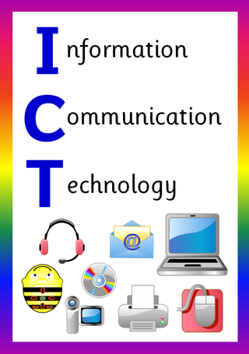
ICT in Business

Slide 2
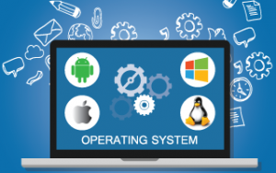
Operating System (OS)
.

Slide 3
In this chapter you will learn about:
Basic Concept of Software
Difference Between System Software & Application Software
Basic Concept of Operating System (OS)
Objectives of Operating System (OS)
Functions of Operating System (OS)
Types of Operating System (OS)
How Utility Software Enhance Performance of an Operating System (OS)

Slide 4
Software
Software is a set of instructions, data or programs used to operate computers and execute specific tasks.
It is the opposite of hardware, which describes the physical aspects of a computer
The user cannot touch the software but can see through the Graphical User Interface (GUI).

Slide 5
Types of Software
System Software
Application Software

Slide 6
System Software
Designed for running the computer hardware parts and the application programs.
Act as a middle layer between the user applications and hardware.
Operating System (OS) is the type of system software.
Operating systems like Windows, macOS, Android and iOS are examples of system software.

Slide 7
Application Software
Performs a specific function likes personal, educational, and business function.
Designed to assist end-users in accomplishing a variety of tasks, which may be related to productivity, creativity, or communication.
Applications software include office suites, graphics software, databases and database management programs, web browsers, word processors, software development tools, image editors and communication platforms.

Slide 8
Operating System (OS)
Operating System (OS) is an interface between a computer user and computer hardware.
It is a system software that manages computer hardware, software resources, and provides common services for computer programs.
It performs all the basic tasks like file management, memory management, process management, handling input and output, and controlling peripheral devices such as disk drives and printers.

Slide 9
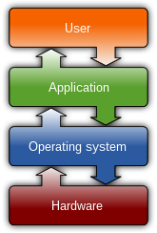

Slide 10
Objectives of Operating System (OS)
To make the computer system convenient to use in an efficient manner.
To hide the details of the hardware resources from the users.
To provide users a convenient interface to use the computer system.
To act as an intermediary between the hardware and its users, making it easier for the users to access and use other resources.
To manage the resources of a computer system.
To keep track of who is using which resource, granting resource requests, and mediating conflicting requests from different programs and users.
To provide efficient and fair sharing of resources among users and programs.

Slide 11
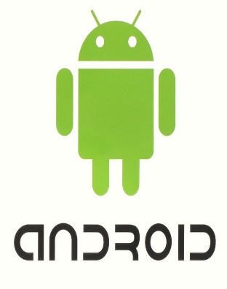
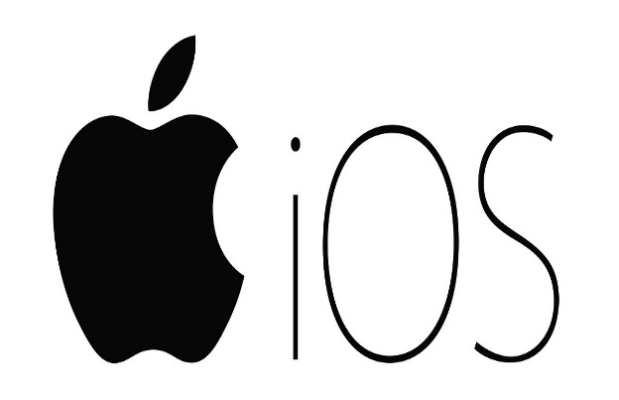
Common Operating System
Linux Operating System.
UNIX Operating System
MS-DOS
Microsoft Windows Operating System.
Ubuntu Operating System
Palm OS
Macintosh Operating System.
Solaris Operating System.
Symbian Operating System.
Google Android Mobile Operating System.
Apple iOS Mobile Operating System.

Slide 12
Platform | Operating System
Microcomputers | Linux, Macintosh OS, MS-DOS, Windows 98, Windows 2000
Minicomputers | Linux, OpenVMS Alpha, UNIX
Mainframe computers | IBM OS/390, IBM OS/400, UNIX
Supercomputers | IRIX, UNICOS

Slide 13
Functions of Operating System (OS)
Providing a User Interface
Running Programs
Managing Hardware Devices
Organizing Files and Folders

Slide 14
Providing a User Interface
The OS provides a user interface (UI), which is an environment for the user to interact with the machine.
The UI is either graphical or text-based;
Graphical User Interface (GUI)
Command Line Interface (CLI)

Slide 15
Graphical User Interface (GUI)
Enables the users to interact with the operating system by means of point-and-click operations.
Graphical icon provided in the UI can be manipulated by the users using a suitable pointing device such as a mouse, trackball, touch screen and light pen.
Considered to be very user- friendly interface because each object is represented with a corresponding icon.

Slide 16
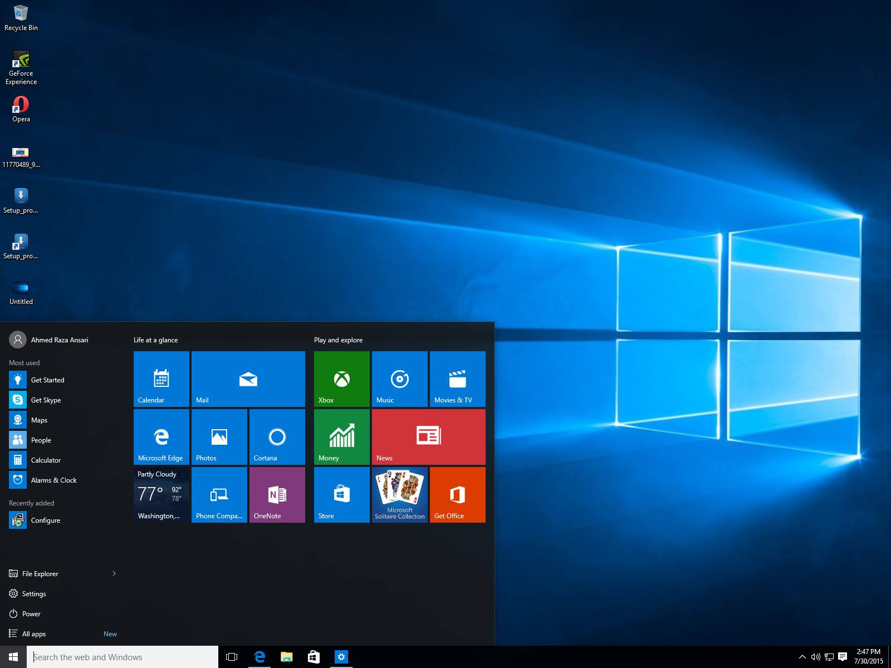

Slide 17
Advantages of GUI Based Operating System (OS)
The GUI interface is easy to understand and even the new users can operate on them on their own.
The GUI interface visually acknowledges and confirms each type of activities performed by the users. For example when the user deletes a file in the Windows operating system, then the operating system asks for the confirmation before deleting it.
The GUI interface enables the users to perform a number of tasks at the same time. This features of the operating system are also known as multitasking.

Slide 18
Command Line Interface (CLI)
A method of interaction that is non-graphical, called the command line interface (CLI).
This is a text-only service with feedback from the OS appearing in text.
Using a CLI requires knowledge of the commands available on a particular machine.

Slide 19
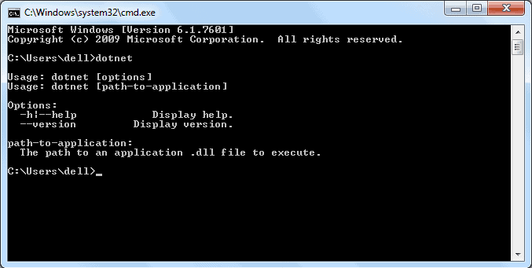

Slide 20
Advantages of Using the Command Line Interface
A faster way to get tasks done
It is more flexible than a GUI
It uses less memory

Slide 21
Running Programs
Loads a program into memory.
Executes the program.
Handles program's execution.
Provides a mechanism for process synchronization.
Provides a mechanism for process communication

Slide 22
Managing Hardware Devices
An operating system manages how software interacts with hardware to receive data from input devices and send the results to output devices.
Every piece of hardware comes with software called a 'device driver', for example, the printer will have a print driver, a mouse will have its own mouse driver.

Slide 23
Organizing Files and Folders
The OS allows to organize the contents of computer in a hierarchical structure of directories that includes files, folders, libraries, and drives.
Windows Explorer helps to manage files and folders by showing the location and contents of every drive, folder, and file on computer.
Creating folders is the key to organizing files because folders keep related documents together.
Following naming conventions and using proper file extensions are also important aspects of file management.

Slide 24
Types of Operating System
Real Time Operating System (RTOS)
Single-User/ Single-Tasking OS
Single-User/ Multitasking OS
Multi-User/ Multitasking OS

Slide 25
Real Time Operating System (RTOS)
A real-time operating system (RTOS) is a special-purpose operating system used in computers that has strict time constraints for any job to be performed.
It is mostly used in environments where a large number of events, mostly external to the computer system, must be accepted and processed in a short time or within certain deadlines.
It is very fast and quick respondent systems.
It requires quick transaction and characterized by supplying immediate response.
Examples of the real-time operating systems: Airline traffic control systems, Command Control Systems, Airlines reservation system, Heart Pacemaker, Network Multimedia Systems, Robot etc.

Slide 26
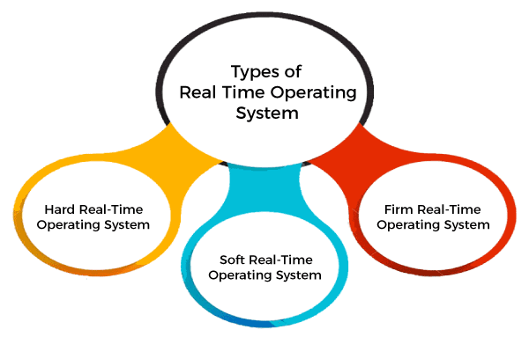

Slide 27
Real Time Operating System (RTOS)
Hard Real-Time Operating System; These operating systems guarantee that critical tasks be completed within a range of time. Examples are Airbag control in cars, anti-lock brake, engine control system, etc.
Soft Real-Time Operating System; This operating system provides some relaxation in the time limit. This type of system is used in Online Transaction systems, digital camera, mobile phones, etc.
Firm Real-time Operating System; RTOS of this type have to follow deadlines as well. In spite of its small impact, missing a deadline can have unintended consequences, including a reduction in the quality of the product. For Example, this system is used in various forms of Multimedia applications.

Slide 28
Real Time Operating System (RTOS)
Advantages
These operating systems guarantee that critical tasks be completed within a very short range of time and in a error free manner.
Disadvantages
Complex Algorithms
Slow device driver can interrupt signals

Slide 29
Single-User/ Single-Tasking OS
Allows a single user to perform only one task at a time.
Functions like printing a document, downloading images, etc., can be performed only one at a time.
Designed especially for wireless phones as well as two-way messaging devices
Examples include MS-DOS, Palm OS, etc.

Slide 30
Single-User/ Single-Tasking OS
Advantages
This operating system occupies less space in memory.
It is cost-effective.
Easy to maintain
Concentrate on one task.
Run on inexpensive computer.
Disadvantages
It can perform only a single task at a time.
Tasks take longer time to complete.
Idle time is higher.

Slide 31
Single-User/Multitasking OS
Developed specially for one user, but this single user is able to perform to multiple tasks run at a same time frame.
Examples such as one can write any text, while surfing internet and downloading images with watching movies, etc.
This type of operating system is found in personal desktop and laptop computers.
Examples include Microsoft Windows, Linux and Macintosh OS.

Slide 32
Single-User/Multitasking OS
Advantages
It is time saving as it performs multiple tasks at a time yielding high productivity.
Disadvantages
This operating system is highly complex and occupies more space.
Require expensive computer.

Slide 33
Multi-User/ Multitasking OS
Supports more than one user at a time, performing more than one task at a time.
Powerful computer like a mainframe or supercomputer is required for multi-user, multi-tasking operating system to make maximum use of the machine.
Permits several users to utilize the programs that are concurrently running on a single network server.
UNIX, VMS is example of a multiuser/ multitasking operating system.

Slide 34
Multi-User/ Multitasking OS
Advantages
It is highly productive as it performs multiple tasks at a time.
It is time saving as we don’t have to make changes in many desktops, instead can make changes only to the server.
Disadvantages
If the connection to the server is broken, user cannot perform any task on the client as it is connected to that server.
Powerful computer like a mainframe or supercomputer is required.

Slide 35
Enhancing an OS with Utility Software
Software developers are constantly creating new programs, called utilities, that enhance or extend the operating system's capabilities by offering new features not provided by the operating system itself.
Utility Software is system software that helps to maintain the proper and smooth functioning of a Computer System.
It assists the Operating System to manage, organize, maintain, and optimize the functioning of the computer system.

Slide 36
Popular Utility Software
Backup Software
Anti-Virus Software
Firewall
Intrusion Detection
Screen Savers

Slide 37
Backup Software
Backup software creates extra exact copies of files, databases, or entire computers and is used to do backups.
Restore the backups to disk in the event of data loss, file corruption, accidental or intentional deletion or a disaster.
Popular backup software tools include Norton Ghost, Symantec Backup Exec, Acronis True Image and TotalRecovery Pro.

Slide 38
Anti-Virus Software
Antivirus utility can examine the contents of a disk or RAM for hidden viruses and files that may act as hosts for virus code.
Antivirus products not only detect and remove viruses; they also help to recover data that has been lost because of a virus.
Popular antivirus software providers include AVG, McAfee, Norton and Kaspersky.

Slide 39
Firewall
Firewall is a network security device that monitors incoming and outgoing network traffic and permits or blocks data packets based on a set of security rules.
Its purpose is to establish a barrier between the internal network and incoming traffic from external sources (such as the internet) in order to block malicious traffic like viruses and hackers.
Kerio WinRoute Pro, Cisco Secure Firewall, Zone Labs Firewall etc. are common firewall platforms.

Slide 40
Intrusion Detection
Intrusion detection software identifies the types of attacks that a firewall is preventing, documents the attempts, and alerts users to specific types of intrusion attempts.
Snort is the popular network intrusion detection & prevention system software.

Slide 41
Screen Savers
Screen savers are popular utilities, although they serve little purpose other than to hide what would otherwise be displayed on the screen.
A screen saver automatically appears when a keyboard or pointing device has not been used for a specified period of time.
It was first used to prevent damage to older monitors but is now used as a way to prevent viewing of desktop contents while the user is away.
Fliqlo, System 47 etc. are the popular screen saver software platform.

Slide 42
End of Chapter
.

