Slide 1
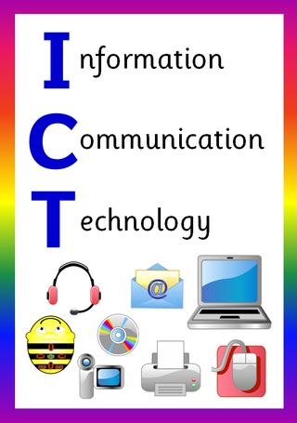
ICT in Business

Slide 2
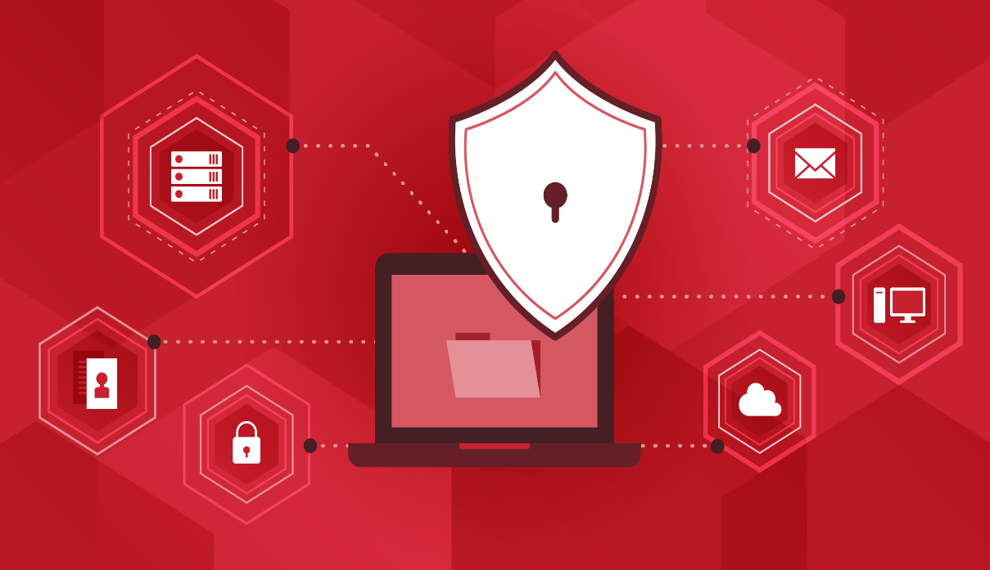
Computer Threats
&
Basic Security Measures
.

Slide 3
Learning Objectives
In this chapter you will learn about:
Basic Concept of Threat
Types of Threats
Threats to the User
Threats to Hardware
Threats to Data
Security Measures for Threats

Slide 4
Threats
Computer security threats are constantly evolving. These threats are masters of disguise and deception, always evolving new ways to irritate, steal, and harm.
A threat is any scenario or occurrence that has the potential to harm the computer through unauthorized access, destruction, disclosure, data manipulation, and/or denial of service.
Basically, a computer threat is a term that relates to the security of a computer system being compromised. This is possible dangers that can affect the smooth functioning of a computer.
This threat can lead to cyber-attacks and data being stolen, lost, or manipulated. Damage can be irreparable in some cases.

Slide 5
Threats
A computer threat can be "intentional" such as hacking or "accidental" such as malfunctioning or physical damage.
If a user can gauge the degree of harm that different threats can cause, they can prioritize them and take countermeasures.
Regularly backing up users data is a countermeasure against the treat of data loss. A firewall is a countermeasure against hackers.
In the present age, computer security threats are constantly increasing as the world is going digital.

Slide 6
Types of Threats
Computer threats can be classified into:
Threat to the User
  Identity Theft
  Loss of Privacy
  Computer Related Injuries
  Online Spying Tools
  Email Spam
Threat to Hardware
  Power Related Threats
  Theft and Vandalism
  Natural Disasters
Threat to Data
  Malware, Viruses and Malicious Programs
  Cybercrime
  Cyber Terrorism

Slide 7
Threat to the User
Identity Theft
Identity theft is a form of crime in which someone’s personal information is used without permission.
Public profiles on social networks or other popular online services can be used as the source of data, helping criminals to impersonate their targets.
Affected individuals can suffer financial loss due to unauthorized withdrawals and purchases made in their names.
However, identity theft can also be done to damage the victim’s reputation.

Slide 8
Threat to the User
Methods of Obtaining Information
Criminals obtain information by using various methods, such as;
Shoulder Surfing; Shoulder surfing means watching someone while entering personal ID information for a private transaction.
Snagging; A thief can try to snag information by listening through a telephone extension, through a wiretap while the victim gives credit card information to a legitimate agent.
Dumpster Diving; Dumpster diving is looking for treasure in someone else's trash. In the world of information technology (IT), dumpster diving is a technique used to retrieve information that could be used to carry out an attack or gain access to a computer network from disposed items.
Social Engineering; Social engineering is the art of manipulating people so they give up confidential information such as passwords or bank information by disguising as something legitimate.
High Tech Methods; The ID thieves can get information using a computer and Internet connection. A person’s identity may be snagged from unsecured internet sites.

Slide 9
Threat to the User
Loss of Privacy
People are disclosing their personal information while transactions and that information are being generated and reaching the hands of other parties. Thus, privacy could be lost.
Social media records that are open to the public are another way of losing privacy.

Slide 10
Threat to the User
Computer Related Injuries
Computer use can cause physical injuries to the user.
Prolonged mouse and keyboard use, staring at a monitor for long time, and poor seating conditions are the primary cause of such injuries.
It can cause especially eyesight problem and other health related problems.

Slide 11
Threat to the User
Online Spying Tools
Software developers have created a number of ways to track user’s online activities using internet. Many of these tools, which may pose a threat to users, are discussed further below;
Cookies
Cookies are regarded as a significant threat to privacy, despite their beneficial purpose. This is because they can be used to store and report many types of information, like user online activity history, visited sites, passwords, etc. Later, these can be used against the user’s wishes.
Web Bugs
A web bug can record what pages user view, key words user type into a search engine, personal information user enter in a form on a web page, and other data. Because Web bugs are hidden, they are considered by many to be eavesdropping devices.

Slide 12
Threat to the User
Spyware
Spyware is installed on a computer without the user’s knowledge and collects information without the user's consent. Spyware can record individual keystrokes, Web usage, e-mail addresses, personal information, and other types of data. Besides, spyware can also refer to legitimate software that monitors your data for commercial purposes like advertising. However, malicious spyware is explicitly used to profit from stolen data.

Slide 13
Threat to the User
Email Spam
Email spam, also referred to as junk email or simply spam, is unsolicited messages sent in bulk by email.
Most email spam messages are commercial in nature. Whether commercial or not, many are not only annoying as a form of attention theft, but also dangerous because they may contain links that lead to phishing web sites or sites that are hosting malware or include malware as file attachments.
Spammers collect email addresses from chat rooms, websites, customer lists, newsgroups, and viruses that harvest users' address books. These collected email addresses are sometimes also sold to other spammers.

Slide 14
Threats to Hardware
Power Related Threats
Power problems affect computer in two ways:
  Power fluctuations, when the strength of your electrical service rises or falls, can cause component failures.
  Power failure, when power is lost altogether, causes systems to shut down.
Both power failures and fluctuations can result in a loss of data. Uninterruptible Power Supplies (UPS) can be a countermeasure to this threat.

Slide 15
Threats to Hardware
Theft and Vandalism
Thieves can steal the entire computer or cause hardware vandalism, which is the act of intentionally or unintentionally breaking or destroying computer hardware.
In both cases, the system and the data stored were completely destroyed.
Keep the PC in a secure area, lock the computer to a desk, do not eat near the computer, handle equipment with care, etc. can be countermeasures to this theft and vandalism.

Slide 16
Threats to Hardware
Natural Disasters
Disaster may be natural and manmade.
This disaster could result in a total loss.
Natural disaster (flood, fire, and earthquake) is difficult to protect. Because natural disasters vary by location.
User has to take preparation and have to be aware about the natural disaster.
User can take steps to protect his/her computer from manmade disasters.

Slide 17
Threats to Data
Malware, Viruses and Malicious Programs
The term malware describes viruses, worms, Trojan horses etc.
These virulent programs represent the most common threat to user’s information.
Viruses are pieces of a computer program that attach themselves to host programs.
Worms are particular to networks, spreading to other machines on any network you are connected to and carrying out preprogrammed attacks on the computers.
Trojan horses, like their namesake, introduce malicious code under the guise of a useful program

Slide 18
Threats to Data
Cybercrime
The use of a computer to carry out any conventional criminal act, such as fraud, is called cybercrime and is a growing menace.
Cybercrime is growing so rapidly, in fact, that the federal government has created a handful of agencies to deal with computer related crimes.
Hacking remains the most common form of cybercrime and it continues to grow in popularity.
A hacker is someone who uses a computer and network or internet connection to intrude into another computer or system to perform an illegal act.
At one time, a hacker was just a person who understood computers well; however, hacking now refers to criminal or antisocial activity.

Slide 19
Threats to Data
Cyber Terrorism
Cyber warfare and cyber terrorism are new forms of warfare; they attack the critical information infrastructure of the nation.
The conventional goal in the case of cyber terrorism is to harm or control key computer systems, or digital controls.
It is done to accomplish an indicator aim such as to disrupt a power grid or telecommunications.
Typical targets are power plants, nuclear facilities, water treatment plants, and government agencies.

Slide 20
Security Measures
The basic security measures for various threats are;
  Use Strong Passwords
  Use Password Manager
  Limit & Control Access to Critical Data
  Put Up a Firewall
  Use Security Software
  Update Programs and Systems Regularly
  Secure the Portable Devices
  Secure Wi-Fi Network
  Monitor for Intrusion
  Schedule Backups
  Be Smart with Emails and Surfing the Web
  Turn Off Computer and Disconnect from the Internet
  Raise Awareness

Slide 21
End of Chapter
.

