Slide 1
Muscle
http://www.innerbody.com/image/musfov.html

Slide 2
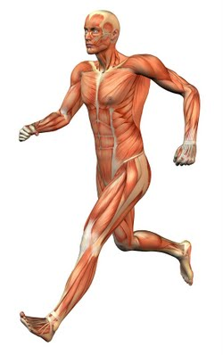
Introduction
The muscular system is the series of muscles throughout the body that moves the skeleton, maintains posture through steady contraction, circulates blood throughout the body and generates heat through cell metabolism.

Slide 3
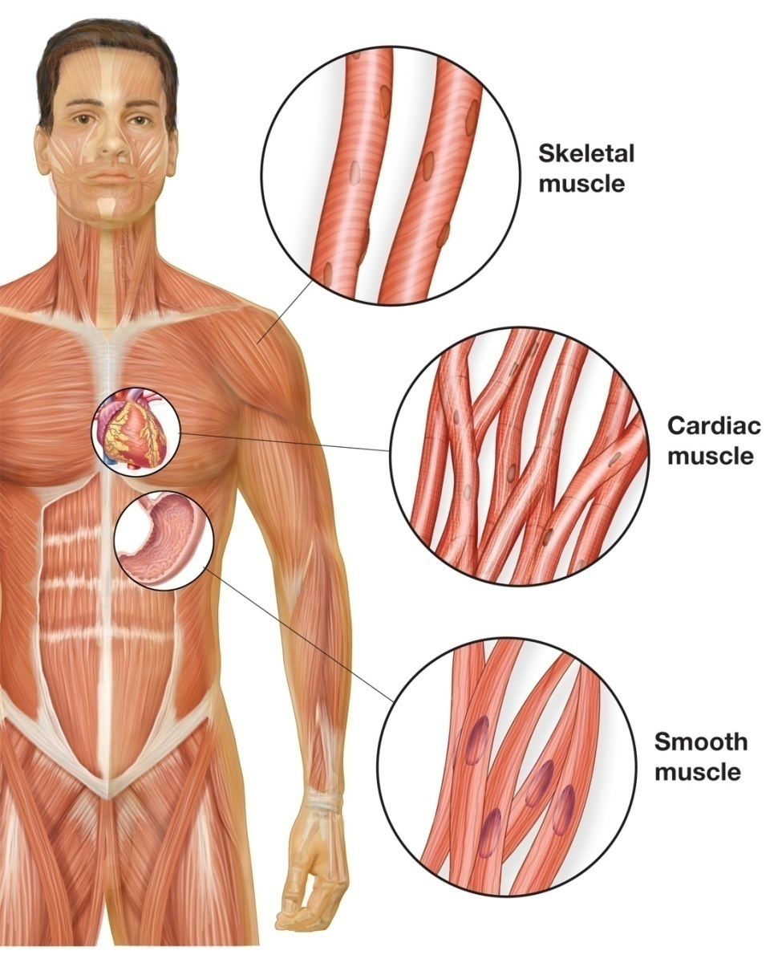
Major types of muscles
Anatomical:
Skeletal muscle
Cardiac muscle
Smooth muscle
Functional:
Voluntary
Involuntary

Slide 4
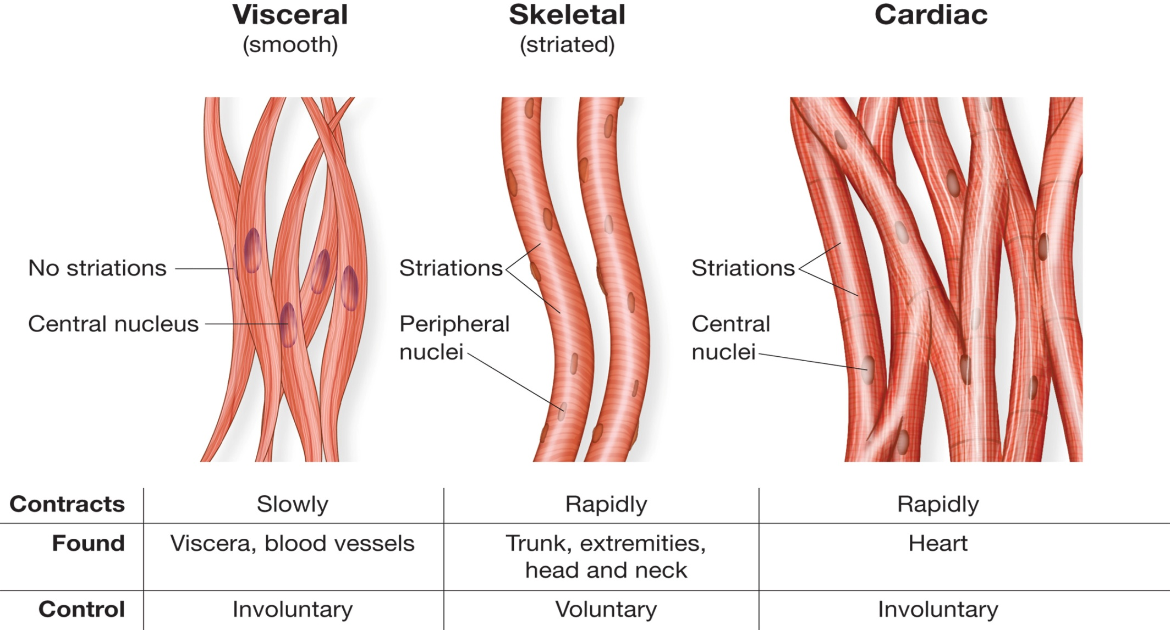
Comparison of 3 major types of muscle

Slide 5
Skeletal muscle
attached to bones
responsible for skeletal movements
CNS controls the skeletal muscles - these muscles are under conscious, or voluntary, control.
The basic unit is the muscle fiber with many nuclei.

Slide 6
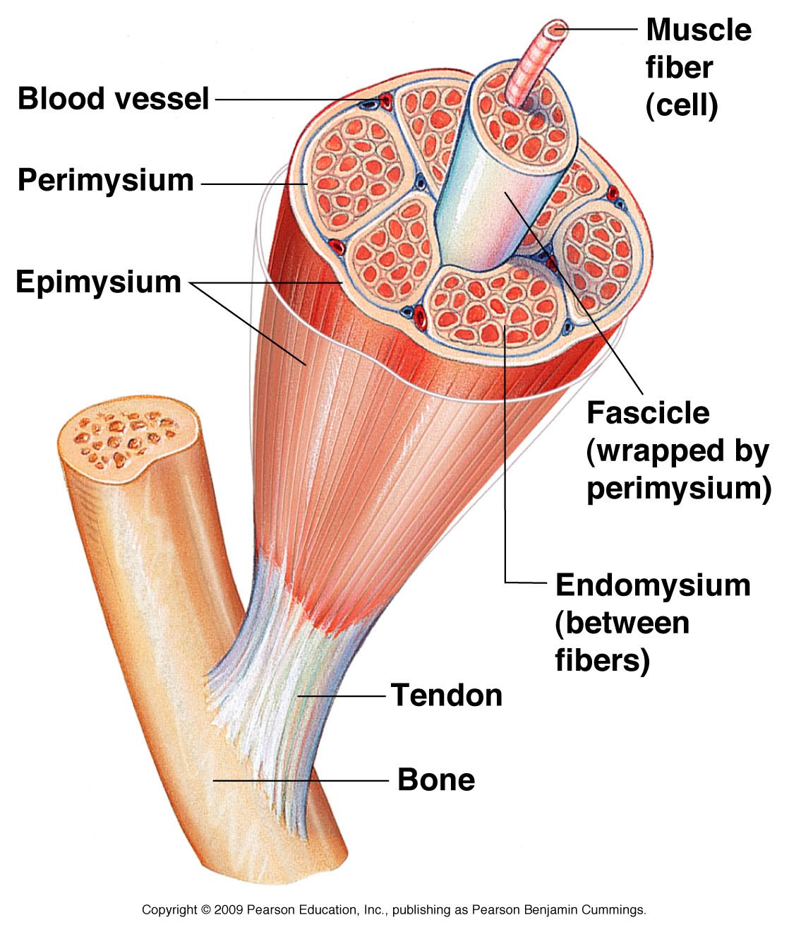
Structure of skeletal muscle

Slide 7
Names of Skeletal Muscles
Skeletal muscles are named based on many different factors
Location: muscles derive their names from their anatomical region.
  The rectus abdominis and transverse abdominis are found in the abdominal region
Origin and insertion: named based upon their connection to a stationary bone (origin) and a moving bone (insertion)
  occipitofrontalis (connecting the occipital bone to the frontal bone).
Number of origins: Some muscles connect to more than one bone or to more than one place on a bone. A muscle with two origins is called a biceps. A muscle with three origins is a triceps muscle. Finally, a muscle with four origins is a quadriceps muscle.
Shape, size & direction
  The muscles whose fibers run straight up and down are the rectus abdominis, the ones running transversely (left to right) are the transverse abdominis, and the ones running at an angle are the obliques.
Function:
  In the leg, there are muscles called adductors whose role is to adduct (pull together) the legs.

Slide 8
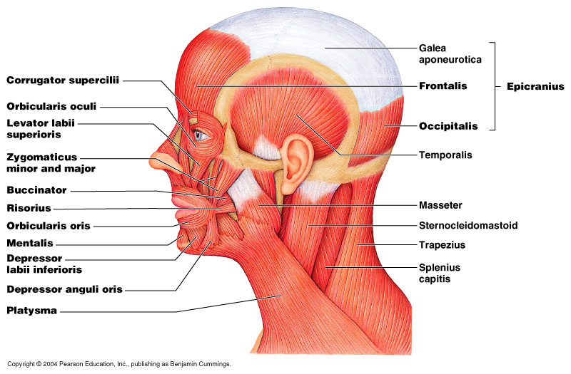
Muscles of the Scalp and Face

Slide 9
Muscles of the Scalp and Face
Epicranius consists of:
  frontalis (or frontal belly of epicranius)
  occipitalis (or occipital belly of epicranius)
  These two muscles pull the scalp forward and backward
Various muscles are involved in opening and closing the eyes and mouth, and smiling
Eg: orbicularis oculi, orbicularis oris, zygomaticus etc.

Slide 10
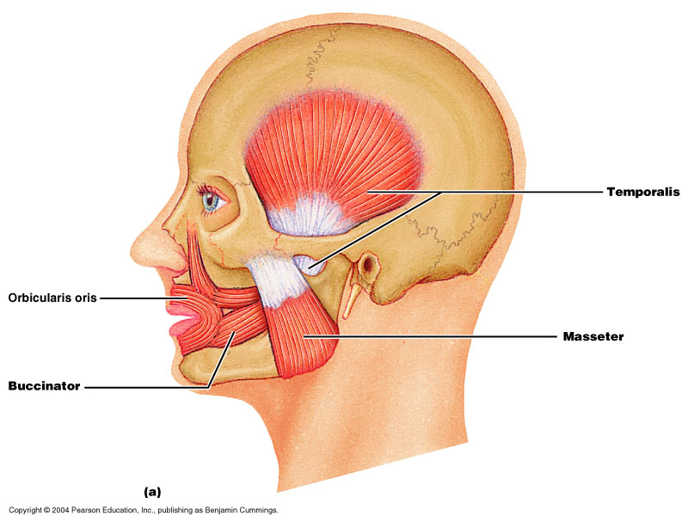
Muscles of the Scalp and Face
There are multiple muscles involved in mastication (chewing)
  Prime movers
  temporalis
  masseter
  Synergists
  buccinator
  orbicularis oris

Slide 11
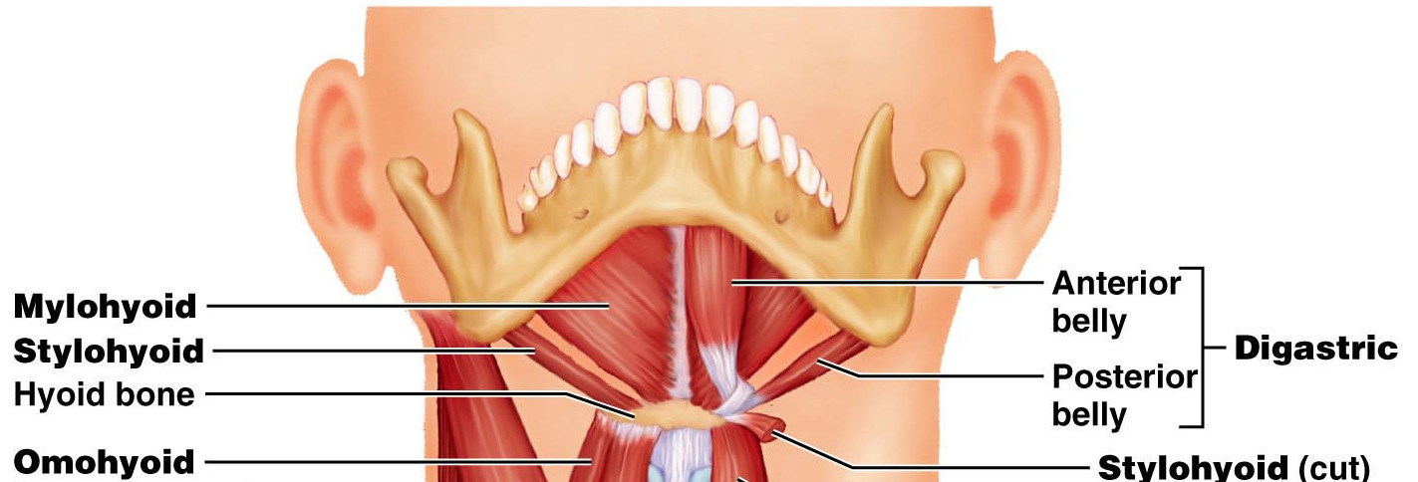
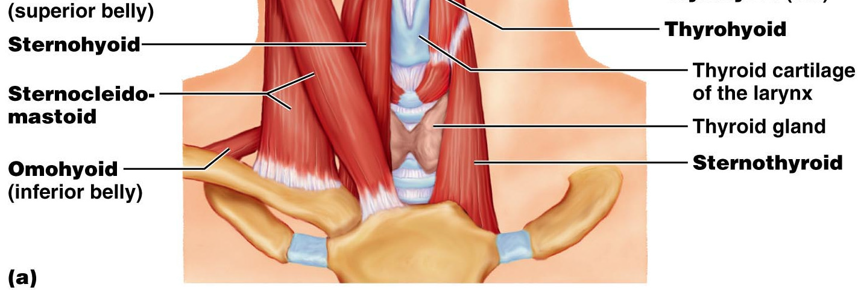
Muscles of the Anterior Neck
Suprahyoid muscles –
Digastric (Ant and Post Belly)
and Stylohyoid.
Infrahyoid muscles-
Omohyoid,
Sternohyoid,
Sternothyroid,
and Thyrohyoid.

Slide 12
Cardiac muscle
found in the walls of the heart
under control of the autonomic nervous system.
cardiac muscle cell has one central nucleus
contraction of cardiac muscle is involuntary, strong, and rhythmical.

Slide 13
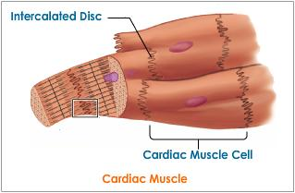
Structure of cardiac muscle
A prominent and unique feature of cardiac muscle is the presence of irregularly-spaced dark bands between myocytes - intercalated discs

Slide 14
Structure of cardiac muscle
The intercalated discs have two important functions:
‘glue’ the myocytes together so that they do not pull apart when the heart contracts
allow an electrical connection between the cells, which is vital to the function of the heart as a whole.

Slide 15
Smooth muscle
found in the walls of the hollow internal organs (blood vessels, the gastrointestinal tract, bladder, and uterus)
under control of the autonomic nervous system - cannot be controlled consciously and thus acts involuntarily.
one central nucleus.
contracts slowly and rhythmically.

Slide 16
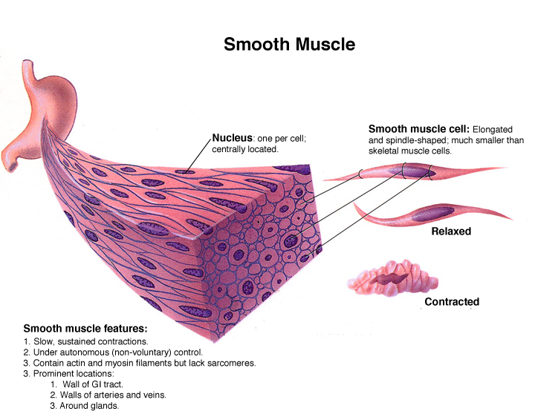

Slide 17
Summery………….
Major types of muscles
Description of
  Skeletal muscle
  Cardiac Muscle
  Smooth Muscle
  Muscle of scalp and neck
  Muscle of Mastication
  Muscle of Anterior neck

