Slide 1

MEETINGS
JANNATUL FERDOUS HIMIKA
LECTURER
BUSINESS ADMINISTRATION
DAFFODIL INTERNATIONAL UNIVERSITY

Slide 2
After completing this session you will be able to:
Define terms associated with meetings
Define the term meeting
State the importance of meetings in the business organization
List the various types of meetings

Slide 3

Define the term meeting
A meeting is a forum for communicating with or among people. Meetings are important aspects of the workplace, as a lot of time is spent discussing and making decisions on issues that are regarded as important.

Slide 4
Characteristics of a Meeting
Meetings are usually:
Structured – there is an agenda listing the specific topics to be discussed
Designed to achieve stated outcomes or objectives
Planned with those who are expected to attend via a notice of meeting.

Slide 5
Meeting may be called to?
Present information
Explain new procedures
Evaluate performance and provide feedback
Make decisions
Inspire and motivate employees
Discuss re-organisation

Slide 6
Meetings are important because they?
Formalise the decision-making processes in a business or organisation
1
Bring individuals together to 'have their say' about issues
2
Foster a spirit of co-operation and teamwork in an organisation
3

Slide 7
Meetings Terms
Term | Meaning
Ad hoc | A meeting is ad hoc when it is convened suddenly for one specific purpose.
Adjourn | Stopping a meeting that is in progress.
By-laws | Written policies and procedures that indicate how board meetings are to be conducted and how people are elected.
Casting vote | If an item under discussion at a meeting is subject to a vote, and there are equal votes for and against, the person who is chairing the meeting will vote so that a definite decision is made.
Chairperson | The person who presides over the meeting
Ex-officio | A person who is not a member of the committee that is meeting but is invited to attend the meeting to make a special contribution
Motion | A formal step to introduce a matter for consideration by the group that is meeting
Proposer | A person who suggests a motion

Slide 8
Meeting terms cont'd
Proxy​ | A person receives authorization to act on behalf of another person at the meeting​
Quorum​ | The minimum number of people required to attend a meeting.​
Ratify​ | To approve or express consent at a meeting​
Rescind​ | To annul, revoke or cancel a decision​
Seconder​ | A person who supports a motion proposed by another person.​
Verbatim​ | The use of the exact words as a direct quotation from a source​
Vote​ | Taken when a motion has been proposed​

Slide 9
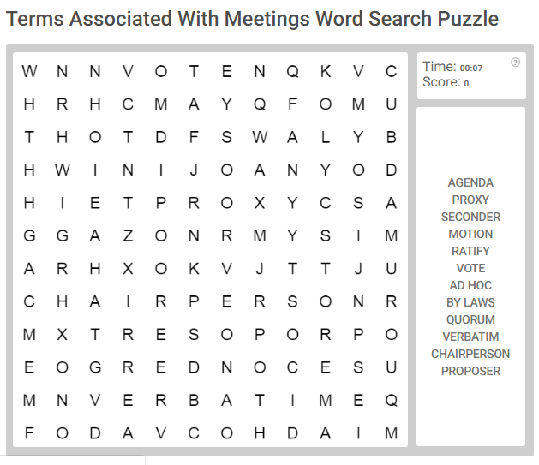
How fast can you find the Meeting terms? Click the link to find out!

Slide 10

Types of Meetings
Formal Meeting | A formal meeting is a pre-planned event with specific topics for discussion along with objectives to be achieved.
General and Departmental Staff Meeting | These are meetings that may involve the members of a department within an organisation.
Annual General Meeting (AGM) | Annual General Meetings are held once a year.
Extraordinary General Meetings (EGMS) | An extraordinary general meeting of a company can be called at any time by the directors or by the shareholders.
Board Meetings | Board meetings are called according to the by-laws or constitution of the organisation
Committee Meetings | Committees are small groups set up to make decisions about projects or policies.

Slide 11
Type of Meetings cont'd
Ad hoc meetings | An ad hoc meeting may be set up at short notice to resolve a problem or issue.
Emergency Meetings | A type of action meeting that occurs when some type of emergency has occurred and immediate action must be taken
Presentations | The purpose of the meeting is to inform and present informaton rather than to make decisions.
Conventions and Conferences | A gathering of persons to present information on a topic or theme
Seminars | Seminars are meetings that are intended as a learning exercise for their participants
Informal Meetings | Informal meetings are unplanned and require no formal preparation

Slide 12
Test your knowledge of Types of Meetings

Slide 13
References
Caribbean Secondary Examination Council (2019). CSEC Office Administration Syllabus. Macmillan Education retrieved from cxc-store.com

