Slide 1
Copyright

Slide 2
What Is Copyright?
Copyright refers to the legal right of the owner of intellectual property. In simpler terms, copyright is the right to copy. This means that the original creators of products and anyone they give authorization to are the only ones with the exclusive right to reproduce the work.
Copyright law gives creators of original material the exclusive right to further use and duplicate that material for a given amount of time. Once a copyright expires, the copyrighted item becomes public domain.

Slide 3
How Copyrighting Works
When someone creates a product that is viewed as original and that required significant mental activity to create, this product becomes an intellectual property that must be protected from unauthorized duplication. Examples of unique creations include:
Novels
Art
Poetry
Musical lyrics and compositions
Computer software
Graphic designs,
Film
Original architectural designs
Website content

Slide 4
One safeguard that can be used to legally protect an original creation is copyright. Under copyright law, a work is considered original if the author created it from independent thinking void of duplication. This type of work is known as an Original Work of Authorship (OWA).
Anyone with an original work of authorship automatically has the copyright to that work, preventing anyone else from using or replicating it. The copyright can be registered voluntarily by the original owner if they would like to get an upper hand in the legal system in the event that the need arises

Slide 5
Not all types of work can be copyrighted. A copyright does not protect ideas, discoveries, concepts, or theories. Brand names, logos, slogans, domain names, and titles also cannot be protected under copyright law. For an original work to be copyrighted, it has to be in tangible form.
This means that any speech, discoveries, musical scores, or ideas have to be written down in physical form in order to be protected by copyright.

Slide 6
Who can apply for a copyright in Bangladesh?
The relevant provisions of the Copyright Act, 2000 state that an application for registering copyright may be made by
the author or publisher of, or
the owner of, or
other people interested in the copyright.

Slide 7
Once an application is received by the Registrar, he or she may, after holding an enquiry deemed essential in his or her opinion, enter the details of work in the Register of Copyrights and issue a certificate of such registration to the applicant unless, for reasons that have to be recorded in a written form, the Registrar decides that such entry should not be made in respect of any work.
The primary ownership of the copyright under general circumstances lies with the author. However, the owner of the copyright may assign the copyright or grant any interest in the copyright by license. Licenses may also be granted by the Copyright Board in consultation with the author.

Slide 8
Determining Ownership of Copyright
Public addresses/speeches- Usually the person who delivers the speech is the owner of the copyright, provided he is not giving the speech on behalf of someone else.
Computer Program- The individual or individuals, or institution that was appointed to create the program is/are considered the first owner(s) of the computer program, unless stipulated otherwise in a contract.
Local Authority- In case of a work made or published by or under the direction or the control of any local authority, such authority is the first owner.
Government Work- In all cases of work for the government, the government will be considered the first owner of the copyright.

Slide 9
Why is it important to get your work Copyrighted?
As a form of intellectual property, copyright is an extremely important tool for original creators. There are several reasons to get your work copyrighted, some of which have been mentioned below:
In case the creator is involved in an infringement lawsuit, the register copyright provides legal proof of ownership which serves to maximise the damages.
Registering copyright ensures that the creator is the only person who is allowed to produce sequels, pursue adaptations or publish reinterpretations of the original work.

Slide 10
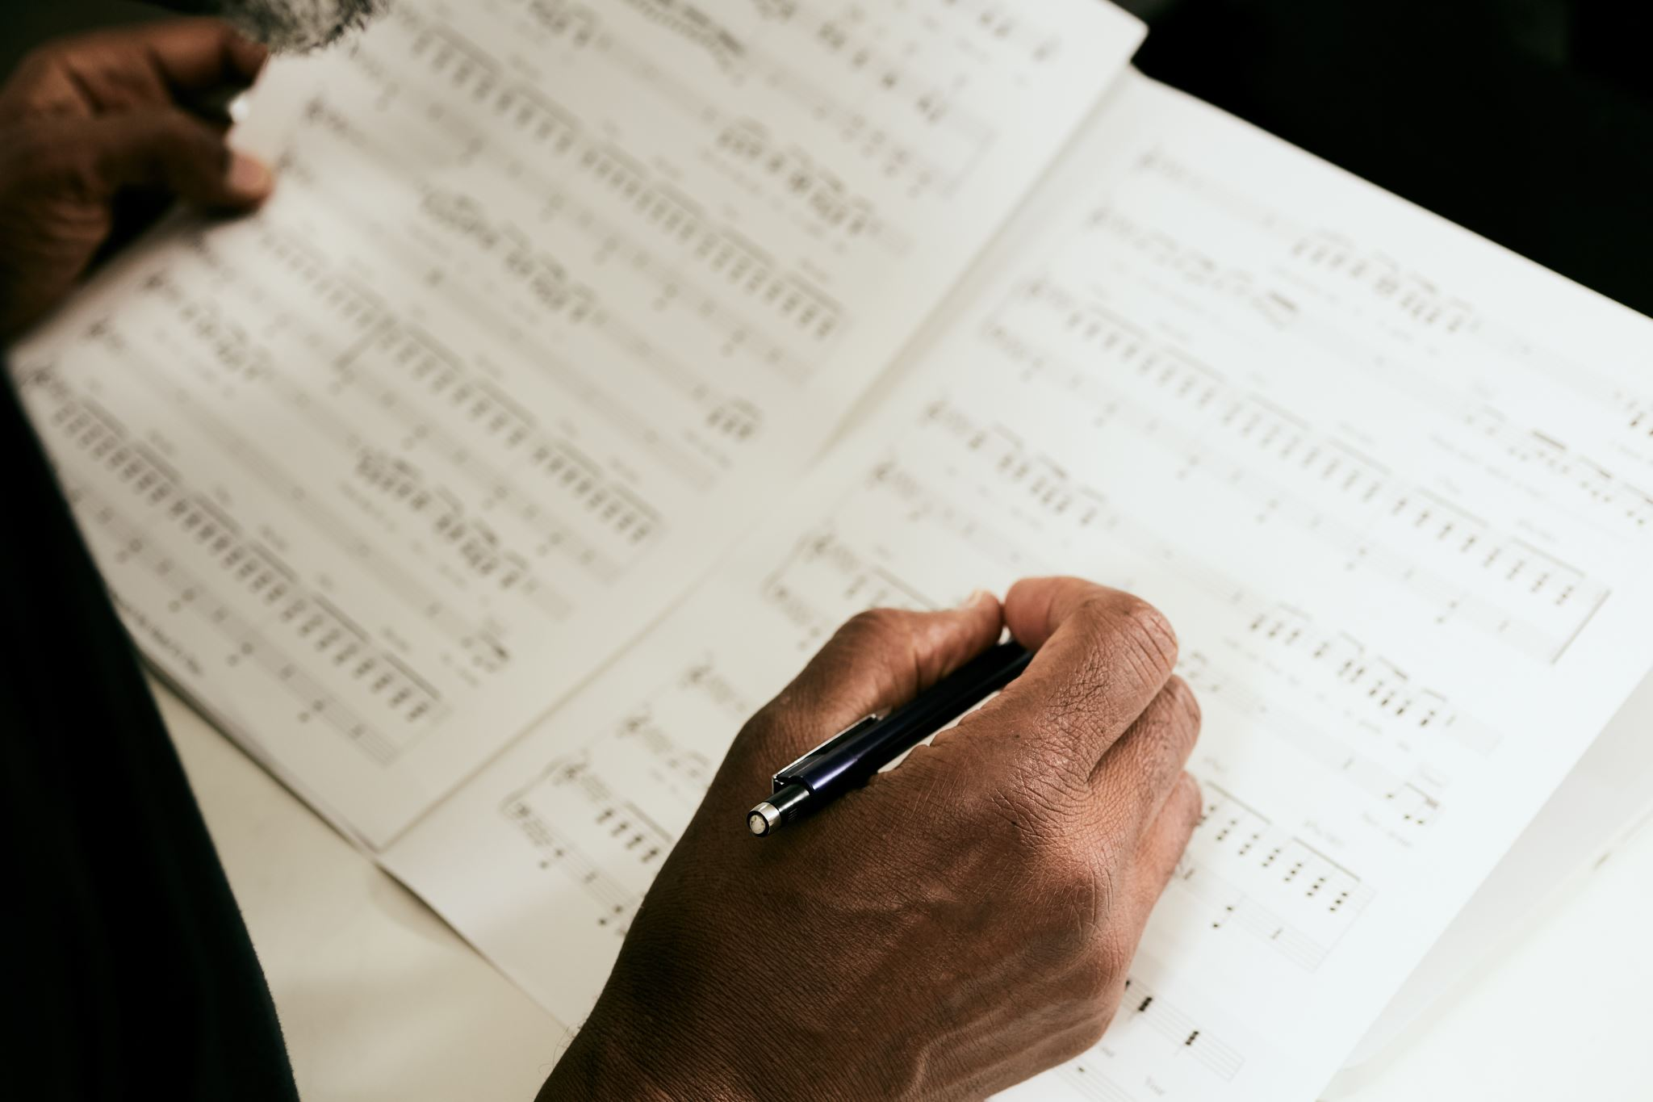
A copyright implies inter alia the exclusive right
to reproduce the work
to issue copies of the work to the public
to perform or broadcast the work
to make any translation or adaption of the work.
In addition to this, special moral rights lie with the author.

Slide 11
Duration Of The Copyright
Under the copyright law of Bangladesh, depending on the nature of work, there is a specific period of time for which the copyright is valid. The rights arising to the owner or other beneficiaries from the copyright exist only during this time. The durations are given below:

Slide 12
NATURE OF THE WORK | DURATION
Literary, Artistic, Musical, Dramatic Works | 60 years from the beginning of the calendar years next following the year in which the author dies (Life + 60 years)
Photographs | 60 years from the beginning of calendar year next following the year in which the photograph is published (60 years from publication)
Cinematographic film | 60 years following the year in which the film is published (60 years from publication)
Performance | 50 years from the beginning of the year next following the year in which the performance is made (50 years from the first performance is made)
Sound Recordings | 60 years from the date of publication
Broadcasting | 25 years from the beginning of the calendar year next following the year in which the broadcasting is made (25 years from broadcasting)
Joint authorship of work | 60 years from the death of last surviving author ( 60 years from death of the last surviving author)
Government work and work of local authorities | 60 years from the date of publication

Slide 13
Steps Of Obtaining A Copyright In Bangladesh
Filing Of An Application
The first step to obtaining a copyright registration in Bangladesh is filing the properly drafted application as per the rules given in the First Schedule of the 2000 Act.
The law requires each application to be accompanies by the prescribed fee mentioned in the Second Schedule of the Copyright Rules.
In addition to this, the copyright of each singular work requires a separate, corresponding application. The copyright application should be duly signed by the applicant or the advocate in whose favour a Vakalatnama or Power of Attorney has been executed.

Slide 14
Examination and Notice Procedure
Once the application has been filed, it is thoroughly examined by the Registrar. This is followed by serving a notice regarding the concerned application to every person who is likely to have an interest in the subject matter of the application.
Any such individual who has an objection to the registration of the copyright in question has to file a letter of objection with the Copyright Office.
The objection letter must state the following-
Details of the interested party
Application No. and files of the work against which objection is filed
Grounds for objection against registration of copyright
Documentary evidence that substantiates the objection claimed in the letter
Other documents/details as per the objection raised/required by the Copyright Office

Slide 15
Registration
If the Registrar receives any objection, he may after holding an inquiry through due process, enter the specifics of the work in the application in the Register of Copyright and issue a certificate of registration to the applicant. If he rejects the application, the Registrar has a duty to record in writing the grounds of such refusal or rejection.

Slide 16
What Is Copyright Infringement?
Copyright infringement is the use or production of copyright-protected material without the permission of the copyright holder. Copyright infringement means that the rights afforded to the copyright holder, such as the exclusive use of a work for a set period of time, are being breached by a third party.
Music and movies are two of the most well-known forms of entertainment that suffer from significant amounts of copyright infringement. Infringement cases may lead to contingent liabilities, which are amounts set aside in case of a possible lawsuit.

Slide 17
Copyright Infringement In Bangladesh
The following acts amount to copyright infringement in Bangladesh:
Making unauthorised use of the copyrighted work without the explicit permission of the copyright owner of such work.
Performing an act which comes within the purview of the exclusive right of the owner of the copyright.
Importing infringing copies of the copyrighted work
Using the copyrighted work in trade exhibits in public
Permitting for profit any place to be used for the performance of the work in public where such performance constitutes an infringement of the copyright in the work
Distributing either for the purpose of trade or to such an extent as to affect prejudicially the owner of the copyright

Slide 18
Legal Remedies
The copyright owner whose copyright has been infringed has a number of legal remedies in order to protect his or her creation including:
Filing a civil suit in order to secure an injunction, furnishing of accounts of the infringing party and claiming damages. A suit or other civil proceedings relating to infringement of copyright is to be filed in the Court of District Judge, within whose jurisdiction the plaintiff resides or carries on business or where the cause of action arose.

Slide 19
2. Filing a criminal suit for the apprehension and imprisonment of the infringing party or imposition of fine or both, seizure of infringing copies etc. Criminal proceedings are available in order to punish the persons who have violated the copyright law.
3. Administrative remedies through filing an application with the Registrar of Copyrights seeking a ban on the import of infringing copies into Bangladesh.

Slide 20
How Do You Prove Copyright Infringement?
In some cases, copyright infringement can be difficult to prove. Steps an individual can take to prove copyright infringement has occurred is first to prove they have ownership of the copyright.
The next step would be to prove that the alleged infringing individual had access to this copyrighted work, and then to prove that the original copyrighted item has been copied.
If the alleged copied work is not identical or very similar to the original work, it can be difficult to prove copied elements.

Slide 21
Real-World Example
For example, the music industry was caught off guard by the development of online music-sharing websites such as Napster.
Napster was an online music website that allowed peer-to-peer sharing of music files through their network. Customers would share or distribute music of various artists for free. Record companies within the music industry sued Napster for copyright infringement to protect their intellectual property and won their case.
Napster was found in violation of copyright laws because, in part, the company knew of the widespread distribution and did not do enough to stop it. Also, the music was copied and used by customers, which was financially harmful to record companies and the sale of their music. Napster was also found to have financially benefited at the expense of record companies by allowing the copy and distribution of music.

Slide 22
Companies seeking targets for copyright infringement claims can also go after the companies providing the files, but could also seek damages from internet service providers (ISPs) as well as individual users.
In a more recent music-related copyright infringement case, in 2020, the estate of Randy Wolfe, a member of the band Spirit, claimed copyright infringement against the band Led Zeppelin. The estate claimed that Led Zeppelin had copied parts of Spirit's song "Taurus" in their song "Stairway to Heaven." The case began in 2014 but was finalized in 2020 in Led Zeppelin's favor.

