Slide 1
Food Chemistry 0711-2101
Department of Nutrition & Food Engineering
Daffodil International University

Slide 2
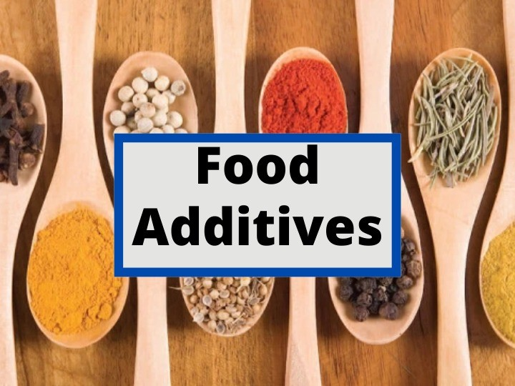
Today’s topic

Slide 3
Introduction
Food additives are substances not naturally present in food but added to food to improve its flavor, appearance, texture, or shelf life.
They serve various functions, including enhancing flavor, preserving freshness, improving texture, and maintaining nutritional value.
Understanding food additives is crucial for several reasons. Firstly, they are extensively used in the food industry to achieve specific qualities in food products. Secondly, some additives may have potential health implications, so consumers need to be aware of their presence and effects. Thirdly, knowledge about food additives helps consumers make informed choices about the foods they consume, considering factors such as dietary preferences, health concerns, and ethical considerations.
Regulatory bodies such as the FDA (Food and Drug Administration) and EFSA (European Food Safety Authority) evaluate the safety of food additives.

Slide 4
Functions of Food additives
Decrease the risk of contamination by certain microbes.
Maintain/ improve natural quality
Enhance appearance and improve shelf-life

Slide 5
Major Categories
Preservatives
Colors
pH Controlling agents
Flavors
Sweetners
Emulsifiers and stabilizers
Antioxidants
Processing aids

Slide 6
Health Risk of Food Additives
While many additives are considered safe for consumption when used within regulatory limits, some individuals may be sensitive or allergic to certain additives, and there can be potential health risks associated with their consumption.
Allergic reactions: Some people may be allergic to certain food additives, such as artificial colors, flavors, or preservatives.
Hyperactivity in children: particularly artificial colors and preservatives cause hyperactivity or behavioral problems in children.
Cancer risk: there is a potential carcinogenic effects of certain food additives, such as artificial preservatives like nitrites and nitrates.
Increased risk of chronic diseases: High intake of certain food additives, such as artificial sweeteners or high levels of sodium in flavor enhancers, may contribute to an increased risk of chronic diseases like obesity, diabetes, cardiovascular disease, and hypertension.
Gastrointestinal problems: Certain food additives, such as emulsifiers and thickeners, may disrupt the balance of gut bacteria or irritate the gastrointestinal tract.
Negative impact on nutrient absorption: particularly certain preservatives and artificial sweeteners, may interfere with the absorption of nutrients in the digestive system, potentially leading to nutritional deficiencies over time.

Slide 7
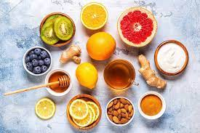
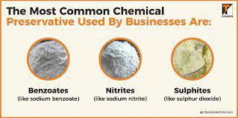
Preservatives
Chemicals such as salt, alcohols and acetic acids have been used for several years for preserving meat, vegetables and pickling of foods. This process rely on reducing water activity/ pH in the food to inhibit the growth of pathogenic organisms. It also maintains nutritional value, flavor , texture and color of food.
Three types of preservatives used in foods.
Natural food preservatives: These are the traditional preservatives in food that are also used at home while making pickles, jams and juices etc. These include- salt ,sugar alcohol, vinegar etc. sugar and salts drops the growth of bacteria in food. To preserve meat and fish , salt is still used as a natural food preservative.
Chemical food Preservatives: They are the best and most effective for a longer shelf-life. These include- benzoates, nitrites, sulphites, sorbates etc. Sodium benzoate used in jams and fruit juice, Sorbic acid in baked goods, cheese, and wine etc. Antioxidants are also considered as chemical food preservatives that act as frtee radical scavenger.

Slide 8
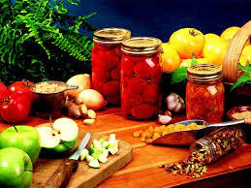
Preservatives
3. Artificial food Preservatives:
Anti-microbial agent: added to food to prevent or inhibit the growth of microorganisms, including bacteria, yeasts, molds, and fungi. These agents play a crucial role in extending the shelf life of food products by reducing the risk of spoilage and foodborne illness.
Anti-oxidants agents: used to prevent lipids and vitamins oxidation in food products. They are primarily used to prevent auto-oxidation and subsequent development of rancidity and off flavors. These are varied from natural substances (Vitamin C & E) to synthetic substances (BHT & BHA)
Anti-browning agents: used to prevent both enzymatic and non-enzymatic browning in foods.

Slide 9
Food colors
Food colors, also known as food dyes, are substances added to food and beverages to enhance their visual appearance or to compensate for color loss during processing.
Types of colors used as food additives :
Natural colors
Derived from plants, fruits, vegetables, and minerals.
Synthetic colors
Artificially produced through chemical processes.
Examples: Beta-carotene (yellow-orange), Anthocyanins (red-purple), Chlorophyll (green), Turmeric (yellow).
Examples: Tartrazine (yellow), Allura Red (red), Brilliant Blue (blue), Sunset Yellow (yellow-orange).

Slide 10
pH Controlling agents
Nutritive additives
pH controlling agents, or acidulants, adjust acidity or alkalinity in food products. They enhance flavor, preserve freshness, and stabilize pH levels. Examples include citric acid, lactic acid, sodium bicarbonate (baking soda), and sodium citrate. These agents are crucial for achieving desired taste, texture, and safety in various foods, but their usage must comply with regulatory standards.
Nutritive additives are added to food to boost their nutritional content, providing essential vitamins, minerals, amino acids, and fatty acids. Examples include vitamins like A, C, and D, minerals such as calcium and iron, essential amino acids like lysine and tryptophan, and beneficial fatty acids like omega-3s. These additives help address nutrient deficiencies and support overall health, but must be used responsibly to avoid imbalance or toxicity.

Slide 11
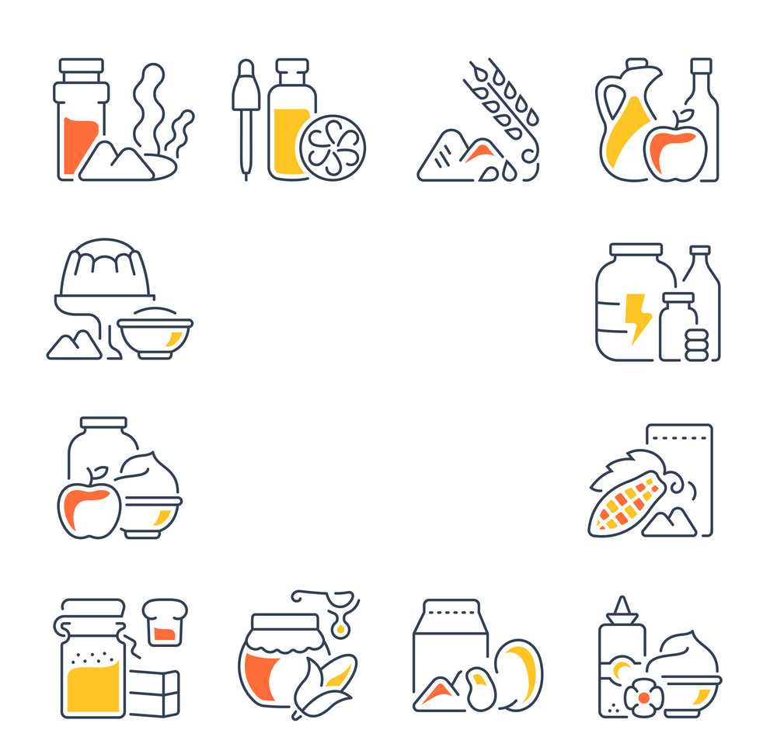
Food Additives
Part 2

Slide 12
Emulsifying and Stabilizing agent
Emulsifying Agents:
An emulsifying agent (also known as an emulsifier) is a compound or substance that stabilizes emulsions. Emulsions are mixtures of two immiscible substances (usually oil and water) that remain dispersed as small droplets throughout each other.
The term “emulsifier” comes from the Latin word meaning “to milk,” referencing milk as an emulsion of water and fat.
Emulsifiers have both a hydrophilic (polar) and a hydrophobic (nonpolar) portion, making them soluble in both oil and water.
They prevent the separation of oil and water by increasing the kinetic stability of the mixture, ensuring that the components do not separate based on density.
Examples of emulsifiers include:
Lecithin: Found in egg yolks and used in mayonnaise to prevent oil separation.
Mustard: Contains multiple chemicals in the mucilage around the seed that act together as emulsifiers.
Sodium phosphates, sodium stearoyl lactylate, soy lecithin, Pickering stabilization, and DATEM (diacetyl tartaric acid ester of monoglyceride) are also common emulsifiers

Slide 13
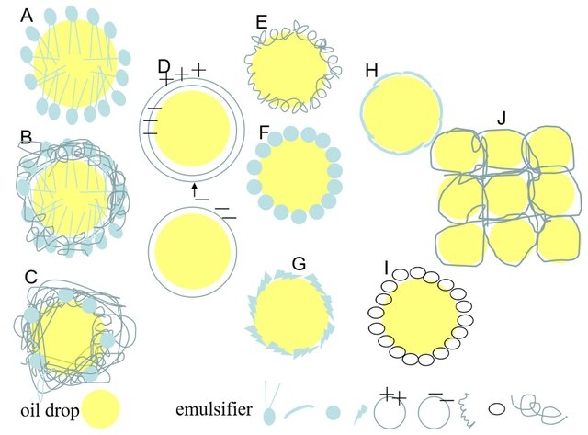
Stabilizing agent
Stabilizing Agents:
Stabilizers are substances that increase stability and thickness by helping foods remain in an emulsion and retain their physical characteristics.
They prevent the separation of ingredients that normally do not mix, such as oil and water.
Examples of stabilizers include starches, pectin, and gums, which are commonly used in soups, sauces, and puddings

Slide 14
Anti cacking agent
An anticaking agent is an additive placed in powdered or granulated materials, such as table salt, to prevent the formation of lumps (caking) and for easing packaging, transport, and consumption.
For example, tricalcium phosphate (E341(iii)) is commonly used in powdered drinks, powdered milk, non-dairy creamer, instant powders, table salt, and spices to improve fluidity and prevent caking.
Other anti-caking agents you might encounter include:
Sodium aluminosilicate or silicon dioxide (E551), often used in salt and spices.
Magnesium stearate (E470b), which helps prevent sticking and is used in various food products.
Cornstarch, which is added to powdered sugar to prevent clumping.
These agents are typically added in very small amounts and have a significant impact on the functionality and quality of food ingredients12. They are essential for maintaining the quality of dry goods, especially in humid environments where moisture can cause ingredients to stick together and form hard lumps

Slide 15
Flavouring agents
Flavouring agents are substances added to food or drinks to enhance or modify their taste, aroma, or texture. These agents can be natural or artificial and come in various forms such as liquids, powders, or extracts. Some examples of natural flavouring agents include herbs, spices, fruits, and vegetables, while artificial flavourings are often made using chemicals or synthetic compounds. Flavouring agents are used in a wide range of food and beverage products, including baked goods, candies, soft drinks, and processed foods. They can also be used in medications and oral care products

Slide 16
Flavouring agents
Some common uses of flavouring agents in the food industry include:
Flavouring food products: Flavoring agents are added to food products to enhance their taste and aroma. For example, vanilla extract is often added to baked goods like cakes and cookies to give them a sweet, vanilla flavour.
Masking unpleasant tastes or odors: Flavoring agents can be used to mask or cover up unpleasant tastes or odors in food products. For example, citrus flavours are often used in soft drinks to mask the bitter taste of caffeine.
Creating unique flavours: Flavoring agents can be used to create unique flavor combinations that are not found in nature. For example, a strawberry cheesecake flavored yogurt may use both natural and artificial flavouring agents to create a unique taste.
Standardizing flavour: Flavoring agents can be used to standardize the flavour of a food product so that it tastes the same every time it is produced. This is particularly important for mass-produced foods where consistency is key.
Extending shelf life: Flavoring agents can be used to extend the shelf life of food products by masking any off-flavours that may develop over time.

Slide 17
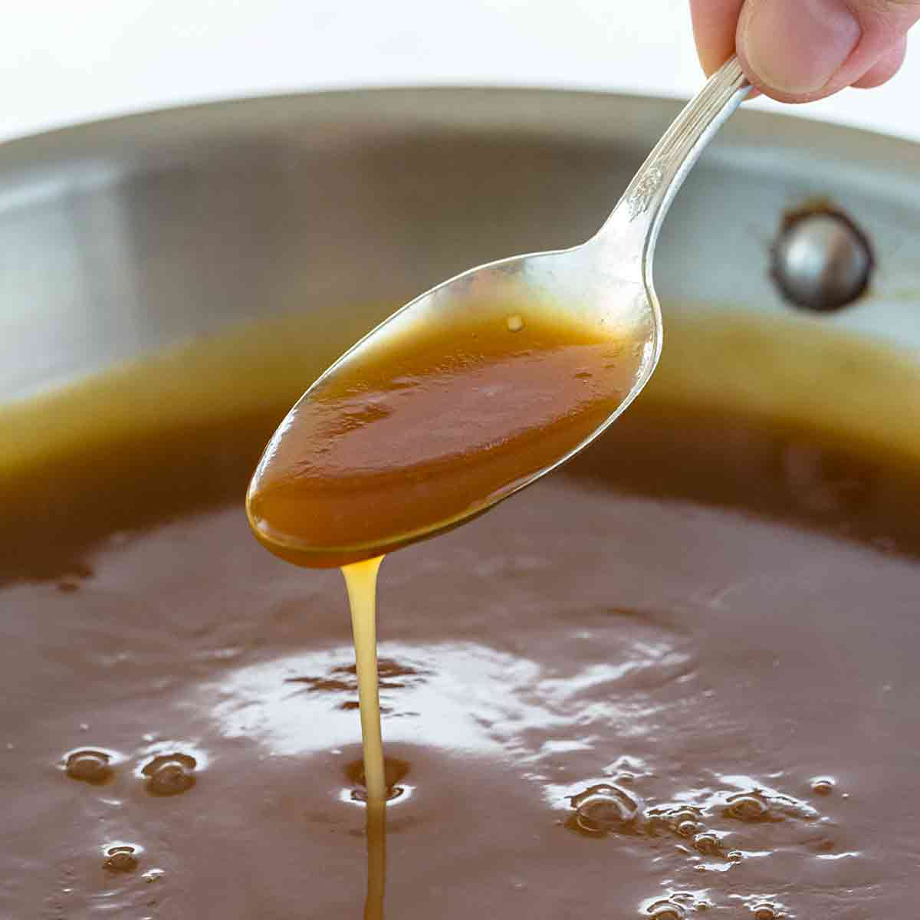
Thickeners
Thickening agents, or thickeners, are hydrocolloids that increase the viscosity of a solution or mixture without significantly affecting its other properties, such as taste. Hydrocolloids are a heterogeneous group of long-chain polymers that, when dispersed in water, produce a thickening or viscous and gelling effect.
As food additives, food thickeners also stabilize food products by increasing the suspension and emulsification of colloids, including gels, sols, and emulsions. Some examples are given bellow

Slide 18
Thickeners
Thickener | Common Applications
Gum Arabic (E414) | Hard jelly sweets and soft drinks
Carob/Locust Bean Gum (E410) | Sauces, salad dressings, fruit fillings, and ice creams
Guar Gum (E412) | Dairy products, sauces, and dressings
Pectin (E440) | Jams, milk drinks, and fruit juices
Sodium Carboxymethyl Cellulose (E466) | Breads, cakes, ice creams, and fruit drinks
Starch (E1401-1451) | Sauces, pie fillings, sweets, and puddings
Agars (E406) | Jellies, bakery products, sauces, and meat products
Alginates (E400-404) | Fruit drinks, soups, sauces, and bakery fillings
Carrageenans (E407) | Dairy products and meat products
Gellan Gum (E418) | Dairy products and desserts
Xanthan Gum (E415) | Sauces, salad dressings, and non-dairy beverage

Slide 19
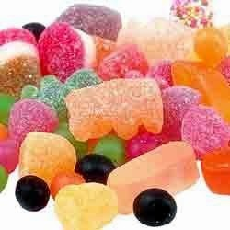
Firming agents
Firming agents are substance added to precipitate residual pectin, thus strengthening the supporting tissue and preventing its collapse during processing. Fruits and vegetables contain pectin components that are relatively insoluble and form a firm gel around the fibrous tissues of the fruit and prevent its collapse. Addition of calcium salts causes the formation of calcium pectate gel, which supports the tissues and affords protection against softening during processing. The calcium salt is sometimes added to the canned vegetable in the form of a tablet containing both sodium chloride and calcium chloride
Typical firming agents are:
Calcium carbonate (E170)
Calcium hydrogen sulfite (E227)
Calcium citrates (E333)
Calcium phosphates (E341)
Calcium sulfate (E516)
Calcium chloride (E509)
Magnesium chloride (E511)
Magnesium sulfate (E518)
Calcium gluconate (E578)
Magnesium gluconate (E580)

Slide 20
Bleaching and Clarifying agents
Bleaching agents are additives used in the food industry to improve the color and quality of food products. While they enhance appearance, they also come with certain considerations. Here are some common types of bleaching agents:
Function:
Color Enhancement: Bleaching agents improve the appearance of food products like flour, sugar, and oils by enhancing their color, making them more appealing to consumers.
Consistency: Ensures uniform color across food products, which is crucial for items like flour and sugar.
Extended Shelf Life: Helps in removing impurities that cause spoilage, thereby extending the product’s freshness.
Cost-Effective: Reduces production costs and waste by producing visually appealing and consistent products.

Slide 21
Bleaching and Clarifying agents
Disadvantages:
Health Risks: Some agents can leave harmful residues, potentially posing health risks, such as chlorine dioxide which can form dangerous byproducts.
Nutrient Loss: The bleaching process can reduce the nutritional value of foods, affecting vitamins and minerals.
Environmental Impact: Chlorine-based bleaches can harm aquatic ecosystems if not properly disposed of.
Allergies: Certain bleaching agents can trigger allergic reactions in sensitive individuals.
Regulatory Compliance: Strict regulations govern the use of bleaching agents, requiring adherence to ensure food safety

Slide 22
Bleaching and Clarifying agents
Examples Hydrogen Peroxide (H₂O₂): Widely used to whiten flour, making it appear brighter and more appealing. Also serves as an effective disinfectant, contributing to food safety.
Benzoyl Peroxide: Commonly used in the baking industry, especially in wheat flour production. Improves the color and texture of flour, making it suitable for baked goods like bread and pastries.
Azodicarbonamide (ADA): A versatile bleaching agent used in the food industry. Used for bleaching flour and improving dough texture.
Ascorbic Acid (Vitamin C): Ascorbic acid is a naturally occurring compound found in fruits and vegetables. It is used as a bleaching agent and dough conditioner in the food industry. Ascorbic acid not only helps to whiten flour but also enhances the quality and shelf life of baked products.
Chlorine Dioxide: Chlorine dioxide is employed as a bleaching agent in the processing of various food products, including flour and starch. It is highly effective in removing impurities and dark pigments, resulting in a more appealing final product

Slide 23
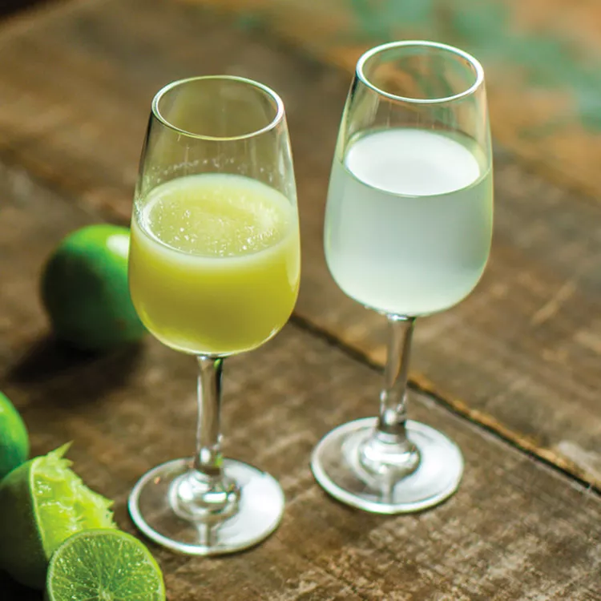
Bleaching and Clarifying agents
Clarifying agents are compounds that clean liquids like juice, beer, and wine of particles and contaminants. The contaminants and particles might be dissolved or suspended. Bentonite, gelatin, keelson, and isinglass are typical clarifiers.
Clarifying agents play a crucial role in maintaining the quality of horticultural foods. Here’s how they contribute:
Impurity Removal: Clarifying agents help remove impurities, cloudiness, and undesirable particles from fruit juices, wines, and horticultural products.
Visual Appeal: They enhance the visual appeal and quality of these products, improving marketability.
Stabilization: Clarifying agents stabilize formulations, prevent sedimentation, and preserve natural flavors and nutritional value.
Consistency and Shelf Life: They contribute to product consistency and extend shelf life, ensuring a consistent and appealing product for consumers

Slide 24
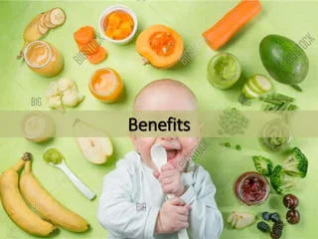
Benefits and Risk of Food Additives
Enhancing Nutritive Value: Food additives can be nutritional or non-nutritional. Nutritional additives specifically work to improve the food's value for growth, maintaining life, and promoting health in humans and animals. They are key in enhancing the usefulness of food and feedstuffs.
Preservation: Additives are essential for maintaining the safety, freshness, and taste of food over time. They help keep food safe for consumption by preventing spoilage and maintaining quality.
Improving Taste and Aroma: Additives enhance the sensory attributes of food, including taste, aroma, texture, and appearance. While some additives are beneficial and safe, others might have adverse health effects; thus, their use is regulated and categorized based on their function.
Maintain the wholesomeness of foods:Bacteria and other germs can cause foodborne illnesses. Preservatives reduce the spoilage that these germs can cause. Certain preservatives help preserve the flavor in baked goods by preventing the fats and oils from going bad. Preservatives also keep fresh fruits from turning brown when they are exposed to the air.
Aiding in Weight Management: Certain food additives are used to modify food's taste and texture and can assist in weight loss. Approved by dieticians, these additives help burn fat without adding extra calories, acting as fat blockers

Slide 25
Risk
Health Risks Associated with Food Additives
Hyperactivity in Children:
Artificial food colors have been linked to causing hyperactivity in sensitive children, reigniting concerns among parents and researchers who advocate for reducing these additives in children's diets.
Allergic Reactions:
Some individuals experience allergic reactions to food additives used in many processed foods. These reactions can range from mild to severe and include ingredients like flavors, colors, and preservatives.
Contribution to Hypertension:
Certain food additives have been identified to potentially raise blood pressure, making them a risk factor for hypertension. This can lead to serious health issues, including heart attacks and strokes.
Obesity:
Some additives can increase the caloric content of foods, contributing to weight gain and obesity. Awareness of these additives is crucial for maintaining a healthy diet
Other Adverse Reactions: Food additives are also associated with various types of health issues, including:
Digestive disorders: such as diarrhea and colicky pains.
Nervous disorders: including hyperactivity, insomnia, and irritability.
Respiratory problems: such as asthma, rhinitis, and sinusitis.
Skin problems: including hives, itching, rashes, and swelling

Slide 26
Standards
The Codex Alimentarius, often referred to as "Codex," is a collection of internationally recognized standards, guidelines, and codes of practice that aim to ensure food safety and quality in the international food trade. Established by the Food and Agriculture Organization (FAO) and the World Health Organization (WHO) in 1963, Codex serves as a reference point for food producers, processors, national food control agencies, regulators, and international food trade.
Standards for Food Products: Codex establishes standards for a wide range of food products to ensure their safety for consumption. These standards may include permissible levels of contaminants, food hygiene, food additives, pesticide residues, and vet drugs residues in foods
ADI: A main purpose of the risk assessment of food additives is the derivation of an Acceptable Daily Intake (ADI) as a health-based guidance value. An ADI is the estimated maximum amount to which individuals may be exposed daily over their lifetimes without appreciable health risk

Slide 27
Standards
Food Additive (E Code) | Function | ADI | Common Uses
Aspartame (E951) | Artificial sweetener | 40 mg/kg body weight | Used in diet sodas, sugar-free gum, and low-calorie foods.
Monosodium Glutamate (MSG, E621) | Flavor enhancer | Not specified, deemed "Generally Recognized As Safe" (GRAS) the United States Food and Drug Administration (FDA) | Common in Asian cuisine, snacks, soups, and processed foods.
Tartrazine (Yellow 5, E102) | Synthetic dye | Up to 7.5 mg/kg body weight | Used in candies, soft drinks, instant puddings, and flavored chips.
Sodium Benzoate (E211) | Preservative | Up to 5 mg/kg body weight | Used in acidic foods like salads, pickles, soft drinks, and fruit juices.
Sodium Nitrite (E250) | Preservative and color fixative | 0-0.07 mg/kg body weight | Used in processed meats such as bacon, ham, sausages, and hot dogs

Slide 28
E code
E codes are numerical codes used to identify food additives that have been assessed for use within the European Union (EU) and are considered safe. These codes are commonly found on food labels throughout the EU to inform consumers about the specific additives used in the production of a food item. The "E" stands for Europe or European Union. Certainly! Below is a concise table format presenting the categories of food additives along with some examples, utilizing the European Union's E code system:
E Code Range | Category | Examples
E100-E199 | Colors | E100 (Curcumin), E133 (Brilliant Blue FCF)
E200-E299 | Preservatives | E202 (Potassium sorbate), E211 (Sodium benzoate)
E300-E399 | Antioxidants and Acidity Regulators | E300 (Ascorbic acid), E330 (Citric acid)
E400-E499 | Thickeners, Stabilizers, Emulsifiers | E415 (Xanthan gum), E471 (Mono- and diglycerides of fatty acids)
E500-E599 | pH Regulators and Anti-caking Agents | E500 (Sodium bicarbonate), E551 (Silicon dioxide)
E600-E699 | Flavor Enhancers | E621 (Monosodium glutamate, MSG)
E900-E999 | Miscellaneous | E904 (Shellac), E951 (Aspartame)
E1000-E1599 | Additional Chemicals | E1200 (Polydextrose), E1520 (Propylene glycol)

Slide 29
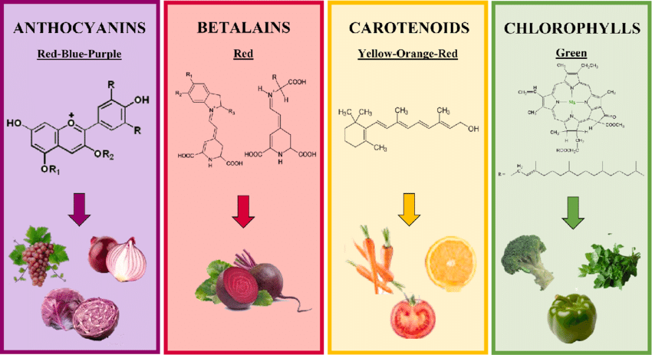
Pigments
Foods, particularly fruits and vegetables, are naturally colored mainly by four groups of pigments: the green chlorophylls, the yellow-orange-red carotenoids, the red-blue-purple anthocyanins and the red betanin. These pigments are also incorporated into food products by direct addition or indirectly. These compounds have drawn considerable attention in recent years, not because of their coloring properties, but due to their potential health-promoting effects

