Slide 1
Cluster
Md. Asif Mahmud Ridoy
Lecturer
Department of Computer Science and Engineering

Slide 2
Agenda
What is Hadoop
Hadoop Components
Hadoop Cluster Architecture
Size of Hadoop Architecture
Single Node and Multi-Node Cluster
Communication Protocol in Hadoop Cluster
Benefits of Hadoop Cluster
Challenges of Hadoop Cluster

Slide 3
What is Hadoop
Hadoop is an open project overseen by the Apache Software Foundation
Originally based on papers published by Google in 2003 and 2004
Hadoop committers work at several different organizations – Including Cloudera, Yahoo!, Facebook, LinkedIn
Hadoop takes a radical new approach to the problem of distributed computing – distribute the data as it’s initially stored in the system and individual nodes work on data local to the nodes.

Slide 4
History of Hadoop

Slide 5
Who Uses Hadoop?

Slide 6
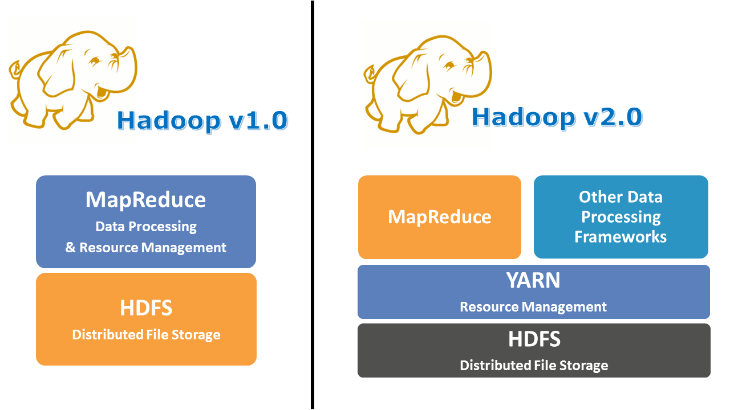
Hadoop Components
Application
& Resource Management
Layer
Application Layer
Resource Management
Layer
Storage Layer
Storage Layer

Slide 7
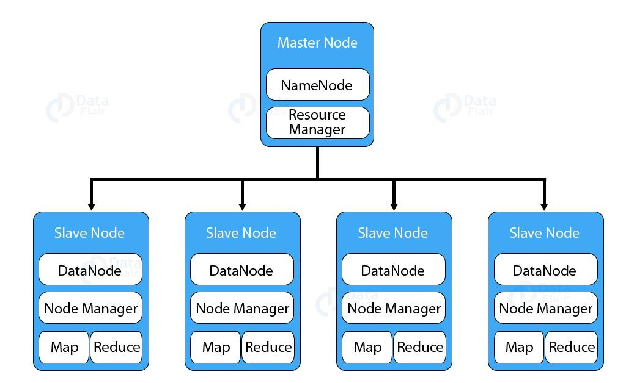
HDFS
HDFS stands for Hadoop Distributed File System. It provides for data storage of Hadoop. HDFS splits the data unit into smaller units called blocks and stores them in a distributed manner.
It has got two clusters running.
Master node – NameNode
Slave nodes – DataNode.

Slide 8
Block in HDFS
Block is nothing but the smallest unit of storage on a computer system. It is the smallest contiguous storage allocated to a file. In Hadoop, we have a default block size of 128MB or 256 MB.

Slide 9
What is Cluster
A Hadoop cluster is a collection of computers, known as nodes, that are networked together to perform parallel computations on big data sets.
Hadoop clusters consist of a network of connected master and slave nodes that utilize high availability, low-cost commodity hardware.

Slide 10
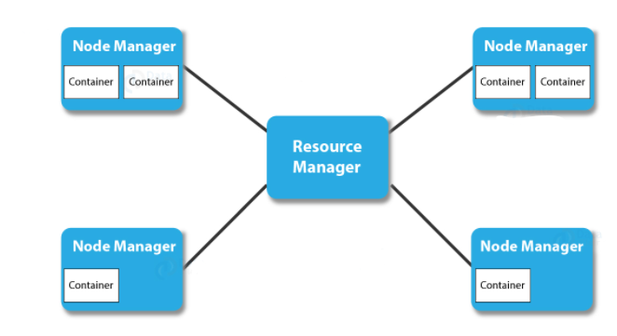
Hadoop Cluster Architecture
Master node in Hadoop Cluster Consists of
NameNode
Resource Manager

Slide 11
Hadoop Cluster Architecture
Slave nodes in the Hadoop Cluster Consists of
DataNode
NodeManager
Client Node

Slide 12
Single Node Cluster
Consist of only one node.
All the NameNode, DataNode, ResourceManager, and NodeManager are on a single machine.
Only one DataNode is running.
Mainly used for studying and testing purposes

Slide 13
Multi-Node Cluster
Consist of multiple node.
Clusters run on separate host or machine.
NameNode cluster run on the master machine
DataNode clusters runs on the slave machines.
Used in organizations for analysing Big Data.

Slide 14
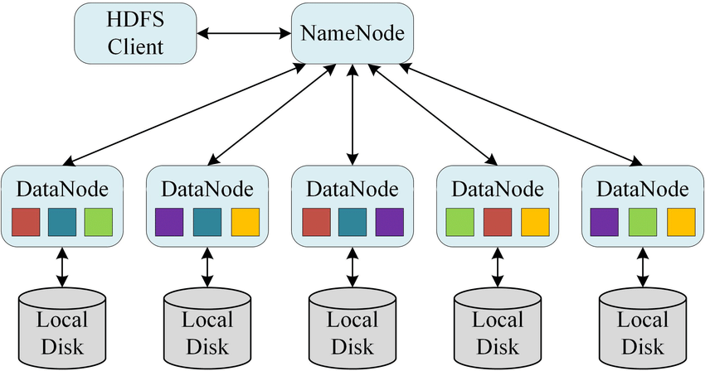
Self-healing
DataNodes send heartbeats to the NameNode
After a period without any heartbeats, a DataNode is assumed to be lost
NameNode determines which blocks were on the lost node
NameNode finds other DataNodes with copies of these blocks
These DataNodes are instructed to copy the blocks to other nodes
Replication is actively maintained
Same block stored in different DataNodes

Slide 15
What is cluster size in Hadoop?
A Hadoop cluster size is a set of metrics that defines storage and compute capabilities to run Hadoop workloads, namely :
Number of nodes : number of Master nodes, number of Edge Nodes, number of Worker Nodes.
Configuration of each type node: number of cores per node, RAM and Disk Volume.

Slide 16
Calculating Hadoop Cluster Capacity
For example: Let's say that you need 500TB of space. If you have a JBOD of 12 disks, and each disk can store 6TB of data, then the data node capacity, or the maximum amount of data that each node can store, will be 72 TB. Data nodes can be added as the data grows, so to start with its better to select the lowest number of data nodes required.
In this case, the number of data nodes required to store 500TB of data equals 500/72, or approximately 7.

Slide 17
Communication Protocols Used in Hadoop Clusters
The HDFS communication protocol works on the top of TCP/IP protocol.
The client establishes a connection with NameNode using configurable TCP port.
Hadoop cluster establishes the connection to the client using client protocol.
DataNode talks to NameNode using the DataNode Protocol.

Slide 18
Benefits of Hadoop Clusters
Robustness
Data disks failures, heartbeats and re-replication
Cluster Rebalancing
Data integrity
Metadata disk failure
Snapshot

Slide 19
What are the challenges of a Hadoop Cluster?
Issue with small files
High processing overhead
Only batch processing is supported
Iterative Processing

Slide 20
References
Data-Flair
Data-Bricks

