Slide 1
Food Chemistry 0711-2101 Chemistry of Food Processing
Department of Nutrition & Food Engineering
Daffodil International University

Slide 2
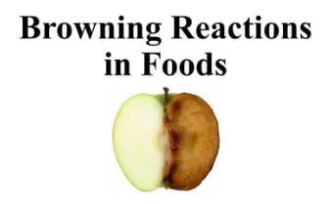
Contents
Non-enzymatic browning
Pigment formation
Melanoidin
Maillard polymers
Caramelization
Ascorbic acid oxidation
Antioxidant activity of non-enzymatic browning products
Inhibition of non-enzymatic browning.

Slide 3
Browning Reactions in Food Introduction
Browning reactions in food are widespread phenomena which take place during processing and storage.
These reactions occur during the manufacture of meat, fish, fruit, and vegetable products, as well as when fresh fruits and vegetables are subjected to mechanical injury.
Browning affects the flavor, appearance, and nutritive value of the food products involved.
For certain foods, browning is an important part of the preparation process. For example, in the manufacture of coffee, tea, beer, and maple syrup, and in the toasting of bread, it enhances the appearance and flavor of these products.
Browning, to a limited degree, is considered desirable in apple juice, potato chips, and
French fries.
To control or inhibit these reactions it is important to understand the mechanisms involved.
Three browning mechanisms appear to be involved in foods, as shown in Table 1 Ascorbic acid browning can proceed either by the enzyme ascorbic acid oxidase or by direct atmospheric oxygen and oxidation of ascorbic acid.

Slide 4
Browning Reactions in Food Introduction
Three browning mechanisms appear to be involved in foods, as shown in Table. Ascorbic acid browning can proceed either by the enzyme ascorbic acid oxidase or by direct atmospheric oxygen and oxidation of ascorbic acid.

Slide 5
Non-Enzymatic Browning Introduction
During the preparation and processing of foods, one soon becomes acquainted with the phenomenon of browning associated with heated and stored products. This phenomenon, referred to as non-enzymatic browning.
The importance of this reaction in the production of foods is illustrated by its contribution to the flavor, color, and aroma of coffee, caramel, bread, and breakfast cereals.
Careful control must be exercised to minimize excessive browning, which could lead to unpleasant changes in the food product.
In recent years there has been considerable focus on the deleterious effects of non-enzymatic browning reactions in food.
Particular concern is the toxicity and potential mutagenicity of some of the intermediates formed.
Not all the intermediates formed are deleterious as some appear to exert considerable antioxidant activity.
Three major pathways: Maillard reaction, Caramelization, and Ascorbic acid oxidation.

Slide 6
Non-Enzymatic Browning Maillard Reaction
The formation of brown pigments and melanoidins was first observed by the French chemist Louis Camille Maillard (1912) following the heating of a solution of glucose and lysine (Finot, 2005).
This reaction was subsequently referred to as the Maillard reaction and essentially covers all those reactions involving compounds with amino groups and carbonyl groups present in foods.
These include amines, amino acids, and proteins interacting with sugars, aldehydes, and ketones, as well as with products of lipid oxidation.
The general mechanism of browning was first proposed by Hodge (1953).
The importance of this reaction in living systems has also been the subject of extensive studies over the past 30 years. This reaction can also occur in vivo, originally being referred to as non-enzymatic glycosylation, and later as glycation (Tessier, 2010).
The random damage to extracellular proteins in the human body, as a result of glycation, has important implications for aging and chronic diseases such as diabetes (Brownlee, 2001).

Slide 7
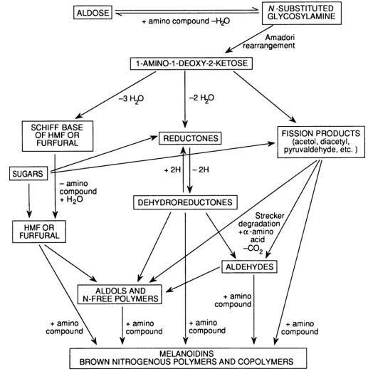
Non-Enzymatic Browning Maillard Reaction
.

Slide 8
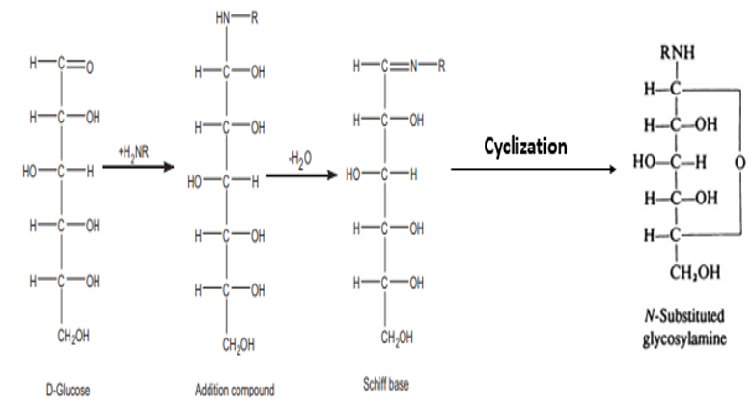
Non-Enzymatic Browning Maillard Reaction- Carbonylamino Reaction
The first step in the Maillard reaction involves condensation between the a-amino groups of amino acids or proteins and the carbonyl groups of reducing sugars: this defines the carbonylamino reaction.
The initial product is an addition compound which rapidly loses water to form a Schiff base followed by cyclization to the corresponding N-substituted glycosylamine:

Slide 9
Non-Enzymatic Browning Maillard Reaction- Carbonylamino Reaction
The formation of the N-substituted glycosylamine involves condensation of the amine group of the amino acid with a carbonyl group of a reducing sugar.
This reaction is not necessarily restricted to α-amino acids and can involve the participation of other amino groups found in peptides and proteins.
This is facilitated when the pH of the medium is above the isoelectric point of the amino group, thus producing basic amino groups.
Lysine provided the majority of free amino groups in proteins, in the form of ε-amino groups, which were the main participant in this reaction.
Maillard reaction rate was reported to be affected by the length of the peptide chain. Chain length could be an important factor affecting the reaction and the formation of Maillard reaction products.
The reaction rate may be greatly affected by the extent of hydrolysis of the peptide bond and its stability as the heating time is increased.

Slide 10
Non-Enzymatic Browning Maillard Reaction-Amadori Rearrangement
The final condensation product in the carbonylamino reaction is the N-substituted glycosylamine. This compound is extremely unstable and underwent a series of rearrangements.
These changes involved isomerization of the N-substituted glycosylamine to the corresponding fructose-amino acid.
The transition from an aldose to a ketose sugar derivative is referred to as the Amadori rearrangement and involves protonation of nitrogen at carbon 1 (C1).
In the case of ketones and amines, ketosylamines are formed which then undergo the Heyns rearrangement to form 2-amino-2-deoxy aldoses by protonation of the oxygen at C6.
The Amadori rearrangement has been demonstrated for a series of glucose-amino acid complexes. The reactions leading up to the formation of 1-amino-1-deoxy-2 ketose are all reversible.

Slide 11
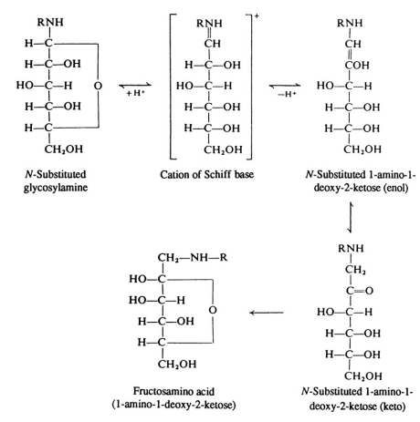
Non-Enzymatic Browning Maillard Reaction-Amadori Rearrangement
.

Slide 12
Non-Enzymatic Browning Maillard Reaction-Amadori Rearrangement
The products are quite stable and have been identified in freeze-dried peaches and apricots, tomato powder, soy sauce and milk.
A number of Amadori compounds from crude extracts of Maillard reaction systems have been identified such as alanine-fructose, Leucine-fructose, hydroxyproline-fructose, and tryptophan-fructose.
The level of Amadori compounds reached a maximum prior to the development of any brown color. The most significant consequence of this reaction is the loss of available lysine.
In foods containing proteins and glucose, one of the Amadori compounds formed is ε-fructosyl-lysine or furosine.
Milk, with lactose as the major carbohydrate, forms lactulosyl-lysine when heated.
Amadori compounds, such as furosine, are used to assess the quality of a variety of food products such as dairy, eggs, cereals, vegetables, tomatoes, infant cereals, honey, and dehydrated fruits.
The formation of furosine in cookies was highly correlated with the initial water content of the dough under the same baking conditions.

Slide 13
Non-Enzymatic Browning Maillard Reaction-Amadori Rearrangement
4-hydroxy-alkenals can be formed in a non-lipid system from 2-deoxyribose catalyzed by amino acids.
These are important, including lipid peroxidation products that can form Schiff base adducts with nitrogen nucleophiles, such as amino acids and proteins, and then undergo vinylogous Amadori rearrangement.
While these Amadori intermediates do not contribute directly to browning or flavor, they result in a loss of nutritional value due in large part to the unavailability of the ε-amino group of lysine.

Slide 14
Pigment Formation
The reactions involved in the conversion of 1-amino-1-deoxy-1-ketose derivatives to brown pigments or melanoidins are extremely complex and incompletely understood.
Three distinct pathways have been proposed, two of which are directly involved in pigment formation. They involve different labile intermediates, which are the enol forms of the Amadori compounds.
Via Amadori Compounds
In one pathway, enolization of 1-amino-1-deoxy-2-ketose occurs at 2 and 3 positions to irreversibly produce 2,3-enediol. This then undergoes a series of changes including the loss of the amine from C1 to form a methyl dicarbonyl intermediate.
The second pathway involves formation of 1,2-eneaminol from the Amadori product in which a hydroxyl group is lost at C3, followed by deamination at C1 and addition of water to form 3-deoxyhexosulose. Both hexose derivatives, 1-deoxyhexosulose and 3-deoxyhexosulose, are very reactive and will undergo retro-aldolization to form a-dicarbonyls such as glyoxal, methylglyoxal, and 2,3-butanedione.
The subsequent reactions are complex and involve a series of aldol condensation and polymerization reactions. The final products are nitrogenous compounds which give rise to the dark brown pigmentation. A low pH favors the 1,2-eneaminol pathway while a high pH favors the pathway involving the conversion of 2,3-enediol to reductones and the subsequent fragmentation to furaneol and pyrones.

Slide 15
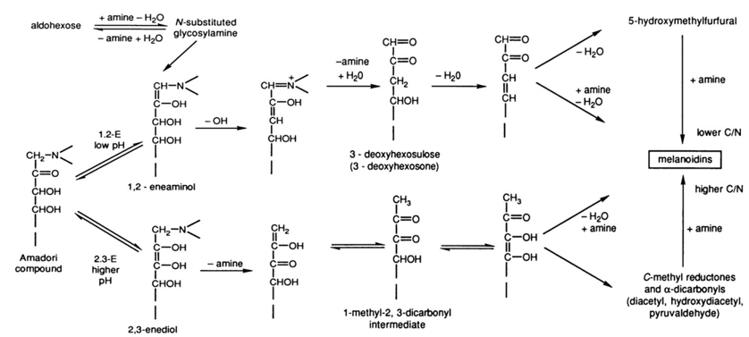
Pigment Formation
.

Slide 16
Pigment Formation
Alternative Pathways
Alternative pathway involves the formation of free radicals in browning mixtures of carbonyl compounds and amines or amino acids.
Alternative pathway for browning in which the sugar moiety of the Schiff base was cleaved prior to the Amadori rearrangement, leading to the formation of glycolaldehyde alkylimine or its corresponding eneaminol.
The formation of methylglyoxal dialkylimine, a C_{2n} compound, is also occur during the initial stages of the Maillard reaction. The formation of this C₂ compound was thought to arise directly from the Amadori rearrangement.
Under acidic conditions, the traditionally accepted pathway involved osone formation via the Amadori rearrangement.
Under alkaline conditions, however, they largely attributed the increase in browning to sugar fragmentation to C2 and C3 fragments.
However, suggested that this pathway be considered as a concomitant one occurring along with the established Maillard reaction scheme.

Slide 17
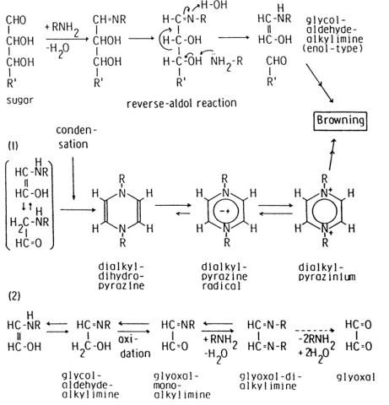
Pigment Formation
.

Slide 18
Pigment Formation
Strecker Degradation
The third pathway in the Maillard reaction is concerned with the oxidative degradation of amino acids in the presence of a-dicarbonyls or other conjugated dicarbonyl compounds formed from Amadori compounds. This reaction is based on the work originally carried out by Strecker over a century ago in which he observed the oxidation of alanine by alloxan, a weak oxidizing agent. The reaction, now referred to as the Strecker degradation, is not directly concerned with pigment formation but provides reducing compounds essential for its formation.
The initial reaction involves the formation of a Schiff base with the amino acid. The tuatomeric end-form then decarboxylates to produce the eneaminol, which then undergoes hydrolysis to the corresponding aldehyde with one carbon less, together with a 1-amino-2-keto compound. The aldehydes formed during the Strecker degradation reaction contribute to flavor.
It is the secondary products of Strecker degradation that are responsible for the strong aroma of cocoa. The contribution of the Strecker aldehydes isobutyric, isovaleric, and methional to roasted food aroma was only auxiliary.
Condensation of the intermediates formed by Strecker degradation produced many heterocyclic compounds, pyrazines, pyrrolines, oxazoles, oxazolines, and thiazole derivatives responsible for the flavor of heated foods.

Slide 19
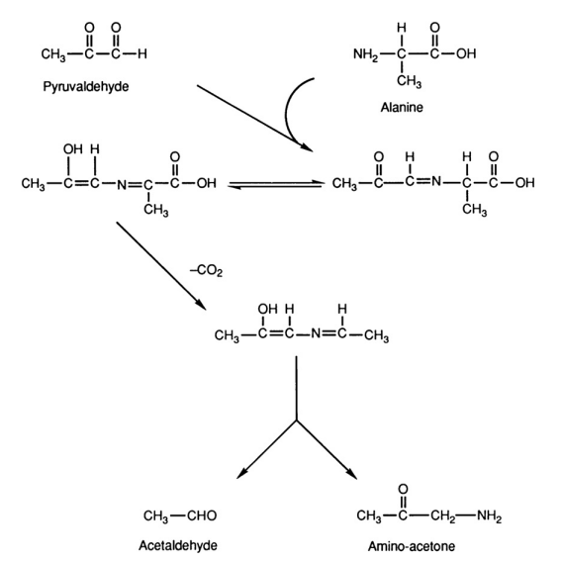
Pigment Formation
Strecker Degradation

Slide 20
Melanoidine- Maillard Polymers
The final products formed in the Maillard reaction are polymers or melanoidins. Unlike the flavor and aroma compounds, the origin and nature of these polymers are poorly understood.
Numerous studies have attempted to examine melanoidins in model systems. Increasing amounts of water-soluble, non-dialyzable polymers with molecular weights greater than 16,000 were obtained for both glycine and methionine systems as a function of time.
Elemental analyses of polymers prepared from glycine model systems were similar, which suggested that the amino acid was incorporated into the polymer.
The binding of metal ions to these Melanoidin was evident by their greater solubility in tap water than in distilled water.
The non-dialyzable polymer that is formed by dehydration and polymerization of an Amadori compound is Melanoidine.
The formation of melanoidins appears to involve two separate pathways. One pathway leads to the formation of protein-based melanoidins from deoxysones, while the other is based on sugar degradation products. The latter reaction was resulted in the formation of low-molecular-weight colored compounds with furan and pyrrolidine structures and high-molecular-weight brown compounds.
A-Dicarbonyls were key intermediates in the formation of the carbohydrate-based melanoidins. These include the long-chain dicarbonyls, 1,3-deoxyosone and 1,4-dideoxyosones, and the short-chain dicarbonyls, methylglyoxal and glyoxal. They proposed a carbohydrate-based melanoidin structure resulting from the aldol condensation of a-dicarbonyl compounds.

Slide 21
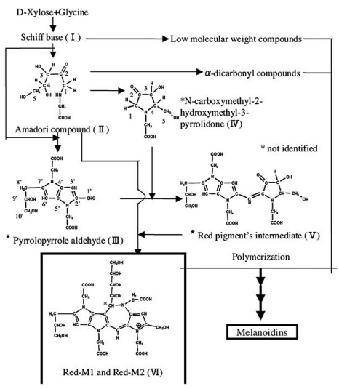
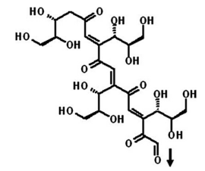
Melanoidine- Maillard POLYMERS
Proposed formation pathway for products from the reaction of D xylose (1 M) incubated with glycine (0.1 M) and sodium hydrogen carbonate (0.1 M) in a 60%ethanol solution (pH 8.1)

Slide 22
Melanoidine- Maillard Polymers
Colored melanoidins were formed in the presence of methylglyoxal, as under alkaline conditions it forms a carbanion on the third carbon atom, which then proceeds to form colored melanoidins by aldol condensation. In the case of glyoxal a similar reaction is not possible as it is unable to form a carbanion.
Extensive studies conducted on the formation of protein-based melanoidins used a D-xylose- glycine model system. Using this model system, a Maillard reaction-1 pigment (Blue-M1) that was considered to be an oligomer intermediate in the formation of melanoidins.
A second blue pigment (Blue-M2) which had a higher molecular weight compound than Blue- M1 and was thought to arise from the interaction between Blue-M1 and di-D-xyuloseglycine.
In addition to the blue pigments, Blue-M1 and Blue-M2, recently identified several red pigments (Red-M1 and Red-M2) using the same D-xylose- glycine system.
The actual mechanism involved in the formation of melanoidins, advanced glycation end products from these intermediate pigments, was finally resolved by shows the formation of a Schiff base and Amadori compound from xylose and glycine, followed by the formation of 3-deoxyxylosone (3-DX). The latter compound then reacts with glycine to form pyrrole-2-carbaldehyde, which then reacts with imine to form pyrrolo pyrrole-2-carbaldehydes (PPA). PPA is the precursor of the blue pigment-M1, an intermediate pigment formed by decarboxylation of two molecules of PPA. The blue pigments then readily polymerize to the brown-colored melanoidins. Similar blue pigments were also detected in glucose-glycine and D-xylose and β-alanine model systems.

Slide 23
Melanoidine- Maillard Polymers
Proposed formation pathway for products from the reaction of D xylose (1 M) incubated with glycine (0.1 M) and sodium hydrogen carbonate (0.1 M) in a 60%ethanol solution (pH 8.1)

Slide 24
Non-Enzymatic Browning Conditions for the Maillard Reaction
pH and Buffers
The carbonylamino reaction can develop in acidic or alkaline media, although it is favored under alkaline conditions, where the amine groups of the amino acids, peptides, and proteins are in the basic form. Increasing the pH also ensures that more of the hexoses are in the open chain or reducing form. A higher pH environment intensifies Maillard browning in most instances. More browning was observed in Leucine-glucose, lysine-glucose, lysine-fructose, and proline-glucose systems.
Similar effects were observed for microwave-irradiated samples. When extrusion cooking was used, the effects of pH were temperature dependent. Volatile compounds increased with decreasing pH at 180 °C but increased with rising pH at 120 °C.
The role of buffers in non-enzymatic reactions has been shown to increase the rate of browning for sugar-amino acid systems as a result of their influence on the ionic environment in which the reaction takes place. Using a glycine-glucose model system, phosphate buffer enhanced the browning rate and loss of amino acid at pH 7 and 25 °C while citrate buffer had only a minimal effect. The catalytic ability of the phosphate buffer was attributed, in part, to its ability to act as a base catalyst for Amadori rearrangement.

Slide 25
Non-Enzymatic Browning Conditions for the Maillard Reaction
Temperature
The temperature dependence of this reaction has been demonstrated in a number of quantitative studies, where increased rates were reported with rise in temperature.
A leucine and glucose system also exhibited a greater browning rate at 122 °C than at 100 °C. Similarly, mixture of glucose and glycine generated more volatile compounds at elevated reaction temperatures from 100 °C to 300 °C.
Moisture Content
The Maillard reaction proceeds rapidly in solution, although complete dehydration or excessive moisture levels inhibit this process. For a casein- glucose system, the maximum loss of free amino groups occurred between 65% and 70% relative humidity, which corresponded to a level at which the reactants were still in a comparatively dry state.

Slide 26
Non-Enzymatic Browning Conditions for the Maillard Reaction
High Pressure
High-pressure processing has gained much attention because of its minimal effect on food flavor and nutrient quality. In combination with other factors, high pressure may lead to some flavor variation. The effect of high pressure on the Maillard reaction varied depending on the pH of the medium. In a glucose and lysine system with pH ranging from 7.0 to 7.5, high pressure had insignificant effects.
At a higher pH, high pressure hastened the Maillard reaction, with the opposite effect observed at a lower pH. This suggested that pressure induced the ionization of the acid groups in the system, resulting in a lower pH and a subsequent rate reduction.
High pressure also enhanced the formation of tetramethylpyrazine under weak acidic conditions indicated that Amadori arrangement products formed more rapidly and subsequently degraded under high pressure, resulting in an increase in intermediate and advanced reaction products.

Slide 27
Non-Enzymatic Browning Conditions for the Maillard Reaction
Pulsed Electric Field and Ultrasound
Using an asparagine- glucose model system, applying a pulsed electric field at an intensity above 30 kV/cm resulted in a dramatic increase in the formation of MRPs. Ultrasonic treatment, at high intensities, can be used to promote the Maillard reaction in a glycine-maltose model.
Sugars
Reducing sugars are essential ingredients in these reactions, providing the carbonyl groups for interaction with the free amino groups of amino acids, peptides, and proteins. The initial rate of this reaction is dependent on the rate at which the sugar ring opens to the oxo or reducible form.
The concentration of the oxo form of the sugar is increased with increasing pH. The amount of the oxo form was much higher for pentoses than hexoses, thus explaining the greater reactivity of pentoses in browning systems.
Reducing sugars exerted an inhibitory effect on the hydrolysis of casein by trypsin because of the unavailability of certain essential amino acids resulting from non-enzymatic browning reactions. The fructose system browned at a faster rate during the first 80 hour period but was subsequently taken over by the glucose system. The consumption pattern of glucose and fructose paralleled the rate of browning.
The pentose sugars were all more reactive than the corresponding hexose sugars, with ribose being the most active, followed by xylose and arabinose.

Slide 28
Non-Enzymatic Browning Conditions for the Maillard Reaction
Metals
The formation of metal complexes with amino acids can influence the Maillard reaction. This reaction was catalyzed by copper and iron, and inhibited by manganese and tin.

Slide 29
Caramelization
Caramelization is another example of non-enzymatic browning involving the degradation of sugars and generally proceeds simultaneously with the Maillard reaction. Caramelization of sugars contributes markedly to the production of brown pigments and may lead to an overestimation of the Maillard reaction and its associated properties in foods.
When sugars are heated above their melting points they darken to a brown coloration under alkaline or acidic conditions. If this reaction is not carefully controlled it can lead to the production of unpleasant, burned, and bitter products. Consequently, it is important to control this reaction during food processing while still retaining the pleasant qualities of caramel. Caramel colors used for coloring foods vary in color from very dark brown to black, syrup-like liquids or powders.
The different caramel colors are prepared by heating food-grade carbohydrates with ammonia, sulfite, and/or acid and alkaline reactants.
The chemical composition of caramel is extremely complex and still poorly understood, although caramels produced from different sugars all show similarity in composition.

Slide 30
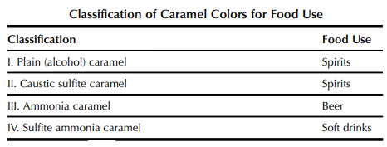
Caramelization
.

Slide 31
Caramelization
Acidic Degradation
The first step involves the stepwise conversion of D-glucose to Dructose and D-mannose. These transformations can be mediated by organic acid catalysts over a pH range of 2.2- 2.9. Continued heating results in the dehydration of sugars, leading to the formation of hydroxymethylfurfural, levulinic acid, and humin. The initial product, a dicarbonyl, undergoes further degradation.
If the initial sugar was a pentose, the final product was 2-furaldehyde.
The formation of HME, one of the major Caramelization products produced over a pH range of 6.0- 6.7, is presumably a precursor of the pigment. In addition to HMF, a minor product, 2-(2-hydroxyacetyl)furan, also appeared to be formed by 2,3-enolization instead of 1,2-enolization of D-fructose.

Slide 32
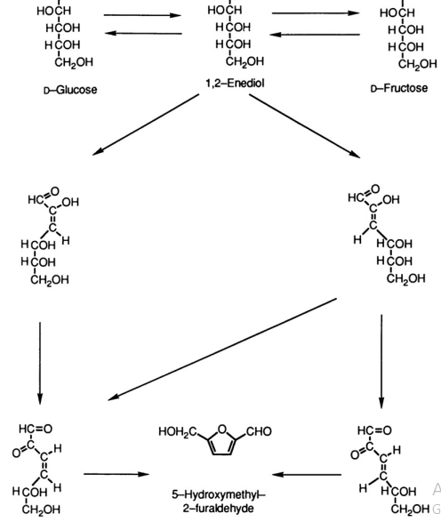
Caramelization
.

Slide 33
Caramelization
Alkaline Degradation
The initial reaction in the degradation of sugars under alkaline conditions follows the Lobry de BruyneAlberda van Eckenstein transformation via the 1,2- and 2,3-enediol. As discussed previously, enolization is a general reaction for carbonyl compounds with an a-hydrogen atom.
Alkalis are much more effective catalysts than acids for the enolization of sugars. Under mild alkaline conditions the series of reactions takes place. Under strong alkaline conditions, continuous enolization progresses along the carbon chain, resulting in a complex mixture of cleavage products including saccharinic acids.
A particular feature of the alkaline degradation of hexoses is the extensive fragmentation which occurs, resulting in the production of 2- and 4-carbon fragments, including saccharinic acids, lactic acid, and 2,4-dihydroxybutyric acid. The recombination of some of these fragments accounts for the formation of a variety of compounds, including 2,4-dihydroxybutyric acid.

Slide 34
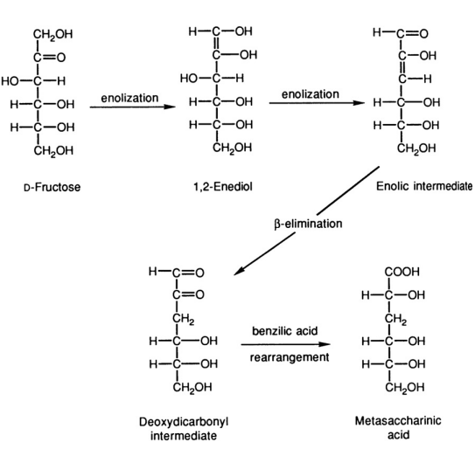
Caramelization
.

Slide 35
Caramelization
Aromatic Compounds
A number of cyclic compounds were isolated among the products formed when aqueous solutions of D-glucose and D-fructose were heated to 160 °C at pH 4.5. These compounds were similar for both hexoses, the yields were much lower in the case of D-glucose. The major compound formed was hydroxymethylfurfural, although a large number of phenolic compounds were also produced.
The predominant phenol detected during the acid degradation of hexoses was isobenzene furanone, whereas chromone alginetin was the major product formed from pentoses and hexuronic acids.
When sugars were degraded under alkaline conditions, a similarity in the pattern of phenolics formed under alkaline or neutral conditions. The compounds identified included a number of cyclic enols and phenols. The low yields obtained for these compounds reflected their instability under alkaline conditions. The formation of cyclopentones was reported from the alkaline treatment of D-fructose. These compounds were isolated among the aroma components of roasted coffee by and had a strong caramel-like odor.
The only common phenolic compounds identified from either the acid or alkaline treatments of glucose were catechol, 4-methyl-1,2-benzene diol, and 3,4-dihydroxy benzaldehyde.
The development of color is extremely complex and involves a series of polymerization reactions. Reductic acid and catechols were much more active color producers than furfurals.

Slide 36
Caramelization
Difructose Anhydrides: A Caramelization Tracer
The condensation of two fructose molecules via caramelization was reported to occur during the heating of sugars or food products rich in sugars, leading to the formation of a major non-volatile fraction containing difructose anhydrides.
They are monitored as a tracer for caramelization in food and food additives as caramels, chicory, and dehydrated foods.
Difructrose anhydrides could be used as an indicator of coffee quality as well as to test the authenticity of honey.

Slide 37
Ascorbic Acid Oxidation
The browning of citrus juices and concentrates also involves Maillard-type reactions between amino acids and sugars present in citrus products.
The Maillard reaction was initiated in citrus juice by the formation of hexosamines from amino acids and sugars. The involvement of ascorbic and dehydroascorbic acids occurred at a later stage in this process via the formation of a-dicarbonyls, similar to that formed during the degradation of sugars. The compounds identified are glyoxal, methyl glyoxal, diacetyl, 3-deoxy-L-pentosone, and L-threosone.
Ascorbic acid plays a central role in the browning of citrus juices and concentrates, for example, lemon and grapefruit. The reaction of ascorbic acid in fruit juices and concentrates is very much dependent on pH, as the browning process is inversely proportional to pH over a range of 2.0- 3.5. Juices with a higher pH are much less susceptible to browning, for example, orange juice at a pH of 3.4. Below pH 4.0, browning is due primarily to decomposition of ascorbic acid to furfural.
Ascorbic acid degradation can occur under both aerobic and anaerobic conditions. While the level of air in juice is kept as low as possible by the use of vacuum deaeration and live steam injection, there is still some dissolved oxygen in the juice (0.05%). Only after the oxygen has been used does anaerobic degradation of vitamin C occur, but at a much slower rate.
An increase in concentration and temperature increased the rate of degradation of ascorbic acid.

Slide 38
Ascorbic Acid Oxidation
The browning of citrus juices is not due solely to ascorbic acid. Amino acids are also involved via the Maillard reaction, depending on the pH of the juice and basicity of the amine.
The main degradation product of juices with pH below 4.0 is furfural. At pH above 4.0 this pathway is inoperative and explains the discoloration of dehydrated vegetables, which also involves ascorbic acid. The discoloration of dehydrated cabbage was due to Strecker degradation between ascorbic acid and amino acid. This was facilitated by interactions between the oxidized products of ascorbic acid, dehydroascorbic or 2,3-diketogulonic acids, and amino acids during the final stages of the drying process.
The formation of pyrazines from ascorbic acid and amino acids was reported under dry-roasting conditions.
The reaction between L-ascorbic acid and L-threonine/L-serine resulted mainly in the formation of pyrazines. The alkylpyrazines formed were 2-methylpyrazine, 2,5-diethylpyraine, 2-ethylpyrazine, 2-ethyl-6-methylpyrazine, 2-ethyl-5-methylpyrazine, 3-ethyl-2,5-dimethylpyrazine, 2,3-diethyl-5-methylpyrazine, and 3,5-diethyl-2-methylpyrazine.

Slide 39
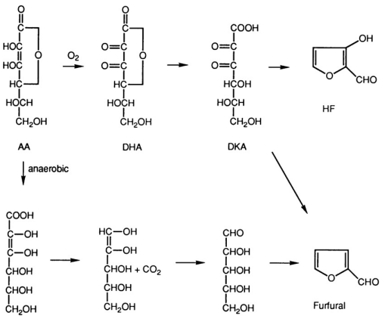
Ascorbic Acid Oxidation
Possible vitamin C (ascorbic acid) degradation pathways. AA: ascorbic acid; DHA:
dehydroascorbic acid; DKA: diketogulonic acid; HF: hydroxyfurfural

Slide 40
Antioxidant Activity of Non-enzymatic Browning Products
The ability of MRPs to retard the development of rancidity has been reported by a number of researchers.
Most studies, have focused on the in vitro antioxidant effects of brown MRPs or melanoidins.
Antioxidant effects of melanoidins have also been reported in beer, roasted cocoa, bread crusts, vinegar, honey, and wine.
The antioxidant protective effects of melanoidins were attributed, in part, to their ability to chelate metals, while the anionic nature of melanoidins enabled them to chelate transition metals.
The nitrogen atoms in melanoidins may chelate Cu. In addition to chelating metal ions, the ability of melanoidins to scavenge free radicals appears to be another mechanism explaining their antioxidant properties.
A strong linear relationship was reported between the color intensity of the melanoidin fraction and their ability to scavenge such free radicals as peroxyl, and 2,2^{l} -azobis-2-methyl-propanimidamine, dichloride (AAH). However, this was attributed to the complex nature of the components in melanoidins, as well as the assay methods used to measure radical-scavenging activity.

Slide 41
Antioxidant Activity of Non-enzymatic Browning Products
Maillard reaction is the main contributor to the antioxidant activity in roasted coffee beans (RC) in a coffee MRP model system, made up of arabinose and serine.
The formation of MRPs in roasted coffee beans, non-roasted coffee beans (NRC), and the arabinose- serine model system (C) was measured by fluorescence, ultraviolet-visible spectra and tristimulus Hunterlab measurements.
The relative antioxidant activities of RC, NRC, and C were monitored by the oxygen radical absorbance capacity and Trolox equivalent antioxidant capacity methods and reducing power (Rp), while total chlorogenic acid content was determined in RC and NRC extracts.
The ultraviolet absorption spectrum for RC was similar to the model MRP extracts (C) but quite different from NRC.
The NRC spectrum, however, was similar to the chlorogenic acid standard but its absence in RC confirmed its almost complete destruction during the roasting process.

Slide 42
Antioxidant Activity of Non-enzymatic Browning Products
While the fluorescent spectrum for RC was similar to the control (C), no fluorescence was observed in the NRC extract, owing to the absence of a Maillard reaction and the lack of formation of MRPs.
The high antioxidant activity associated with the NRC extract was attributed to the natural phenolics, which were substantially lost in the roasted sample.
Consequently, any significant antioxidant activity in RC was attributed primarily to the MRPs formed during the roasting of the coffee beans and their similarity to the MRPs produced in the model system.

Slide 43
Inhibition of Non-enzymatic Browning
A major concern of food technologists is to control or minimize non-enzymatic browning reactions in food processing. The particular method used must be adapted to each food product. Various methods have been proposed for controlling these reactions.
Temperature
An increase in temperature or time of heat treatment accelerates the rate of these reactions. Lowering the temperature during processing and storage can lengthen the lag phase, that is, the period needed for the formation of brown-colored products. Most foods will not brown below 10 °C during normal storage.
Moisture Content
The dependency of browning reactions on moisture content provides a convenient method for control. A reduction in moisture content in solid food products by dehydration reduces the mobility of reactive components. The rate of browning often exhibits a maximum with a moisture content of 30%. Partial dehydration may make browning worse rather than better. In the case of solutions, an increase in water activity will diminish the reaction velocity.

Slide 44
Inhibition of Non-enzymatic Browning
pH
The Maillard reaction is generally favored under more alkaline conditions, so lowering the pH provides a useful method of control. This method has been used in the production of dried egg powderi in which acid is added prior to the dehydration process to lower the pH. The pH is restored by the addition of sodium bicarbonate to the reconstituted egg.
Gas Packing
Gas packing excludes oxygen by packing under an inert gas. This reduces the formation of lipid oxidation products capable of interacting with amino acids. The exclusion of oxygen is thought to affect those reactions involved in the browning process and not the initial carbonylamino reaction step.
Biochemical Agents
Removal or conversion of one of the reactants in the sugar-amino acid interactions forms the basis of the biochemical method. For instance, in the commercial production of egg white, glucose is removed by yeast fermentation prior to drying. The direct application of enzymes such as glucose oxidase and catalase mediates the conversion of glucose to gluconic acid, which is no longer capable of combining with amino acids. This enzyme has been used for many years to remove glucose from egg before spray-drying. Glucose oxidase has the additional advantage of removing any residual oxygen and is used to reduce headspace oxygen during the production of bottled products.

Slide 45
Inhibition of Non-enzymatic Browning
Chemical Inhibitors
A variety of chemical inhibitors has been used to limit browning during the production and storage of a number of different food products. The most widely used are sulfur dioxide and sulfites, although thiols, calcium salts, and aspartic and glutamic acids have also been studied. The use of thiols as inhibitors is limited because of their unpleasant properties.
Sulfur Dioxide
Sulfur dioxide is unique in its ability to inhibit the Maillard reaction and can be applied as a gas or in solution as sulfite or bisulfite. Sulfur dioxide is not only capable of partially bleaching chromophores that have already formed but also inhibits color formation at the beginning of the reaction. The mechanism involves the binding of sulfur dioxide/sulfite with glucose to form hydroxy-sulfonate and other compounds from which sulfur dioxide/sulfite can be reversibly released. This results in the blocking of the carbonyl group of the sugar, rendering it unavailable for interaction in the typical Maillard reaction. As the reaction proceeds, sulfur dioxide/sulfite becomes irreversibly bound. This permits monitoring of the progress of browning by measuring the amount of sulfur dioxide or sulfite in the bound or free form. For example, color development for a glucose glycine model system was not observed by until all the free sulfite was depleted, while the ratio of bound to free sulfite increased as the reaction proceeded.

Slide 46
Inhibition of Non-enzymatic Browning
Chemical Inhibitors
Sulfites
Inhibition of non-enzymatic browning by sulfite appears to involve the formation of stable sulfonates. In the case of ascorbic acid browning, 3-deoxy-4-sulfopentulose is formed with the corresponding 6-carbon compound, 6-deoxy-4-sulfohexulose, for the sulfited inhibition of the Maillard reaction and monitored the formation of several organic sulfonates from sulfited foods.
These compounds possess a dicarbonyl group, which makes them particularly reactive and at elevated temperatures can lead to the formation of sulfur compounds with other food components.
Future research on the role of sulfur dioxide and sulfites in inhibiting the Maillard reaction should focus on the nature of those precursors with which they react. In addition, further information is needed on the effect of time, temperature, pressure, pH, and additives on the quantitative and qualitative formation of compounds formed in foods to which sulfur dioxide or sulfite has been added. This work is particularly important in light of the current trend towards limiting intake of sulfur dioxide and sulfites in foods.

Slide 47
Inhibition of Non-enzymatic Browning
Aspartic and Glutamic Acids
A study indicated the potential of aspartic and glutamic acids for inhibiting the Maillard browning reaction. L-aspartic acid or L-glutamic acid decreased the rate of browning.
Dipping specially prepared potato chips into either aspartic or glutamic acid solutions before frying was accompanied by less darkening. This corresponded to a mean value of 38.4 for the untreated potato chips compared to 46.4 and 43.7 for the potato chips dipped in aspartic and glutamic acids, respectively.
While the various chemical inhibitors discussed can, with varying degrees of success, limit the progress of browning, the nutritional value of the food could still be reduced.
For instance, the initial stage of the Maillard reaction, the carbonylamino step, could still render the amino acids unavailable without any visible browning during this stage. It is extremely difficult to ensure that this step is prevented.

