Slide 1
Areas Covered
1. Introduction
a. Merchandising
b. Study of an Order Sheet
c. Study about different Buyers of RMG
2. Commercial Activities
3. Consumption and Costing
4. Accessories
5. Sample
6. Time aNd Action (TNA) Plan
7. Pre-shipment Inspection (PSI)

Slide 2

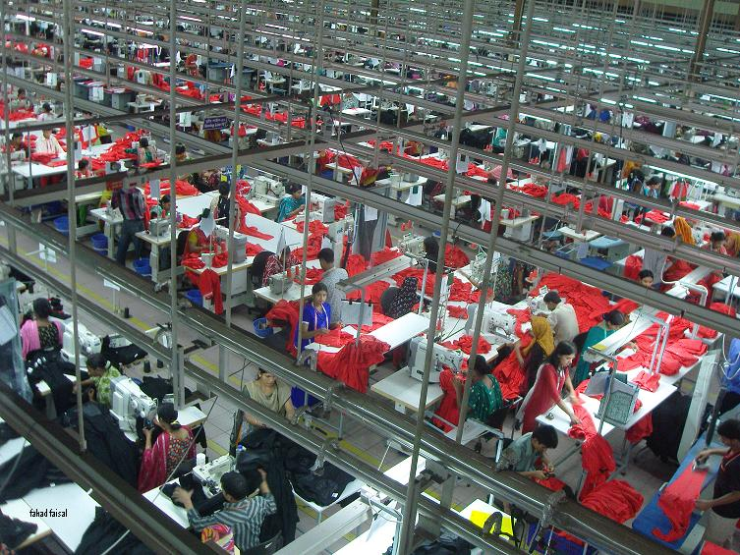
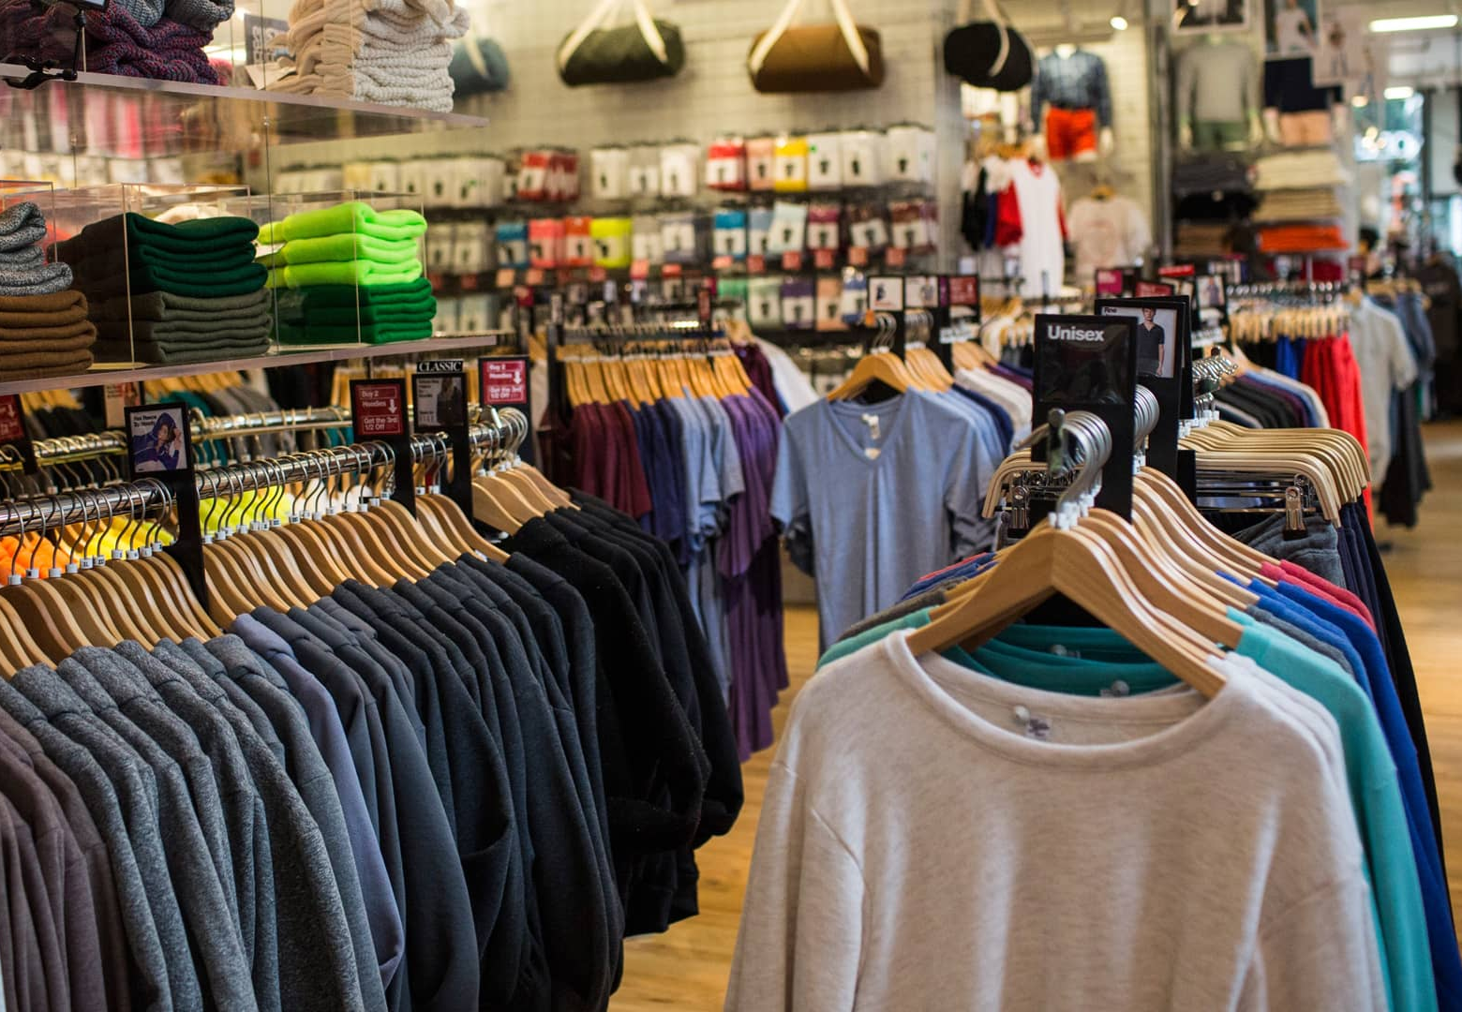
Apparel Supply Chain
Development
Production
Retailing
Steps:
Idea generation
Idea screening
Concept development and testing
Business analysis
Product development
Time: (12 – 24) months
Cost: about 10%
Steps:
Develop sample
Collect raw materials
Cut, sew and finish
Inspection
Deliver to CNF
Time: about (2-4) months
Cost: about 20%
Steps:
Receiving and stocking
Display
Sales promotion
Customer service
Retail selling
Time: (2-4) months/One season
Cost: about 70%

Slide 3
Types of Merchandising
Development Merchandising
Production Merchandising
Retail Merchandising

Slide 4
1. Development Merchandising:
Development merchandising addressed the following six “rights of merchandising”;
i. the right merchandise (material and style),
ii. in the right quantities,
iii. in the right colors, sizes,
iv. at the right time,
v. at the right price, and
vi. in the right place

Slide 5
2. Production Merchandising
Production Merchandising in garment trade refers to the work of contacting with buyer, Costing and quoting price of required garments, Collecting raw materials, Planning and production of the garments, Maintaining required quality level and Shipment to the right destination at right time.

Slide 6
3. Retail Merchandising
Retail merchandising is the displaying merchandise in a way that the potential customers get easily access to their desired goods, attracted to purchase, offer other services to make customer satisfied and replenish the sold quantities.

Slide 7
Flow Chart of Merchandising
Contact Buyer
Audit (For Initial Orders)
Receive Enquiry Sheet
Develop Sample
Consumption Of Material
        Costing of Materials including CM

Slide 8
Flow Chart of Merchandising
        Quotation
        Negotiate with Buyer
        Order Receive
        Receive Master L/C
        Make a TNA
        Booking Fabric and Accessories

Slide 9
Flow Chart of Merchandising
        Open BB L/C
        Sample Approving
        Receive Fabric and Accessories
        Swatch Card Making and Approval
        Approval for Bulk Production
Lab Test

Slide 10
Flow Chart of Merchandising
Pre-production Meeting
Start Bulk Production
Line Inspection
Ex-work
PSI (Pre Shipment Inspection)
Shipment (Ex-Factory)

Slide 11
Basic Qualities of a Merchandiser
Communication Skill: The communication is very much important to promote the business activity. The merchandiser should have the capability to communicate effectively with suppliers, buyers, factory people and other stake holders.
Planning Capability: Merchandiser should be capable of planning, based on the planning the order is to be followed (TNA). If the planning is not done properly it will directly affect the delivery time of the order and the consequence will affect the organization.

Slide 12
Basic Qualities of a Merchandiser
Co-ordinate & Co-operate: Merchandiser is the person who is actually co-ordinate with the number of departments. To Co-ordinate with different people in the industry, he should be co- operative. A merchandiser should be a good motivator as well.
Monitoring ability: Merchandiser should be able to monitor the production of raw material and garment.

Slide 13
Basic Qualities of a Merchandiser
Decision making: For a Merchandiser, decision making power is most important. He should think about the decision to be taken and to act in a right way.
Loyalty: Loyalty is an essential character of human beings. Especially for the business people like merchandiser, it is must.

Slide 14
Basic Qualities of a Merchandiser
Knowledge about the field: Merchandiser should have adequate knowledge about the Fiber, Yarn, Knitting, Weaving, Dyeing and Printing, Embroidery and Finishing process of fabric and garment manufacturing process.
Knowledge on: Garment design, Standard Operating Procedure (SOP), Purchase Order (PO), Product Specification Sheet (PSS), Costing and consumption, testing requirement on fabric, garment and accessories, garments inspection systems, idea about exporting and importing countries and duty rates and customs regulations of those countries.

Slide 15
Basic Qualities of a Merchandiser
Experience: Experience to execute Orders of international buyers, Knowledge of shipping and banking documentation and regulations.
Other Qualities: Education, Experience, Situational Management, Ability to Evaluate, Dedication, Knowledge of expediting procedures and sound personality is required to be a good merchandiser.

Slide 17
Function of a Merchandiser
A. Pre-order Merchandising
B. Post Order Merchandising

Slide 18
Function of a Merchandiser
A. Pre-order Merchandising
  To receive inquiry sheet
  Consumption calculation
  Costing and quoting
  Negotiation
  Price confirmation
  Order confirmation
  Receive master L/C

Slide 19
Function of a Merchandiser
B. Post Order Merchandising
a. Prepare TNA
b. Collecting Raw materials
i. Select the appropriate supplier
ii. Booking fabric and accessories required
to complete the order after careful calculation
with specification mentioned in the order sheet
iii. Receive PI from suppliers
iv. Open BB L/C

Slide 20
Function of a Merchandiser
B. Post Order Merchandising
v. Receive sample of ordered raw materials
for approval
vi. Follow up production
vii. Sending procuring information to the stores
viii. Receive raw materials in store
ix. Inspect raw material (both quality and quantity)

Slide 21
Function of a Merchandiser
B. Post Order Merchandising
c. Sampling
  Proto type sample
  Development sample
  Salesman sample
  Photo sample
  Size set sample
  Pre-production sample
  Shipment Sample

Slide 22
Function of a Merchandiser
B. Post Order Merchandising
d. Banking
○ Receive master L/C
○ Check master L/C
○ Amend master L/C if required
○ Open back to back L/C
○ Submit documents to bank for negotiation

Slide 23
Function of a Merchandiser
B. Post Order Merchandising
e. Production of Garments
○ Making Swatch Card, get approval from buyer and distribute in different sections (Production, QC, store, wash, etc)
○ Booking production line
○ Receive inventory report on raw materials
○ Attend Pre-production meeting
○ Arrange testing of raw materials and send test report to buyer

Slide 24
Function of a Merchandiser
B. Post Order Merchandising
e. Production of Garments
○ Arrange test cutting
○ Start bulk production
○ Request to buyer for Final Inspection
○ Arrange Final Inspection, collect IC and send to buyer
○ Hand over the goods to C&F and collect B/L

Slide 25
Function of a Merchandiser
B. Post Order Merchandising
f. Commercial Activities
Submit required documents to the bank for negotiation (receiving payment). These documents are usually
01. Bill of Lading 02. Bill of Exchange
03. Commercial Invoice 04. Packing List
05. Details Packing List 06. Certificate of Origin
07. Beneficiary’s Certificate 08. Inspection Certificate
09. Lab Test Report 10. Courier Copy
11. Certificate of Origin GSP Form A 12. EXP

Slide 27
Organogram of Merchandising Department
Merchandising Director
GM (X) GM (Sears) GM(Y)
Mgr1 Manager 2 Mgr3
Sr. Merchandiser
Merchandiser
Assistant Merchandiser
Trainee Merchandiser

Slide 29
Duty of Merchandiser to satisfy buyer: 4Rs
Merchandising denotes all the planned activities to execute and dispatch the merchandise on time, taking into consideration of the 4Rs to satisfy the customer. These are
  Right Quantity: To dispatch right quantity of product what buyer ordered.
  Right Quality: It should be with right quality as accepted both parties.
  Right Cost: Everybody wants more from what they are paid.
  Right Time: Keeping delivery schedule is mandatory as apparel is a seasonal product.

Slide 30
Types of Packaging
Solid color solid size: One colored and one size garments in a carton
Solid color assorted size: One colored and different size garments in a carton
Assorted color solid size: Different colored and one size garments in a carton
Assorted color assorted size: Different colored and different size garments in a carton

Slide 31
Types of Packaging
Color Size Quantity
Solid color solid size: White S 24 pieces
Solid color assorted size: White S 8 pieces
M 8 pieces
L 8 pieces
Assorted color solid size: White XL 8 pieces
Black XL 8 pieces
Yellow XL 8 pieces
Assorted color assorted size: White S 8 pieces
Black M 8 pieces
Yellow XL 8 pieces

Slide 32
Golden Rules for Merchandising
1. Be flexible dealing with any buyer for orders and styles
2. Do not overload the factory with excessive order
3. When the production is running, Keep constant attention on
the materials in production floor
4. Never push any order to its extreme. If so, disaster is imminent
5. Approval must be secured in all situations prior to production
6. Be Realistic and practical, pragmatic.

Slide 33
Golden Rules for Merchandising
7. Always try to avoid buyers who seek concession
8. The order should always be protected from any disaster by
constant supervision and follow up
9. Before starting production ensure that you are well equipped (5M’s)
10. Accept order in staggering and balancing through the year
11. Try to avoid accepting any order of rare and unusual in nature
12. Do not accept any order with high risk

Slide 35
Analyze product package
Name of Buyer
Style Number/P.O. Number/ Item Number
Season, Year
Designed By and Creation Date
Any Revision with Date
Size Range of the product
Order Quantity
Size and Color Break Down
Packing Ratio

Slide 36
Analyze product package
Fabric GSM and types in knit garment
Fabric construction and type for woven garment
Measurement sheet with pictorial description
Stitching detail
Accessories details
Details of samples and their destination
Packing details and Quantity per carton
Details of Shipping Marks and Carton Marks
Warehouse address/Details of Destinations

Slide 37
Analyze product package
Details of folding
Details of printing
Details of washing
Details of Freight forwarder and freight payment terms
Details of Lab test requirement and testing Organization
Details of Inspection and Quality level (AQL)
Unit Price (FOB) of the product
Currency
Payment terms, etc

Slide 38
Where to find information
SOP: Contains information related to every order
PO: Contains information related to specific order
PSS/BOM/Tech Pack: Contains information related to product specification of a specific order

