Slide 1
Importance of Study Order Sheet
All the activities of garment production depend on order sheet
What items will have to buy and what quantity
When the items should be delivered in the store
Color wise and size breakdown
Details of garments specification
Details of lab testing
Details of Inspection
Details of delivery schedule, Clearing aNd Forwarding (CNF) agents,
Condition of negotiation (What papers need to submit for payment)
Without having these information, factory cannot produce the right goods that buyer ordered.

Slide 2
Facts about an order sheet
There is NO standard format for order sheet, hence order sheet of one buyer varies from another.
We are going to study an order sheet of a French buyer, named ‘Carrefour’ as their order sheet is quite organized/structured and detail.
Studying this order sheet will not guaranty you that you will understand the order sheet of ALL other buyer! If you study it well, you may understand 70% - 80% of others order sheet.
If you want to study order sheet of another buyer, there will/may be some new information in different structure that you have to know exclusively from the experienced one who handled that buyer.

Slide 3
Structure of supply chain of Carrefour
Outsourcing Office
(China)
Bangladesh
India
Corporate Head office
(France)
Retailing
France
Belgium
Germany, etc
Vietnam

Slide 4
Brief profile of Carrefour
Industry | Retail
Founded | 1 January 1958; 62 years ago
Founder | Marcel Fournier, Denis Defforey, Jacques Defforey
Headquarters | Boulogne-Billancourt , France
Number of locations | 12,225
Area served | Worldwide
Key people | Alexandre Bompard (Chairman & CEO)
Revenue | €74.142 billion (2018)
Operating income | €2,080M (2019)
Net income | €1,314M (2019)
Total assets | €50,802M (2019)
Total equity | €11,675M (2019)
Number of employees | 321,383
Website | www.carrefour.com

Slide 5
Carrefour Stores in Photo

Slide 7
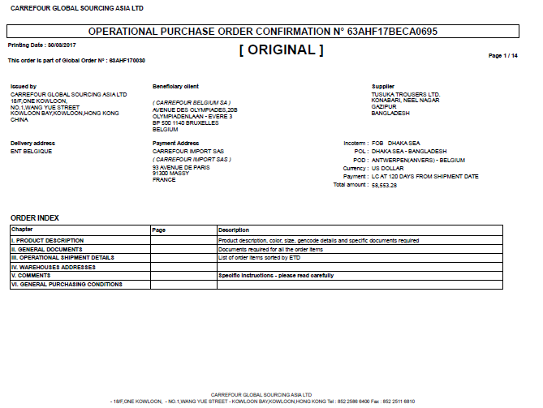

Slide 8
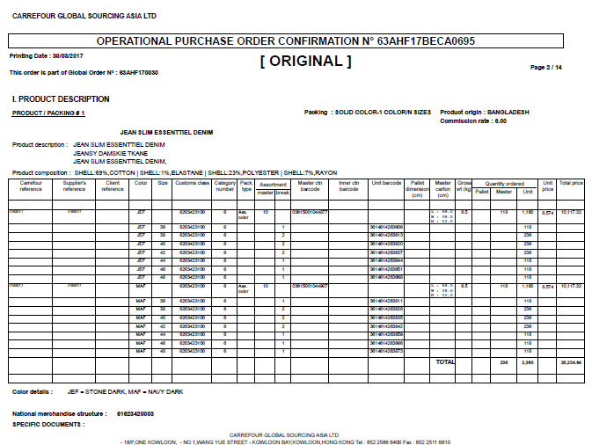

Slide 9
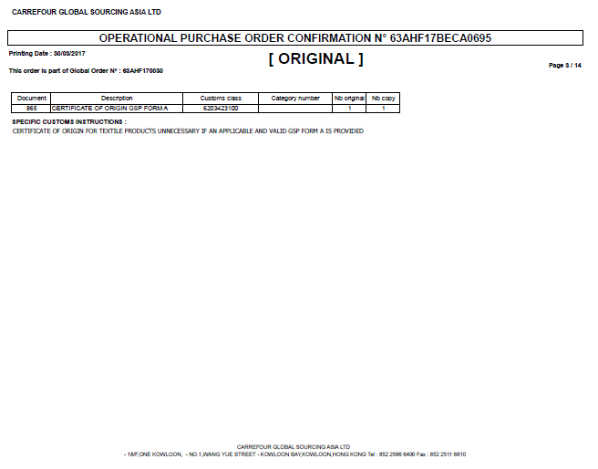

Slide 10
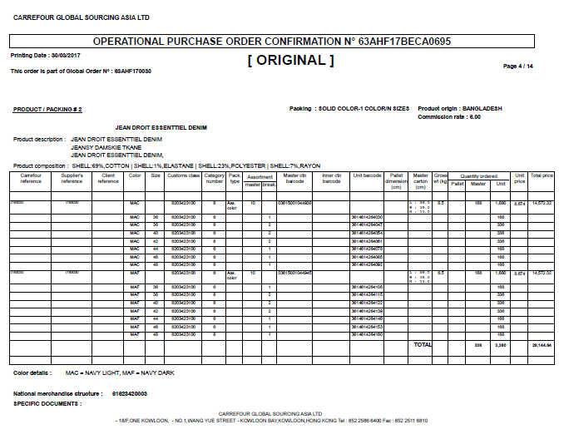

Slide 11
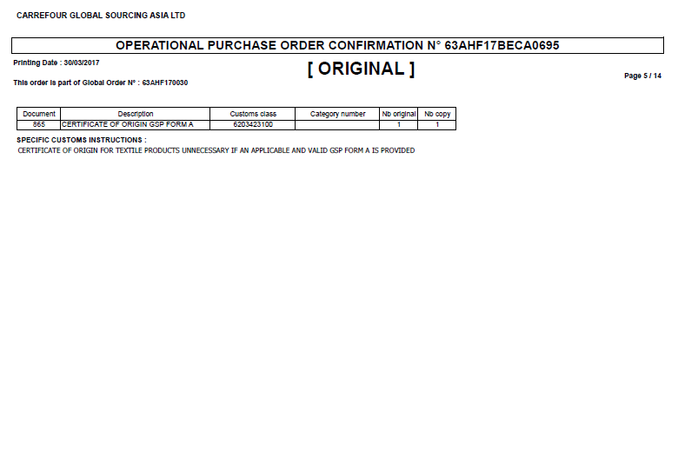

Slide 12
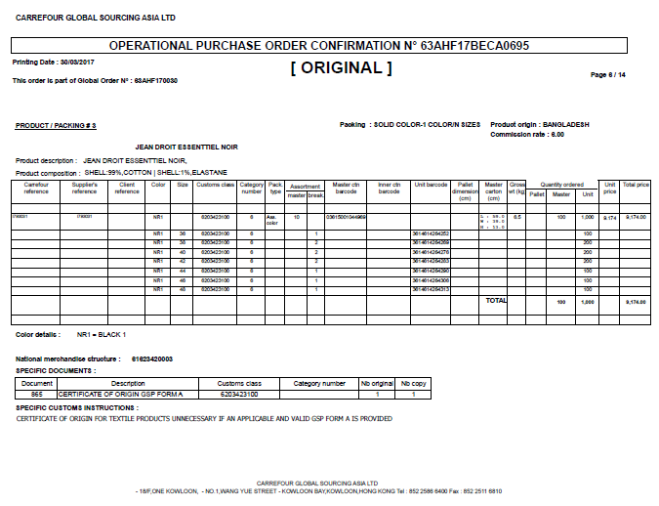

Slide 13
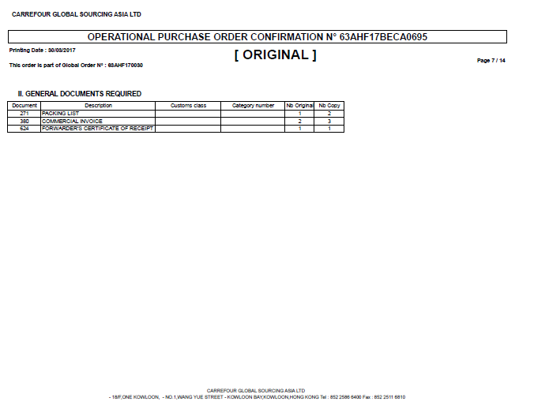

Slide 14
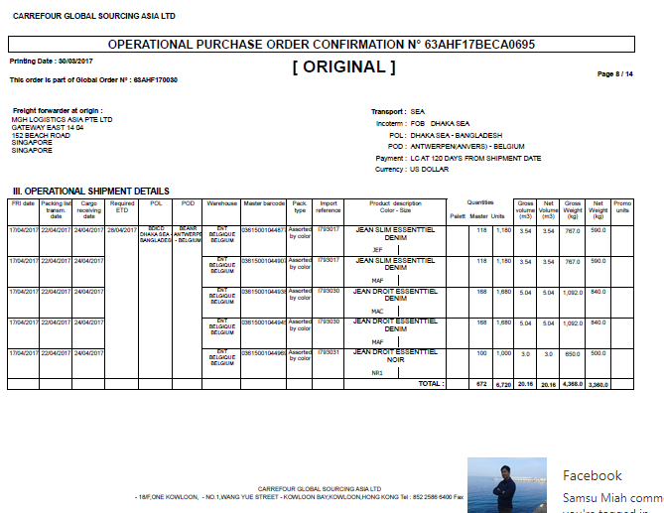

Slide 15
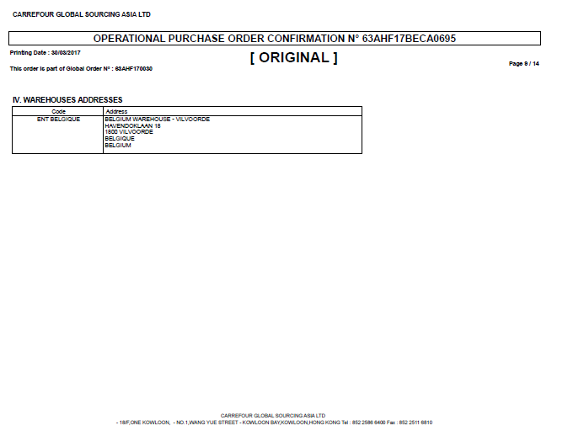

Slide 16
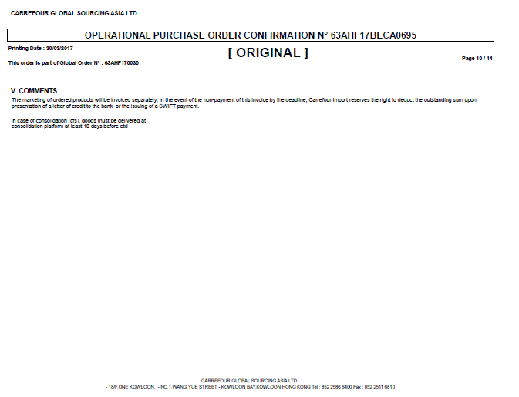

Slide 17
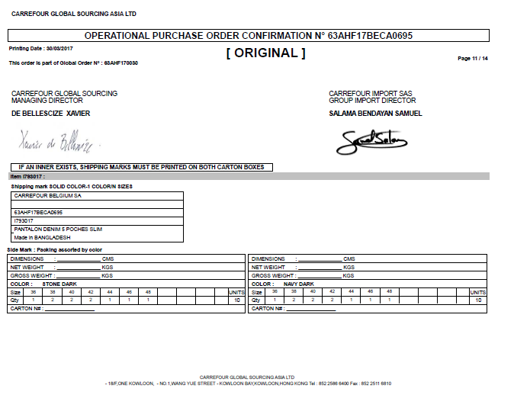

Slide 18
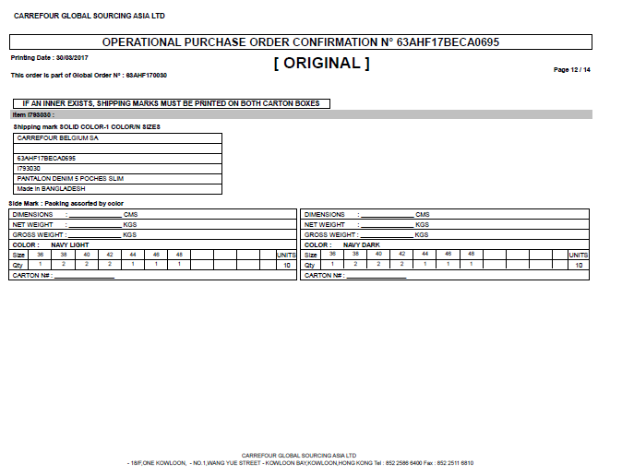

Slide 19
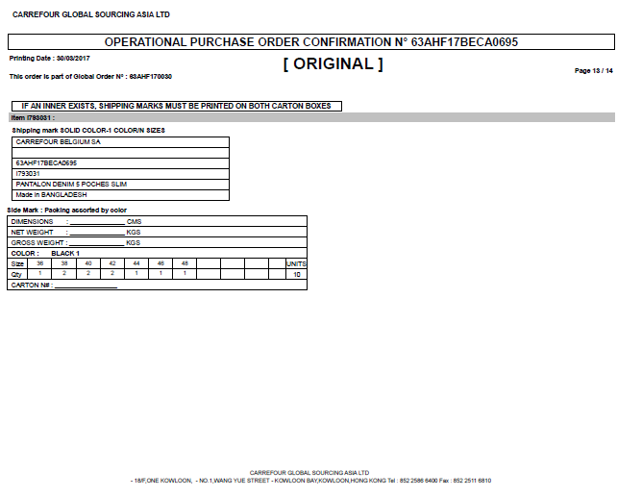

Slide 20
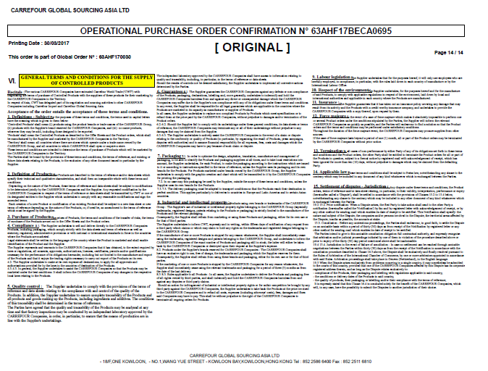

Slide 21
Product Specification Sheet (PSS)

Slide 22
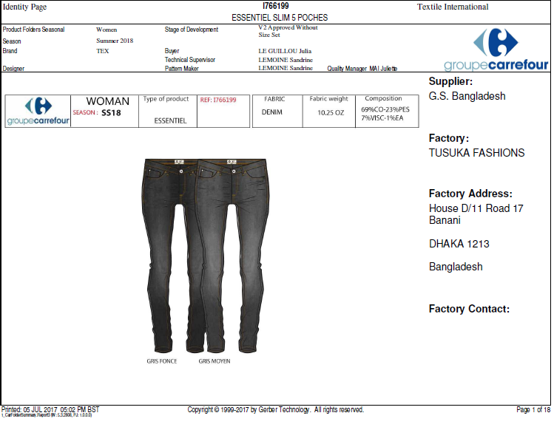

Slide 23
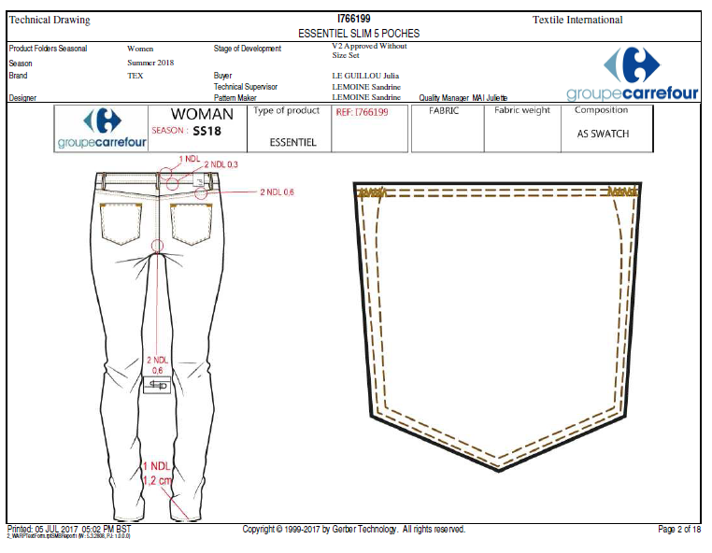

Slide 24
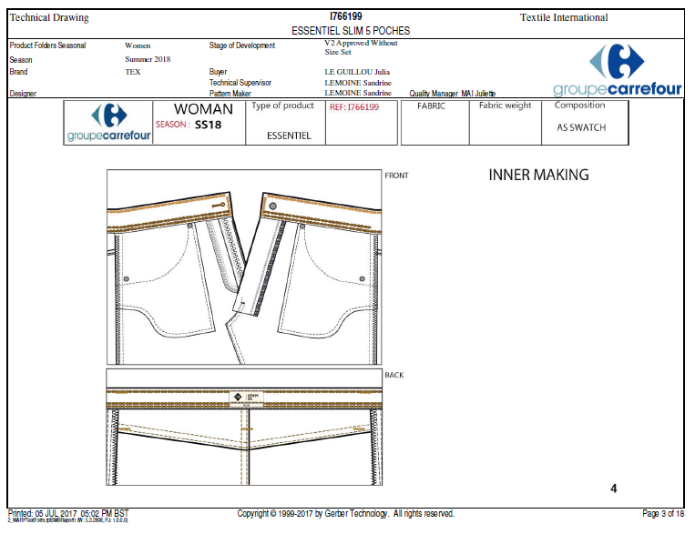

Slide 26
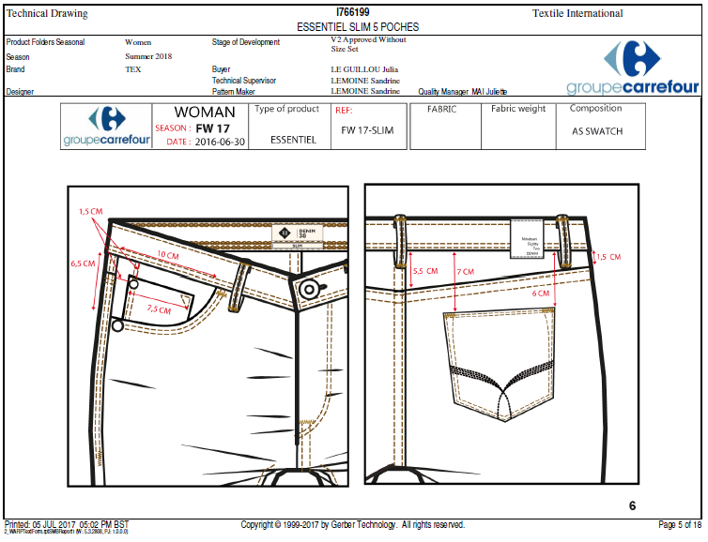

Slide 27
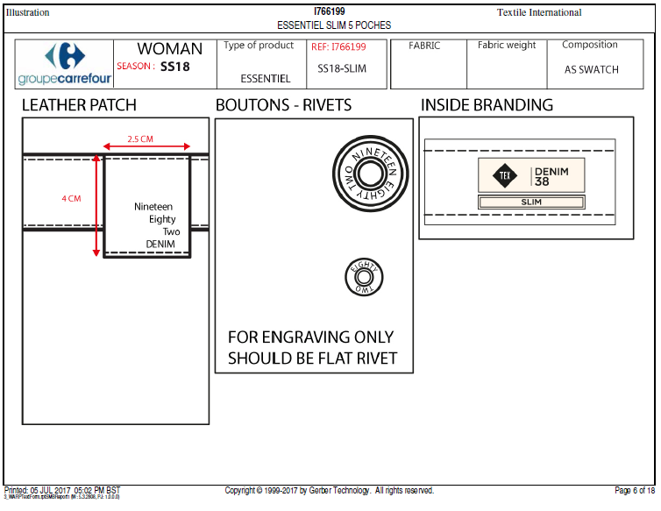

Slide 28
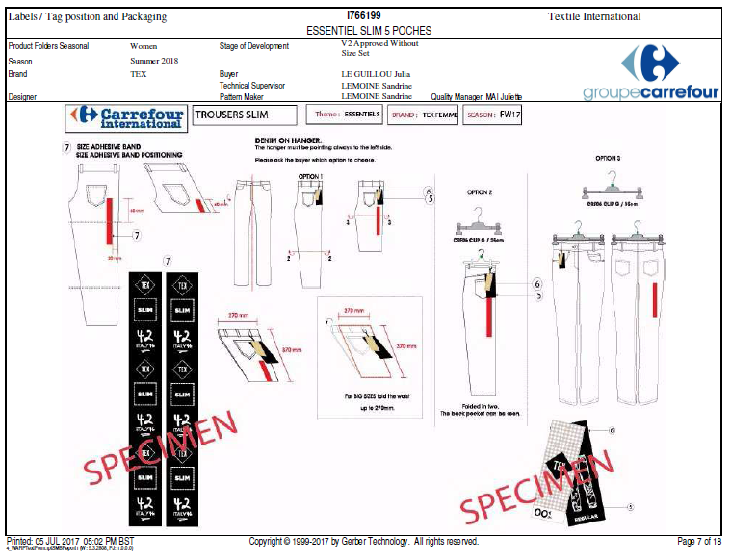

Slide 29
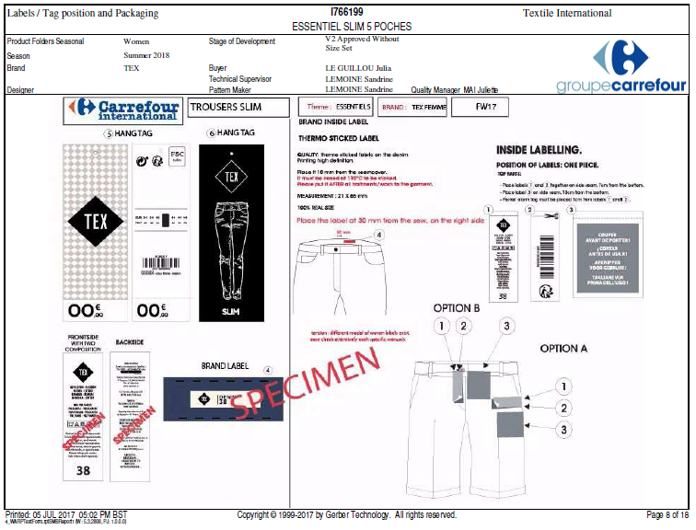

Slide 30
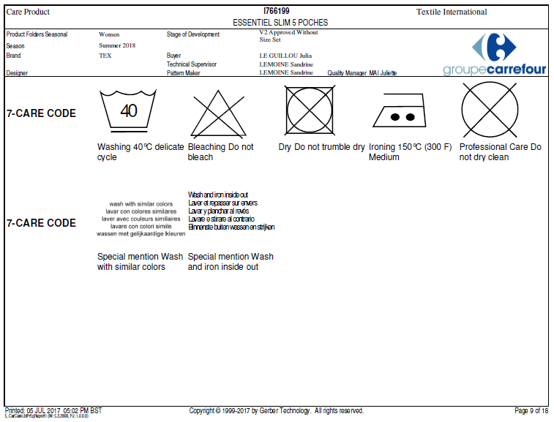

Slide 31
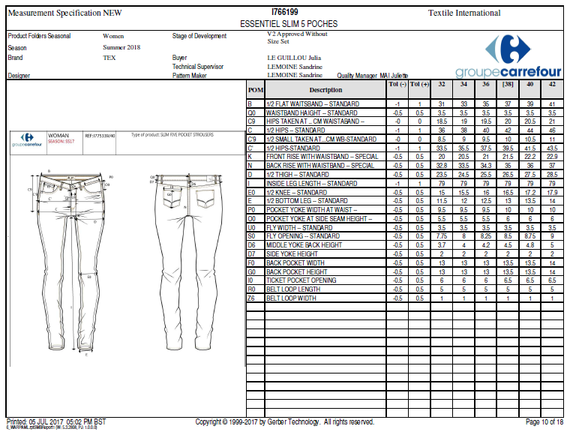

Slide 32
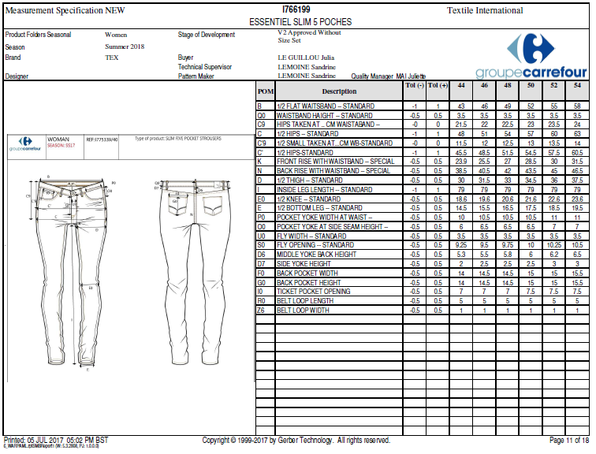

Slide 33
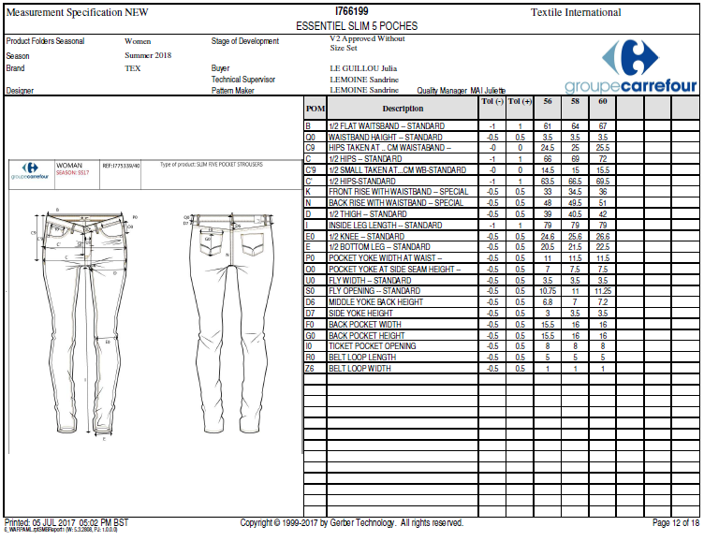

Slide 34
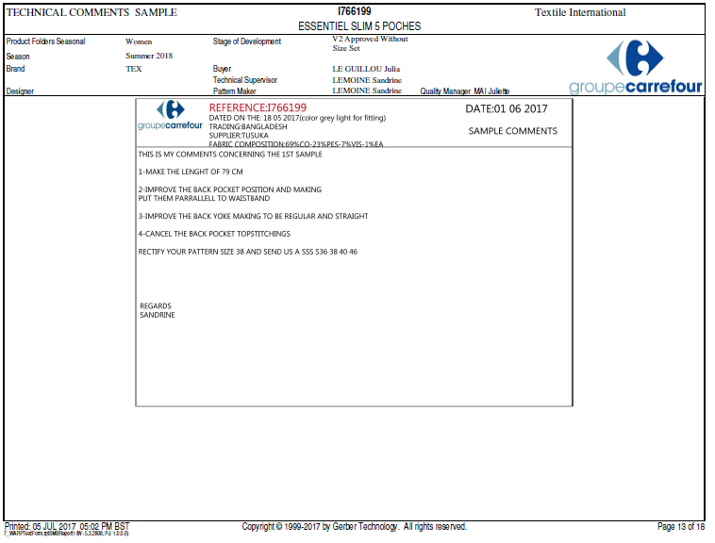

Slide 35
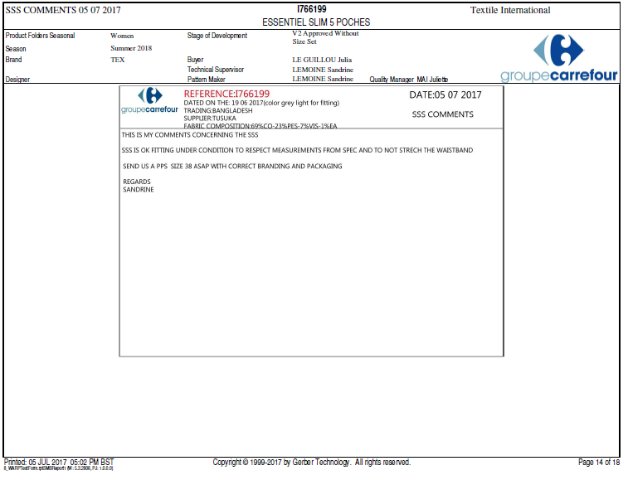

Slide 36
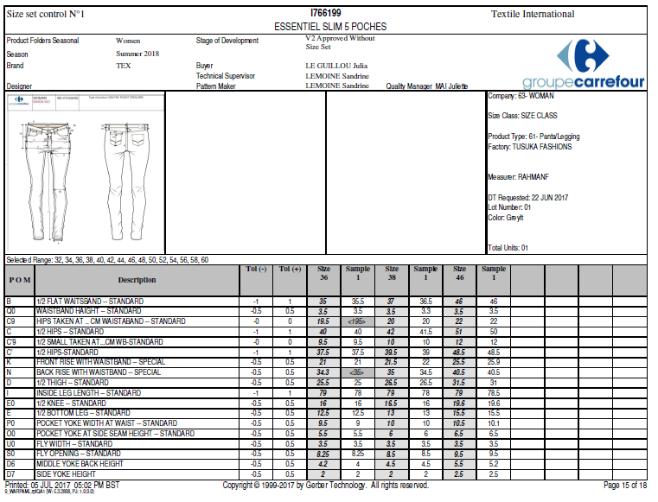

Slide 37
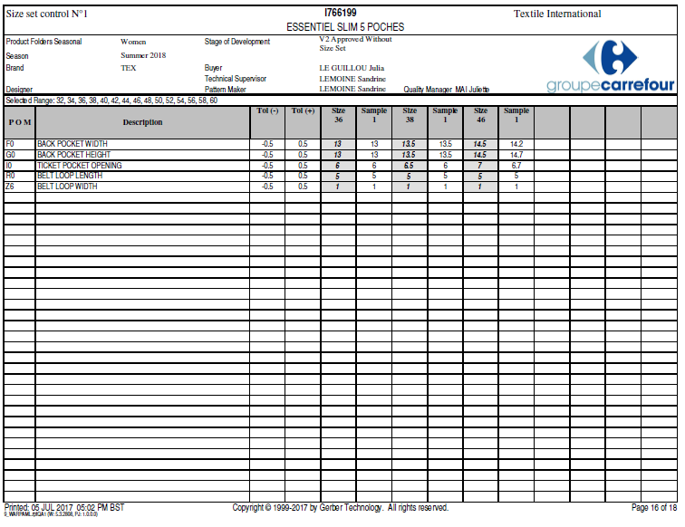

Slide 38
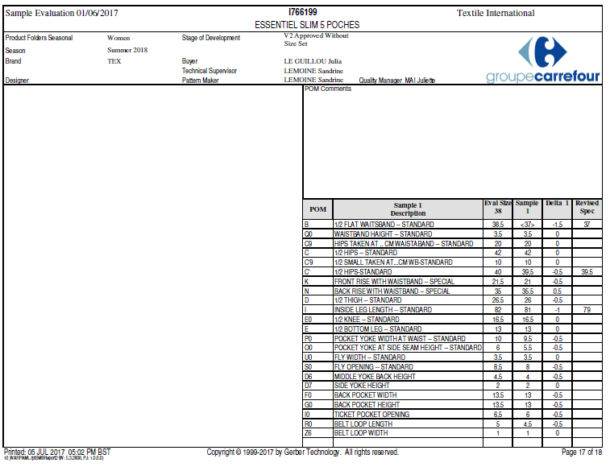

Slide 39
