Slide 1

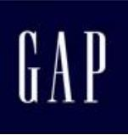
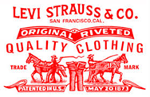
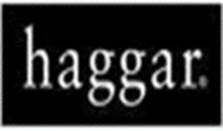


Apparel Buyer’s in Bangladesh
Buyer | Logo | Country | Remark
Walmart |  | USA | World’s biggest retailer. American based hypermarket chain. Controlled by Walton Family. Founded 1962, Bontonville, Arkansas, USA.
GAP |  | USA | Known as Gap Inc. founded in 1969 at San Francisco, California.
LEVI’S |  | USA | Levi Strauss & Co. is famous Denim Brand known for LEVI’S Brand. By Levi Strauss in 1853 at San Francisco.
Haggar |  | USA | Dallas-based menswear brand sold in the United States, Canada, and Mexico.
LEBATEX |  | USA | LebaTex is a New York based commercial textile supplier, producing high-performance upholstery, flame retardant drapery, hospitality, healthcare.

Slide 2

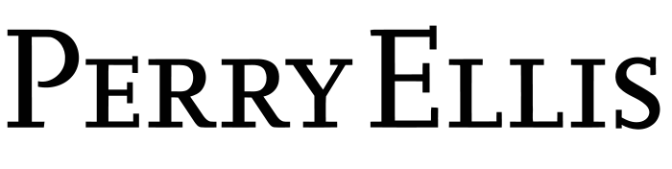


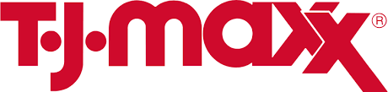
Apparel Buyer’s in Bangladesh
Buyer | Logo | Country | Remark
Phillips- Van Heusen(PVH) |  | USA | PVH Corp. Manhattan based American clothing company. In 1910 invented a new process that fused cloth on a curve.
PERRY ELLIS |  | USA | Owned by Perry Ellis International and founded by designer Perry Ellis. Founded in 1978 at New york.
TESSIVAL |  | USA
CALVIN KLEIN |  | USA | Calvin Klein Inc. is a New York based American fashion house and luxury goods manufacturer established in 1968
TJ MAXX |  | USA | TJ Maxx is an American departmental store chain. Founded in 1976 at Framingham, Massachusetts.

Slide 3





Apparel Buyer’s in Bangladesh
Buyer | Logo | Country | Remark
GUESS |  | USA | Guess markets such as clothing, watches, jewelry, perfumes, and shoes.
KMART |  | USA | In 1899 as S. S. Kresge Corporation and in 1977 started as Kmart corporation.
LINEN GROUP |  | USA
TARGET |  | USA | It is the second largest retailer in USA after Walmart. Minneapolis, Minnesota based.
KOHLS |  | USA | American retailer, founded by Maxwell Kohl in 1927 at Menomonee Falls, Wisconsin, USA.

Slide 4





Apparel Buyer’s in Bangladesh
Buyer | Logo | Country | Remark
JC PENNEY |  | USA | J. C. Penney Company Inc. is an American department store chain founded in 1902 at Wyoming.
SEARS |  | USA | Sears, Roebuck and Company, colloquially known as Sears by Richard Warren Sears and Alvah Curtis Roebuck in 1892.
ALDI |  | GERMANY | ALDI is the German discount chains with over 10,000 stores in 20 countries, and turnover of more than €50 billion founded 1946.
RECTELLA |  | GERMANY | German based luxury bedding and carton retailer.
s. Oliver |  | GERMANY | s.Oliver Bernd Freier GmbH & Co. KG headquartered in Rottendorf that sells apparel, shoes, accessories, jewellery, fragrances and eyewear worldwide.

Slide 5





Apparel Buyer’s in Bangladesh
Buyer | Logo | Country | Remark
GERRY WEBBER |  | GERMANY | is a fashion manufacturer and retailer based in Halle (Westfalen), Germany primarily known for it’s ladies collections.
TOM TAILOR |  | GERMANY | German vertically integrated lifestyle clothing company headquartered in Hamburg.
BETTY BARLAY |  | GERMANY | The Betty Barclay Group GmbH & Co.KG is a women's clothing company funded 1955, headquarter in Heidelberg.
C & A |  | GERMANY | The company was founded by brothers Clemens and August Brenninkmeijer in 1841 as a Dutch textile company, taking its company name from their initials.
TCHIBO |  | GERMANY | With over 1,000 shops, Tchibo is one of Germany's largest retail chains.

Slide 6





Apparel Buyer’s in Bangladesh
Buyer | Logo | Country | Remark
P & C |  | GERMANY | Peek & Cloppenburg is an international chain of retail clothing stores with headquarters in Germany.
LIDL |  | GERMANY | Like fellow German supermarket Aldi, Lidl has a zero waste, no-frills, pass the savings to the consumer approach of displaying most products in their original delivery cartons, allowing the customers to take the product directly from the carton. When the carton is empty, it is simply replaced with a full one. Staffing is minimal
TAKKO FASHION |  | GERMANY | Founded in 1982, the Takko group operates approximately 1,500 branches in 15 European countries
ESPRIT |  | GERMANY | The Esprit flagship stores feature both current Esprit fashion lines and licensee products under one roof. Esprit has an architecture department that designs Esprit stores.
NEW YORKER |  | GERMANY | German clothing retailer headquartered in Braunschweig that primarily addresses the target group of 12- to 39-year-olds.

Slide 7




Apparel Buyer’s in Bangladesh
Buyer | Logo | Country | Remark
URBAN CLASSIC |  | GERMANY | clean designs and simple colors Urban Classics is a brand which is rooted in the German hip-hop scene.
KIK |  | GERMANY | KiK, legally KiK Textilien und Non-Food GmbH, is a German textile discount store chain, KiK is an acronym for "Kunde ist König"(The customer is king).
TESCO |  | UK | Headquarters in Welwyn Garden City, Hertfordshire, England, United Kingdom. It is the third-largest retailer in the world measured by gross revenues and ninth-largest retailer in the world measured by revenues. It has shops in seven countries across Asia and Europe, and is the market leader of groceries in the UK
New look |  | UK | The New Look story began in 1969 as a single fashion store in the UK. From there, they’ve grown to become a leading fast-fashion brand, with 593 in the UK and 302 across Europe, China and Asia.

Slide 8
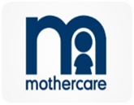

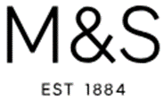


Apparel Buyer’s in Bangladesh
Buyer | Logo | Country | Remark
Mother Care |  | UK | A British retailer which specializes in products for expectant mothers and in general merchandise for children up to 8 years old.
WILSON Imports |  | UK | The Company designs and produces apparels, footwear, and accessories for men, women, and children.
Marks & Spencer(M&S) |  | UK | A major British multinational retailer headquartered in Westminster, London that specializes in selling clothing, home products and luxury food products.
NEXT |  | UK | Next is the largest clothing retailer by sales in the United Kingdom, having overtaken Marks & Spencer in early 2012
MATALAN |  | UK | Matalan is a British fashion and home ware retailer based in Knowsley, United Kingdom. Matalan was amongst the companies who sourced clothes from the Rana Plaza

Slide 9

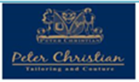



Apparel Buyer’s in Bangladesh
Buyer | Logo | Country | Remark
Sainsbury’s |  | UK | Sainsbury's is the second largest chain of supermarkets in the United Kingdom, with a 16.9% share of the supermarket sector.
Peter Christian |  | UK | Peter Christian is a classic Gentlemen's Outfitter, our range includes men's trousers, jackets and suits and a unique range of Harris Tweed.
JD WILLIAMS |  | UK | J D Williams & Company Limited, the UK's leading direct home shopping company, operating over 20 successful catalogue brands.
TERN |  | UK
PRIMARK |  | UK | Is an Irish fast fashion retailer headquartered in Dublin.

Slide 10


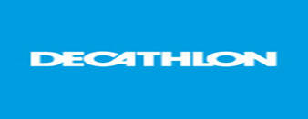
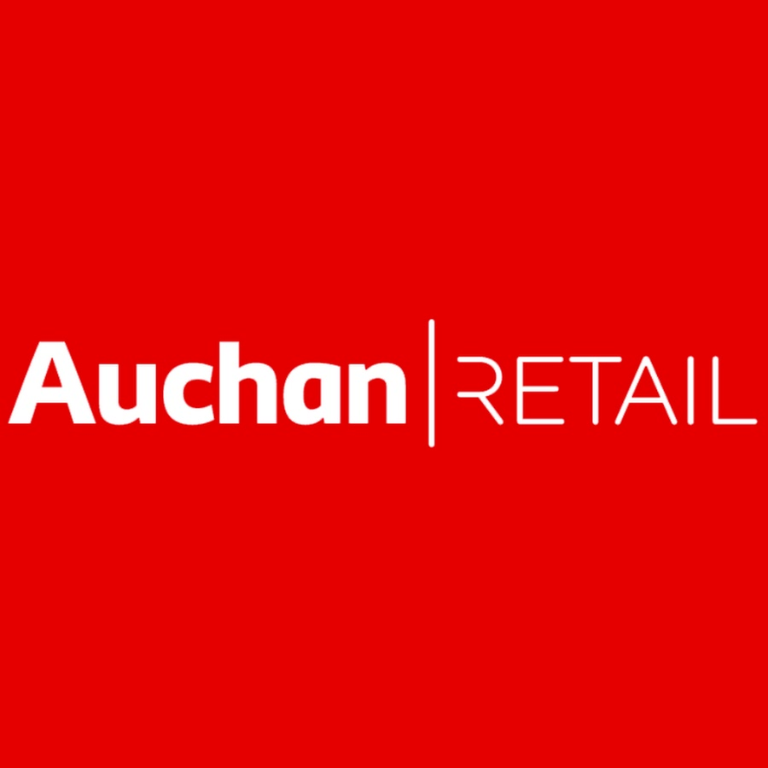

Apparel Buyer’s in Bangladesh
Buyer | Logo | Country | Remark
La redoute |  | UK | La Redoute specialises in ready to wear apparel and home decor, La Redoute is the 2nd largest seller of women's apparel and the 3rd largest seller of linens in France.
PERRY ELLIS |  | UK | Perry Ellis is a clothing brand owned by Perry Ellis International and founded by designer Perry Ellis.
DECATHLON |  | FRANCE | French sporting goods retailer. With over 1400 stores in 48 countries, it is the largest sporting goods retailer in the world.
AUCHAN |  | FRANCE | It is one of the world's principal distribution groups with a presence in France and 15 countries.
CARREFOUR |  | FRANCE | It is one of the largest hypermarket chains in the world with 12,300 self-service shops .

Slide 11





Apparel Buyer’s in Bangladesh
Buyer | Logo | Country | Remark
BEST MOUNTAIN |  | FRANCE | BEST MOUNTAIN is present in Europe and internationally in nearly 1,000 multi-brand and franchised stores.
EDITION ATLAS |  | FRANCE | Die-cast toy manufacturer, they are famous for their toys.
CELIO |  | FRANCE | French men's clothing retailer headquartered in Saint-Ouen, France. It caters primarily to the Continental European market
MONOPRIX |  | FRANCE | French retail chain with its headquarters in Clichy, Hauts-de-Seine, France, near Paris. The company's stores combine food retailing with hardware, clothing, household items and gifts
K & L |  | FRANCE

Slide 12
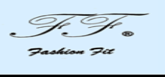




Apparel Buyer’s in Bangladesh
Buyer | Logo | Country | Remark
FASHION FIT |  | FRANCE
OKAIDI |  | FRANCE | Okaïdi proposes modern and creative collections for all life's different moments. Respect each child.
JULES |  | FRANCE | The brand was created in 1991 by Camaïeu under the name of Camaïeu Homme . After separating from her children's textile stores , she also thinks of leaving her sector for men
WE |  | FRANCE | WE Fashion, is originally a Dutch fashion chain which sells clothing, shoes, bags and other accessories. WE has approximately 240 shops.
CAMAIEU |  | FRANCE | Camaïeu is a French retail clothing company which manufactures and sells its own collections of women's clothing.

Slide 13


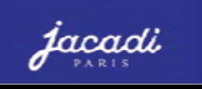


Apparel Buyer’s in Bangladesh
Buyer | Logo | Country | Remark
BONOBO |  | FRANCE | Bonobos is an e-commerce-driven apparel subsidiary of Walmart headquartered in New York City that designs and sells men's clothing.
PHILDAR |  | FRANCE | Phildar is a company French of ready-to-wear feminine and ready-to-knit. Phildar continues to grow everywhere in France in cities with more than 10,000 inhabitants and we find the brand in Europe and North America
JACADI |  | FRANCE | Jacadi is a registered French of ready-to-wear specializing in children's clothing from 0 to 12 years. The brand is inspired by the clothes of France of the Belle Epoque.
KIABI |  | FRANCE | Kiabi is the French largest fashion retail brand and offers his own label products across womenswear, menswear, boys, girls and babywea
ZARA –INDITEX GROUP |  | SPAIN | Zara (retailer) ... It is the main brand of the Inditex group, Europe’s largest apparel retailer

Slide 14
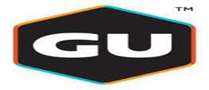



Apparel Buyer’s in Bangladesh
Buyer | Logo | Country | Remark
GU |  | JAPAN | G.U. is a Japanese discount casual wear designer, manufacturer and retailer, with 280 stores across the country.
EL CORTE |  | SPAIN | Headquartered in Madrid, is the biggest department store group in Europe and ranks fourth worldwide.
PALM GROVE |  | SPAIN | Palm Grove produce a range of golf clothing including polo shirts and sweaters
MANGO |  | SPAIN | A Spanish clothing design and manufacturing company, founded in Barcelona, Catalonia,
MAYORAL |  | SPAIN | Mayoral, a Spanish Children's Fashion Company presents their collection of clothes and accessories for new born, plus boys and girls clothing.

Slide 15


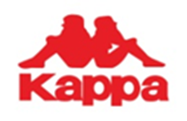


Apparel Buyer’s in Bangladesh
Buyer | Logo | Country | Remark
Benetton |  | ITALY | Introduced Garment Dyeing
TERRANOVA |  | ITALY | Terranova - is a successful and well-known Italian company, which specialized design, development, manufacture and sale of youth clothing
KAPPA |  | ITALY | Turin based Italian company, popular for sports wear and textile. Founded 1926 and 1967 it became Kappa.
KAPPAHL |  | SWEDEN | "Affordable fashion for many people" and one is aimed at women, men and children with a special focus on women in the middle of life.
LINDEX |  | SWEDEN | Lindex is a Swedish owned fashion chain within the Stockmann Group. The company has around 480 stores in 18 markets.

Slide 16





Apparel Buyer’s in Bangladesh
Buyer | Logo | Country | Remark
H & M |  | SWEDEN | Second biggest retailer of fast fashion in Europe.
IKEA |  | SWEDEN | Whorls biggest furniture retailer.
NYGARD |  | CANADA | Canadian clothing brand based in Winnipeg, Manitoba. It is one of the largest women's clothing manufacturers and suppliers in the world.
ILANCO INTL APPAREL & FASHION |  | CANADA | ILANCO INTERNATIONAL founded by the Cohen brothers in late 1991. Young aggressive and very successful company
ITOCHU |  | JAPAN | Itochu trades in raw materials and finished apparel, and also has a brand business. It owns a portfolio of investments and rights in well-known fashion brands including Converse, Hunting World, Le Sportsac, Mila Schön and Paul Smith.

Slide 17





Apparel Buyer’s in Bangladesh
Buyer | Logo | Country | Remark
UNIQLO |  | JAPAN | Japanese casual wear designer, manufacturer and retailer. The company has been a wholly owned subsidiary of Fast Retailing Co., Ltd. The company operates in Japan and several other countries
AMICO |  | JAPAN | As a men's & women's dress up manufacturer, they ship more than 4,000 items each week to more than 1.200 specialty shops throughout the Japan.
WOOLWORTHS |  | AUSTRALIA | Australian supermarkets accounting for about 80% of the Australian market.
BIG W |  | AUSTRALIA | Big W is an Australian chain of discount department stores, which was founded in regional New South Wales in 1964. The company is a division of Woolworth
THEO DORE |  | AUSTRALIA | Scanlan Theodore is a women's fashion and accessories brand offering a range of ready-to-wear, handbags, and footwear

Slide 18

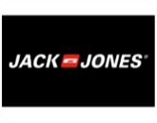

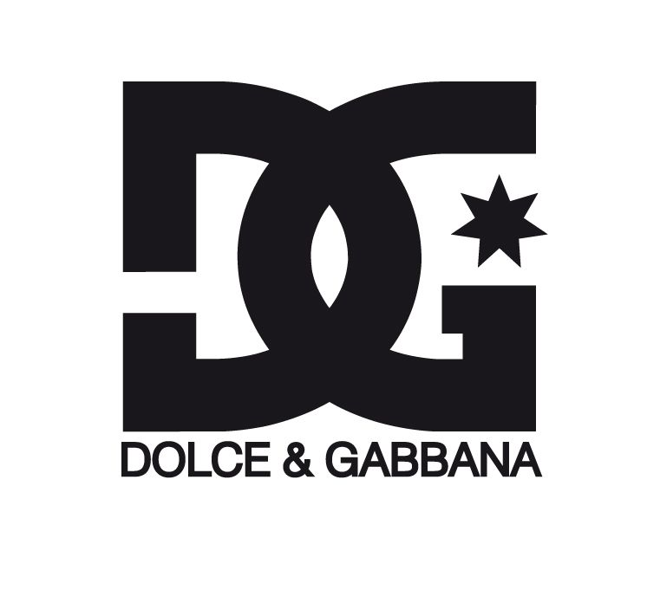

Apparel Buyer’s in Bangladesh
Buyer | Logo | Country | Remark
Indigo Collections |  | POLAND | The Indigo collection This is a new range, aimed at the core, 18-25, feminine casual-comfortable type
Jack and Jones |  | DENMARK | Jack & Jones - brand targeted at younger customers, with underwear and other garments aimed at the young consumer market.
Joules |  | UK | Joules is a British clothing company that sells clothing and home wear products inspired by British country lifestyles.
DOLCE and GABBANA |  | ITALY | Italian luxury fashion house founded in 1985 in Legnano.
TEIDEM |  | THE NETHERLANDS | Teidem BV was founded in 1984 and is based in Leiderdorp, the Netherlands. And retails all shorts of textiles.

Slide 19

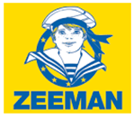

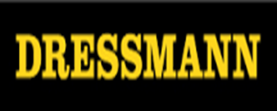

Apparel Buyer’s in Bangladesh
Buyer | Logo | Country | Remark
Holland House Fashion BV |  | THE NETHERLANDS | Holland House Fashion B.V. distributes women’s and kids apparel.
ZEEMAN |  | THE NETHERLANDS | Zeeman is a European chain store with 1,300 establishments in the Netherlands, Germany, Belgium, France, Luxembourg and Spain.
Character world |  | CANADA | Founded as a family business in 1998 by Tommy Schweiger.All shorts of kids hometex and home décor lineup.
DRESSMAN |  | NORWAY | Dressmann is now the leading chain of men's clothing stores in Northern Europe.
Charles Vögele(CV) |  | SWITZERLAND | Swiss fashion retailer based in Pfäffikon SZ. Charles Vögele and his wife Agnes and initially sold special clothing for scooter riders .

Slide 20

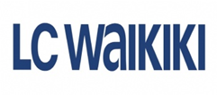

Apparel Buyer’s in Bangladesh
Buyer | Logo | Country | Remark
STOCKMANN |  | FINLAND | Stockmann Retail comprises 8 department stores and an online store. Stockmann's department stores operate in Finland, Estonia and Latvia.
LC WAIKIKI |  | FRANCE | 1988Foundation of LC Waikiki. LC Waikiki was founded in France, in 1988, by French designer Georges Amouyal ... 1997LC Waikiki Becomes a Turkish Brand.
LI & FUNG |  | HONG KONG | BIGGEST BUYING HOUSE. Li & Fung Limited is a Hong Kong based supply chain manager primarily for US and EU brands.

