Slide 1


International Commercial Terminology (InCoTerm)

Slide 2
Letter of Credit – L/C
L/C:
A letter of credit is a letter from a bank guaranteeing that a buyer's payment to a seller will be received on time and for the correct amount. In the event that the buyer is unable to make a payment on the purchase, the bank will be required to cover the full or remaining amount of the purchase. It may be offered as a facility.
In other word, A documentary credit, or letter of credit is an undertaking issued by a bank for the account of the buyer (applicant), to pay the seller (beneficiary) provided the terms and conditions of the documentary credit are complied with.

Slide 3
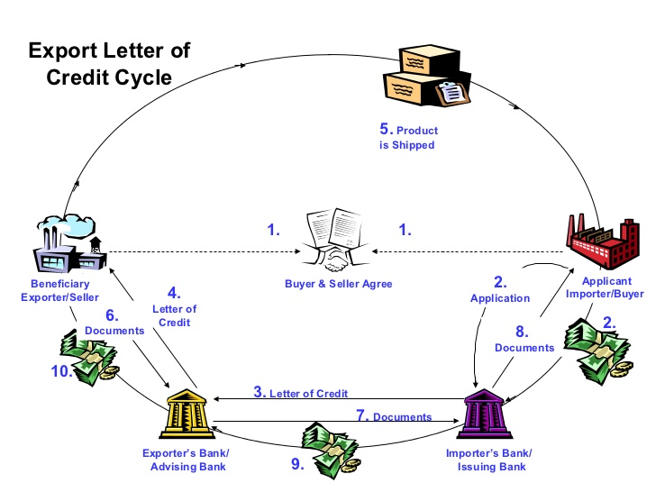
Process flow index of letter of credit (L/C)

Slide 4
Process Flow Index of L/C:
Stepwise Activity
Buyer submits Purchase Order or Contract to Seller.
Buyer places application for Letter of Credit with buyer’s bank.
Buyer’s bank sends confirmation of Letter of Credit to Seller’s confirming bank.
Confirming bank sends copy of Letter of Credit to Seller.
Seller sends ordered goods to the freight forwarder of buyer, Freight forwarder exports order to Buyer. Freight forwarder sends export documents to Seller
Seller presents Letter of Credit and export documentation to confirming bank for settlement.
Exporter’s bank forwards export documents to Buyer’s Bank.
Buyer’s bank presents copies of export documents to Buyer;
Buyer’s bank pays under terms of the Letter of Credit.
Exporters bank disburse the amount to the exporter after deducting BB L/C, charges and Packing Credit (PC) with interest (if any).

Slide 5
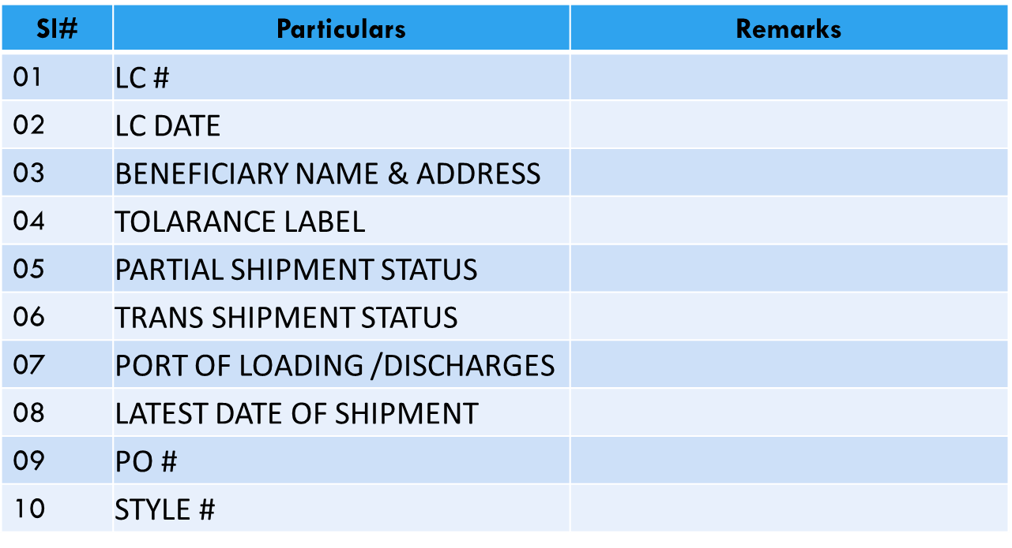
Check List for Master L/C

Slide 6
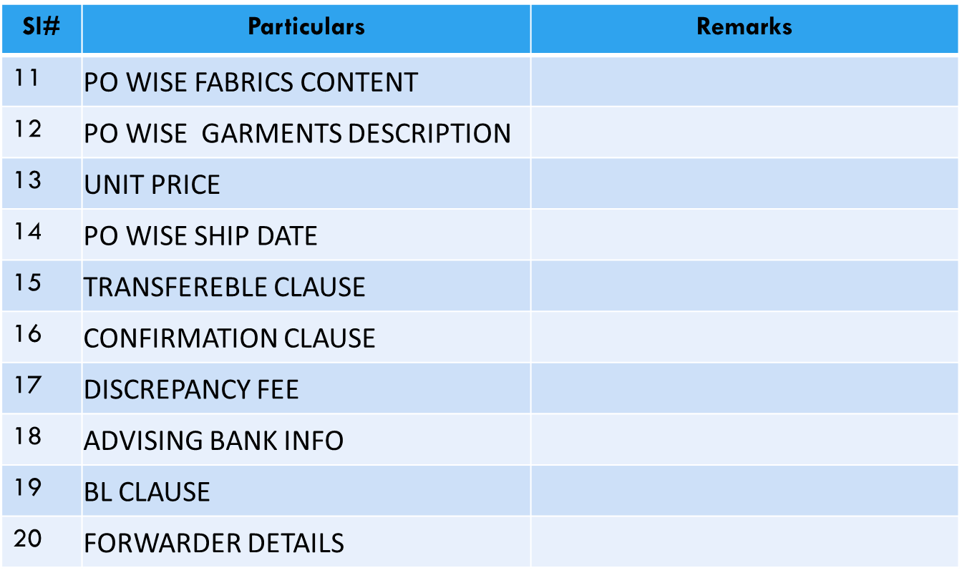
Check List for Master L/C

Slide 7
Why use a letter of credit?
Letters of credit are most commonly used when a buyer in one country purchases goods from a seller in another country. The seller may ask the buyer to provide a letter of credit to guarantee payment for the goods.
The main advantage of using a letter of credit is that it can give security to both the seller and the buyer.

Slide 8
Types of letter of credit (L/C)
Revocable Letter of Credit: Without the permission of the seller/exporter(beneficiary), buyer/importer (applicant) can cancel or make any correction of this type of Letter of Credit through the issuing Bank.
Irrevocable Letter of Credit: Without the permission of the seller/exporter(beneficiary), buyer/importer (applicant) cannot cancel or make any amendment of this type of Letter of Credit through the issuing Bank. It can only be cancelled without the permission of the seller/exporter (beneficiary) if it is expired. Exporters always want this type of letter of credit.
Red Clause Letter of Credit: This is the specific type of letter of credit that carries a provision (traditionally written or typed in red ink) which allows an exporter/beneficiary to draw up to a fixed sum from the advising or paying-bank, in advance of the shipment or before showing the prescribed documents.

Slide 9
Types of letter of credit (L/C)
Back to Back Letter of Credit : The Back to Back Letter of Credit (sometimes referred to as the Baby or Slave Letter of Credit) is issued on the authority of the Master Letter of Credit (Master LC). Back to Back Letter of Credit is issued by the exporter’s bank (advising bank) to the supplier to acquire raw materials. Permission of the ultimate buyer bank is not required to issue a back to back letter of credit. An exporter of garments can spend up to 70% of Master L/C value to collect raw materials.

Slide 11
Documents usually required for Negotiation
Bill of Lading
Bill of Exchange
Commercial Invoice
Packing List
Details Packing List
Certificate of Origin

Slide 12
Documents usually required for Negotiation
7. Beneficiary’s Certificate
8. Inspection Certificate
9. Lab Test Report
10. Courier Copy
11. Certificate of Origin GSP Form A
12. EXP

Slide 13
1. Bill Of Lading
The term bill of lading consists of two words –‘bill’ and 'lading’ the term 'bill' means the cost for any services supplied and the term 'lading' means to load a cargo onto a ship or transport,
A bill of lading is a document which acknowledges that the particular goods have been loaded on board as cargo for transporting to a definite address to the identified exporter of those goods.
The B/L document is issued by the Transportation Company or carrier to a shipper and the document is also signed by the captain of the board.
  Importance:
  The most important fact is that the bill of lading serves as evidence of a valid contract of carriage between the consignor and the carrier.
  It is a document issued by the carrier confirming that the goods described on the contract matches with the received goods on board in good condition.
  It is also a document of transfer that governs all the legal aspects of physical carriage and it may be endorsed affecting ownership of the goods.
  It creates a safe and liable carriage of the goods as it binds the carrier to its terms and the owner of the goods at a specific moment

Slide 14
2. Bill of Exchange
A written, unconditional order by one party (the drawer) to another (the drawee) to pay a certain sum, either immediately (a sight bill) or on a fixed date (a term bill), for payment of goods and/or services received.
A bill of exchange is generally used in international trade and aims at binding one party to pay a fixed amount of money to another party at a predestined future date.

Slide 15
3. Commercial Invoice
Document required by customs to determine true value of the imported goods, for assessment of duties and taxes. A commercial invoice (in addition to other information), must identify the buyer and seller, and clearly indicate the
(1) date and terms of sale,
(2) quantity, weight and/or volume of the shipment,
(3) type of packaging,
(4) complete description of goods,
(5) unit value and total value, and
(6) insurance, shipping and other charges (as applicable)

Slide 16
4. Packing List
Itemized list of articles usually included in each shipping package, giving the quantity, description, and weight of the contents. Prepared by the shipper and sent to the consignee for accurate tallying of the delivered goods.

Slide 17
5. Details Packing List
A details packing list is a document that includes ‘details’ about the contents of a package.

Slide 18
6. Certificate of Origin
Origin declarations are the simplest form of origin of goods approval methods. Exporters simply insert a standard origin declaration text to any of the commercial documents, that is all.

Slide 19
7. Beneficiary’s Certificate
Beneficiary certificate is a document that provides beneficiary admittance that the action or the event stipulated in the credit has been fulfilled.

Slide 20
8. Inspection Certificate
A document certifying that merchandise (such as perishable goods) was in good condition and right quantity at the time of inspection, usually immediately prior to shipment.

Slide 21
9. Lab Test Report
According to the buyers’ testing requirements garments, fabrics, yarn and accessories (zipper, button, eyelet etc.) need to be tested by the buyer approved testing labs to ensure that the goods maintain quality standards and there is no presence of restricted chemicals in garments and accessories.
The lab test requirements vary according to the buyers, sourcing countries and products.

Slide 22
10. Courier Copy
A courier is an individual responsible for the exchange of items between two or more parties. Couriers are usually employed by a company that charges a flat rate to the party using the courier service.
Courier Copy is the evidence of sending Original Generalized System of Preferences (GSP), Country of Origin (CO) and other required documents.

Slide 23
11. Certificate of Origin GSP Form A
First of all you should be exporting one of the donor countries, which applies GSP schemes in favor of the developing countries and least developed countries.
Form A is a special certificate of origin, which needs to be presented to the importing country's custom in order to be benefited from reduced tariff rates under GSP schemes.

Slide 24
12. EXP (Export Permission)
A document that is permitting to export of certain types of goods, usually issued by a government authority.

Slide 26
InCoTerm: Types of Orders
CM – Cut and Make: Buyer Provides everything and receive goods from factory
CMT – Cut, Make and Trims: CM + Factory purchase trims
EXW - Ex-Works: CMT + Factory purchase fabric
FOB - Free On Board: EXW + Transport to pronounce sea/air port
CNF - Cost aNd Freight: FOB + Freight of vessel
CIF – Cost, Insurance and Freight: FOB + Cost of insurance
CM :
CMT :
EXW :
FOB :
CNF :
CIF :
Cut
Make
Cut
Make
Trim
Cut
Make
Trim
Fabric
Cut
Make
Trim
Fabric
Transport
Cut
Make
Trim
Fabric
Transport
Freight
Cut
Make
Trim
Fabric
Transport
Freight
Insurance

Slide 27
Types of Orders: CM, CMT and ExW
CM (Cut and Make): This refers to the manufacturing cost and this term means “Cut and Make”. The buyer supplies all the materials required to the manufacturer to complete an order to the supplier and buyer receives the goods from the factory premise.
CMT (Cut, Make and Trim): The term means “Cut, Make and Trim”. The buyer provides the fabric and the supplier makes the garments collecting all types of accessories to complete an order to the supplier and buyer receives the goods from the factory premise.
ExW (Ex-Works): The Supplier has to collect all the raw materials; both fabric and accessories. The supplier delivers the goods to the buyer at his premises, i.e., factory, warehouse. The buyer bears all the costs and risks involved upon delivery of the goods until the desired destination.

Slide 28
Types of Orders: FOB and CNF
FOB (Free on Board): This terms means “Free on Board”. The supplier is responsible for all the expenses of raw material and other charges (including export licenses, etc.) and risks until the goods have handed over to the Clearing and Forwarding (C&F) agent of buyer at the port of shipment. The buyer contracts and pays for the freight and insurance and bears all risks of loss or damage to the goods as soon as the merchandise handed over to buyers C&F agent. The buyer also pays for all import duties and clears the goods through customs at the point of destination.
CNF (Cost aNd Freight): The seller/supplier is responsible to collect all the raw material, contract the carrier, pay the freight and loading the goods to the vessel. The buyer bears the risk of the goods from the time they pass the ship’s rail at the port of shipment and pay for the insurance coverage and responsible for the unloading costs at the port of destination.

Slide 29
Types of Orders: CIF
CIF (Cost, Insurance, Freight):
The seller’s price includes all cost and charges, freight and insurance up to the port of destination, From that point the buyer has to bear all charges and risks, including unloading costs.

