Slide 1
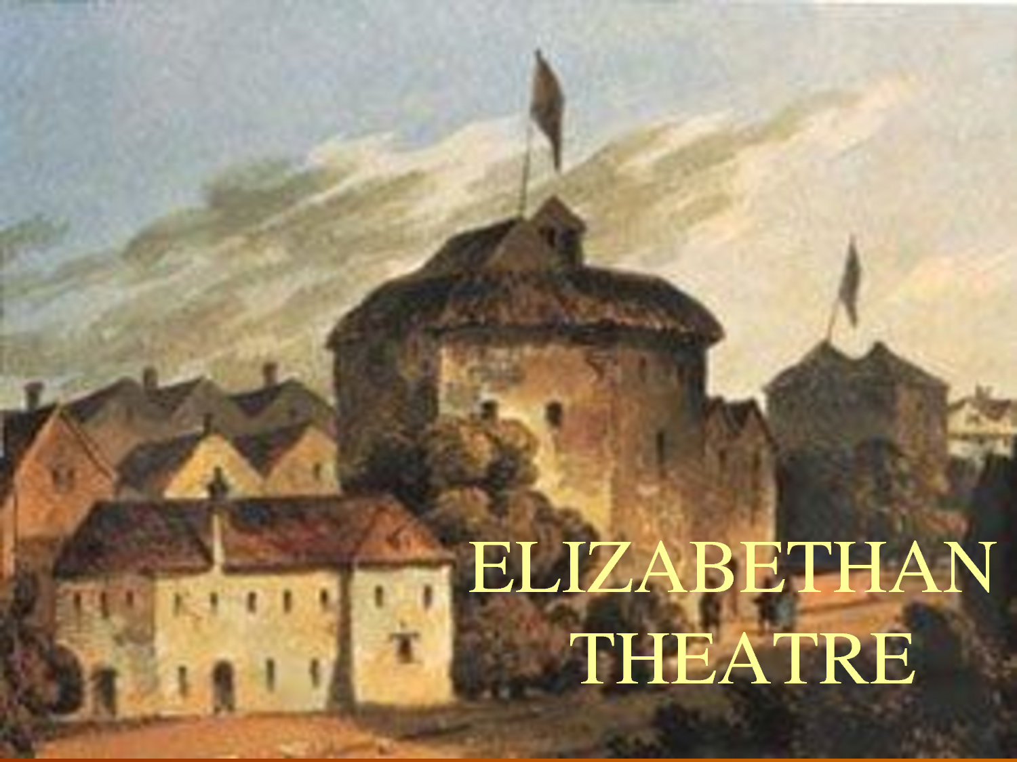

Slide 2
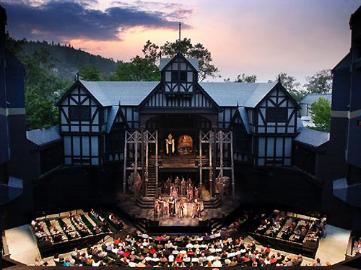

Slide 3
Theatre
There were no Elizabethan theatres until 1576 - plays were performed in the courtyards of inns - they were referred to as 'inn-yards.‘
James Burbage built the very first theatre in 1576 with his brother-in-law John Brayne, appropriately named 'The Theatre'.
Elizabethan theatres attracted huge crowds - up to 3000 people.

Slide 4
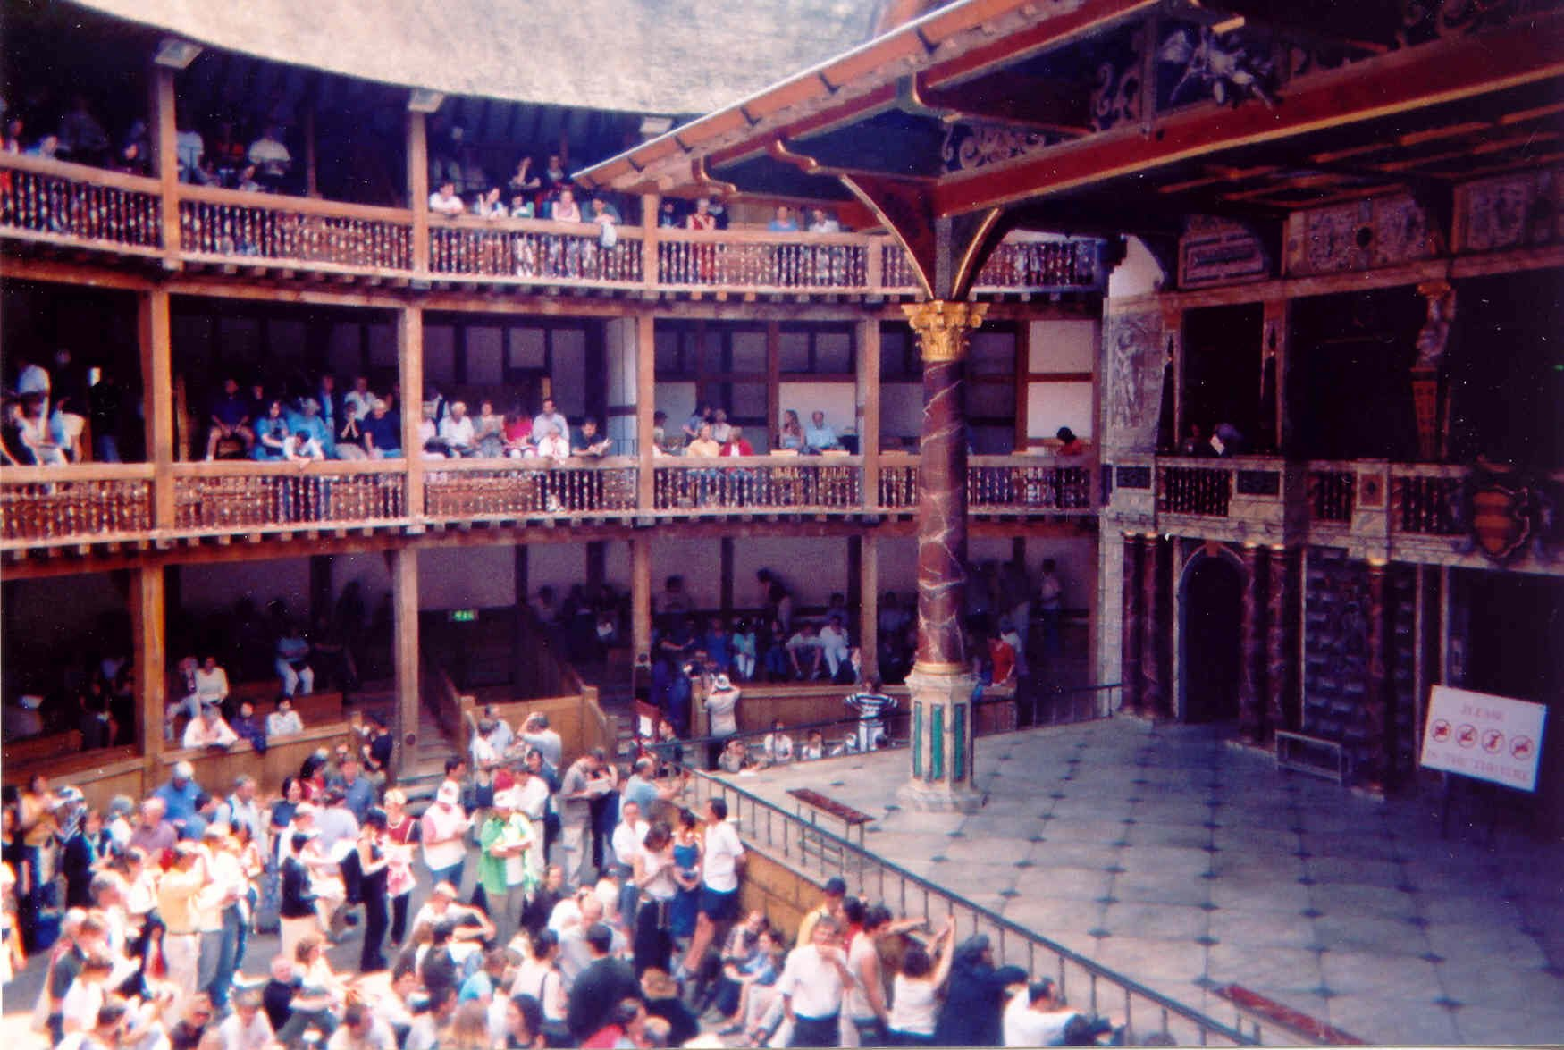

Slide 5
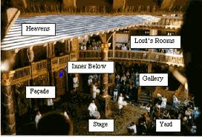

Slide 6
Theatre
The Globe Theatre was built by a carpenter called Peter Smith together with his workforce. They started building in 1597 and it was finished in 1598.
All theatres located in the city were forced to move to the South side of the River Thames due to objections to the theatres by the people, church.

Slide 7
Actors & Viewers
Acting was not a highly paid or highly respected profession.
Teenage boys who hadn't gone through puberty would play the roles of women.
Plays were often crude (by modern standards).
Poor people called the groundlings, or penny knaves, were famous their love of plays.

