Slide 1
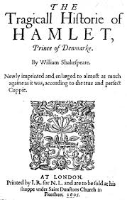
Hamlet (problem play or revenge tragedy)
William Shakespeare

Slide 2
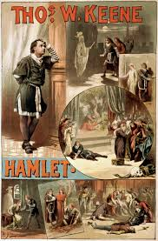
Hamlet in productions

Slide 3
The most famous soliloquy

Slide 4
The Performance
It is assumed that Shakespeare completed the play in 1601. According to contemporary references, Hamlet became an instant hit, and the great Shakespearean actor, Richard Burbage, received much acclaim in the lead role. Hamlet's popularity grew steadily until the closing of the theatres by the puritanical government (1642-1660).

Slide 5
Source
It is based on a Norse legend composed by Saxo Grammaticus in Latin around 1200 AD. The sixteen books that comprise Saxo Grammaticus' Gesta Danorum, or History of the Danes, tell of the rise and fall of the great rulers of Denmark, and the tale of Amleth.
Shakespeare used the earlier play based on this Norse legend by Thomas Kyd, called the Ur-Hamlet.

Slide 6
Key Facts
major conflict · Hamlet feels a responsibility to avenge his father’s murder by his uncle Claudius, but Claudius is now the king and thus well protected. Moreover, Hamlet struggles with his doubts about whether he can trust the ghost and whether killing Claudius is the appropriate thing to do.
setting (time) · The late medieval period, though the play’s chronological setting is notoriously imprecise
settings (place) · Denmark

Slide 7
Key Facts
tone · Dark, ironic, melancholy, passionate, contemplative, desperate, violent
themes · The impossibility of certainty; the complexity of action; the mystery of death; the nation as a diseased body
motifs · Incest and incestuous desire; ears and hearing; death and suicide; darkness and the supernatural; misogyny

Slide 8
Character Map

Slide 9
Senecan Influence
The machinery of revenge
Ghost
Crude and violent scenes
Madness

Slide 10
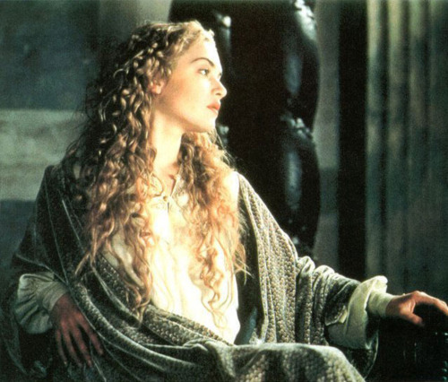
Female Characters
Gertrude
Ophelia

Slide 11
Hamlet meeting his father’s ghost

Slide 12
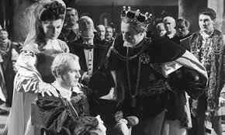
Melancholy Hamlet at the court
Laurence Olivier's rather more conventional 1948 film of Hamlet: with Eileen Herlie (left) as Gertrude, Olivier as the prince, and Basil Sydney as Claudius

Slide 13
The actors

Slide 14
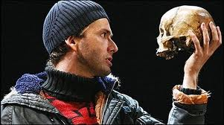
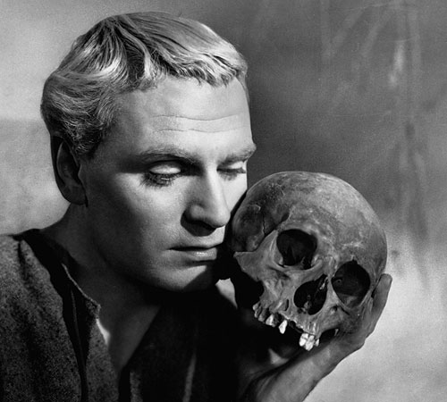
The grave-digging scene

Slide 15
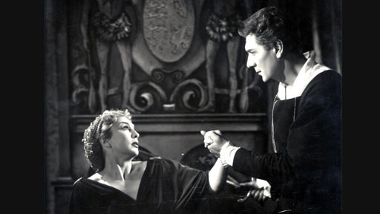
Confronting Gertrude

Slide 16
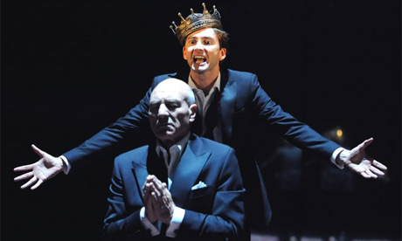
Unable to kill Claudius

Slide 17
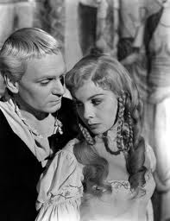
Hamlet-Ophelia

Slide 18
Ophelia’s drowning

Slide 19
Sword Fight: Laertes-Hamlet

Slide 20
Freudian Analysis
Oedipus Complex: Though he hates his fratricidal uncle, he nevertheless unconsciously identifies with him—for, having killed Hamlet's father and married his mother, Claudius has carried out what are Hamlet's own unconscious wishes. In addition, marriage to Hamlet's mother gives the uncle the unconscious status of the father—destructive impulses towards whom provoke great anxiety and meet with repression.

Slide 21
Misogyny in Hamlet
Feeling betrayed by the two closest women in his life, Hamlet becomes extremely cynical about women in general ("Frailty, thy name is woman!“). He shows a particular obsession with what he perceives to be a connection between female sexuality and moral corruption.

