Slide 2
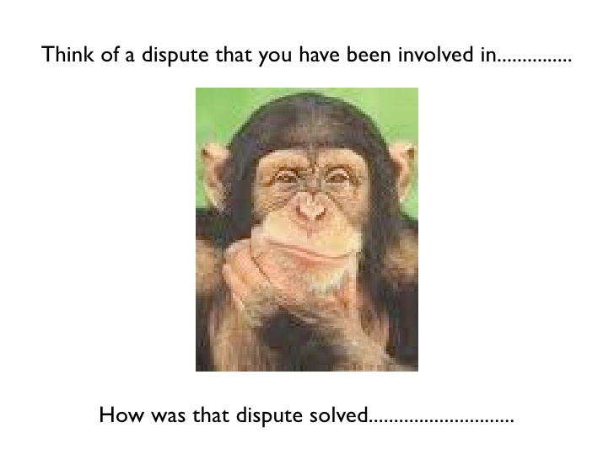

Slide 15
Tank you

