Slide 1
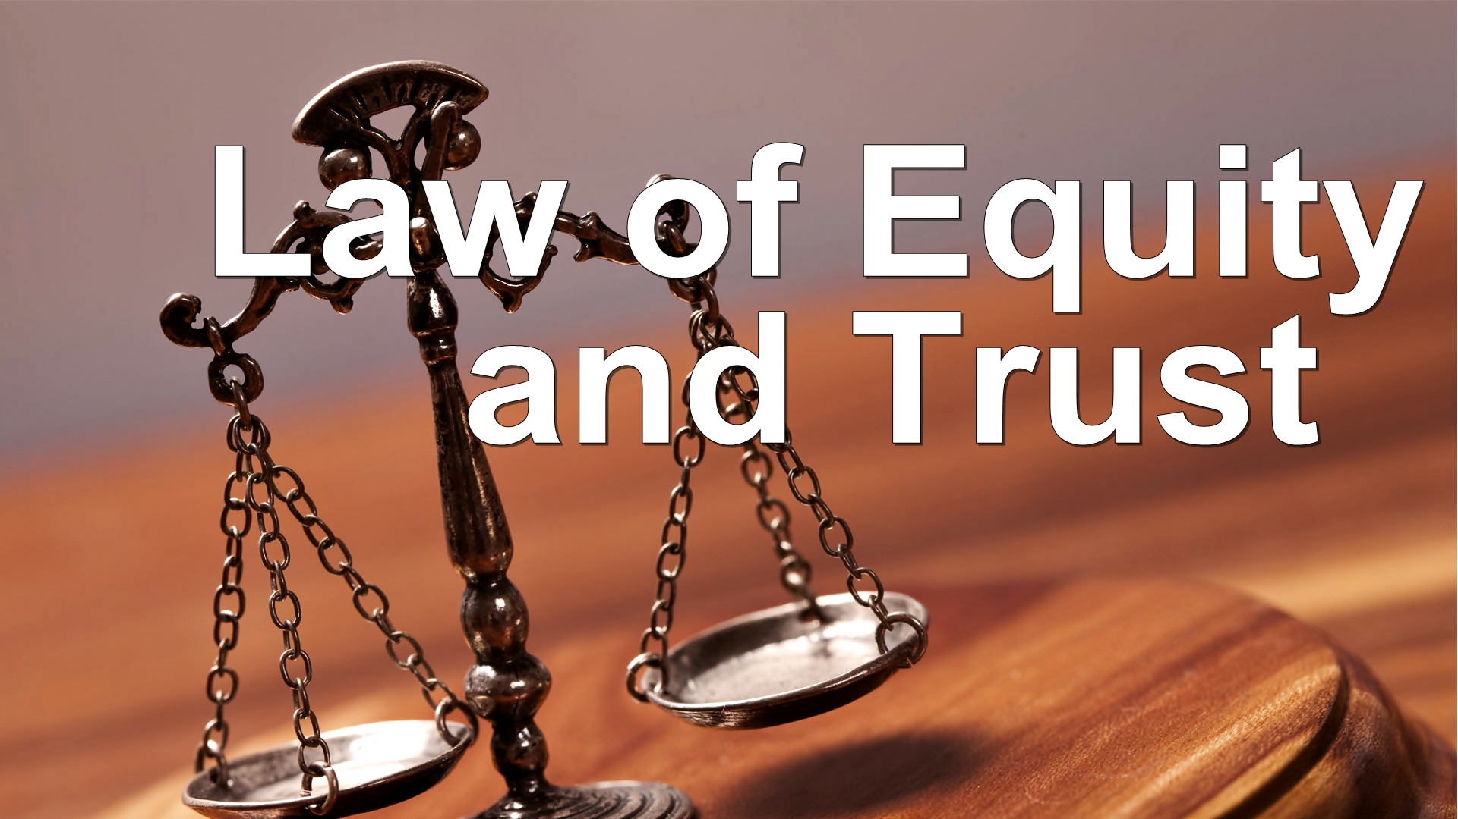

Slide 2


Slide 3


Slide 4


Slide 5
THE CONSTITUTION OF THE PEOPLE’S REPUBLIC OF BANGLADESH
Article 27
Equality before law
All citizens are equal before law and are entitled to equal protection of law.

Slide 6
Article 28
Discrimination on grounds of religion, etc.
(1) The State shall not discriminate against any citizen on grounds only of religion, race, caste, sex or place of birth.
(4) Nothing in this article shall prevent the State from making special provision in favour of women or children or for the advancement of any backward section of citizens.

Slide 7
Equity
Dictionary meaning: The quality of being fair and impartial
Equity is what the good conscience of human being dictates

Slide 8
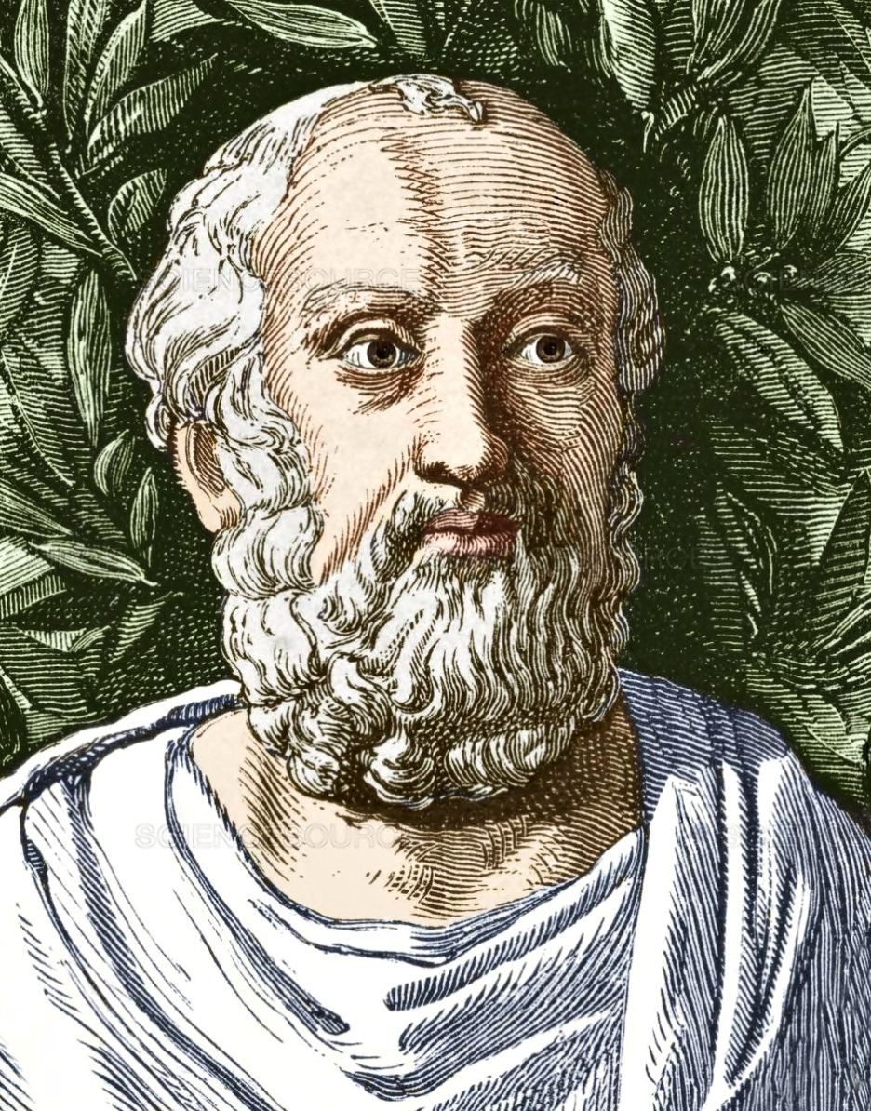
According to Plato
Equity is a necessary element which ensures justice to the imperfect impact of legal rules.

Slide 9
In Delhi Development Authority vs. Skipper Construction Company (1996), the Supreme Court observed that the jurisdiction and power of Supreme Court to make orders to do complete justice is exercised to meet the situations which ensure justice is exercised to meet the situations which cannot be effectively dealt with under the existing law.

Slide 10
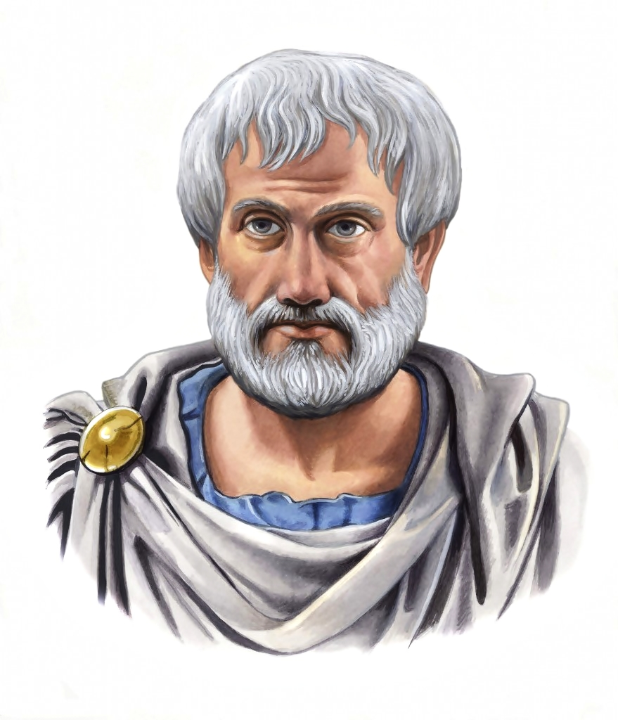
According to Aristotle
Equity is just and better than one kind of justice – not better than absolute justice, but better than the error which has been arrived from the absoluteness of the statement.

Slide 11
In C. Chenga Reddy vs. State Of Andhra Pradesh, (1996), the court observed that a court of Equity must so act within the permissible limits so as to prevent injustice.

Slide 12
Lowe vs. Dixon, (1885):
A, B and C were sureties for the payment of 3000 dollar and A become insolvent. The rule at law was that B’s and C’s liability to pay 1000 dollar each remained. But in equity those who can pay their shares must also make good the shares of those who cannot and so B and C were liable for 1500 dollar each. Here, therefore, the rule of equity prevails.

Slide 13
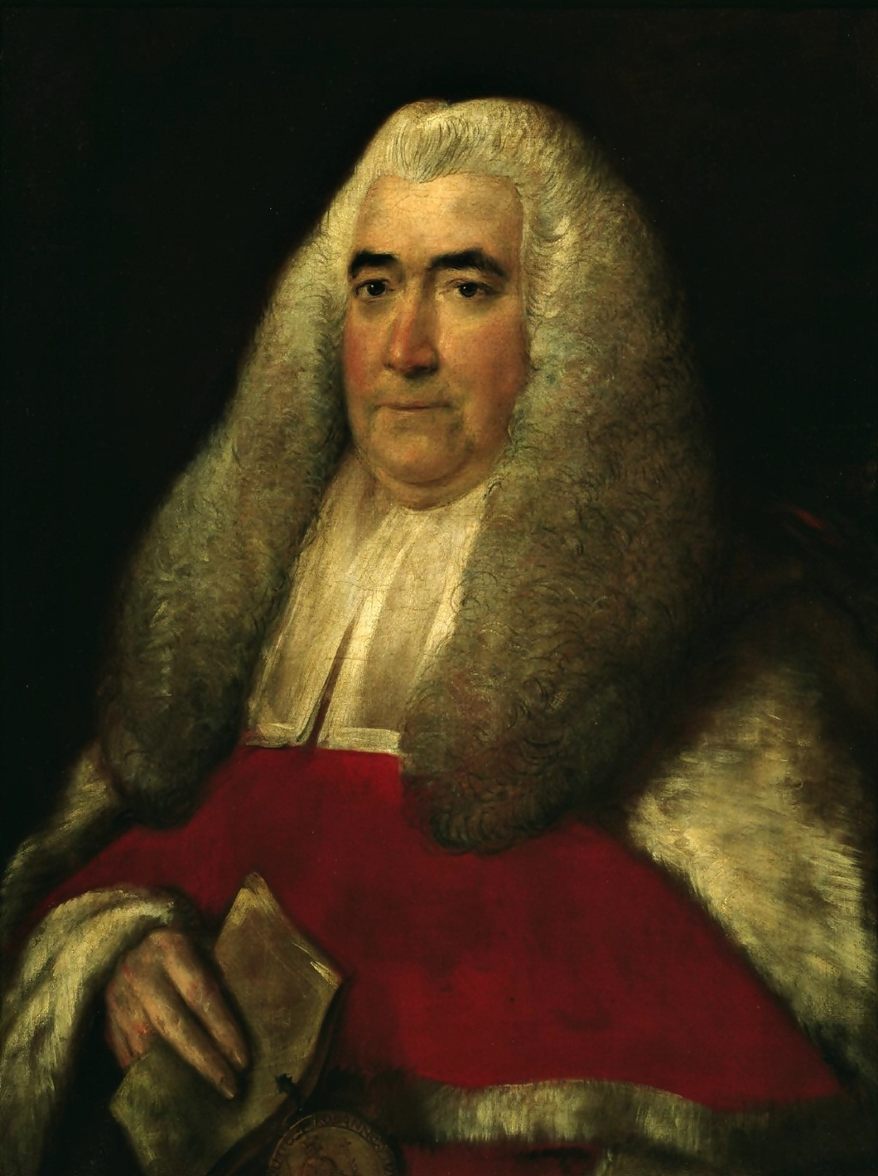
According to Blackstone
Equity is the soul and spirit of all law. Positive law is constructed and natural is made by it. Equity is the synonyms of justice.

Slide 14
In The Attorney General of Hong Kong vs. Reid, (1993), the Supreme Court said that absence of provision in law for relief cannot deter the Supreme Court from doing justice between the parties. Doing justice between the parties is a compulsion of judicial conscience on the part of the Supreme Court as a court of Equity.

Slide 15


Slide 16
Equity means, a system of law designed to entitled remedies for wrong which were not legally recognized under the common law or for which no adequate remedy was provided by the common law.
After 1066(Anglo-Saxon period) all laws were local and enforced on local courts. General hierarchies of the courts were:
1. Kings court
2. The Court of Common Pleas
3. The Court of Exchequer
4. Assize Court

Slide 17
1. Kings court:
The Kings council carried out the three functions of the state, namely:
(i) Legislative
(ii) Executive
(iii) Judicial
It dealt with all cases in which the King had a direct interest, like: breaches of the peace.

Slide 18
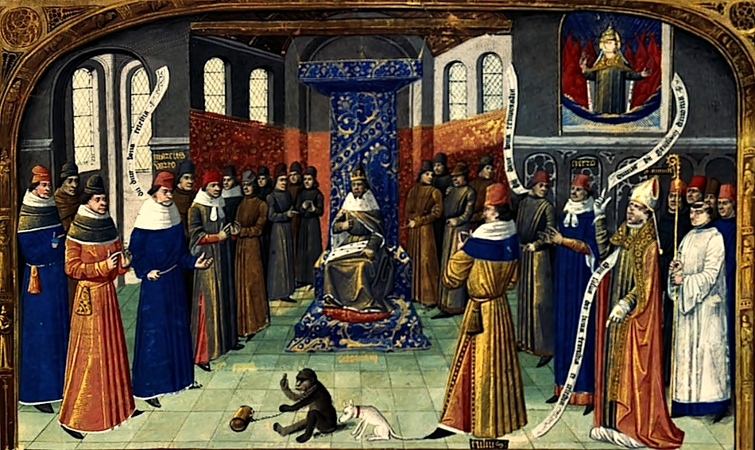

Slide 19
2. The Court of Common Pleas:
The Court of Common Pleas dealt with disputes between individuals, while the king’s council travelled round the country
3. The Court of Exchequer:
The Court of Exchequer dealt with the collection of revenues.
4. Assize Court:
King Henry II established trial by jury by a grand assize of twelve knights in land disputes.

Slide 20
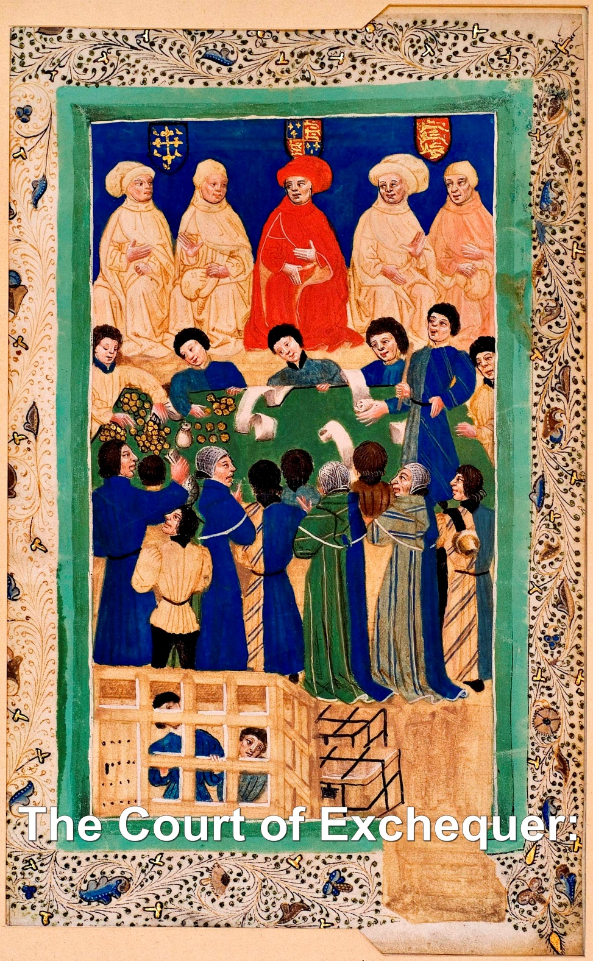

Slide 21
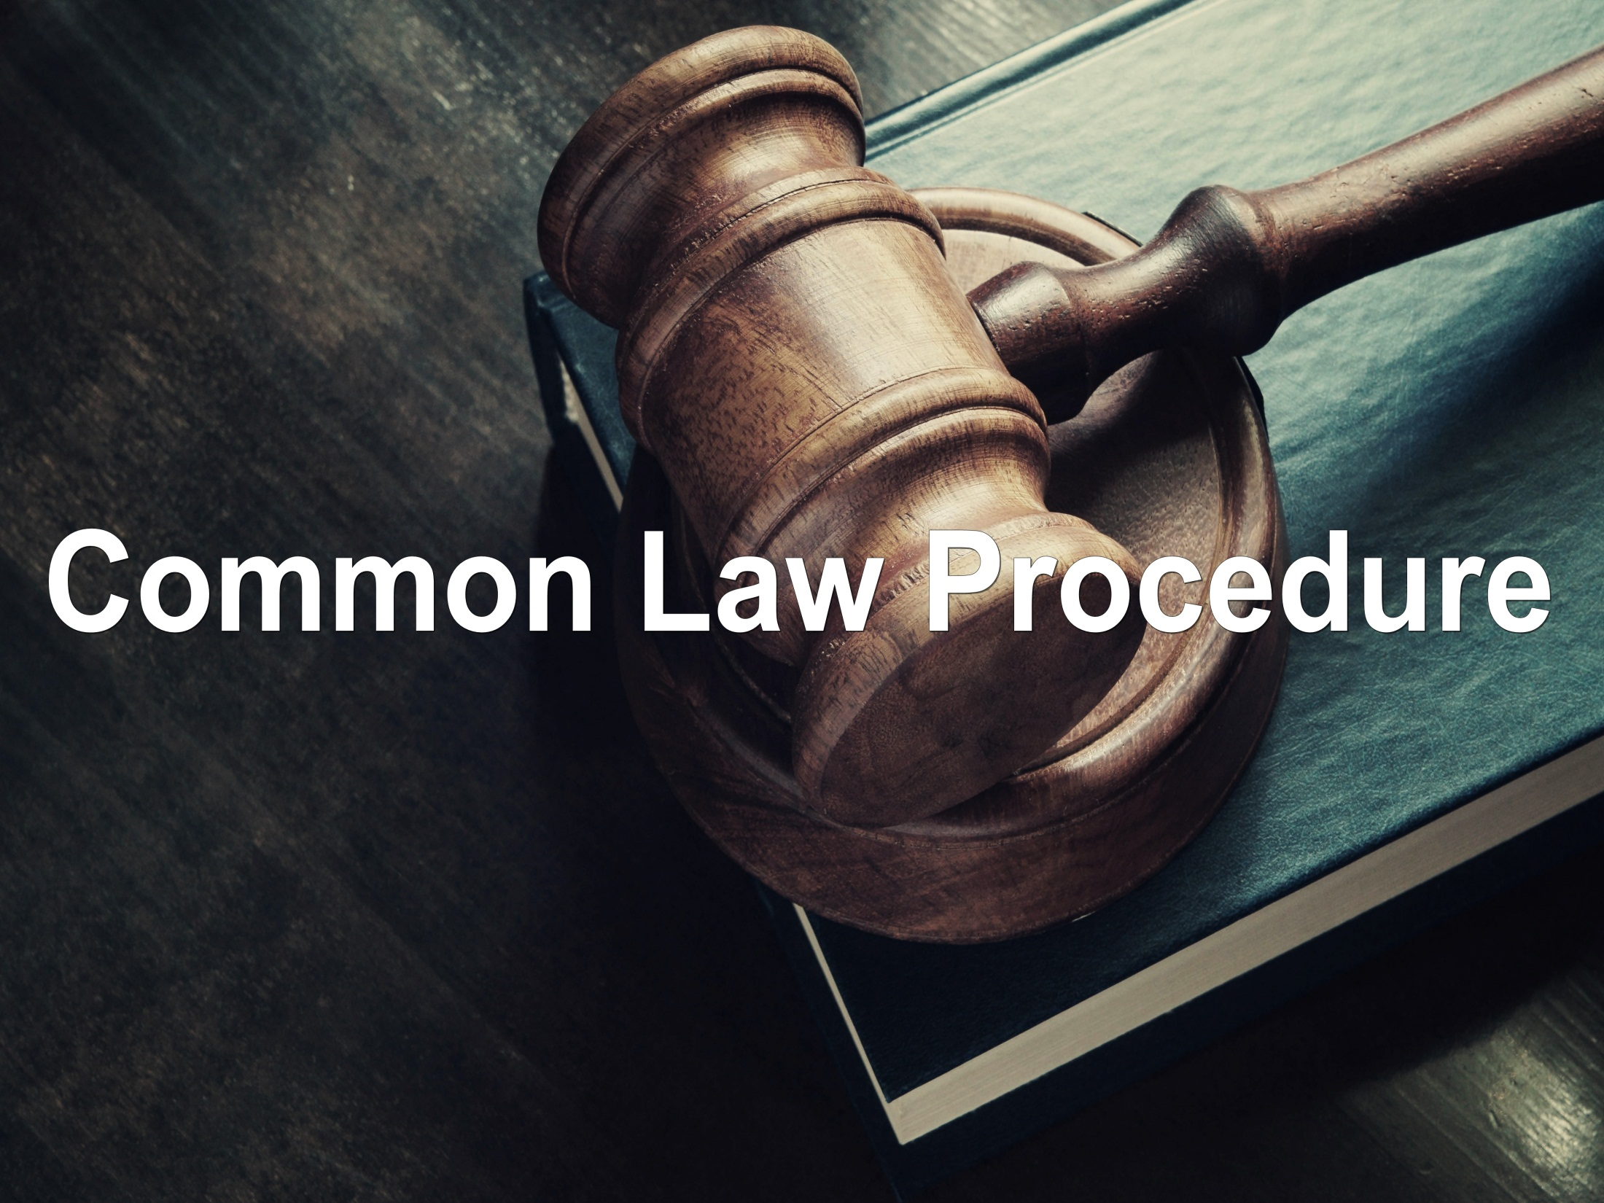

Slide 22
Common law procedure was very much depended on two sources:
1. Precedent
2. The Writ system

Slide 23
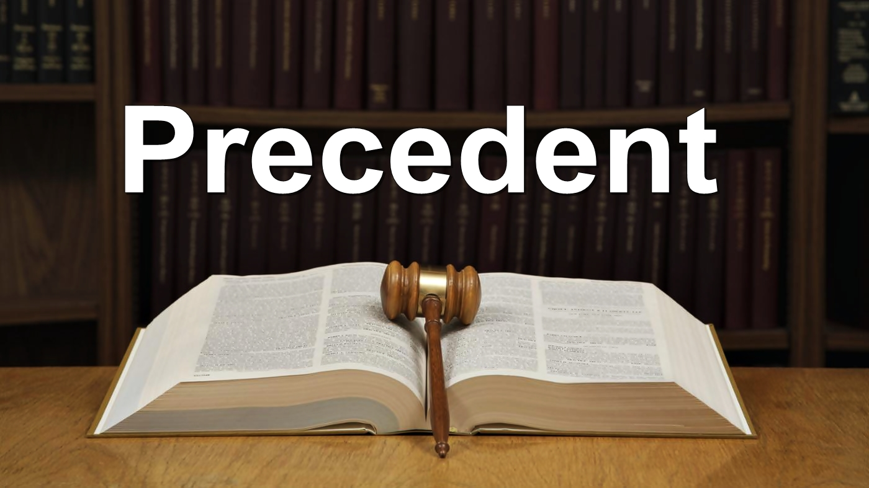

Slide 24
1. The Precedent:
As the number of the common law courts grew, the judges began to use previous decisions as a guide for later case. This was the beginning of the doctrine of precedent. In common law legal systems, a precedent is a principle or rule established in a previous legal case that is either binding on or persuasive for a court when deciding subsequent cases with similar issues or facts.

Slide 25
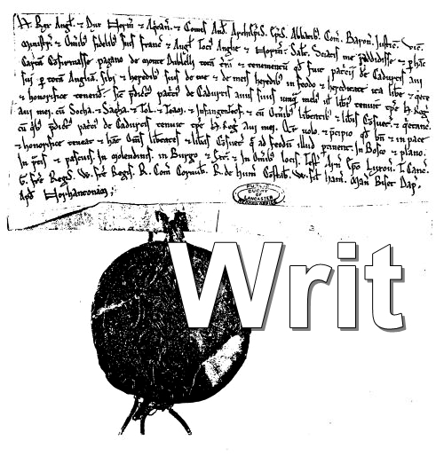

Slide 26
2. The Writ system:
The judges also developed the writ system. A writ is simply a document setting out the details of a claim. Over a period of time the writ system become extremely formal. The judges often spend more time examining the validity of the writ than the merits of the claim.

Slide 27
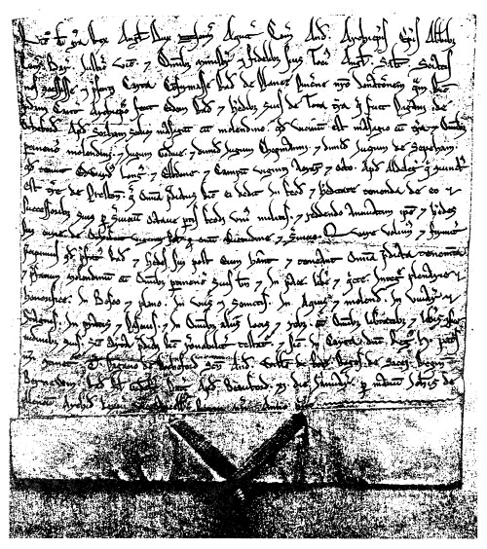

Slide 28
Defects of the common system
There are also other faults with the common law courts, for example:
1. The common law courts used juries which could be corrupted
2. The common law had only one remedy, damages, which was often inadequate
3. The common law paid too much attention to formalities
4. The common law courts did not recognize the trust

Slide 29
Development of Equity
People were disappointed with the decision of the common court. They began to file petition to the king as he was the “Fountain of justice”. The increasing number of litigations was not possible to handle by the King alone. As a result the King empowered a Chancellor settle the disputes using his conscience and the Chancellor was known as the “Keeper of the King”. The Chancellor was generally a bishop and learned in civil and common law.

Slide 30
The chancellor dealt with petitions on the basis of moral law by determining what is morally right. In 1474 the Chancellor issued the first decree in his own name, which was the beginning of the independent “court of Chancery” apart from the King’s council.

Slide 31
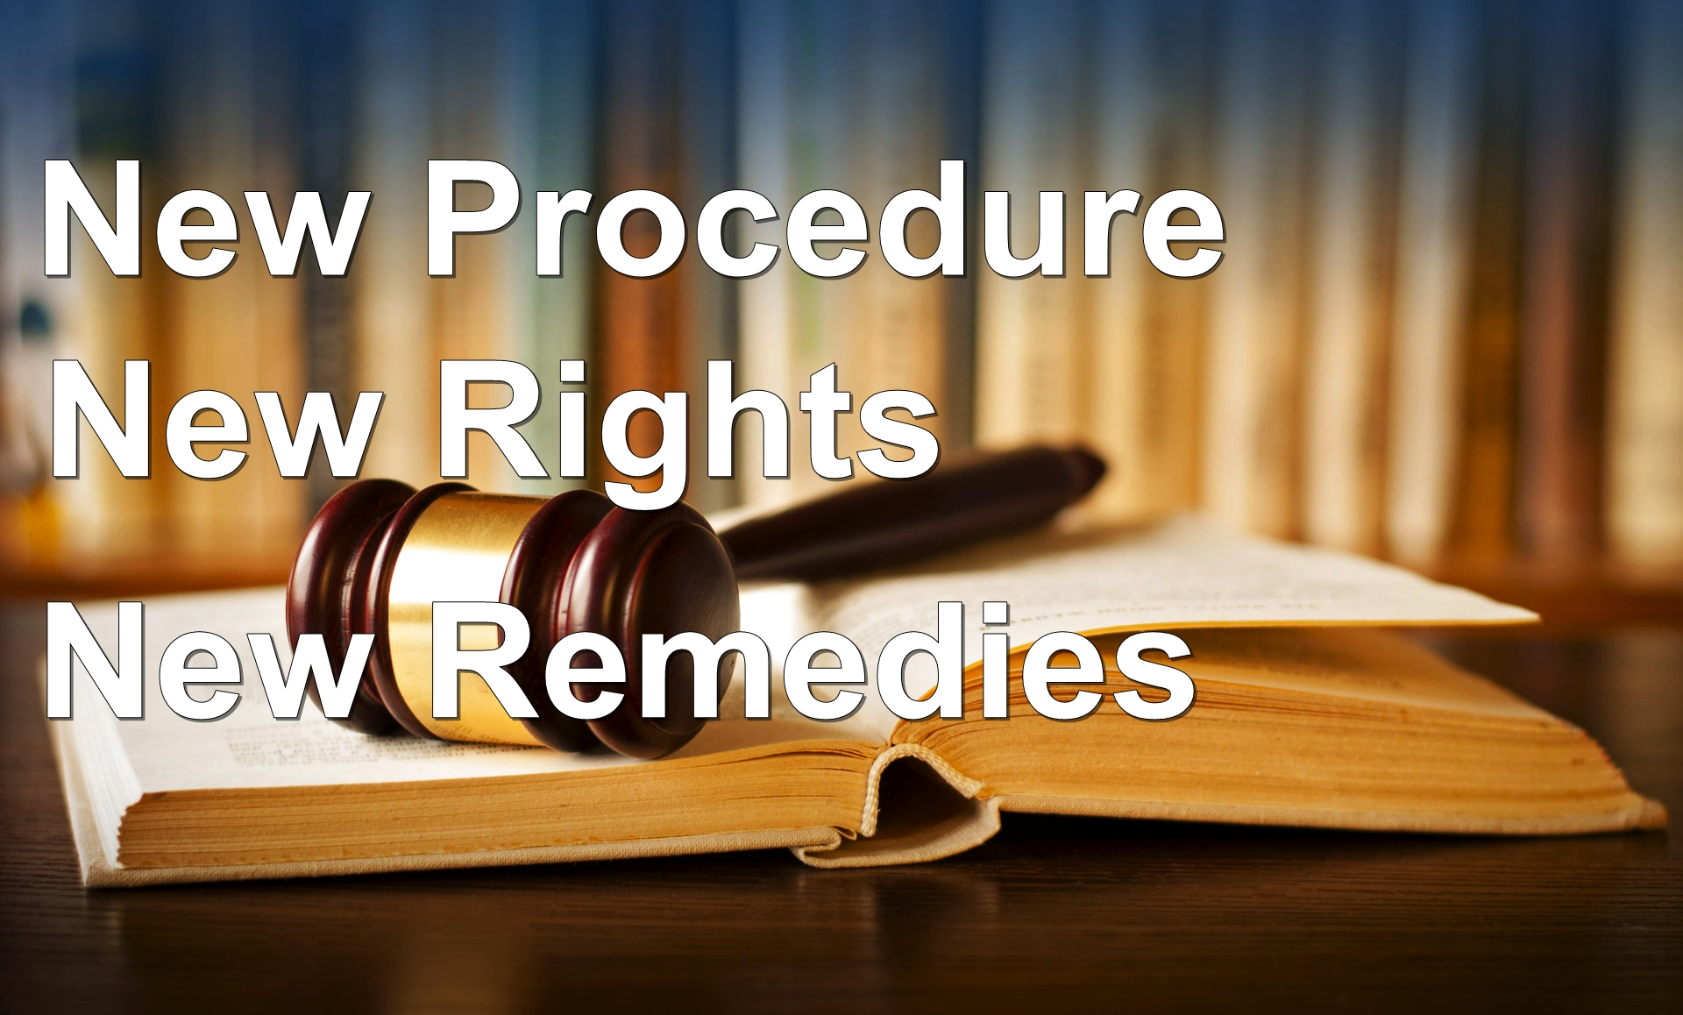

Slide 32
New procedure:
Equity was not bound by the writ system and cases were heard in English instead of Latin. The chancellor did not use juries and he could order any party to disclose documents.

Slide 33
New Rights:
Equity created new rights by recognizing trusts and giving beneficiaries rights against trustees. The common law did not recognize such a device and regarded the trustees as owners.

Slide 34


Slide 35
1.Specific performance:
Which is an order compelling a party to perform their part of a contract specifically as agreed by the parties earlier.
Real estate transactions are almost always granted this relief. Other examples would be original paintings from a famous artist like da Vinci, Picasso, or Van Gogh; a unique, one-of-a-kind custom vehicle; a piece of jewelry with a unique and specialized design, unlike any other; a rare stamp collection etc.

Slide 36
2. Rectification:
If a written document does not reflect the actual agreement that the parties have reached, the court was empowered to rectify the contract, which is to substitute the original text with corrected wording to give effect to the parties' true intentions.

Slide 37
3. Rescission:
This allowed parties to a contract to be put back in their original position in the case of misrepresentation, fraud or undue influence etc.
Rescission of a contract may be ordered by a court as an equitable remedy in a civil lawsuit, and is intended to bring the parties as close to the same position they were in before they entered into the contract as possible.

Slide 38
4. Injunction:
An injunction is an equitable remedy in the form of a court order that compels a party to do or refrain from specific acts. A party that fails to comply with an injunction faces criminal or civil penalties, including possible monetary sanctions and even imprisonment. They can also be charged with contempt of court.

Slide 39
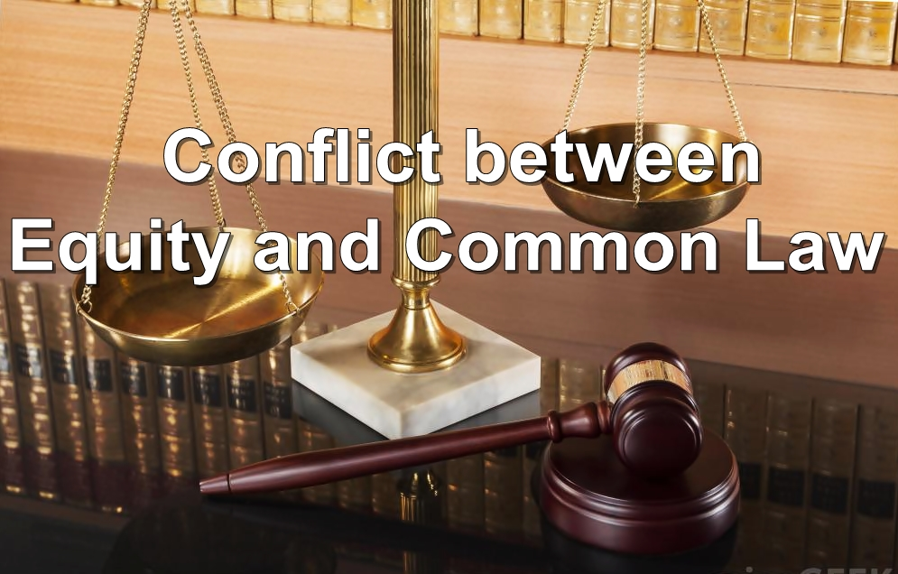

Slide 40
The Court of Equity (Chancery) became very popular because of its flexibility, superior procedure and its more appropriate remedies. Problems arose as to issue of injunction when the common law court objected on an injunction upon a party passed by the Equity court.
Earl of Oxford’s case (1615) is a foundational case for the common law world that held equity (equitable principle) takes precedence over the common law. There was a dispute between the owner of a land and a farmer who had cultivated crops in the land.

Slide 41
The court of equity gave decision in favour of the farmer as the crops had been ripe and immediate cutting was necessary. The court imposes an injunction upon the owner of the land and the common law court challenged their jurisdiction. A big dispute arose between the court of equity and common law court.

Slide 42
The King decreed on the advice of the Attorneys General that if there was a conflict between the common law and equity, equity would prevail. Equity’s primacy in England was later enshrined in the Judicature Acts in 1873 and 1875, which also served to fuse the courts of equity and the common into one unified court system.

Slide 43
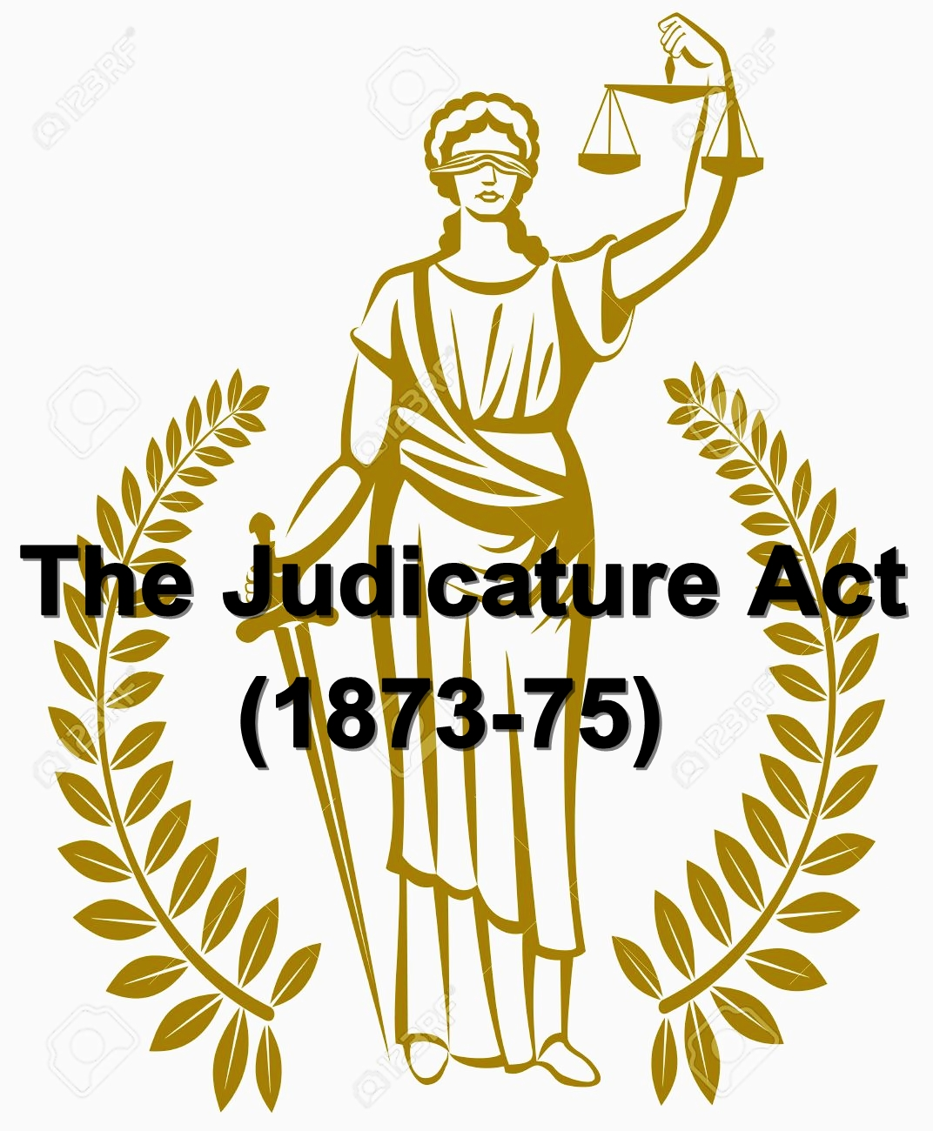

Slide 44
In 1873 first Judicature Act was enacted to make a fusion between common law and equity but the process wasn’t completely successful.
In 1875 another Judicature Act was passed. It successfully created a fusion between common law and equity. This Act is very important because after its enactment, the judges of judicial court can apply equity. Thus the court becomes not only a court of law or a court of equity but also a court of complete jurisdiction.

Slide 45
However, this didn’t fuse the principals of common law and equity, which still remain as separate body of rules. “The two streams have met and still run in the same channel but their water does not mix (Maitland)”.
In 1881 first time in England “High Court of Justice” was established and from then each and every court tried to apply equity.

Slide 46


Slide 47
In the case of D.S. Nakhara vs. Union of India, (1980), the Supreme Court of India held that: “Every new norm of socio-economic justice, every new measure of social justice is commenced for the first time at some point of history. If at that time it is rejected as being without a precedent, the law as an instrument of social engineering would have long since been dead and no tears would have been shed”

Slide 48
Section 561A of the Code of Criminal Procedure
Section 561A says,
“Nothing in this Code shall be deemed to limit or affect the inherent power of the High Court Division to make such orders as may be necessary to give effect to any order under this Code, or to prevent abuse of the process of any Court or otherwise to secure the ends of justice.”

Slide 49


