Slide 1
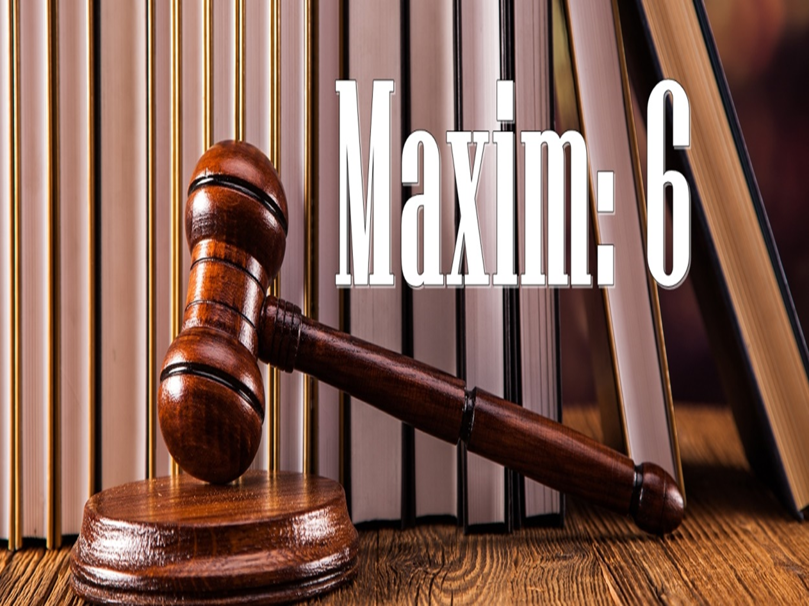

Slide 2
Equity looks to the intent rather than the form

Slide 3
A Court of Equity is concerned more with the real intention of the parties than with the actual form of the transaction in question. Equity gives effect to what the real intention of the parties to a contract is, and, like law, it is not always to be guided by the language in which that intention is expressed in the deed.

Slide 4
If a party to a contract for the sale of land fails to complete on the day fixed for completion, at law he is in breach of his contract, whereas in equity it will usually suffice if he is ready to complete within a reasonable period thereafter. Equity as a matter of fact regards the spirit and not the latter of the law.

Slide 5
Parkin vs Therold (1852)
The Court held that “Courts of equity make a distinction in all cases between that which is matter of substance and which is matter of form, and if they found that by insisting on the form, the substance will be defeated, they hold it to be inequitable to allow person insists on such form, and thereby defeat the substance”

Slide 6
History
Common law was very rigid and inflexible. It could not respond favorably to the demand of time. It regarded the form of a transaction to be more important than its substance. It looked to the very letter of the agreement and not the intention behind it. On the other hand, Equity looks to the spirit not to the letter, it looks to the intention of parties and not to the words.

Slide 7
Example:
A and B made an agreement that after 30 days, A will buy B’s land with consideration of 5 Lac taka.
On the certain date A failed to pay the whole amount.
In these circumstances, common law declared it as a breach of contract without any remedy.

Slide 8
In this same circumstance, equity didn’t take the rigid attitude. It allows a reasonable time to pay the rest of the amount.
In case of enforcing an agreement, equity didn’t give undue importance to the negative sides of a agreement but looked through the document to find out its real intention. Thus a contract which could lawfully have been effected by two or more transaction was held valid by equity.

Slide 9
1. Relief against Penalties
It is applied in cases where obligation is imposed under law, but reasonable time relaxation may help in completion the transaction with period of proceedings. The principle object of the contract which lies in its performance and not in the implementation of penalty.
.

Slide 10
In some agreements, provisions are inserted to the effect that in case of breach the party responsible for breach will have to pay a certain sum to the other party. When the sum payable on default is merely a pre-estimate of the loss likely to result to the other party on account of the breach, it is called liquidated damages. When the sum payable is a punishment for failure to perform the contract, it is in the nature of penalty.

Slide 11
At the time when the parties enter into a contract, they only contemplate (look, observe, watch) that it will be performed, and that, in case of failure to perform, they assure that whatever loss a party suffers by the breach of the contract by the other, would be made good. The naming of a sum as the amount payable on default is merely a security for performance.

Slide 12
A sum names by way of penalty is intended to terrorize the other party to perform the contract, while the sum named by way of damages is intended to secure the performance of the contract by the other party. The Court of equity does allow damages actually suffered by the breach but does not allow penalty.

Slide 13
2. Relief against Forfeiture:
This maxim also applies where property comes under obligation due to non-performance of contract. A property, which is mortgaged but the repayment of loan or credit, is delayed within stipulated time period; creditor reserves the right to dispose of it to recover his debt. But it is unfair to forfeit the property at once because the cause of contract was not to forfeit the property but it was just protection of interest given to creditor.

Slide 14
Creditor is liable to serve notice to debtor before going to the sale proceed and reasonable time must be given for repayment. If the proceeding of auction is started, foreclosure of property can be stopped upon the payment of debt with interest.

Slide 15
Sometimes in a rent deed a condition is inserted that the landlord in case of non-payment of rent will be entitled to re-entry and the lease would be forfeited. Such clause in a lease is merely incorporated as a security for the regular payment of rent. The intention is not that lessee be ejected rather the intention is that he should pay the rent regularly.

Slide 16
The Court of equity, therefore, would not order forfeiture for non-payment of rent, if the lessor could be compensated. It could be done when the lessee paid to the lessor in Court the full amount due from him on account of rent together with interest thereon, and full costs of the suit.

Slide 17
3. Precatory trust
A trust is created with
(1) an intention on his part to create a trust thereby,
(2) the purpose of the trust,
(3) the beneficiary, and
(4) the trust property.

Slide 18
Where an author uses words such as ‘I hope’, ‘I request’ or ‘I recommend’ the first condition is missing. In cases where subsequent ingredients are found, in early days, it was held by the equity courts that he had the intention.
Equity in such cases ignored the form and looked to the intention. The document as a whole was taken into consideration.
This view is in use now but not as liberally as before.

Slide 19
4. Relief in Regards to Mortgage
The mortgagor has a right to obtain his property back by payment of the debt and that is his right of redemption. The mortgagor’s right of redemption is guarded by courts and this has been expressed in a well-known legal maxim, “Once a mortgage, always a mortgage, and nothing but a mortgage”.

Slide 20
If the mortgagor can’t redeem his property within the time set in the deed, his legal right is gone but he can still have in equity, his right to redeem the mortgage and any condition that bars such redemption will not be legally enforceable.
Noakes & Co. vs Rice (1902)
Lord Davey expressed that “ A mortgage can not be made irredeemable and a provision to that effect is void”

Slide 21
Salt vs Marquess of Northampton (1892)
On the death of his son (Mortgagor), the father was allowed to redeem the mortgage even though there was a deliberate contract by the son that the securities should belong absolutely to the mortgagee in case of failure of payment within specific time.
Stanley vs Wilde (1899)
Any provision inserted in a mortgage deed preventing redemption is meant to be a clog or fetter (Obstruction) on the equity of redemption, and is void.

Slide 22
Limitations and exceptions:
This maxim has neither limits nor exceptions. It can be applied anywhere.

Slide 23


