Slide 1
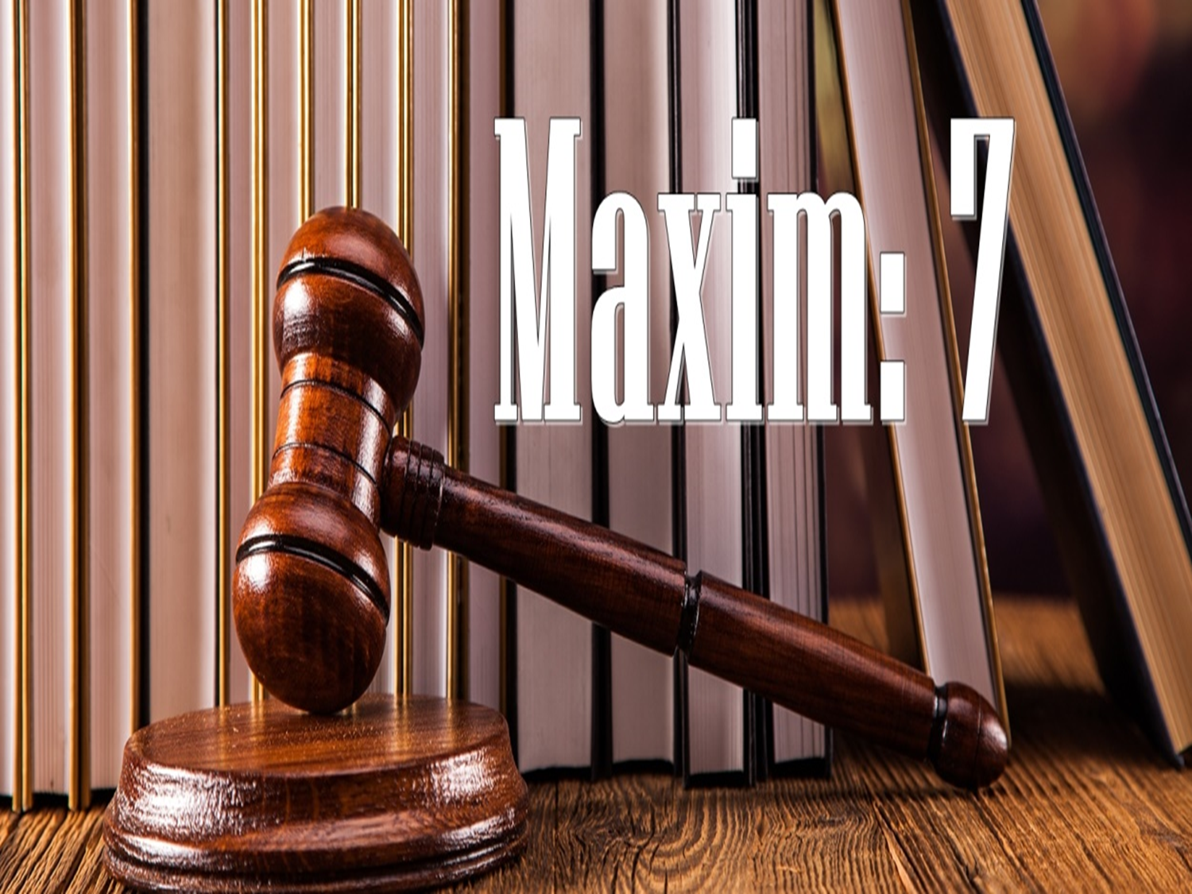

Slide 2
Equity looks on that, as done which ought to be done

Slide 3
If A makes T trustee leaving 50,000 Taka to purchase a land for the use of B. T does not purchase the land and by the time, B dies leaving all immovable property to X and all movable property to Y. Now, who should get the 50,000 Taka? Equity in such cases would definitely regard the purchase of land which ought to have been made as made. The money thus goes to X.

Slide 4
If someone undertakes an obligation for the other, equity courts look on it as done and as producing the same results as if the obligation had been actually performed.
When a person undertakes any obligation upon himself with his conscience, it becomes his legal and moral duty to fulfill the obligation.

Slide 5
From this aspect, equity looks on the conscience of the person because circumstance can be changed, parties can be dead but the conscience reflects the real intention of taking such obligation and it must be fulfilled as it is ought, not in any similar method.

Slide 6
Walsh Vs Lonsdale, (1882)
A person who enters into possession of land under a specifically enforceable agreement for lease, is regarded in any court having jurisdiction to enforce it as being in the same position as between himself and the other party to the agreement as if the lease had actually been granted to him.

Slide 7
Application
The application and working of this maxim can be well-examined from the following instance:
(i) Doctrine of conversion
(ii) Executory contracts
(iii) Doctrine of part performance

Slide 8
(i) Doctrine of conversion
When the parties have entered into a binding contract for the sale of land, the buyer becomes the “Equitable Owner” and he becomes the “Legal Owner” after the sale is completed.
The doctrine is used to make a buyer the equitable owner to the property at the time when parties signed a contract binding them to purchase the land at a later date.

Slide 9
Lachmere vs Lady Lachmere, (1735)
What ought to have been done shall be taken as done.

Slide 10
Point to be noted
If the contract is not executed or buyer becomes insolvent and both seller and buyer agree to alter the contract will reconvert the contract to same position as it was before the agreement.
Decision of parties is sufficient cause for re-conversion.

Slide 11
(ii) Executory contracts
A contract that has been fully performed by one party but not by the other party is classified as an executory contract.
It has two form:
1. Assignment of future property
2. Agreement for a transfer

Slide 12
1. Assignment of future property
A person is entitled to enter into a contract regarding any goods, services or properties which is not available in the time of entering into the contract but it will be available in a future date.
When the subject matter of the contract comes into existence, the contract becomes executed.

Slide 13
Holroyd v Marshall, (1862)
“A” transferred his machinery to “P”, who should hold it in trust for “H”. Machinery which was subject of transfer included the machinery in the mill and also the one that would be purchased and added thereto or substituted for the present one.
New machinery was added thereafter. The point of dispute was whether H could claim it, or the execution creditor of A (P) could claim it.

Slide 14
It was held that H’s claim would prevail over that of the execution creditor (P), as H obtained an equitable title as soon as the new machinery was added to the old.

Slide 15
2. Agreement for a transfer
A lease agreement did not by itself create any legal right at Common law. Unless and until the execution of deed, no legal rights lost or created between them.
But equity could not tolerate this unjust position. It therefore conferred an equitable tile upon the person having the lease agreement in his favour.

Slide 16
Walsh v Lonsdale, (1882)
It was decided that an agreement for lease could be treated as a lease in equity.

Slide 17
Conditions
In order that the doctrine may operate with full force, the following conditions must be fulfilled:
1. A contract to transfer a legal title must exist.
2. It should be capable of being proved, either by some acts of part-performance or by writing.
3. It should be capable of specific performance
4. The suit should be filed within prescribed time.
5. The title so sought to be acquired must have support at law.

Slide 18
(iii) Doctrine of part performance
Part-Performance doctrine is an equitable principle that allows a court to recognize and enforce an oral contract despite its legal deficiencies. It provides a way around the statutory bar to the enforcement of an oral contract. By applying the part performance doctrine, a party can establish the existence of a contract despite the lack of any written evidence.

Slide 19
Generally, without written evidence a contract does not satisfy the formal requirements set by legislatures under their statutes of frauds. The doctrine of part performance is an exception to this.
In case of land transaction if a party pays part of the consideration and agrees to pay rest part in a future date:
1. There is nothing to prevent the second party from claiming the balance at a future date.
2. The first party is bound equally to pay the rest amount.

Slide 20
Recognition
Many of the doctrines of English equity have taken statutory form in Bangladesh.
1. The Transfer of Property Act, 1882
(Section 40) Illustration “A contracts to sell Ulipur to B. While the contract is still in force he sells Ulipur to C, who has notice of the contract. B may enforce the contract against C to the same extent as against A.”

Slide 21
2. The Transfer of Property Act, 1882
(Section 53/A) Part performance.
3. The Specific Relief Act, 1877
(Section 12) relating to the specific performance of part of a contract also illustrates the application of the maxim.

Slide 22
4. The Trust Act, 1882
(Section 91) Where a person acquires property with notice that another person has entered into an existing contract affecting that property, of which specific performance could be enforced, the former must hold the property for the benefit of the latter to the extent necessary to give effect to the contract.

Slide 23


