Slide 1
Paradigms of Rural Development
Department of Development Studies
Daffodil International University

Slide 2
Why Do we need to study these theories?
Before we start studying rural development, we have to gather a minimum amount of knowledge on the trends and variations of the development approaches taken over time.
Theories will give us a simple view on the development techniques which can be applied in the rural areas.
Theories will help us to have a clear understanding of the mainstream development thinking.

Slide 3
The Modernization Theory
Modernization theory is also known as the “Free World model of development”.
The Modernization Theory was the justification for the US hegemony in the context of the Cold War.
The essence of the theory was the transfer of Western technology and rationality, without changing class structure as a means of development, and removal of all social and ideological obstacles to such a process.

Slide 4
Historical background to modernization theory
1 Post world war two’s deepening poverty in some countries
2 Ideological competition from communism
3 Increasing unrest in some countries
The above posed a threat to capitalism, and especially the USA
This led to the development of modernisation theory (mainly by US economists and policy makers)

Slide 5
Modernisation theorists aimed to:
explain why poorer countries failed to evolve into modern societies
Reduce the spread of communism by presenting capitalist values as the solution to poverty
Modernisation theory has become
increasingly influential, especially since post
collapse of USSR

Slide 6
The Key Assumptions of Modernization Theory
Application of Western science and technology in order to increase production is essential for achieving development.
The process of development can be delineated into a series of stages, and all societies pass through those stages.
In the process of development, traditional social and political institutions are replaced by modern ones.
Traditional feudal forms of political power will be replaced by democratic forms of governance.

Slide 8
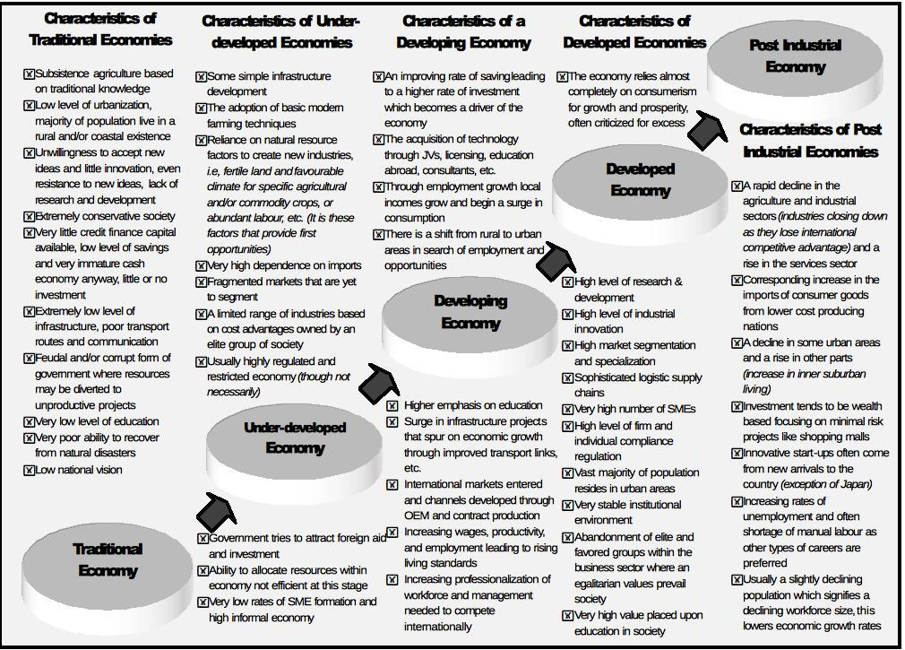

Slide 9
Rostow’s evolutionary ladder of development (economic factors)
5 The age of high Mass consumption
4 The drive to maturity: economic and cultural factors lead to increasing prosperity for all
3 Take-off: high economic growth and investment in infrastructure begins
2 Pre-conditions for take-off: the West assists development through aid and industrial investment
1 Traditional society: poverty, primary production and traditional values

Slide 10
Stage One: Traditional Society “A traditional society is one whose structure is developed within limited production functions.
Low productivity agriculture is a large % of the economy
Political power dominates economic power
Low rates of investment ( < 5% of GDP)
Inefficient property rights

Slide 11
Stage Two: Preconditions for Take Off
Conditions:
Transfer resources from agriculture to manufacturing
Shift from regional to national/international focus
Must shift away from having children
People must be rewarded not for their “connections” but their economic abilities

Slide 12
Stage Three: Take-off
Short period (20-30 years) of intensive growth
In this short period we get
increase in investment: “[I] regard as a necessary but not sufficient condition for the take-off the fact that the net investment rise from 5% to over 10%…”
development of a leading sector
emergence of new institutions
“The take-off is the interval when the old blocks and resistances to steady growth are finally overcome. The forces making for economic progress, which yielded limited bursts and enclaves of modern activity, expand and come to dominate the society. Growth becomes its normal condition.

Slide 13
Stage Four: Drive to maturity
“…for these purposes we define it as the period when a society has effectively applied the range of (then) modern technology to the bulk of its resources.”
Occurs roughly 60 years after take-off---
Increase in investment (10% to 20%)
Development of modern capitalist economy and self-sustained growth Pass to Stage Five: High Mass Consumption

Slide 14
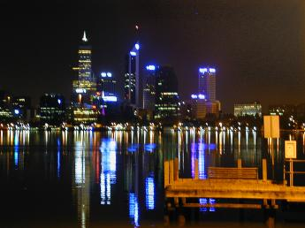
Stage Five: High Mass Consumption
5. High mass consumption
High output levels
Mass consumption of consumer durables
High proportion of employment in service sector
Service industry dominates the economy – banking, insurance, finance, marketing, entertainment, leisure and so on.

Slide 15
Modernization Theory
Modernization as economic phenomenon
Roy Harrod and Evsey Domar: Classical growth model (Martinussen, 1997)
Played a major role in the development debate and was incorporated into many planning model in the late 20th century
Total production is a result of investment in material production apparatus
Output is a function of capital input
Other conditions, including non-economic factors, could be disregarded as irrelevant or adapting with the economic growth

Slide 16
Modernization Theory (cont.)
Modernization as economic phenomenon
Capital accumulation and balanced growth (Martinussen)—capital accumulation increase supply of goods create increase demand
Paul Rosenstein: “Big push” is needed for growth
Ragnar Nurkse: “Two poverty circles”
W. Arthur Lewis: the relationship between profit and saving (capital accumulation)
W.W. Rostow: Five stage theory
Unbalanced growth and income distribution
Albert Hirschman: Imbalances are inevitable
Simon Kuznets: greater inequality as the poorest experience growth slower than the average until a certain range

Slide 17
Modernization Theory (cont.)
Modernization as non-economic process
David E. Apter: “In non-industrial society, politics becomes the mechanism of integration”
Importance of traditionality: The varied responses of tradition to modernization account for many of the differences in political forms
Joseph R. Gusfield: “Traditional” and “modern” are neither incompatible nor internally consistent terms
Not simple dichotomies but heterogeneity and interpretations to be analyzed
Ferrel Heady
Modernization for political development is to grow the political capability and interlinkage of political development with other aspects of social change with multidimensional process

Slide 18
Modernization Theory (cont.)
Modernization as non-economic process
Gunnar Myrdal: A theory of social stagnation and transformation (Martinussen)
Non-economic factors as central factors
Outputs and incomes
Conditions of production
Levels of living
Attitudes toward life and work
Institutions
Policies

Slide 19
Some characteristics of modernization
Commercialization,industrialization
Innovation
Colonialism as a modernization force
Colonialism demonstrated the role of commerce and bureaucracy in modernization
Colonialism at its best has been one very useful mechanism for modernizing
Four main stages: the pioneering, bureaucratic, representative, and responsible governmental stages.

Slide 20
Modernization, Industrialization, Development
Industrialization is that aspect of modernization so powerful in its consequences, based on the use of the machine
Modernization, as a means of identifying those social arrangements, as a means of observing how changes.
Development is a dramatic revolutionary change

Slide 21
Modernisation theory – role of the West in developing countries
Western investment in factories, expertise and equipment – use loans from World Bank (Trickle down)
Western funding to introduce meritocratic education (values of universalism, individualism and competition (Hoselitz)

Slide 22
Modernisation theory – the West and the developing countries (continued)
iii Mass media to disseminate modern ideas
iv Urbanisation to be encouraged

Slide 23
Criticism of modernisation theory
It is ethnocentric because
(a) it devalues traditional values and social institutions e.g. extended families
(b) it ignores increasing inequality within and between countries
(c) it is not a neutral theory as it suggests (it promotes western capitalist values)

Slide 24
Education in developing world mainly benefits small, local elites (those at the top)
It assumes unlimited natural resources for industrial expansion. (ignores ecological issues)
Notes:
Brain drain; why put money into school systems knowing educated wont stay in your country after graduation;

Slide 25
The Dependency Theory
The initial support for the Dependency Theory came from Latin America, particularly from the work of Raul Prebisch and his associates at the Economic Commission for Latin America (ECLA).
However, the chief spokesman for the theory was Andre Gunder Frank, who dismissed the Modernization Theory as useless from a policy perspective.

Slide 26
The Key Assumptions of Dependency Theory
1) The developed countries (the First World) could not have achieved the level of development that they have, without the systematic exploitation of the developing countries (the Third World).
2) That the process of development passes through a series of stages is an illusion. Developing countries cannot attain development following the path adopted by developed countries, so long as the exploitative world system exists.

Slide 27
The Key Assumptions of Dependency Theory
3) Countries that are now poor were not so to begin with; rather they have been forced into the stage of underdevelopment by a global system of capitalist exploitation.
4) Developing countries can develop only by snapping their links with the developed countries.

Slide 28
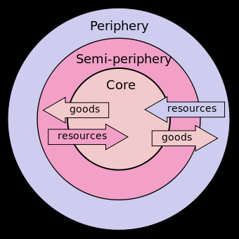
Dependency Theory
The development of the rich world was achieved by exploitation of the developing world. The diagram to the right very simply shows how resources are moving from the periphery (developing) to the core (developed).
That developing countries moved into production of cash crops (coffee, tea, cocoa) which meant that they were no longer subsistent and actually dependent on developed countries for food imports and food aid.
That the development of many countries were slowed or stopped by the arrival of colonists. He points out that many countries were richer before colonisation than after.

Slide 29
It has gained popularity because
Many poor countries owe large debts to developed countries or international banks
The world is now more globalized with many developed country TNCs operating in and possibly exploiting developing countries.
Developed countries tend to specialize in more value added industries like banking and manufacturing, widening the development gap even more. The diagram to the right shows how goods flow to the periphery. This can increase debt and hamper there own independence and technological development
Many international organizations are dominated by developed countries e.g. G20, World Bank, IMF and even the UN Security Council
Many developing countries have now become reliant on NGO help
Population growth is highest in developing countries so many are suffering from greater overpopulation and are more dependent on foreign help.

Slide 30
Escobar
Martinussen
Structuralist & Ind Dev
Andre Gunder Frank
Satellites
(Periphery)
Modern
(developed)
Valenzuela et al.
Modernization
theory
Development
Dependency
theory
World Capitalist system
Metropoles
(Center)
Traditional
(under-developed)
Gusfield
Martinussen
Growth and Modern
Isbister
Heady
Martinussen
Underdev & Dependency

Slide 31
Leibenstein’s Critical Minimum Effort Thesis
The central idea of Harvey Leibenstein’s ‘Critical Minimum Effort Thesis’ is that in order to attain sustained secular growth, it is essential that the initial stimulant to development is of a certain critical minimum size.
Leibenstein’s thesis is more realistic than Rosenstein-Rodan’s Big Push theory in the sense that the critical minimum effort can be properly timed and broken up into a series of smaller efforts to put the economy on the path of sustained development.

Slide 32
Lewis’ Model of Economic Development
W. Arthur Lewis’ model is based on the fact that in many developing countries, there exist large reservoirs of labour whose marginal productivity is negligible, zero or even negative.
This labour is available in unlimited quantities at a wage equal to the subsistence level of living, plus a margin sufficient to overcome the friction of moving from the ‘subsistence sector’ to the ‘capitalist sector’, which may be called ‘subsistence plus’ wage.

Slide 33
Lewis’ Model of Economic Development
As the supply of labour is unlimited, new industries can be set up and the existing ones can be expanded without limit, at the ruling wage rate.
The capitalist sector also needs skilled workers. But Lewis maintains that skilled labour is only a temporary bottleneck and can be removed by providing training facilities to unskilled workers.

Slide 34
Lewis’ Model of Economic Development
Since the marginal productivity of labour in the capitalist sector is higher than the ruling wage rate, there results a capitalist surplus.
This surplus is used for capital formation, which makes possible employment of more people from the subsistence sector.
The increase in investment by the capitalists raises the marginal productivity of labour, which induces capitalist employers to increase their labour force till the marginal productivity of labour falls to a level equivalent to the ruling wage rate.

Slide 35
Lewis’ Model of Economic Development
The process goes on till the capital–labour ratio rises to the point where the supply of labour becomes inelastic.
Some critics have pointed out that Lewis’ optimism concerning development by absorption of disguised unemployment from agriculture is unfounded, because it is not possible to transfer a large number of workers permanently and on a full-time basis from agriculture to industry, without a drop in the agricultural output, that is, the marginal productivity of the labour in agriculture is not zero.

Slide 36
The Gandhian Model of Rural Development: Key Arguments
1) Real India is found not in its cities, but in its villages.
2) The revival of villages is possible only when the villagers are exploited no more. Exploitation of villagers by city dwellers was ‘violence’ in Gandhiji’s opinion.
3) Simple living and high thinking, implying voluntary reduction of materialistic wants, and pursuit of moral and spiritual principles of life.

Slide 37
The Gandhian Model of Rural Development: Key Arguments
4) Dignity of labour: everyone must earn his bread by physical labour and one who labours must necessarily get his subsistence.
5) Preference to the use of indigenous (swadeshi) products, services and institutions.
6) Balance between the ends and the means: Gandhiji believed that non-violence and truth could not be sustained unless a balance between the ends and the means was maintained.

Slide 38
References
Singh, K. (2009). Rural development: principles, policies and management. SAGE Publications India.
Jha, U. M., & Jha, N. (2008). Economics of rural development. International journal of rural studies (IJRS) vol, 15.
Chambers, R. (2014). Rural development: Putting the last first. Routledge.

