Slide 1
Interpolation

Slide 2
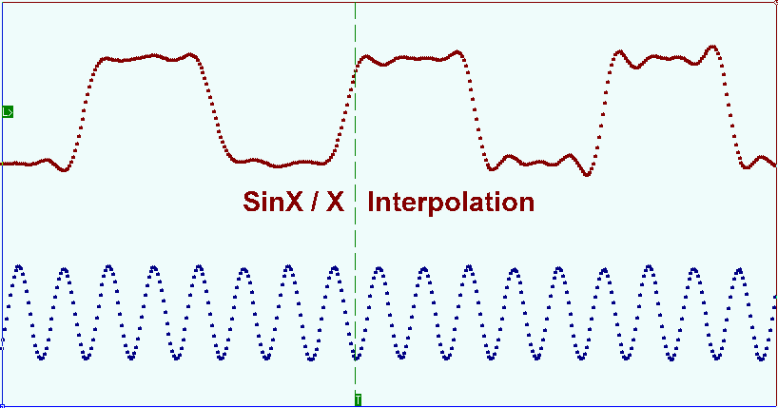
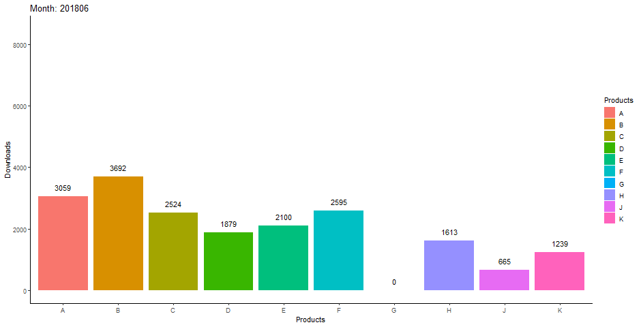
Interpolation

Slide 3
Interpolation ?
In the mathematical field of numerical analysis, interpolation is a method of constructing new data points within the range of a discrete set of known data points.
In our daily life we are sometimes confronted with the problem where we become interested in finding some unknown values with help of a given set of observations.

Slide 4
Example:
We have to find out the population of Bangladesh in 1978 when we know the population of Bangladesh in the year 1971, 1975, 1979, 1984, 1988, 1992 and so on.

Slide 5
That is :
The figure of population are available for 1971, 1975, 1979, 1984, 1988, 1992 etc., then the process of finding the population of 1978 is known as interpolation.
x | 1971 | 1975 | 1979 | 1984 | 1988 | 1992
y | 25 | 26 | 27 | 58 | 78 | 86
If $x=1978$ , then what is the population, $y$ ?

Slide 6
Types of Interpolation
Piecewise constant interpolation
Linear interpolation
Polynomial interpolation ; $Y=f(X)$
Spline interpolation

Slide 7
Mathematical Definition of Interpolation
Mathematically, let a function $y=f(x)$ be
$f\left(a\right), f\left(a+h\right), f\left(a+2h\right)…………f(a+nh)$
for $x=a, a+h, a+2h,……a+nh$ respectively.
Then the method of finding $f(x)$ for $x=α,$ where $α$ lies in the range $a$ and $a+nh$ is known as interpolation
and if the value of $x=α$ lies outside this range it is called extrapolation.

Slide 8
For example, let as suppose we are given the following data.
Then the method of finding $f(10)$ or $f(4)$ with help of the given data will be called interpolation ,
and that for $f(27)$ or $f(−2)$ will be known as extrapolation.
$$x$$ | 0 | 3 | 6 | 9 | 12 | 15
$$f(x)$$ | 1 | 2 | 7 | 12 | 17 | 22

Slide 9
Forward Difference
If $y_{0}, y_{1}, y_{2},….,y_{n}$ denote a set of values of $y$,
then $y_{1}−y_{0}, y_{2}−y_{1},…,y_{n}−y_{n−1}$ are called the differences of $y$.
Denoting the differences by $Δy_{0}, Δy_{1},…,Δy_{n−1}$ respectively,
we have, $Δy_{0}=y_{1}−y_{0},$
$Δy_{1}=y_{2}−y_{1},$
……………………….
$Δy_{n−1}=y_{n}−y_{n−1}$
Where $Δ$ is called the forward difference operator
and $Δy_{0}, Δy_{1}, … , Δy_{n−1}$ are called first forward differences.

Slide 10
Forward Difference (Remain Part)
The differences of the first forward differences are called second forward differences
and
denoted by $Δ^{2}y_{0}, Δ^{2}y_{1},…,Δ^{2}y_{n−1}$
So, $Δ^{2}y_{0}=Δy_{1}−Δy_{0},$
${ Δ}^{2}y_{1}=Δy_{2}−Δy_{1},$
………………………………
$Δ^{2}y_{n−2}=Δy_{n−1}−Δy_{n−2}$
Similarly, third, fourth, fifth etc. forward differences can be obtained.

Slide 11
Prove that ${∆^{2}y_{2}\text{=}y}_{4}−{2y}_{3}+y_{2}$
$∆^{2}y_{2}=∆y_{3}−∆y_{2}$
$=y_{4}−y_{3}−{(y}_{3}−y_{2})$
$=y_{4}−y_{3}−y_{3}+y_{2}$
$=y_{4}−{2y}_{3}+y_{2}$
$∆y_{3}$= $y_{4}−y_{3}$
$∆y_{2}$= $y_{3}−y_{2}$
Try yourself: Prove that ${∆^{3}y_{3}\text{=}y}_{6}−{3y}_{5}+{3y}_{4}−y_{3}$

Slide 12
Forward Difference Table
$$x$$ | $$y$$ | $$Δ$$ | $$Δ^{2}$$ | $$Δ^{3}$$ | $$Δ^{4}$$ | $$Δ^{5}$$ | $$Δ^{6}$$
$$x_{0}$$ | $$y_{0}$$
$$x_{1}$$ | $$y_{1}$$
$$x_{2}$$ | $$y_{2}$$
$$x_{3}$$ | $$y_{3}$$
$$x_{4}$$ | $$y_{4}$$
$$x_{5}$$ | $$y_{5}$$
$$x_{6}$$ | $$y_{6}$$
$$y_{0}$$
$Δy_{0}$= $y_{1}−y_{0}$
$Δy_{0}$= $y_{1}−y_{0}$
$$y_{1}$$
$Δ^{2}y_{0}$= $Δy_{1} −Δy_{0}$
$$y_{1}$$
$Δ^{2}y_{0}$= $Δy_{1} −Δy_{0}$
$Δy_{1}$= $y_{2}−y_{1}$
$Δy_{1}$= $y_{2}−y_{1}$
$Δy_{1}$= $y_{2}−y_{1}$
$Δ^{3}y_{0}$=$Δ^{2}y_{1}−Δ^{2}y_{0}$
$Δ^{3}y_{0}$=$Δ^{2}y_{1}−Δ^{2}y_{0}$
$Δ^{2}y_{1}$= $Δy_{2} −Δy_{1}$
$Δ^{2}y_{1}$= $Δy_{2} −Δy_{1}$
$$y_{2}$$
$Δ^{2}y_{1}$= $Δy_{2} −Δy_{1}$
$$y_{2}$$
$Δ^{4}y_{0}$=$Δ^{3}y_{1}−Δ^{3}y_{0}$
$Δ^{4}y_{0}$=$Δ^{3}y_{1}−Δ^{3}y_{0}$
$Δ^{3}y_{1}$=$Δ^{2}y_{2}−Δ^{2}y_{1}$
$Δ^{3}y_{1}$=$Δ^{2}y_{2}−Δ^{2}y_{1}$
$Δ^{3}y_{1}$=$Δ^{2}y_{2}−Δ^{2}y_{1}$
$Δ^{5}y_{0}$=$Δ^{4}y_{1}−Δ^{4}y_{0}$
$Δy_{2}$= $y_{3}−y_{2}$
$Δ^{5}y_{0}$=$Δ^{4}y_{1}−Δ^{4}y_{0}$
$Δy_{2}$= $y_{3}−y_{2}$
$Δy_{2}$= $y_{3}−y_{2}$
$$y_{3}$$
$Δ^{2}y_{2}$= $Δy_{3} −Δy_{2}$
$Δ^{4}y_{1}$=$Δ^{3}y_{2}−Δ^{3}y_{1}$
$Δ^{4}y_{1}$=$Δ^{3}y_{2}−Δ^{3}y_{1}$
$Δ^{2}y_{2}$= $Δy_{3} −Δy_{2}$
$Δ^{4}y_{1}$=$Δ^{3}y_{2}−Δ^{3}y_{1}$
$Δ^{6}y_{0}$=$Δ^{5}y_{1}−Δ^{5}y_{0}$
$$y_{3}$$
$Δ^{2}y_{2}$= $Δy_{3} −Δy_{2}$
$Δy_{3}$= $y_{4}−y_{3}$
$Δy_{3}$= $y_{4}−y_{3}$
$Δy_{3}$= $y_{4}−y_{3}$
$Δ^{3}y_{2}$=$Δ^{2}y_{3}−Δ^{2}y_{2}$
$Δ^{3}y_{2}$=$Δ^{2}y_{3}−Δ^{2}y_{2}$
$Δ^{3}y_{2}$=$Δ^{2}y_{3}−Δ^{2}y_{2}$
$Δ^{5}y_{1}$=$Δ^{4}y_{2}−Δ^{4}y_{1}$
$Δ^{5}y_{1}$=$Δ^{4}y_{2}−Δ^{4}y_{1}$
$$y_{4}$$
$Δ^{4}y_{2}$=$Δ^{3}y_{3}−Δ^{3}y_{2}$
$$y_{4}$$
$Δ^{2}y_{3}$= $Δy_{4} −Δy_{3}$
$Δ^{4}y_{2}$=$Δ^{3}y_{3}−Δ^{3}y_{2}$
$Δ^{2}y_{3}$= $Δy_{4} −Δy_{3}$
$Δ^{2}y_{3}$= $Δy_{4} −Δy_{3}$
$Δ^{3}y_{3}$=$Δ^{2}y_{4}−Δ^{2}y_{3}$
$Δy_{4}$= $y_{5}−y_{4}$
$Δ^{3}y_{3}$=$Δ^{2}y_{4}−Δ^{2}y_{3}$
$Δy_{4}$= $y_{5}−y_{4}$
$Δy_{4}$= $y_{5}−y_{4}$
$$y_{5}$$
$Δ^{2}y_{4}$= $Δy_{5} −Δy_{4}$
$$y_{5}$$
$Δ^{2}y_{4}$= $Δy_{5} −Δy_{4}$
$Δy_{5}$= $y_{6}−y_{5}$
$Δy_{5}$= $y_{6}−y_{5}$
$$y_{6}$$

Slide 13
Example : Forward Difference Table
Example: Find the Forward Difference table by the following data is: x : 20 23 26 29 y : 0.342 0.3907 0.4384 0.4848
$$x$$ | $$y$$ | $$Δ$$ | $$Δ^{2}$$ | $$Δ^{3}$$
$$x_{0}=20$$ | $$y_{0}=0.342$$
$$x_{1}=23$$ | $$y_{1}=0.3907$$
$$x_{2}=26$$ | $$y_{2}=0.4384$$
$$x_{3}=29$$ | $$y_{3}=0.4848$$
$Δy_{0}$= $y_{1}−y_{0}$
$$y_{0}=0.342$$
$Δy_{1}$= $y_{2}−y_{1}$
$$Δy_{0}=0.0487$$
$$Δy_{0}=0.0487$$
$$Δ^{2}y_{0}=−0.0010$$
$Δy_{2}$= $y_{3}−y_{2}$
$$y_{1}=0.3907$$
$$Δ^{2}y_{0}=−0.0010$$
$$y_{1}=0.3907$$
$$Δy_{1}=0.0477$$
$$Δy_{1}=0.0477$$
$$Δy_{1}=0.0477$$
$$Δ^{3}y_{0}=−0.0003$$
$Δ^{2}y_{0}$= $Δy_{1} −Δy_{0}$
$$y_{2}=0.4384$$
$$y_{2}=0.4384$$
$$Δ^{2}y_{1}=−0.0013$$
$$Δ^{2}y_{1}=−0.0013$$
$Δ^{2}y_{1}$= $Δy_{2} −Δy_{1}$
$$Δy_{2}=0.0464$$
$$Δy_{2}=0.0464$$
$$y_{3}=0.4848$$
$Δ^{3}y_{0}$=$Δ^{2}y_{1}−Δ^{2}y_{0}$

Slide 14
Types of Interpolation (According to Method)
If the difference of value of x is Unequal or Equal.
Interpolation
If the difference of value of x is equal
Newton’s Interpolation Formula
Lagrange’s Interpolation Formula
Newton’s Forward Interpolation Formula
Newton’s Backward Interpolation Formula

Slide 15
Newton’s Interpolation Formula
Newton’s Forward Interpolation Formula
Newton’s Backward Interpolation Formula
Find the value of y at $x=21$ from the following data:
Find the value of y at $x=28$ from the following data:
x | 20 | 23 | 26 | 29
y | 0.342 | 0.3907 | 0.4384 | 0.4848
x | 20 | 23 | 26 | 29
y | 0.342 | 0.3907 | 0.4384 | 0.4848

Slide 16
If the given data is,
Then the Newton’s forward interpolation formula will be,
$y\left(x\right)=y_{0}+u Δy_{0}+\frac{u\left(u−1\right)}{2!}Δ^{2}y_{0}+\frac{u\left(u−1\right)(u−2)}{3!}Δ^{3}y_{0}+…+\frac{u\left(u−1\right)\left(u−2\right)…(u−n+1)}{n!}Δ^{n}y_{0}$
where, $u=\frac{x −{ x}_{0}}{h}$; $h$ is the difference of $x$ values in the chart.
$$x$$ | $$x_{0}$$ | $$x_{1}$$ | $$x_{2}$$ | … | $$x_{n}$$
$$y$$ | $$y_{0}$$ | $$y_{1}$$ | $$y_{2}$$ | … | $$y_{n}$$
$$∆^{0} y_{0}$$
$${u ∆}^{1} y_{0}$$
$$\frac{u\left(u−1\right)}{2!}Δ^{2}y_{0}$$
And so on.

Slide 17
Problem 1. Find the value of y at x=21 from the following data: x : 20 23 26 29 y : 0.342 0.3907 0.4384 0.4848
Solution: We construct the difference table for the given data is as follows:
$$x$$ | $$y$$ | $$Δ$$ | $$Δ^{2}$$ | $$Δ^{3}$$
$$x_{0}=20$$ | $$y_{0}=0.342$$
$$x_{1}=23$$ | $$y_{1}=0.3907$$
$$x_{2}=26$$ | $$y_{2}=0.4384$$
$$x_{3}=29$$ | $$y_{3}=0.4848$$
$Δy_{0}$= $y_{1}−y_{0}$
$$y_{0}=0.342$$
$Δy_{1}$= $y_{2}−y_{1}$
$$Δy_{0}=0.0487$$
$$Δy_{0}=0.0487$$
$$Δ^{2}y_{0}=−0.0010$$
$Δy_{2}$= $y_{3}−y_{2}$
$$y_{1}=0.3907$$
$$Δ^{2}y_{0}=−0.0010$$
$$y_{1}=0.3907$$
$$Δy_{1}=0.0477$$
$$Δy_{1}=0.0477$$
$$Δy_{1}=0.0477$$
$$Δ^{3}y_{0}=−0.0003$$
$Δ^{2}y_{0}$= $Δy_{1} −Δy_{0}$
$$y_{2}=0.4384$$
$$y_{2}=0.4384$$
$$Δ^{2}y_{1}=−0.0013$$
$$Δ^{2}y_{1}=−0.0013$$
$Δ^{2}y_{1}$= $Δy_{2} −Δy_{1}$
$$Δy_{2}=0.0464$$
$$Δy_{2}=0.0464$$
$$y_{3}=0.4848$$
$Δ^{3}y_{0}$=$Δ^{2}y_{1}−Δ^{2}y_{0}$

Slide 18
Problem 1. Find the value of y at x=21 from the following data: x : 20 23 26 29 y : 0.342 0.3907 0.4384 0.4848
We have to find $y(21)$.
Here $u=\frac{x−x_{0}}{h}$ Since $x=21 , x_{0}= 20, h =3$
$=\frac{21−20}{3}=0.333$
$h$ is the difference of $x$ values in the chart. Here 23-20 =3 ; 26-23 = 3 , 29-26 = 3

Slide 19
Since x=21 is nearer to the beginning of the table, so we use Newton’s forward formula.
$$y\left(x\right)=y_{0}+u Δy_{0}+\frac{u\left(u−1\right)}{2!}Δ^{2}y_{0}+\frac{u\left(u−1\right)(u−2)}{3!}Δ^{3}y_{0}$$
$$x$$ | $$y$$ | $$Δ$$ | $$Δ^{2}$$ | $$Δ^{3}$$
$$x_{0}=20$$ | $$y_{0}=0.342$$
$$x_{1}=23$$ | $$y_{1}=0.3907$$
$$x_{2}=26$$ | $$y_{2}=0.4384$$
$$x_{3}=29$$ | $$y_{3}=0.4848$$
$$y_{0}=0.342$$
$$Δy_{0}=0.0487$$
$$Δy_{0}=0.0487$$
$$Δ^{2}y_{0}=−0.0010$$
$$y_{1}=0.3907$$
$$Δ^{2}y_{0}=−0.0010$$
$$y_{1}=0.3907$$
$$Δy_{1}=0.0477$$
$$Δy_{1}=0.0477$$
$$Δy_{1}=0.0477$$
$$Δ^{3}y_{0}=−0.0003$$
$$y_{2}=0.4384$$
$$y_{2}=0.4384$$
$$Δ^{2}y_{1}=−0.0013$$
$$Δ^{2}y_{1}=−0.0013$$
$$Δy_{2}=0.0464$$
$$Δy_{2}=0.0464$$
$$y_{3}=0.4848$$
$$y\left(21\right)=0.342+0.333×0.0487+\frac{0.333 \left(0.333−1\right)}{2!}(−0.0010)+\frac{0.333 \left(0.333−1\right)\left( 0.333−2\right)}{3!}(−0.0003)$$
$$∴y(21)=0.3583$$

Slide 20
Problem 2. A second-degree polynomial passes through (0,1), (1,3), (2,7), and (3,13). Find the polynomial.
Solution: We construct the difference table for the given data is as follows:
$$x$$ | $$y$$ | $$Δ$$ | $$Δ^{2}$$ | $$Δ^{3}$$
$$x_{0}=0$$ | $$y_{0}=1$$
$$x_{1}=1$$ | $$y_{1}=3$$
$$x_{2}=2$$ | $$y_{2}=7$$
$$x_{3}=3$$ | $$y_{3}=13$$
$Δy_{0}$= $y_{1}−y_{0}$
$$y_{0}=1$$
$Δy_{1}$= $y_{2}−y_{1}$
$$Δy_{0}=2$$
$$Δy_{0}=2$$
$$Δ^{2}y_{0}=2$$
$Δy_{2}$= $y_{3}−y_{2}$
$$y_{1}=3$$
$$Δ^{2}y_{0}=2$$
$$y_{1}=3$$
$$Δy_{1}=4$$
$$Δ^{3}y_{0}=0$$
$$Δy_{1}=4$$
$$Δy_{1}=4$$
$Δ^{2}y_{0}$= $Δy_{1} −Δy_{0}$
$$y_{2}=7$$
$$y_{2}=7$$
$$Δ^{2}y_{1}=2$$
$$Δ^{2}y_{1}=2$$
$Δ^{2}y_{1}$= $Δy_{2} −Δy_{1}$
$$Δy_{2}=6$$
$$Δy_{2}=6$$
$$y_{3}=13$$
$Δ^{3}y_{0}$=$Δ^{2}y_{1}−Δ^{2}y_{0}$

Slide 21
By Newton’s forward interpolation formula, we get
$$f(x)=y_{0}+u Δy_{0}+\frac{u\left(u−1\right)}{2!}Δ^{2}y_{0}+\frac{u\left(u−1\right)(u−2)}{3!}Δ^{3}y_{0}$$
where$,u=\frac{x −{ x}_{0}}{h}$
In this problem, $u=\frac{x−0}{1}=x$
Therefore, f$\left(x\right)=y_{0}+u Δy_{0}+\frac{u\left(u−1\right)}{2!}Δ^{2}y_{0}$
$$⇒f\left(x\right)=1+x×2+\frac{x\left(x−1\right)}{2}.2$$
$⇒f\left(x\right)=x^{2}+x+1$,
which is the required polynomial.
$$x_{0}\text{= }\text{0}$$
h$\text{= }\text{1}$
$$y_{0}\text{= }\text{1}$$
$$Δy_{0}\text{= 2}$$
$$Δ^{2}y_{0}\text{= 2}$$
$$Δ^{3}y_{0}\text{= }\text{0}$$

Slide 22
Practice Work

