Slide 1
Raw Material of Textiles: Fibers

Slide 2
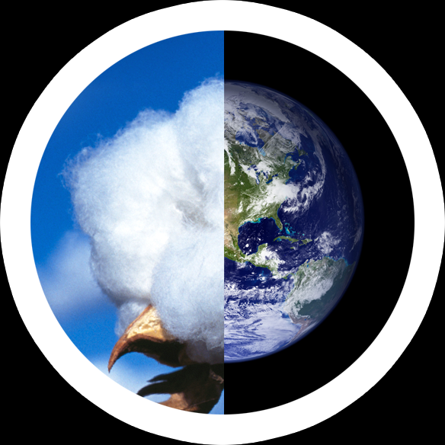
Cotton
Cotton is
soft, fluffy staple fiber
Grows in a ball
Almost pure cellulose
Production
Near about 25 million tons or 110 million bales annually
Consume 2.5% of the world's arable(agricultural) land

Slide 3
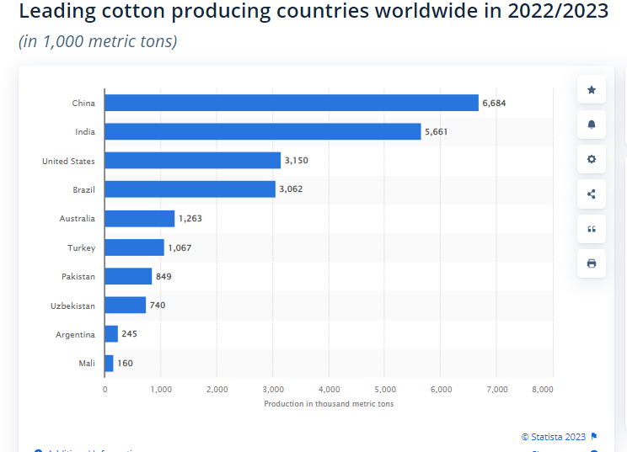
Leading cotton producing countries worldwide

Slide 4
Leading Cotton Exporting Countries

Slide 5
Leading Cotton Importing Countries

Slide 6
Cotton import of Bangladesh
According to the US Department of Agriculture (USDA) Bangladesh’s cotton import to drop to 8 million bales in the marketing year 2022-23 which began in August. This is in line with the country’s plan to increase cotton production five folds by 2030.
According to the USDA's data, till October 2022, Bangladesh imported 7.1 million bales raw cotton, which is downed by 5% year-on-year compared to October 2021.

Slide 7
Cotton importing Destination in 2022/23

Slide 8
Cotton production in Bangladesh
Bangladesh domestically produce only 2 lakh bale that meet 2-3% of the demand. Thus, meets its textile industries cotton demand through import – and Bangladesh is the largest cotton importer in 2022-’23.
The country produced 1.65 lakh bales of cotton 2017/2018 fiscal year, which is less than 3 percent of the annual demand for 10 million bales.
In 2016/2017, Cotton is grown in around 42 thousand hectares of land with a yearly production of nearly 1.5 lakh bales which is only 3 percent of the total quantity demanded by the textile and garments industries of Bangladesh.
In MY 2018/19 cotton imports are forecast up to 7.9 million bales on expectations of increased export market demand for value-added products. Gradual development of the upstream supply chain, including spinning, dyeing, finishing, weaving and printing creates more demand for cotton to meet required needs of the RMG industry.
In order to bump up local production, state-run Cotton Development Board is looking for new farming lands in hilly and swamp areas in various districts along with the existing farming areas in Jashore, Rangpur, Dinajpur, Rajshahi, Gazipur and Mymensingh.

Slide 9
Price of Cotton
The price of cotton is counted in U.S. Dollars per pound. The current price of cotton as of November 19, 2023 was $0.79 per pound and as of March 24, 2021 is $ 84.62 per pound
Historically, Cotton reached an all time high in March of 2011 and a record low in December of 1930.
Cotton is sold in bale,
Cotton bale weighs
396.6 pounds (180 kilograms) in Brazil,
730 pounds (331.1 kilograms) in Egypt and the UK,
392 pounds (177.8 kilograms) in Bangladesh, India, and Pakistan, and
480 pounds (217.7 kilograms) in the US.

Slide 10
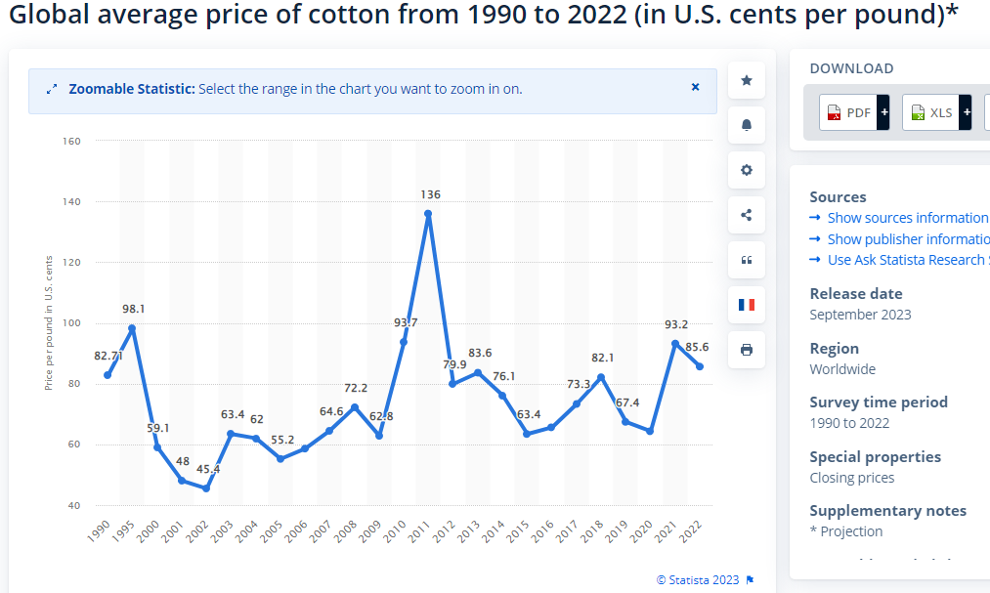
Price of Cotton

Slide 11
Yarn Price

Slide 12
Polyester Top 10 polyester Exporters country
RANK | COUNTRY | EXPORTS(BILLION $)
1 | China | 2,210
2 | United States | 1,575
3 | Germany | 1,493
4 | United Kingdom | 813.2
5 | Japan | 697
6 | France | 578.6
7 | Netherlands | 576.9
8 | Korea, South | 557.3
9 | Russia | 515
10 | Italy | 474

Slide 13
Uses of Polyester fibre:
Use of Polyester in Garments:
Polyester is used in the manufacturing of all kinds of clothes and home furnishings like bedspreads, sheets, pillows, furniture, carpets and even curtains.
Industrial Uses of Polyester:
Polyester fibre and filament:
Polyester Staple Fiber(PSF): As textile fiber, Total Production was 17.9 million tons in 2018
Polyester Filament Yarn (PFY): As textile Yarn, Total Production was 37.5 million tons in 2018
PET: The most common use of polyester today is to make the plastic bottles that store our much beloved beverages. These shatterproof and cheap bottles are an absolute boon to the beverages industry.
Mylar: An unusual and little known use of polyester is in the manufacturing of balloons which are really pretty decorated ones that are gifted on special occasions. These are made of Mylar – a kind of polyester film manufactured by DuPont. The balloons are made of a composite of Mylar and aluminum foil.
Miscellaneous: Polyester is also used to manufacture high strength ropes, thread, hoses, sails, power belting and much more in industries.

Slide 14
Wool Top Exporting Countries
Country | Export value | Percent of total export
Australia | $1.94 B | 67%
New Zealand | $226 M | 7.8%
South Africa | $248 M | 8.6%
Uruguay | 64.4M | 2.2%
United Kindom | 54.4M | 1.9%
Argentina | 49.7M | 1.7%
Germany | 46.8M | 1.6%
Spain | 34.4M | 1.2%
Brazil | 30.6M | 1.1%
Peru | 21.8M | 0.75 %

Slide 15
Top Wool fibre importing countries
Country | Imprt value | Percent of total import
China | 2.13B | 72%
India | 242M | 8.2%
Czech Republic | 180M | 6.15%
Italy | 149M | 5%
Uruguay | 50.6M | 1.7%
Egypt | 40.6M | 1.4%
United kindom | 21.5M | 0.73%
Turkey | 19.2M | 0.65%
Germany | 12M | 0.41%
United states | 8.4M | 0.289%

Slide 16
Price comparison (US cents/lb)
Cotton | Polyester | Wool | Viscose | Nylon
75-85 | 65-75 | 600 | 100-110 | 160-170

