Slide 1
Chapter :1 (Lesson-1)
Globalization

Slide 2
Learning objectives
After reading this chapter, students will be able to-
1. Understand what is meant by the term globalization. 2. Recognize the main drivers of globalization.

Slide 3
Lesson Contents
What is globalization?
Factors in increased globalization
What is international business?
Why firms go international?
Basic concepts of international business
Reasons for international business
Barriers to international trade

Slide 4
What is Globalization?
The broadening set of interdependent relationships among people from different parts of a world that happens to be divided into nations.
It refers to the integration of world economies through the reduction of barriers to the movement of trade, capital, technology and people.

Slide 5
What is Globalization?
Globalization has two main components:
Historically distinct and separate national markets are merging and creating the “global market”
Falling trade barriers make it easier to sell globally
Consumers’ tastes and preferences are converging on some global norm
Firms promote the trend by offering the same basic products worldwide

Slide 6
What is Globalization?
Globalization has two main components:
Firms source goods and services from locations around the globe to capitalize on national differences in the cost and quality of factors of production like land, labor, energy, and capital
Companies can
lower their overall cost structure
improve the quality or functionality of their product offering

Slide 7
Factors in increased Globalization
Increase and expansion of technology
Liberalization of cross border trade and resource movement
Development of services that support international business
Growing consumer pressures
Increased global competition
Changing political situations
Expanded cross national cooperation

Slide 8
What is International Business?
All commercial transactions—including sales, investments, and transportation—that take place between two or more countries.
John D Daniels and Lee H Radebaugh in their book, ‘International Business’, define international business as, all commercial transactions- private and governmental between two or more countries. Private companies undertake such transactions for profit; governments may or may not do the same in their transactions. These transactions include sales, investments and transportation’.

Slide 9
Why Firms Go International?
Several factors underlie the growth of international business. These could be put as: Facilitators, Drivers, Attractions and Compulsions.
Facilitators, Drivers, Attractions and Compulsions of International Business
Facilitators | Drivers | Attractions | Compulsions
Factor mobility Economic reforms Opening up of command economics The Bretton Woods system / WTO regime Developments in communication and transportation technology spheres. | Innate growth impetus or urge of the MNCS Constant search for growth Management culture of MNCs | Access to the raw materials Sales growth Low cost production Enhanced profitability | limitations of domestic market Risk-minimizing by diversification

Slide 10
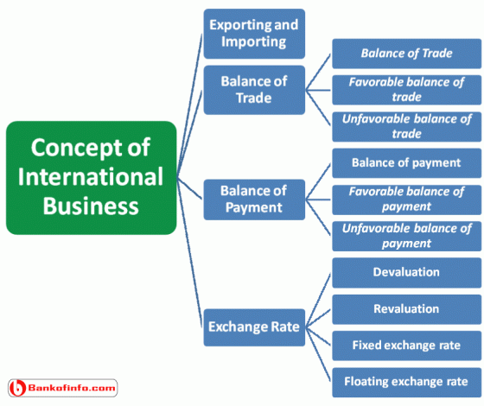
Basic Concepts of International Business

Slide 11
Basic Concepts of International Business
Exporting and Importing: Exporting is concerned with the selling of domestic goods in another country. Importing is concerned with purchasing goods made in another country.
Balance of Trade: The Balance of trade represents the difference between the visible export and import. It may be shown in the following way.
Balance of Trade = Visible export-Visible import.
Favorable balance of trade: Favorable balance of trade indicates that a country’s export is higher that its import.
Unfavorable balance of trade: When a country’s imports are higher than its exports, then it is called unfavorable balance of trade.

Slide 12
Basic Concepts of International Business
Balance of Payment: A Balance of payment represents the difference between visible plus invisible export and visible plus invisible import. It may be shown in the following equation.
Balance of payment = (Visible export + invisible export)-(Visible import +invisible import)
Favorable balance of payment: If more money is flowing in the country than flowing out of the country.
Unfavorable balance of payment: An unfavorable balance of payment exists when more money is flowing out of the country than flowing in.

Slide 13
Basic Concepts of International Business
Exchange Rate: It is the rate at which one country can exchange its currency with other country’s currency. Exchange rate is of four types:
Devaluation: Reducing the value of nation’s currency in relation to currencies of other nations.
Revaluation: Revaluation increased the value of a country’s currency in relation to that of the other countries.
Fixed exchange rate: It is an unvarying exchange rate, which is set by the government.
Floating exchange rate: An exchange rate that fluctuates with market conditions.

Slide 14
Reasons for International Business
No nation in the world can produce all of the products that its people need and want.
Some nations have an abundance of natural resources and lack of technological know-how, like Saudi Arabia and some there countries have sufficient technology but few natural resources, like Japan.
If a country becomes self-sufficient then other nations would like to trade with that country in order to meet their people’s want.
Two (2) main reasons for international business are:
Absolute advantage
Comparative advantage

Slide 15
Barriers to International Trade
Cultural and social barriers
Political barriers
Tariffs and trade restrictions
Tariffs
Quotas
Embargoes
Boycotts
Standards
Anti dumping Penalties
Monetary Barriers
Blocked currency
Differential exchange rate
Government approval for securing foreign exchange

Slide 16
Thank you for you nice cooperation
Any Question?????

