Slide 1
Chapter :1 (Lesson-2)
Globalization

Slide 2
Learning objectives
After reading this lesson, students will be able to-
1. Describe the changing nature of the global economy. 2. Explain the main arguments in the debate overs the impact of globalization.

Slide 3
Lesson Contents
Forms of international business.
Advantages of international business.
Disadvantages of international business.
The emergences of global institutions.
Drivers of globalization.
Declining trade and investment barriers.
The role of technological changes.

Slide 4
Forms of International Business
Forms of International Business
Exporting
Licensing
Franchising
Joint Venture
Management Contracts
Turnkey Projects
Strategic International Alliances
Direct Foreign Investment

Slide 5
Advantages of International Business
Earning valuable foreign currency
Division of labor
Optimum utilization of available resources
Increase in the standard of living of people
Benefits to consumers
Encouragement to industrialization
International peace and harmony

Slide 6
Advantages of International Business
Cultural development
Economies of large-scale production
Stability in prices of product
Widening the market for products
Advantageous in emergencies
Creating employment opportunities
Increase in Government revenue

Slide 7
Disadvantages of International Business
Adverse effects on economy
Competition with developed countries
Rivalry among nations
Colonization
Exploitation
Legal problems
Publicity of undesirable fashions
Language problems
Dumping policy
Complicated technical procedure
Shortage of goods in the exporting country
Adverse effects on home industry

Slide 8
The Emergence of Global Institutions
Global institutions
manage, regulate, and police the global market place
promote the establishment of multinational treaties to govern the global business system
the World Trade Organization (WTO) - polices world trading system and ensures nations adhere to the rules established in WTO treaties
In 2010, its 154 members accounted for 97% of world trade
the International Monetary Fund (IMF) - maintains order in the international monetary system
Notes:
As more business activities takes place across national borders, several global institutions have emerged to manage, regulate, and police the global marketplace, and to promote the establishment of multinational treaties to govern the global business system. We’ll talk more about these institutions in later chapters, but for now, let’s take a quick look at some of them.
One of the most important global institutions is the World Trade Organization, or WTO, which is responsible for policing the world trading system, and making sure that members adhere to trade treaties. The 154 nations that account for about 97 percent of the world’s trade are all WTO members, so the organization is very influential in working toward an open business system where goods can cross national borders without barriers to trade and investment.
The International Monetary Fund, or IMF, is responsible for maintaining order in the international monetary system, and as we’ll see in later chapters, is a significant player in the global economy.

Slide 9
The Emergence of Global Institutions
the World Bank - promotes economic development
the United Nations (UN) - maintains international peace and security, develops friendly relations among nations, cooperates in solving international problems and promotes respect for human rights, and is a center for harmonizing the actions of nations.
Notes:
The World Bank promotes economic development by making loans to cash-strapped nations wishing to make significant infrastructure improvements like building dams or roads.
Finally, the United Nations, or UN, is committed to preserving peace through international cooperation and collective security. Nearly every country in the world belongs to the UN, and accepts its basic principles of international relations.

Slide 10
Drivers of Globalization
Question: What is driving the move toward greater globalization?
Answer:
declining trade and investment barriers
technological change
Notes:
You might be wondering what prompted the move toward globalization. Two macro factors are important: first, the decline in trade and investment barriers that has taken place since World War II, and second, technological change, specifically dramatic improvements in communication, information processing, and transportation technologies. Let’s talk about each of these.

Slide 11
Declining Trade and Investment Barriers
International trade occurs when a firm exports goods or services to consumers in another country
Foreign direct investment (FDI) occurs when a firm invests resources in business activities outside its home country
During the 1920s and 1930s, many nations erected barriers to international trade and FDI to protect domestic industries from foreign competition.
After WWII, advanced Western countries began removing trade and investment barriers
Notes:
It wasn’t always so easy to trade with other countries. During the 1920s and 1930s, many countries erected barriers to the free flow of goods across borders, and also limited the ability of firms to invest. When a firm invests resources in business activities outside its home country, we say foreign direct investment or FDI has taken place.

Slide 12
Declining Trade and Investment Barriers
Under GATT (the forerunner of the WTO), over 159 nations negotiated further decreases in tariffs and made significant progress on a number of non-tariff issues
Under the WTO, a mechanism now exists for dispute resolution and the enforcement of trade laws, and there is a push to cut tariffs on industrial goods, services, and agricultural products
Lower trade barriers help companies view the world as a single market and establish production activities in optimal locations around the globe
This has led to an acceleration in the volume of world trade and investment since the early 1980s
Notes:
At the end of World War II, nations, learning from mistakes made in the 1920s and 1930s, worked toward removing barriers that prevented the free flow of goods, services, and capital between countries. The process was formalized using the General Agreement on Tariffs and Trade, or GATT.
The GATT was replaced by the WTO which, like the GATT, provides a forum for dispute resolution and the enforcement of trade laws, and has set new goals for further reducing trade barriers on industrial goods, services, and agricultural products.

Slide 13
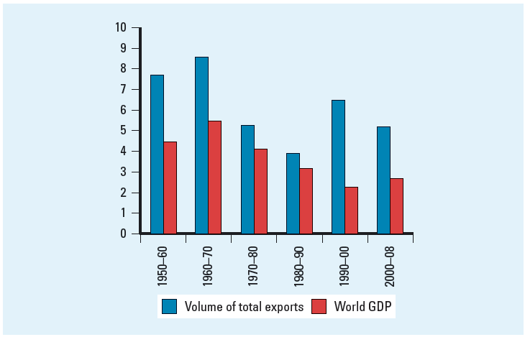
Declining Trade and Investment Barriers
Figure1.1: Growth in World Merchandise Trade and Production,
1950 - 2008
Notes:
As you can see, world trade and production was very limited in the early 1950s, but thanks to the GATT and its role in promoting a reduction in trade barriers, the volume of world trade and world production has increased dramatically, especially since the 1980s.
Because trade barriers are lower, firms like Boeing and Nike are now able to view the world, rather than a single country, as their market, and as a result, the world as a whole is significantly wealthier. Production and sales now take place in multiple markets creating interdependency between countries for goods and services.

Slide 14
The Role of Technological Change
Since World War II, there have been major advances in communication, information processing, and transportation
The microprocessor - lowered the cost of global communication and the cost of coordinating and controlling a global organization
U.S. web-based transactions - $133 billion in 2008
1.6 billion Internet users in 2009
Commercial jet aircraft and super freighters and the introduction of containerization - simplify trans-shipment from one mode of transport to another
Notes:
The role of technological change has also been critical to the globalization of markets. Major advances in communication, information processing, and transportation technology have made what had been possibilities into tangible realities!
The cost of global communication has fallen because advances in telecommunications and information processing help firms coordinate and control global organizations at a fraction of what it might have cost even a decade ago. The microprocessor that facilitates high-power, low-cost computing is perhaps the most important of these developments.
The Internet has made it possible for even small companies to play a role in the global economy. Yet, less than twenty years ago, this technology didn’t even exist. Growth in Internet usage has gone from fewer than 1 million users in 1990 to more than 1.6 billion users in 2009—a quarter of the world’s population!
Improvements in transportation such as containerization and the development of super freighters have also facilitated the growth of globalization. The time it takes people and products to get from one place to another has shrunk, as has the cost.

Slide 15
The Role of Technological Change
Question: What are the implications of technological change for the globalization of production?
Answer: Lower transportation costs make a geographically dispersed production system more economical and allow firms to better respond to international customer demands.
Notes:
What does all of this mean? These technological innovations have facilitated the globalization of production. Dell for example, takes advantage of these innovations to control its globally dispersed production system. When a customer submits an order via the company’s web site, it’s immediately transmitted to the suppliers of the various components, wherever they are located in the world. Suppliers have real time access to Dell’s order flows, and can then adjust their production accordingly. Dell uses inexpensive airfreight to transport its products to meet demand as needed. The company maintains a customer service operation in India where English speaking personnel handle calls from the U.S.

Slide 16
The Role of Technological Change
Question: What are the implications of technological change for the globalization of markets?
Answer:
Low cost communications networks help create electronic global marketplaces
Low cost transportation enable firms to create global markets, and facilitate the movement of people from country to country promoting a convergence of consumer tastes and preferences
Notes:
The globalization of markets has also been facilitated by these technological innovations which have helped create global, electronic marketplaces. Ecuador for example, has become a global supplier of roses thanks to falling transportation costs that make it possible to ship flowers while they’re still fresh. Similarly, television networks like MTV and CNN are received in many countries and are contributing to the development of a sort of global culture that transcends national borders.

Slide 17
Thank you for you nice cooperation
Any Question?????

