Slide 1

Chapter :1 (Lesson-3)
Globalization

Slide 2
Learning objectives
After reading this lesson, students will be able to-
1. Understand how the process of globalization is creating opportunities and challenges for management practices.

Slide 3
Lesson Contents
Changing demographics of the global economy.
Changing foreign direct investment picture.
Changing multinational enterprises.
The Changing world order.
The globalization debate.
Ant globalization protests.
Globalization, jobs and income.
Globalization and national sovereignty
Globalization, Labor Policies, and the Environment
Globalization and world’s poor

Slide 4
Changing Demographics of the Global Economy
In the 1960s:
the U.S. dominated the world economy and world trade and world FDI
U.S. multinationals dominated the international business scene
about half the world-- the centrally planned economies of the communist world-- was off limits to Western international business
Today, much of this has changed.
Notes:
Let’s move on to look at how the demographics of the global economy have changed over the last 50 years.
In the 1960s, the U.S. dominated the world economy and world trade picture. U.S. multinational companies were powerful, and because of the Cold War, a significant portion of the world was off limits to the Western companies.
Today, this picture has changed.

Slide 5
Changing Demographics of the Global Economy
In the early 1960s: U.S. - dominant industrial power accounting for about 40.3% of world manufacturing output
By 2008:
  U.S. accounted for only 20.7%
  Other developed nations experienced a similar decline
  Rapid economic growth now in countries like China, India, and Brazil
  Further relative decline by the U.S. is likely
So companies may find both new markets and new competitors in the developing regions of the world
Notes:
By 2008, the U.S. had gone from its position in the 1960s of accounting for more than 40 percent of the world’s manufacturing output, to accounting for just over 20 percent. Countries like China, Brazil, and India have emerged as global economic players.
Most experts expect that similar trends will continue. Countries like the U.S., the U.K., Germany, and Japan that were among the first to industrialize, will continue to see their standings in world exports and world output slip, while developing nations like China, India, and Brazil will see their economies and role in global trade and investment increase.

Slide 6
Changing Demographics of the Global Economy
Table 1.2: The Changing Demographics of World GDP
and Trade
Notes:
As you can see from the Table, the U.S., despite its decline, is still the world’s largest exporter. However, China has emerged to challenge the U.S. for this position.

Slide 7
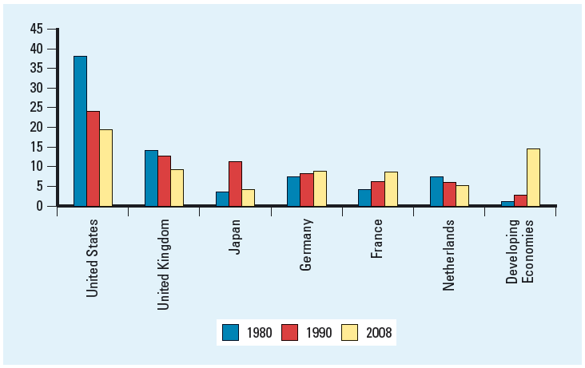
Changing Foreign Direct Investment Picture
Figure 1.2: Percentage Share of Total FDI Stock,
1980 - 2008
Notes:
Figure 1.2 shows that the stock of foreign direct investment by the world’s six most important sources has changed significantly from 1980 to 2008. In particular, notice the decline by the U.S., and the increase by France, and the world’s developing countries.

Slide 8
Changing Foreign Direct Investment Picture
Figure 1.3: FDI Inflows, 1988 - 2008
Notes:
In Figure 1.3, you can see the growth in cross-border flows of foreign direct investment and also the importance of developing nations as destinations for investment. These two trends reflect the internationalization of companies that we have discussed.

Slide 9
The Changing Multinational Enterprise
Globalization has resulted in a decline in the dominance of U.S. firms in the global marketplace
  In 1973, 48.5 % of the world’s 260 largest MNEs were U.S. firms
  By 2008, just 19 of the world’s 100 largest non-financial MNEs were from the U.S., 13 were from France, 13 from Germany, 14 were from Britain, and 10 were from Japan
Small and medium-size firms are now expanding internationally
  easier to build international sales via the Internet
Notes:
In the 1960s, global business activity was dominated by large, U.S. multinational firms. Today, however, things have shifted significantly. Multinational firms from France, Germany, Britain, and Japan have become more important, and there has been a notable decline in the role of U.S. firms. Firms from developing countries such as China and South Korea have also emerged as important players. So, in addition to thinking of American companies like Ford and Microsoft, we now think of South Korea’s Samsung and Hong Kong’s Hutchison Whampoa.
We have also seen an increase in the number of small and medium-sized multinationals, or mini-multinationals. China’s Lenovo for example, acquired IBM’s PC division in 2004, in an effort to become a global player in the PC industry. Lenovo even moved its headquarters to the U.S. as part of its strategy. Traditionally, global markets have been the venue for large firms, but today, thanks to advances in technology like the Internet, international sales can account for a significant share of revenues for small companies, too.

Slide 10
The Changing World Order
The collapse of communism in Eastern Europe
  export and investment opportunities
Economic development in China
  huge opportunities despite continued Communist control
Free market reforms and democracy in Latin America
  new markets and new sources of materials and production
Notes:
Finally, the significant change in world order has affected the global economy. The collapse of communism has brought about new opportunities in Eastern Europe, and China’s economic development and enormous population presents huge opportunities for companies.
Mexico and Latin America have also emerged both as new markets, and as source and production locations.

Slide 11
The Globalization Debate
Question: Is the shift toward a more integrated and interdependent global economy a good thing?
Answer:
Many experts believe that globalization is promoting greater prosperity in the global economy, more jobs, and lower prices for goods and services
Others feel that globalization is not beneficial
Notes:
So far, we’ve focused primarily on the benefits of globalization. But is the shift toward a more integrated and interdependent global economy always a good thing? Not everyone thinks so.

Slide 12
Ant globalization Protests
Question: What are the concerns of critics of globalization?
Answer:
Anti-globalization protesters now turn up at almost every major meeting of a global institution
Protesters fear that globalization is forever changing the world in a negative way
Notes:
Anti-globalization protesters who fear that globalization is forever changing the world in a negative way now turn up at almost every major meeting of global institutions like the WTO and IMF. In some cases, for example in Seattle in 1999, and France in 1999, the protests have been violent. You can learn more about what occurred in France in the Country Focus in your text. Let’s talk about some of the protesters’ concerns.

Slide 13
Globalization, Jobs, and Income
Critics claim jobs in advanced economies are being lost to low-wage nations
Supporters claim while some jobs may be lost, the economy as a whole is better off
  free trade will result in countries specializing in the production of those goods and services that they can produce most efficiently, while importing goods and services that they cannot produce as efficiently, and that in doing so, all countries will gain
Notes:
Critics of globalization worry that jobs are being lost to low-wage nations. They argue that falling trade barriers are allowing companies to move manufacturing jobs to countries where wage rates are low. For example, clothing manufacturing has increasingly shifted away from the U.S. where workers might earn $9 per hour to countries like Honduras where wages are less than 50 cents per hour. Critics believe that this leads to falling wages and living standards in the U.S.
Supporters however, claim that free trade will prompt countries to specialize in what they can produce most efficiently, and to import everything else. They argue that the whole economy will be better off as a result. In other words, if you can buy an imported shirt that was made for pennies in Honduras, you’ll have more money to spend on products the U.S. can produce efficiently like software.

Slide 14
Globalization, Labor Policies, and the Environment
Critics argue free trade encourages firms from advanced nations to move manufacturing facilities offshore to less developed countries with lax environmental and labor regulations
Supporters claim tougher environmental regulation and stricter labor standards reflect economic progress
    as countries get richer as a result of globalization, they raise their environmental and labor standards
    free trade does not lead to more pollution and labor exploitation, it leads to less
Notes:
Another concern raised by protesters is that free trade encourages firms from advanced nations, where there are costly environmental standards, to move manufacturing facilities offshore to less developed countries with lax environmental and labor regulations.
However, advocates of globalization claim that environmental regulation and stricter labor standards go hand in hand with economic progress, so foreign direct investment actually encourages countries to raise their standards. Studies support this claim with the exception of carbon dioxide emissions which appear to rise along with income levels. Advocates of globalization argue that by tying free trade agreements to the implementation of tougher environmental and labor laws, economic growth and globalization can occur together with a decrease in environmental pollution.

Slide 15
Globalization and National Sovereignty
Critics worry economic power is shifting away from national governments and toward supranational organizations such as the WTO, the European Union (EU), and the UN
Supporters argue that the power of these organizations is limited to what nation-states collectively agree to grant
  the organizations must be able to persuade members states to follow certain actions
  without the support of members, the organizations have no power
Notes:
A third concern raised by critics of globalization is the worry that economic power is shifting away from national governments and towards supranational organizations like the WTO and the European Union, or EU.
However, globalization’s supporters argue that the power of these organizations is limited to what they are granted by their members. They also point out that the organizations are designed to promote the collective interests of members, and they won’t gain support for policies that don’t achieve this goal.

Slide 16
Globalization and the World’s Poor
Critics argue the gap between rich and poor has gotten wider and the benefits of globalization have not been shared equally
Supporters suggest that the actions of governments have made limited economic improvement in many countries
  many of the world’s poorest nations are under totalitarian regimes, suffer from endemic corruption, have few property rights, are involved in war, and are burdened by high debt
Notes:
Finally, critics of globalization worry that the gap between rich and poor is growing and that the benefits of globalization haven’t been shared equally.
While supporters of globalization concede the gap between rich and poor has gotten wider, they also contend that it has more to do with the policies countries have followed than with globalization. For example, many countries have chosen to pursue totalitarian regimes, or have failed to contain population growth, and many countries have huge debt loads that are stagnating economic growth.

Slide 17
Thank you for you nice cooperation
Any Question?????

