Slide 1
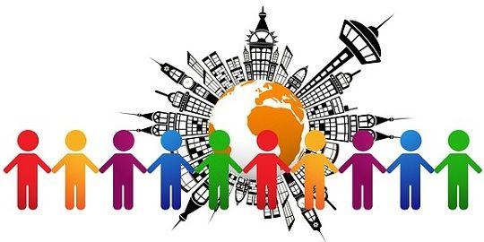
Chapter-4, Lesson-1
Differences in Culture

Slide 2
Lesson Learning objectives
After you have read this lesson you should:
Know what is meant by the culture of a society.
Identify the forces that lead to differences in social culture.
Identify the business and economic implications of difference in culture

Slide 3
Lesson Contents
1. How do cultural differences affect integration business.
2. What is culture?
3. How are culture. Society, And the nation-states related?
4. What determines culture?
5. What is a social structure?
6. What is social stratification?
7. How do religious and ethical systems differ?

Slide 4
How Do Cultural Differences Affect International Business?
Understanding and adapting to the local cultural is important international companies
  cross-cultural literacy - an understanding of how cultural differences across and within nations can affect the way in which business is practiced
A relationship may exist between culture and the costs of doing business in a country or region
  MNCs can be agents of cultural change

Slide 5
What Is Culture?
Culture - a system of values and norms that are shared among a group of people and that when taken together constitute a design for living
where
  values are abstract ideas about what a group believes to be good, right, and desirable
  norms are the social rules and guidelines that prescribe appropriate behavior in particular situations
Society - a group of people who share a common set of values and norms
Notes:
LO 1: Explain what is meant by the culture of a society.

Slide 6
How Are Culture, Society,
And The Nation-State Related?
The relationship between a society and a nation state is not strictly one-to-one
Nation-states are political creations
  can contain one or more cultures
A culture can embrace several nations
  the values and norms of a culture evolve over time

Slide 7
What Determines Culture?
Determinants of Culture
Notes:
LO2: Identify the forces that lead to differences in social culture.

Slide 8
What Is A Social Structure?
Social structure - a society’s basic social organization
A group is an association of two or more people who have a shared sense of identity and who interact with each other in structured ways on the basis of a common set of expectations about each other’s behavior
  individuals are involved in families, work groups, social groups, recreational groups, etc.

Slide 9
What Is Social Stratification?
All societies are stratified on a hierarchical basis into social categories, or social strata
Social mobility - the extent to which individuals can move out of the strata into which they are born
    caste system
    class system
The significance attached to social strata in business contacts
    class consciousness
Notes:
LO2: Identify the forces that lead to differences in social culture.
LO3: Identify the business and economic implications of differences in culture.

Slide 10
How Do Religious And Ethical Systems Differ?
Religion - shared beliefs and rituals that are concerned with the realm of the sacred
  Christianity
  Islam
  Hinduism
  Buddhism
  5. Confucianism influences behavior and culture
Ethical systems - a set of moral principles, or values, that are used to guide and shape behavior
Notes:
LO2: Identify the forces that lead to differences in social culture.
LO3: Identify the business and economic implications of differences in culture.

Slide 11
Any Confusion?????
Thank you so much for your nice cooperation…...

