Slide 1
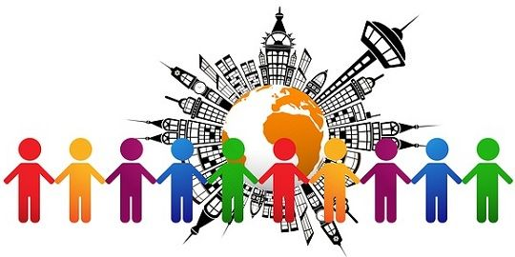
Chapter-4, Lesson-2
Differences in Culture

Slide 2
Lesson Learning objectives
After you have read this lesson you should:
Understand how differences in social culture influence values in the workplace.
Develop an appreciation for the economic and business implications of cultural change.

Slide 3
Lesson Contents
1. What is the role of language in culture?
2. How does culture impact the workplace?
3. Does culture change?
4. What do cultural differences mean for managers?

Slide 4
What Is The Role of Language In Culture?
Language - the spoken and unspoken (nonverbal communication such as facial expressions, personal space, and hand gestures) means of communication
Chinese is the mother tongue of the largest number of people
English is the most widely spoken language in the world and is also becoming the language of international business
but, knowledge of the local language is still beneficial, and in some cases, critical for business success
failing to understand the nonverbal cues of another culture can lead to communication failure
Notes:
LO2: Identify the forces that lead to differences in social culture.

Slide 5
What Is The Role of Education In Culture?
Formal education is the medium through which individuals learn many of the language, conceptual, and mathematical skills that are indispensable in a modern society
important in determining a nation’s competitive advantage
Japan’s postwar success can be linked to its excellent education system
general education levels can be a good index for the kinds of products that might sell in a country
ex. impact of literacy rates
Notes:
LO2: Identify the forces that lead to differences in social culture.

Slide 6
How Does Culture Impact The Workplace?
Hofstede’s dimensions of culture:
Power distance - how a society deals with the fact that people are unequal in physical and intellectual capabilities
Individualism versus collectivism - the relationship between the individual and his fellows
Uncertainty avoidance - the extent to which different cultures socialize their members into accepting ambiguous situations and tolerating ambiguity
Masculinity versus femininity -the relationship between gender and work roles
Notes:
LO4: Recognize how differences in social culture influences values in the workplace.

Slide 7
How Does Culture Impact The Workplace?
Hofstede later expanded added a fifth dimension called Confucian dynamism or long-term orientation
captures attitudes toward time, persistence, ordering by status, protection of face, respect for tradition, and reciprocation of gifts and favors
Japan, Hong Kong, and Thailand scored high on this dimension
the U.S. and Canada scored low

Slide 8
Does Culture Change?
Culture evolves over time
changes in value systems can be slow and painful for a society
Social turmoil - an inevitable outcome of cultural change
as countries become economically stronger, cultural change is particularly common
economic progress encourages a shift from collectivism to individualism
globalization also brings cultural change

Slide 9
What Do Cultural Differences Mean For Managers?
It is important to develop cross-cultural literacy
companies that are ill informed about the practices of another culture are unlikely to succeed in that culture
There is a connection between culture and national competitive advantage
suggests which countries are likely to produce the most viable competitors
has implications for the choice of countries in which to locate production facilities and do business
Notes:
LO5: Demonstrate an appreciation for the economic and business implications of cultural change.

Slide 10
Any Confusion?????
Thank you so much for your nice cooperation…...

