Slide 1
Chapter-5 (Lesson-1)
International Trade Theory

Slide 2
Lesson Learning Objectives
After reading this lesson the students will be able to;
Understand why nations trade with each other.
Be familiar with the different theories explaining trade flows between nations.
Understand why many economists believe that unrestricted free trade between nations will raise the economic welfare of countries that participate in a free trade system.
Notes:
LO2: Summarize the different theories explaining trade flows between nations.

Slide 3
Lesson Contents
Why is free trade beneficial?
Trade theory and government policy.
What is mercantilism?
Theory of absolute advantage.
Theory of comparative advantage.
The product life cycle theory.
Notes:
LO2: Summarize the different theories explaining trade flows between nations.

Slide 4
Why Is Free Trade Beneficial?
Free trade - a situation where a government does not attempt to influence through quotas or duties what its citizens can buy from another country or what they can produce and sell to another country
trade theory shows why it is beneficial for a country to engage in international trade even for products it is able to produce for itself
Notes:
LO1: Understand why nations trade with each other.

Slide 5
Why Is Free Trade Beneficial?
International trade allows a country;
to specialize in the manufacture and export of products and services that it can produce efficiently
import products and services that can be produced more efficiently in other countries
limits on imports may be beneficial to producers, but not beneficial for consumers

Slide 6
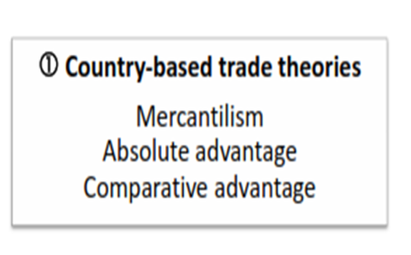
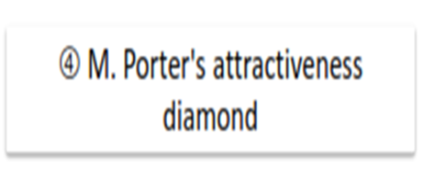
Trade Theory and Govt. Policy

Slide 7
What Is Mercantilism?
Mercantilism (mid-16th century) suggests that it is in a country’s best interest to maintain a trade surplus -to export more than it imports
advocates government intervention to achieve a surplus in the balance of trade
By doing so, a country would accumulate gold and silver and, consequently, increase its national wealth, prestige and power.
Mercantilists believed that the world had a finite store of wealth; therefore, when one country got more, other countries had less.
Notes:
LO2: Summarize the different theories explaining trade flows between nations.

Slide 8
What Is Mercantilism?
Mercantilists restricted imports and encouraged or subsidized exports as a conscious policy to make their citizens better off.
Mercantilists judged the success of trade by the size of the trade balance.
Mercantilism views trade as a zero-sum game
one in which a gain by one country results in a loss by another
Notes:
LO2: Summarize the different theories explaining trade flows between nations.

Slide 9
Theory of Absolute Advantage?
Adam Smith (1776) argued that a country has an absolute advantage in the production of a product when it is more efficient than any other country in producing it
countries should specialize in the production of goods for which they have an absolute advantage and then trade these goods for goods produced by other countries
Theory of Absolute Cost Advantage suggests that a country should produce and export those goods and services for which it is more efficient than other countries and hence has an absolute cost advantage, and import those goods and services for which other countries are more efficient than it and hence enjoy an absolute cost advantage over it.
Notes:
LO2: Summarize the different theories explaining trade flows between nations.

Slide 10
Theory of Absolute Advantage?
Sources of Advantages:
The sources of advantage could be many and diverse.
A natural advantage because of endowments of natural resources like, oil & gas, minerals and metals, valleys and mountains, waters and beaches, climate and eco-system, etc. is a great advantage.
Acquired Advantage is derived from education, knowledge, skills, technology, innovation and R&D capabilities. Today, the acquired advantages command more respects because of its infiniteness.

Slide 11
Theory of Comparative Advantage?
David Ricardo asked what happens when one country has an absolute advantage in the production of all goods
The theory of comparative advantage (1817) - countries should specialize in the production of those goods they produce most efficiently and buy goods that they produce less efficiently from other countries
even if this means buying goods from other countries that they could produce more efficiently at home
Trade is a positive sum game
Notes:
LO2: Summarize the different theories explaining trade flows between nations.
LO3: Recognize why many economists believe that unrestricted free trade between nations will raise the economic welfare of countries that participate in a free trade system.

Slide 12
The Product Life Cycle Theory?
The product life-cycle theory - as products mature both the location of sales and the optimal production location will change affecting the flow and direction of trade
proposed by Ray Vernon in the mid-1960s
Globalization and integration of the world economy has made this theory less valid today
the theory is ethnocentric
production today is dispersed globally
products today are introduced in multiple markets simultaneously
Notes:
LO2: Summarize the different theories explaining trade flows between nations.

Slide 13
Any Question?????
Thank you for you nice cooperation

